Slide 1
Loading
Loading Dimensions
Loading Facts

Slide 2
Loading Dimensions
Physically built to have the minimal sets of components
The primary key is a single field containing meaningless unique integer – Surrogate Keys
De-normalized flat tables – all attributes in a dimension must take on a single value in the presence of a dimension primary key.
Should possess one or more other fields that compose the natural key of the dimension

Slide 3
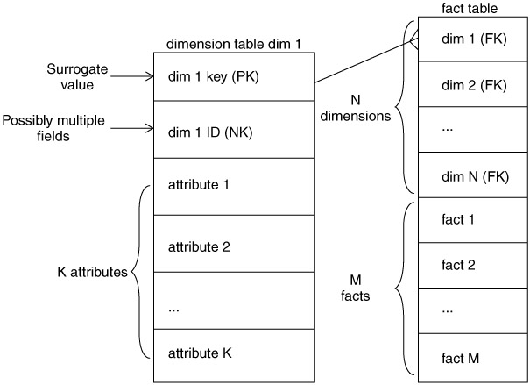

Slide 4
The data loading module consists of all the steps required to administer slowly changing dimensions (SCD) and write the dimension to disk as a physical table in the proper dimensional format with correct primary keys, correct natural keys, and final descriptive attributes.
Creating and assigning the surrogate keys occur in this module.
The table is definitely staged, since it is the object to be loaded into the presentation system of the data warehouse.

Slide 5
Loading dimensions
When DW receives notification that an existing row in dimension has changed it gives out 3 types of responses
Type 1
Type 2
Type 3

Slide 6
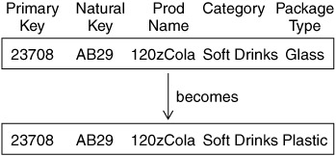
Type 1 Dimension

Slide 7
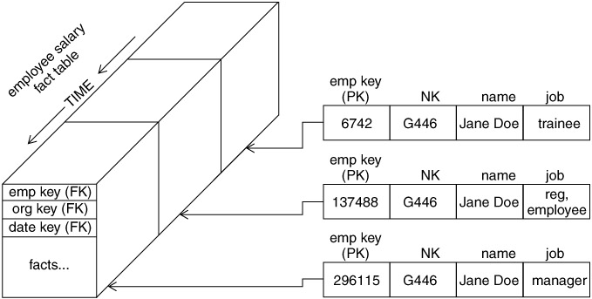
Type 2 Dimension

Slide 8
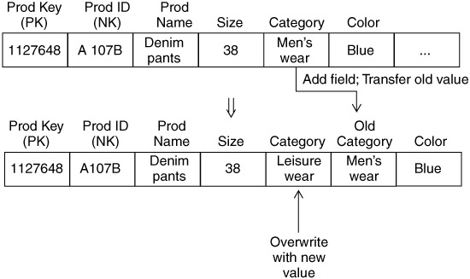
Type 3 Dimensions

Slide 9
Loading facts
Facts
Fact tables hold the measurements of an enterprise. The relationship between fact tables and measurements is extremely simple. If a measurement exists, it can be modeled as a fact table row. If a fact table row exists, it is a measurement

Slide 10
Key Building Process - Facts
When building a fact table, the final ETL step is converting the natural keys in the new input records
ETL maintains a special surrogate key lookup table for each dimension. This table is updated whenever a new dimension entity is created and whenever a Type 2 change occurs on an existing dimension entity
All of the required lookup tables should be pinned in memory so that they can be randomly accessed as each incoming fact record presents its natural keys. This is one of the reasons for making the lookup tables separate from the original data warehouse dimension tables.

Slide 11
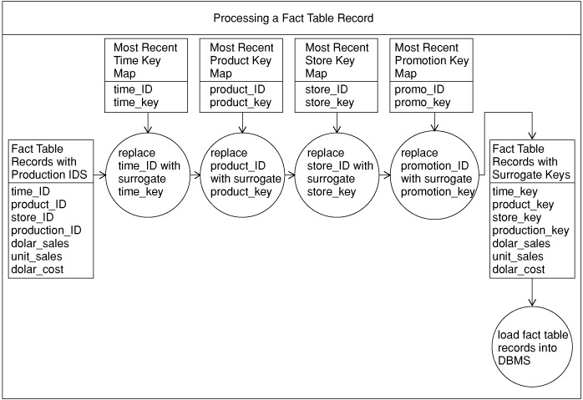
Key Building Process

Slide 13
Loading Fact Tables
Managing Indexes
Performance Killers at load time
Drop all indexes in pre-load time
Segregate Updates from inserts
Load updates
Rebuild indexes

Slide 14
Questions

