Slide 1
Types of DC Generator

Slide 2
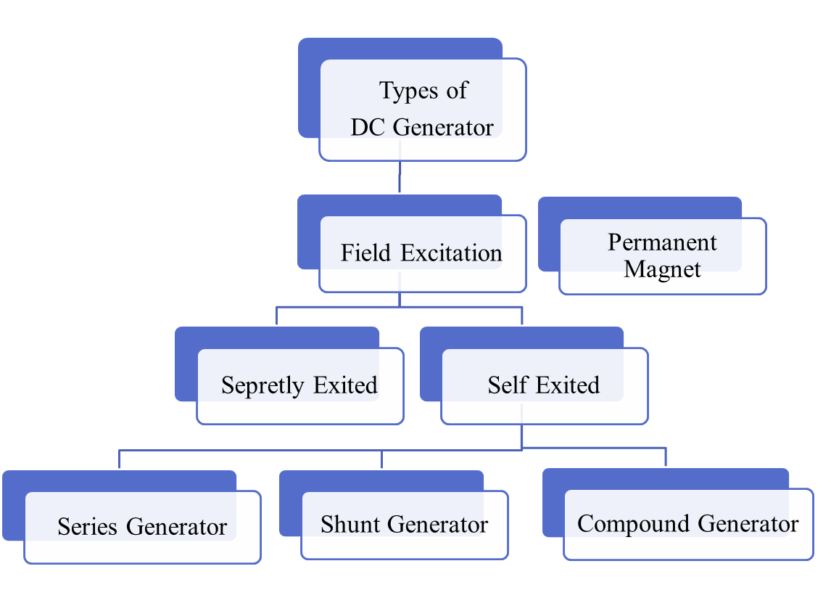
2

Slide 3
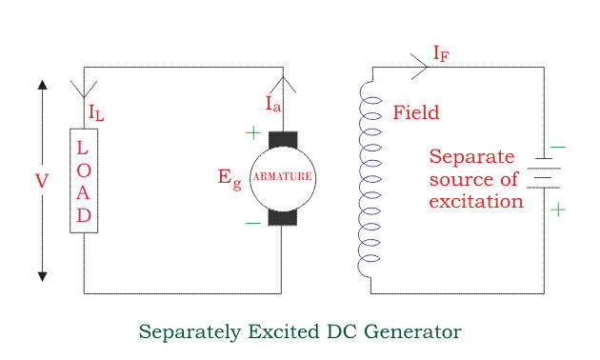
Separately Excited DC Generator
I_{a} = Armature current
I_{L} = Load current
V = Terminal voltage E_{g} = Generated emf
Voltage drop in the armature = I_{a} × R_{a} (R/sub>a is the armature Resistance)
Let, I_{a} = I_{L} = I (say)
Then, Voltage across the load, V = IR_{a}
3
Power generated, P_{g} = E_{g}×I

Slide 4
Self Exited DC Generator
¬These are the generators whose field magnets are energized by the
current supplied by themselves.
¬In these type of machines field coils are internally connected with the armature. Due to residual magnetism some flux is always present
in the poles.
¬When the armature is rotated some emf is induced. Hence some induced current is produced. This small current flows through the field coil as well as the load and thereby strengthening the pole flux.
4

Slide 5
¬As the pole flux strengthened, it will produce more armature emf, which cause further increase of current through the field. This increased field current further raises armature emf and this cumulative phenomenon continues until the excitation reaches to the rated value.
5

Slide 6
According To The Position Of The Field Coil DC Generator Has A Three Type
1)Series Generator 2)Shunt Generator 3)Compound Generator
6

Slide 7
Series Generator
¬In these type of generators, the field windings are connected in series with armature conductors.
¬So, whole current flows through the field coils as well as the load. As series field winding carries full load current it is designed with relatively few turns of thick wire.
¬The Electrical resistance of series field winding is therefore very low (nearly 0.5Ω ).
7

Slide 8
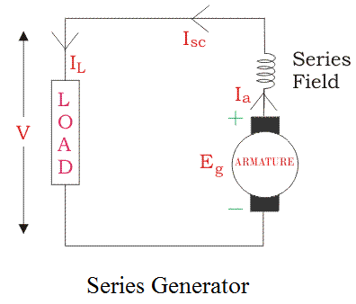
Let,
R_{sc} = Series winding resistance
I_{sc} = Current flowing through the series field R_{a} = Armature Resistance
I_{a} = Armature current I_{L} =Load current
V = Terminal voltage
E_{g} = Generated emf
Then, I_{a} = I_{sc} = I_{L}=I (say)
Voltage across the load, V = E_{g} -I(I_{a} × R_{a}) Power generated, P_{g} = E_{g}×I
Power delivered to the load, P_{L} = V×I
8

Slide 9
Shunt Generator
¬In these type of generators, the field windings are connected in Parallel with armature conductors.
¬In shunt generators the voltage in the field winding is same as the voltage across the terminal.
¬Here armature current I_{a} is dividing in two parts, one is shunt field current I_{sh} and another is load current I_{L}.
¬So, I_{a}= I_{sh} + I_{L} The effective power across the load will be maximum when I_{L} will be maximum.
¬So, it is required to keep shunt field current as small as possible. For this purpose the resistance of the shunt field₉winding generally kept high (100 Ω) and large no of turns are used for the desired emf.

Slide 10
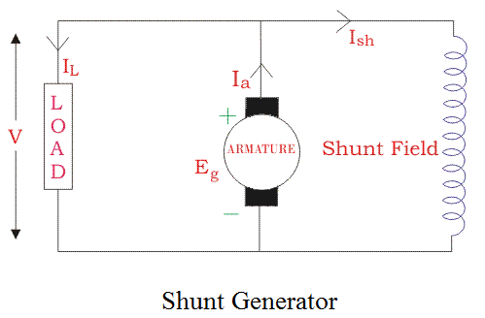
Let,
R_{sh} = Shunt winding Resistance
I_{sh} = Current flowing through the shunt field R_{a} = Armature Resistance
I_{a} = Armature current I_{L} = Load current
V = Terminal voltage E_{g} = Generated emf
Shunt field current, I_{sh} = V/R_{sh} Voltage across the load, V = E_{g}-I_{a} R_{a} Power generated, P_{g}= E_{g} × I_{a}
P¹o⁰wer delivered to the load, P = V×I
L L

Slide 11
Compound DC Generator
¬In series wound generators, the output voltage is directly proportional with load current. In shunt wound generators, output voltage is inversely proportional with load current. A combination of these two types of generators can overcome the disadvantages of both. This combination of windings is called compound wound DC generator.
¬Compound wound generators have both series field winding and shunt field winding.
¬One winding is placed in series with the armature and the other is placed in parallel with the armature¹.¹

Slide 12
Compound Generator Has A two Type
1)Short Shunt
2)Long shunt
12

Slide 13
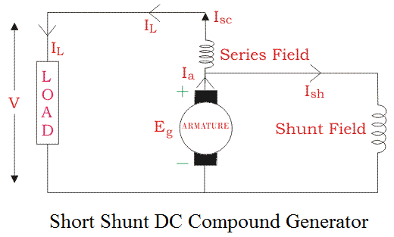
Short Shunt DC compound Generator
Series field current, I_{sc} = I_{L}
Shunt field current, I_{sh} = (V + I_{sc} R_{sc})/R_{sh}
Armature current, I_{a} = I_{sh} + I_{L} Voltage across the load,
V = E_{g} - I_{a} R_{a} - I_{sc} R_{sc}
Power generated, P_{g} = E_{g} × I_{a}
13
Power delivered to the load, P =V×I

Slide 14
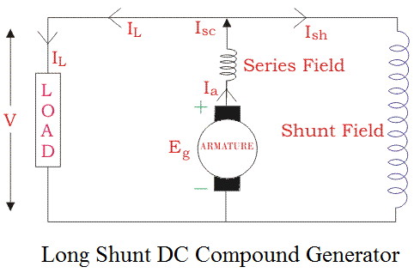
Long Shunt Compound DC Generator
Shunt field current, I_{sh}=V/R_{sh}
Armature current, I_{a}= series field current, I_{sc}= I_{L} + I_{sh}
Voltage across the load, V=E_{g} -I_{a} R_{a}-I_{sc} R_{sc}
=E_{g}-I_{a} (R_{a} + R_{sc}) [∴I_{a}=
I_{cs}]
Power generated, P_{g}= E_{g} × I_{a}
14
Power delivered to the load, P_{L}=V×I_{L}

Slide 15
¬In a compound generator, the shunt field is stronger than the series field. When the series field assists the shunt field, generator is said to be commutatively compound generator.
¬On the other hand if series field opposes the shunt field, the generator is said to be differentially compound generator.
15

Slide 16
Thank
You…
16

