Slide 1
What is Price ?
A price is the amount of money that a buyer gives to a seller in exchange for a good or a service.

Slide 2
Pricing strategy
Pricing strategy refers to method companies use to price their products or services. Almost all companies, large or small, base the price of their products and services on production, labor and advertising expenses and then add on a certain percentage so they can make a profit.

Slide 3
Types of pricing strategies:
Price Penetration
Price Skimming
Loss Leader Pricing
Psychological Pricing
Discrimination Pricing
Going Rate Pricing
Cost Plus Pricing
Value Based Pricing
.

Slide 4
1) Price Penetration
Penetration pricing is the pricing technique of setting a relatively low initial entry price, usually lower than the intended established price, to attract new customers. The strategy aims to encourage customers to switch to the new product because of the lower price
Penetration pricing is a pricing strategy that is used to quickly gain market share by setting an initially low price

Slide 5
2) Price Skimming
Price skimming is a pricing strategy in which a marketer sets a relatively high initial price for a product or service at first, then lowers the price over time.
The main benefit of a skimming pricing strategy is that it helps you make more money.
Skimming pricing is used when a product, which is new in the market or just launched, is sold at a relatively high price because of its uniqueness, benefits to customers or its current Wow factor. However, slowly but surely when the product gets older in the market, then the price is dropped and the product is brought at competitive pricing

Slide 6
3) Loss Leader Pricing
Pricing strategy where a product is sold at a price below its market cost to stimulate other sales of more profitable goods or services.
A loss leader is a pricing strategy where product or service that is offered at a price that is not profitable, but is sold or offered in order to attract new customers or to sell additional products and services to those customers.
This is a common practice when a business first enters a market. Essentially, a loss leader introduces new customers to a service or product in the hope of building a customer base and securing future recurring revenue.

Slide 7
Example of loss leader
A classic example is that of razor blades. Companies like Gillette essentially give their razor units away for free, knowing that customers have to buy their replacement blades, which is where the company makes its profit.

Slide 8
4) Psychological Pricing
Psychological pricing is a pricing and marketing strategy based on the theory that certain prices have a psychological impact. Retail prices are often expressed as "odd prices": a little less than a round number, e.g. $19.99 or £2.98. There is evidence that consumers tend to perceive "odd prices" as being lower than they actually are, tending to round to the next lowest monetary unit. Thus, prices such as $1.99 are associated with spending $1 rather than $2.

Slide 9
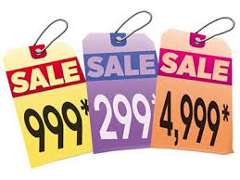
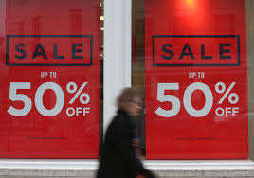
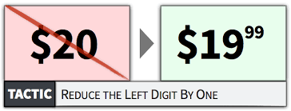
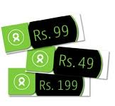
Example:

Slide 10
5) Discrimination Pricing
Price discrimination is a pricing strategy that charges customers different prices for the same product or service. In pure price discrimination, the seller charges each customer the maximum price he or she will pay.

Slide 11
An Example of Price Discrimination in Airlines
Consumers buying airline tickets several months in advance typically pay less than consumers purchasing at the last minute. When demand for a particular flight is high, airlines raise ticket prices. In contrast, when tickets for a flight are not selling well, the airline reduces the cost of available tickets. Because many passengers prefer flying home late on Sunday, those flights tend to be more expensive than flights leaving early Sunday morning.

Slide 12
6) Going Rate Pricing
Setting a price for a product or service using the prevailing market price as a basis. Going rate pricing is a common practice with homogeneous products with very little variation from one producer to another
Basically, the company sets a price of its products and services in line with the competitor’s prices,
Such products are steel, aluminium, paper, fertilizer, etc., the firms dealing with these usually charge the same price from the customers.

Slide 13
7) Cost Plus Pricing
Cost plus pricing involves adding a markup to the cost of goods and services to arrive at a selling price. Under this approach, you add together the direct material cost, direct labor cost, and overhead costs for a product, and add to it a markup percentage in order to derive the price of the product ...
simply calculating your costs and adding a mark-up

Slide 14
8) Value based pricing
Setting a price based on how much the customer believes what you’re selling is worth
Value-based pricing is a method of arriving at an amount to charge for goods or services through assessing their perceived value to the purchaser.
Customers may assess one company's product to be of greater value than a competitor's for many reasons including brand image, design, packaging, marketing, warranties, previous experiences and word of mouth.
Example, Apple has traditionally been able to achieve a higher profit margin because of the perceived value of its products and brand.

