Slide 1
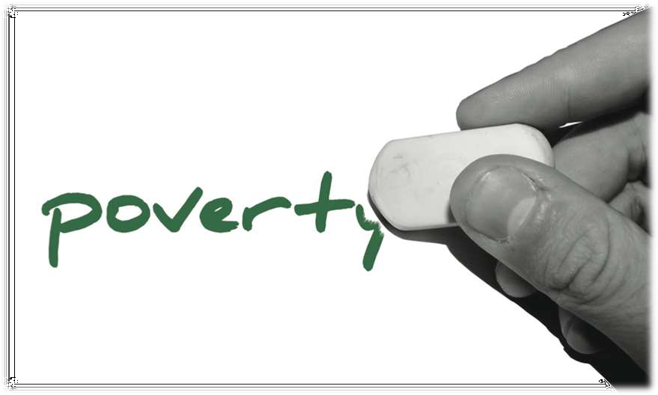
The biggest obstacle for the developing WORLD

Slide 2
What is Poverty ?
◆ Poverty refers to the condition of not having the means to afford basic human needs such as clean water, nutrition, health care, clothing and shelter
◆ Poverty is the condition of having fewer resources or less income than others within a society or country, or compared to worldwide averages
◆ Poverty is the world at its worst when people are deprived of basic everyday things that we everyday take for granted like food, water shelter, money, and clothes
◆ It indicates a condition in which a person fails to maintain a living standard adequate for a comfortable lifestyle

Slide 3
Poverty – According to UN
“Fundamentally, poverty is a denial of choices and opportunities, a violation of human dignity. It means lack of basic capacity to participate effectively in society
It means not having enough to feed and cloth a family, not having a school or clinic to go to, not having the land on which to grow one’s food or a job to earn one’s living, not having access to credit
It means insecurity, powerlessness and exclusion of individuals, households and communities
It means susceptibility to violence, and it often implies living on marginal or fragile environments, without access to clean water or sanitation”

Slide 4
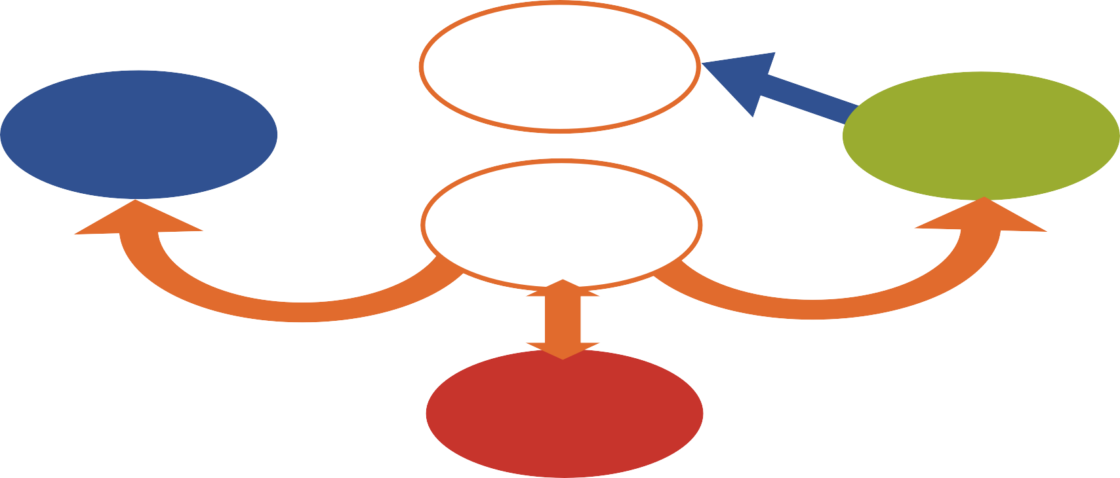
Hunger
Can’t Work
Lack of education
Disease
Poverty
Fewer job opportunities

Slide 5
Types of Poverty
Poverty is generally of two types:
Absolute Poverty
Relative Poverty
Absolute Poverty :
◆ It refers to the state of severe deprivation of basic human needs
◆ It refers to the measure of poverty, keeping in view the per capita intake of calories and minimum level of consumption.
◆ Per capita income : National income/ Population

Slide 6
Types of Poverty
Relative Poverty :
◆ Under Relative Poverty the economic conditions of different regions or countries is compared.
◆ It is defined contextually as Economic inequality in location or society in which people live.
◆ The capita income and the national income are the two indicators of relative poverty.
◆ According to UNO those countries are treated poor whose per capita income is less than US $725 per annum.

Slide 8
Poverty line
◆ The poverty threshold or poverty line is the minimum level of income deemed adequate in a given country.
◆ In practice, like the definition of poverty, the official or common understanding of the poverty line is significantly higher in developed countries than in developing countries.
◆ The common international poverty line has in the past been roughly $1 a day.

Slide 9
Poverty line
◆ In 2008, the World Bank came out with a revised figure of
$1.25 at 2005 purchasing-power parity (PPP).
◆ Determining the poverty line is usually done by finding the total cost of all the essential resources that an average human adult consumes in one year.
◆ The largest of these expenses is typically the rent required to live in an apartment, so historically, economists have paid particular attention to the real estate market and housing prices as a strong poverty line affecter.

Slide 10
Causes of poverty
◆ Lack of education
◆ Large Scale Import
◆ Division of Agricultural land
◆ Moral Culture
◆ Government Policies
◆ Corruption
◆ Privatization
◆ Overpopulation
◆ Unemployment

Slide 11
Causes of poverty
◆ Law and Order
◆ Increase in Utility Charges
◆ Inflation
◆ Imposition of Taxes
◆ Non-Productive Expenditures
◆ Low Living Standard
◆ Landlordism
◆ Nepotism
◆ Backward Infrastructure

Slide 12
Effects of poverty
◆ Child labour
◆ Crimes and violence
◆ Health Problems
◆ From a moral and religious values
◆ Homelessness
◆ Shorter lives
◆ Children antisocial behaviour
◆ Hunger

Slide 13
Almost half – over three billion people – live on less than
$2.50 a day
98% of the world’s hungry people live in developing countries
50,000 people die every day as a result of poverty

Slide 14
Solutions of poverty
◆ ENSURING RESOURCES FOR POOR
◆ BY EMPOWERING THE POORS
◆ EQUAL ACESS OVER MARKETS
◆ INCREASING AGRICULTURE
◆ DEVELOPMENT IN CONSTRUCTION
◆ ROLE OF MICROFINANCE

Slide 15
Solutions of poverty
◆ HEALTH FACILITIES
◆ POVERTY ELIMINATING PROGRAMMES
◆ ECOCOMIC GROWTH
◆ EDUCATION
◆ POPULATION CONTROLLING
◆ DEVELOPMENT OF AGRICULTURAL LAND

Slide 16
Home work LATEST STATISTICS ON POVERTY IN PAKISTAN

