Slide 1
Overview
The traditional understanding of the scientific method to look at the world with a scientific eye is to observe with no perceived notions. Popper noticed that everyone have perceived notion of some kinds.(People see what they want to see). When you care about something means you already have some beliefs about it. Methods like (Freud) that only served to conform beliefs were Pseudo-science and they could be used to prove anything.
The question is ....
When we begin to test a theory are we looking to conform it or to dis-conform it..
Science disconforms and Pseudo science conforms

Slide 2
Cont...
Popper claims its easy to find confirmation of a theory if you are looking for it.
Popper observed that every good theory is prohibitied
Every false belief we discover is actually good because that gets us that much closer to believing only true things. The only genuine test of a theory is one that's attempting to falisify it.
Popper point out that irrefutable theories are not scientific. If it cant be tested then it have no much value.
LET YOUR BELIEFS GO AND ACCEPT EVIDENCE.
According to popper knowledge is about probability and contingency

Slide 3
You have to be open to the idea that your beliefs might be false because that the only way that holding onto them can really mean anything.
The discovery of problem is more good than solution of a problem.

Slide 4
Chapter 1: A SURVEY OF SOME FUNDAMENTAL PROBLEMS

Slide 5
A SURVEY OF SOME FUNDAMENTAL PROBLEMS
A scientist, whether theorist or experimenter, puts forward statements, or systems of statements, and tests them step by step. In the field of the empirical sciences, more particularly, he constructs hypotheses, or systems of theories, and tests them against experience by observation and experiment.
The writer suggests that this is the task of the logic of scientific discovery, gives a logical analysis of this procedure, and that is to analyse the methods of empirical sciences.

Slide 6
THE PROBLEM OF INDUCTION
Science is about putting forward and testing theories. Falsifiability figures prominently as Popper's method for testing theories. He repeatedly shows that theories are never verifiable, only falsifiable. Concepts of universality and singularity help to define falsifiability. Singular statements, or occurrences, are subsets of universal events. Basic statements are particular types of singular statement that can serve as a basis to empirically falsify theories.
What are the methods of empirical science and who do we call empirical science?
Empirical science use primarily inductive methods (singular → universal statements )
Whether inductive reasoning leads to knowledge
Knowledge is created by conjecture and criticism
Inductive inference can attain some degree of reliability or of probability. They are called ‘probabilistic inferences’
Seeking for theories with a high probability of being true was a false goal that is in conflict with the search for knowledge
Scientific statement can only attain continuous degrees of probability whose unattainable upper and lower limits are truth and falsity

Slide 7
Elimination of psychologism
The initial stage is to invent a theory.
psychology explaining non-psychological laws
Contrast between psychology of knowledge (empirical facts) and logic of knowledge (logical relations)
There is no such thing as a logical methods of having new ideas, or logical reconstruction of this process
Ever discovery contains an irrational element, a creative intuition.

Slide 8
Distinguish four different lines along which the testing of a theory could be carried out.
First there is the logical comparison of the conclusions among themselves, by which the internal consistency of the system is tested.
Secondly, there is the investigation of the logical form of the theory, with the object of determining whether it has the character of an empirical or scientific theory, or whether it is, for example, tautological.
Thirdly, there is the comparison with other theories, chiefly with the aim of determining whether the theory would constitute a scientific advance should it survive our various tests.
And finally, there is the testing of the theory by way of empirical applications of the conclusions which can be derived from it.

Slide 9
Deductive testing of theories
Conclusions are drawn by means of logical deduction
Ways of theory testing involve: checking for internal consistency, logical flow in statement, comparison with other theories, and empirical application
Inductive logic doesn’t provide a difference between empirical and metaphysical (logic) characters of theoretical systems

Slide 10
The problem of demarcation
Ability to distinguish between empirical science on one hand and mathematics and logic on other.
On thid basis the writer said that the main issue in rejecting the method of induction is that it doesn’t provide a suitable criterion of demarcation.
Where as modern positivists are apt to see more clearly that science isn’t a system of concepts but rather a system of statements.
What kind of theory, what kind of methodology, is useful and will advance humankind. <
This is called the demarcation problem.

Slide 11
Experience as a method
Requirements of an empirical theoretical system includes: it must represent a possible world, with a possible experience, and must be different from other worlds
Theoretical systems can be distinguished on the basis of experience.
In order to make this idea a little more precise, we may distinguish three requirements which our empirical theoretical system will have to satisfy.
First, it must be synthetic, so that it may represent a non-contradictory, a possible world.
Secondly, it must satisfy the criterion of demarcation, ie. it must not be metaphysical, but must represent a world of possible experience.
Thirdly, it must be a system distinguished in some way from other such systems as the one which represents our world of experience.

Slide 12
Example
Analytic-synthetic (again)
Synthetic: All men are arrogant
Analytic: All men are human
Analytic sentences and claims are empty, they are tautological
Therefore only synthetic claims (induction) are scientific

Slide 13
Falsifiability as a criterion of demarcation
All systems must be conclusively decidable
Theories are never empirically verifiable, but tested by experience
A system is admitted as empirical or scientific only if it is capable of being tested by experience
Asymmetry between verifiability and falsifiability
What characterizes the empirical method is its manner of exposing to falsification, in every conceivable way, the system to be tested/

Slide 14
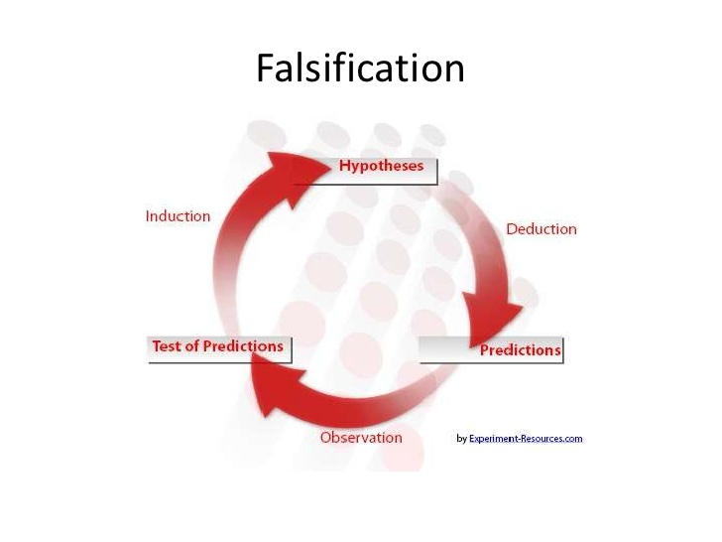

Slide 15
The problem of ‘empirical basis’
How are singular statements tested
Must distinguish between subjective experiences or our findings of conviction, and objective logical relations.
If falsifiability is to be at all applicable as a criterion of demarcation, then we must clearly separate the psychological from the logical and methodological aspects of the problem. We must distinguish between our subjective experiences or our feelings of conviction and, on the other hand, the objective logical relations subsisting among the various systems of scientific statements, and within each of them.

Slide 16
Scientific objectivity and subjective conviction
Scientific theories are never fully justifiable or verifiable, but that they are nevertheless testable
Objectivity lies in the fact that theories can be inter- subjectively tested
Systems of theories are tested by deducing from them statement of a lesser level of universality. These statements in their turn, since they are to be inter- subjectively testable, must be testable in like manner.
Lack of possible tests can’t make a statement true.

Slide 17
Chapter 2: ON THE PROBLEM OF A THEORY OF SCIENTIFIC METHOD
Epistemology, or the logic of scientific discovery, should be identified with the theory of scientific method. The decision here proposed for laying down suitable rules for what I call the ‘empirical method’ is closely connected with my criterion of demarcation.

Slide 18
On the problem of theory of scientific methods
On the problem of theory of scientific methods
Why methodological decisions are indispensable
Empirical science should be characterized by its methods
Distinguishing characteristics of empirical systems is in their susceptibility to revision- they can be criticized and superseded with better ones.
Writer said he shall try to establish the rules, or norms, by which the scientist is guided when he is engaged in research or in discovery, in the sense here understood.

Slide 19
The naturalistic approach to the theory of methods
Naturalistic approach that studies actual scientific behavior or procedure of science is uncritical as it adopts an inductive method.
The view according to which methodology is an empirical science in its turn - a study of the actual behavior of scientists, or of the actual procedure of ‘science’ - may be described as ‘naturalistic’. Thus the writer reject the naturalistic view. It is uncritical. Its upholders fail to notice that whenever they believe themselves to have discovered a fact, they have only proposed a convention, and the convention is liable to turn into a dogma.
Conventions are liable to be turned into dogmas.

Slide 20
Methodological rules as conventions
Rules of games of empirical science
Methodological rules are different from logic
Majority of problems of theoretical philosophy can be re-interpreted as problems of method.
(1) The game of science is, in principle, without end. He who decides one day that scientific statements do not call for any further test, that they can be regarded as finally verified, retires from the game.
(2) Once a hypothesis has been proposed and tested, and has proved its mettle, it may not be allowed to drop out without ‘good reason’. A ‘good reason’ may be, for instance: replacement of the hypothesis by another which is better testable; or the falsification of one of the consequences of the hypothesis.

