Slide 1
Pontics

Slide 2
Pontic Definition
An artificial tooth on a fixed dental prosthesis that replaces a missing natural tooth, restores its function, and usually fills the space previously occupied by the clinical crown

Slide 3
Definition
Tylman –pontic is the suspended member of a fixed partial denture. it replaces the lost natural tooth, restores function ,and occupies the space of the missing tooth.

Slide 4
Ideal requirements
Smooth surfaced and convex in all directions
Easily cleansable
Pinpoint pressure free contact on the ridge
No irritation to the gingival tissues
Restore function
No abutment overloading
Color stable

Slide 5
Functions of Pontics
Mastication
Speech
Esthetics

Slide 6
Mucosal Contact
ridge lap
modified ridge lap
ovate
conical

Slide 7
No Mucosal Contact
sanitary(hygenic)
modified sanitary

Slide 8
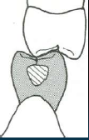
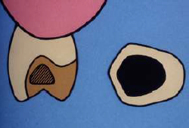
Ridge lap pontic

Slide 9
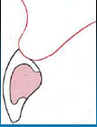
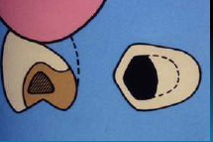
Modified ridge lap pontic

Slide 10
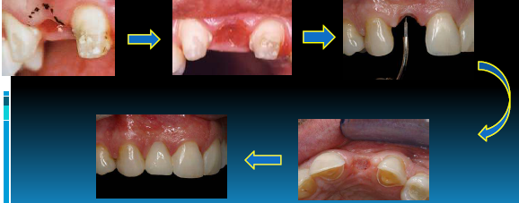
Ovate pontic

Slide 11
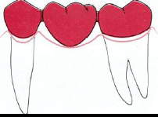
Conical pontic

Slide 13
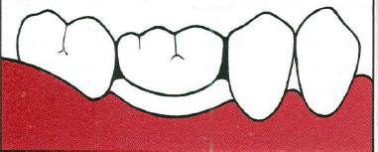
No Mucosal Contact
Sanitary or hygienic

Slide 14
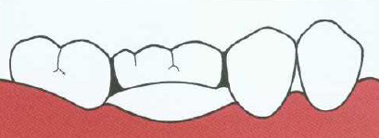
Modified Sanitary

