Slide 1
Planning and decision making

Slide 2
What is planning?
Plans are methods for achieving a desired result.
Planning provides a sense of purpose and direction.
It is a comprehensive framework for making decisions in advance. It also facilitates the organizing, leading, and controlling functions
of management.

Slide 3
Planning involves selecting missions and objectives and the actions to achieve them; it requires decision making, which is choosing from among alternative future courses of action.

Slide 4
Strategic planning
Is the process by which top management determines overall organizational purposes and objectives and how they are to be achieved.

Slide 5
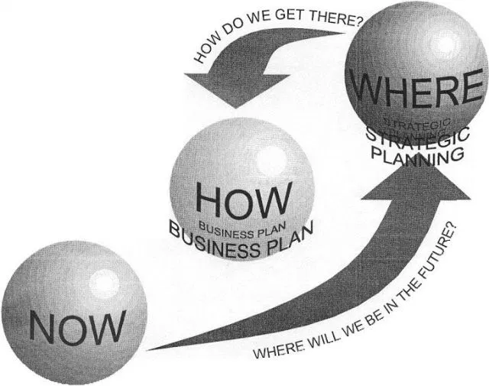

Slide 6
4 Types of Plan
Hierarchical plans,
Standing plans,
Single-use plans, and
Contingency plans.

Slide 7
1) Hierarchical Plans:
These plans are drawn at three major hierarchical levels namely the institutional, the managerial and the technical core. The plans for these three levels are;
Strategic plan
Administrative or Intermediate plan
Operational plan

Slide 8
2) Standing Plans:
Standing plans are drawn to cover issues that managers face repeatedly. Such a standing plan may be called standard operating procedure (SOP). Generally, five types of standing plans are used;
Mission or purpose
Strategy
Policies
Rules
Procedures

Slide 9
3) Single-use Plans:
Single-use plans are prepared for single or unique situations or problems and are normally discarded or replaced after one use. Generally, four types of single-use plans are used. These are;
Objectives or Goals
Programs
Projects
Budgets

Slide 10
4) Contingency Plans:
Contingency plans are made to deal with situations that might crop up if these assumptions turn out to be wrong. Thus contingency planning is the development of alternative courses of action to be taken if events disrupt a planned course of action

Slide 12
Decision Making
Decision-making is regarded as the cognitive process resulting in the selection of a belief or a course of action among several alternative possibilities.
Every decision-making process produces a final choice, which may or may not prompt action.
Decision-making is the process of identifying and choosing alternatives based on the values, preferences and beliefs of the decision-maker.

Slide 13
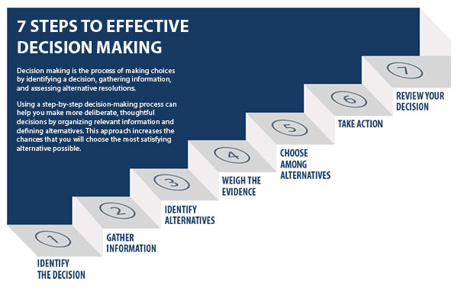

Slide 14
Step 1: Identify the decision
You realize that you need to make a decision. Try to clearly define the nature of the decision you must make. This first step is very important.
Step 2: Gather relevant information
Collect some pertinent information before you make your decision: what information is needed, the best sources of information, and how to get it. This step involves both internal and external “work.” Some information is internal: you’ll seek it through a process of self-assessment. Other information is external: you’ll find it online, in books, from other people, and from other sources.

Slide 15
Step 3: Identify the alternatives
As you collect information, you will probably identify several possible paths of action, or alternatives. You can also use your imagination and additional information to construct new alternatives. In this step, you will list all possible and desirable alternatives.
Step 4: Weigh the evidence
Draw on your information and emotions to imagine what it would be like if you carried out each of the alternatives to the end. Evaluate whether the need identified in Step 1 would be met or resolved through the use of each alternative. As you go through this difficult internal process, you’ll begin to favor certain alternatives: those that seem to have a higher potential for reaching your goal. Finally, place the alternatives in a priority order, based upon your own value system.

Slide 16
Step 5: Choose among alternatives
Once you have weighed all the evidence, you are ready to select the alternative that seems to be best one for you. You may even choose a combination of alternatives. Your choice in Step 5 may very likely be the same or similar to the alternative you placed at the top of your list at the end of Step 4.
Step 6: Take action
You’re now ready to take some positive action by beginning to implement the alternative you chose in Step 5.

Slide 17
Step 7: Review your decision & its consequences
In this final step, consider the results of your decision and evaluate whether or not it has resolved the need you identified in Step 1. If the decision has not met the identified need, you may want to repeat certain steps of the process to make a new decision. For example, you might want to gather more detailed or somewhat different information or explore additional alternatives.

