Slide 1
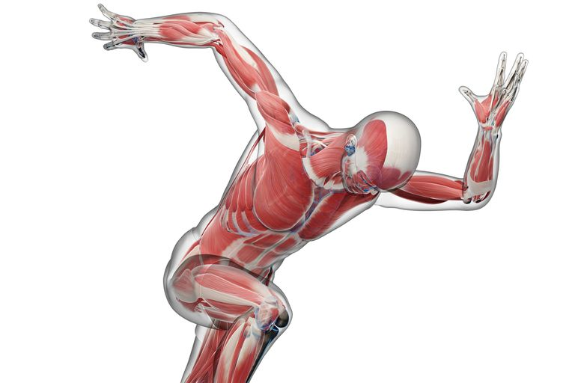
Dr. M.Jaffar PT
DPT(NCS,KMU)
MSNMPT*(RIU)
Mechanics of movement

Slide 2
Speed.
The rate at which someone or something moves or operates or is able to move or operate.
Speed is the distance traveled per unit of time.
It is how fast an object is moving.
Speed is the scalar quantity that is the magnitude of the velocity vector.
It doesn't have a direction.
Higher speed means an object is moving faster
Speed most often describes acceleration or a high rate of motion. ...
As a verb, it means to “move along quickly,” like how you speed around on your bike.

Slide 4
VELOCITY:
It is how fast an object is moving.
Speed with direction
Velocity, by definition, is a vector quantity that indicates distance per time and direction.
Velocity measures displacement over time, as opposed to distance. Acceleration is defined in technical terms as a vector quantity that indicates the rate of change of velocity

Slide 7
ACCELERATION:
In physics, acceleration is the rate of change of velocity of an object with respect to time.
An object's acceleration is the net result of all forces acting on the object, as described by Newton's Second Law.

Slide 8
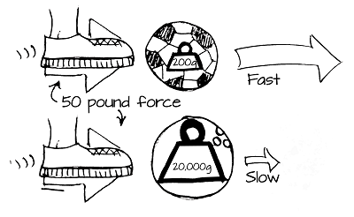
.

Slide 11
INERTIA
Inertia is the resistance of any physical object to any change in its velocity.
This includes changes to the object's speed, or direction of motion.
An aspect of this property is the tendency of objects to keep moving in a straight line at a constant speed, when no forces act upon them.
A ball rolling down a hill will continue to roll unless friction or another force stops it

Slide 12
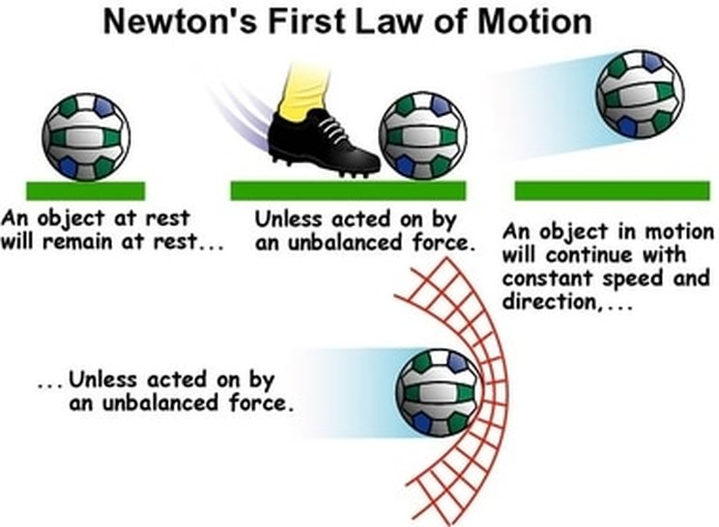

Slide 13
MOMENTUM:
Momentum is a physics term; it refers to the quantity of motion that an object has.
If an object is in motion (on the move) then it has momentum.
Momentum can be defined as "mass in motion.“
Momentum depends upon the variables mass and velocity

Slide 16
FRICTION:
Friction is the resistance to motion of one object moving relative to another.
It is not a fundamental force, like gravity or electromagnetism.
Instead, scientists believe it is the result of the electromagnetic attraction between charged particles in two touching surfaces.

Slide 18
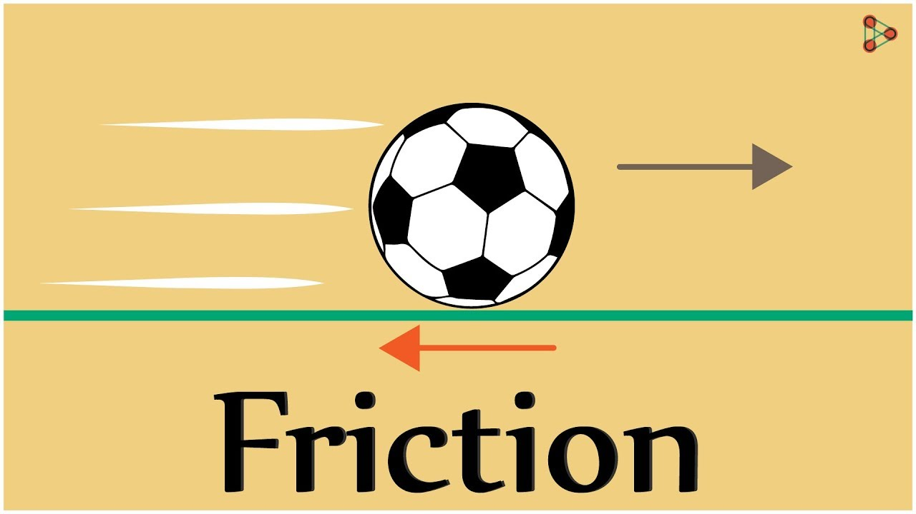

Slide 19
