Slide 1
Marketing mix
The marketing mix has been defined as the "set of marketing tools that the firm uses to proceed its marketing objectives in the target market". Thus the marketing mix refers to four broad levels of marketing decision, namely: product, price, promotion, and place.

Slide 2
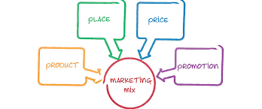
It is about putting the right product in the right place, at the right time, and at the right price. The difficult part is doing this well, as you need to know every aspect of your business plan

Slide 3
#1 Marketing Mix – Product
A product is an item that is built or produced to satisfy the needs of a certain group of people. The product can be intangible or tangible as it can be in the form of services or goods.
You must ensure to have the right type of product that is in demand for your market. So during the product development phase, the marketer must do an extensive research on the life cycle of the product that they are creating.

Slide 4
In developing the right product, you have to answer the following questions:
What does the client want from the service or product?
What features must the product have to meet the client’s needs?
Are there any necessary features that you missed out?
What’s the name of the product?
Does it have a catchy name?
What are the sizes or colors available?
How is the product different from the products of your competitors?
What does the product look like?

Slide 5
#2 Marketing Mix – Price
The price of the product is basically the amount that a customer pays to enjoy it.
It is also a very important component of a marketing plan as it determines your firm’s profit and survival. Adjusting the price of the product has a big impact on the entire marketing strategy as well as greatly affecting the sales and demand of the product.
If a company is new to the market and has not made a name for themselves yet, it is unlikely that your target market will be willing to pay a high price.

Slide 6
There are three major pricing strategies, and these are:
Market penetration pricing where the price of a product is initially set low to rapidly reach a wide fraction of the market
Market skimming pricing strategy in which a marketer sets a relatively high initial price for a product or service at first, then lowers the price over time
Neutral pricing the prices are set by the general market, with your prices just as your competitors' prices.

Slide 7
#3 Marketing Mix – Place
Placement or distribution is a very important part of the product mix. You have to position and distribute the product in a place that is accessible to potential buyers.
This comes with a deep understanding of your target market. Understand them inside out and you will discover the most efficient positioning and distribution channels that directly speak with your market.

Slide 8
There are many distribution strategies, including:
Intensive distribution
Exclusive distribution
Selective distribution
Franchising

Slide 9
#4 Marketing Mix – Promotion
Promotion is a very important component of marketing as it can boost brand recognition and sales. Promotion is comprised of various elements like:
Public Relations
Advertising
Sales Promotion
Personal selling

Slide 10
Advertising typically covers communication methods that are paid for like television advertisements, radio commercials, print media, and internet advertisements
Public relations, on the other hand, are communications that are typically not paid for. This includes press releases, exhibitions, sponsorship deals, seminars, conferences, and events.

Slide 11
THE EXTENDED MARKETING MIX
In the late 70’s it was widely acknowledged by Marketers that the Marketing Mix should be updated. This led to the creation of the Extended Marketing Mix in 1981 by Booms & Bitner which added 3 new elements to the 4 Ps Principle. This now allowed the extended Marketing Mix to include products that are services and not just physical things.

Slide 12
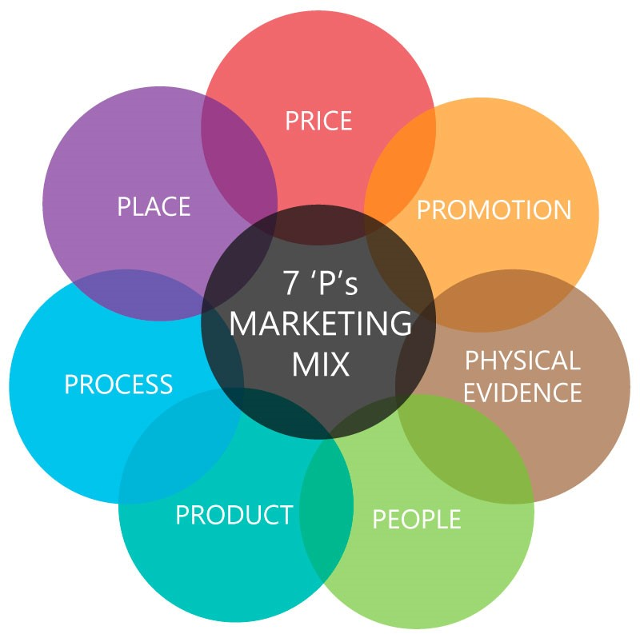

Slide 13
The extended 7 Ps:
People – All companies are reliant on the people who run them from front line Sales staff to the Managing Director. Having the right people is essential because they are as much a part of your business offering as the products/services you are offering.
People refer to the staff and salespeople who work for your business, including yourself.
When you provide excellent customer service, you create a positive experience for your customers, and in doing so market your brand to them. In turn, existing customers may spread the word about your excellent service and you can win referrals.
Give your business a competitive advantage by recruiting the right people, training your staff to develop their skills, and retaining good staff.

Slide 14
Processes – Process refers to the processes involved in delivering your products and services to the customer. It is also about being 'easy to do business with'.
Having good process in place ensures that you:
repeatedly deliver the same standard of service to your customers
save time and money by increasing efficiency.
Physical Evidence – Almost all services include some physical elements even if the bulk of what the consumer is paying for is intangible.
Physical evidence refers to everything your customers see when interacting with your business. This includes:
the physical environment where you provide the product or service
the layout or interior design
your packaging
your branding.
Physical evidence can also refer to your staff and how they dress and act.
Consider how your store's layout, fixtures and signage can build your brand and increase your sales.

