Slide 1
LEISHMANIA
By
HUMA IMTIAZ

Slide 2
LEISHMANIA
The genus Leishmania includes four major pathogens:
Leishmania donovani
Leishmania tropica
Leishmania mexicana
Leishmania braziliensis

Slide 3
Leishmania donovani
Disease: kala-azar (visceral leishmaniasis)
Important Properties
The life cycle involves the sandfly as the vector and a variety of mammals such as dogs, foxes, and rodents as reservoirs
Only female flies are vectors because only they take blood meals (a requirement for egg maturation)

Slide 4
Life cycle
When the sandfly sucks blood from an infected host, it ingests macrophages-containing amastigotes
After dissolution of the macrophages, the freed amastigotes differentiate into promastigotes in the gut
They multiply and then migrate to the pharynx, where they can be transmitted during the next bite
The cycle in the sandfly takes approximately 10 days

Slide 5
Life cycle
Shortly after an infected sandfly bites a human, the promastigotes are engulfed by macrophages, where they transform into amastigotes
Amastigotes can remain in the cytoplasm of macrophages.
The infected cells die and release progeny amastigotes that infect other macrophages and reticuloendothelial cells
The cycle is completed when the fly ingests macrophages containing the amastigotes

Slide 6
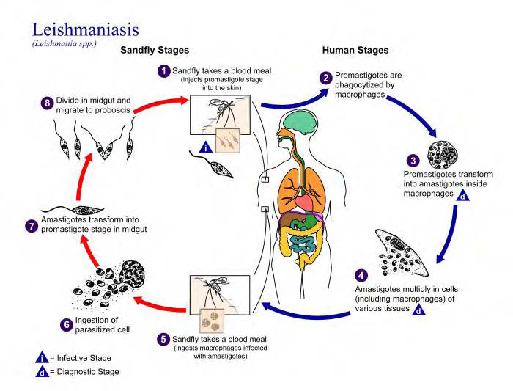

Slide 7
Pathogenesis
In visceral leishmaniasis, the organs of the reticuloendothelial system (liver, spleen, and bone marrow) are the most severely affected
Reduced bone marrow activity, coupled with cellular destruction in the spleen, results in anemia, leukopenia, and thrombocytopenia
This leads to secondary infections and a tendency to bleed
The striking enlargement of the spleen is due to a combination of proliferating macrophages and sequestered blood cells

Slide 8
Clinical Findings
Symptoms begin with intermittent fever, weakness, and weight loss
Massive enlargement of the spleen is characteristic
Hyperpigmentation of the skin is seen in light-skinned patients (kala-azar means black sickness)
The course of the disease runs for months to years
Initially, patients feel reasonably well despite persistent fever
As anemia, leukopenia, and thrombocytopenia become more profound, weakness, infection, and gastrointestinal bleeding occur
Untreated severe disease is nearly always fatal as a result of secondary infection

Slide 9
Laboratory Diagnosis
Diagnosis is usually made by detecting amastigotes in a bone marrow, spleen, or lymph node biopsy preparation

Slide 10
Leishmania tropica, Leishmania mexicana, & Leishmania braziliensis
Disease
L. tropica and L. mexicana both cause cutaneous leishmaniasis; the former organism is found in the Old World, whereas the latter is found only in the Americas
L. braziliensis causes mucocutaneous leishmaniasis

Slide 11
Leishmania tropica, Leishmania mexicana, & Leishmania braziliensis
Important Properties
Sandflies are the vectors for these three organisms, and forest rodents are their main reservoirs
The life cycle of these parasites is essentially the same as that of L. donovani
Pathogenesis & Epidemiology
The lesions are confined to the skin in cutaneous leishmaniasis and to the mucous membranes, cartilage, and skin in mucocutaneous leishmaniasis
The lesions tend to become superinfected with bacteria

Slide 12
Leishmania tropica, Leishmania mexicana, & Leishmania braziliensis
Clinical Findings
The initial lesion of cutaneous leishmaniasis is a red papule at the bite site, usually on an exposed extremity
This enlarges slowly to form multiple satellite nodules that coalesce and ulcerate
There is usually a single lesion that heals spontaneously in patients with a competent immune system
However, in certain individuals, if cell-mediated immunity does not develop, the lesions can spread to involve large areas of skin and contain enormous numbers of organisms

Slide 13
Leishmania tropica, Leishmania mexicana, & Leishmania braziliensis
Mucocutaneous leishmaniasis begins with a papule at the bite site, but then metastatic lesions form, usually at the mucocutaneous junction of the nose and mouth
Ulcerating lesions destroy nasal cartilage but not adjacent bone
These lesions heal slowly
Laboratory Diagnosis
Diagnosis is usually made microscopically by demonstrating the presence of amastigotes in a smear taken from the skin lesion

