Slide 1
Project Management
IQRA NATIONAL UNIVERSITY
Lecture 03
PRODUCTION MANAGEMENT & THREE PRODUCTION PROCESSES
PREPARED BY ENGR. IMTIAZ KHAN LECTURER CED ,INU PESH

Slide 2
What is Production management
Production management means planning, organizing, directing and controlling of production activities.
Production management deals with converting raw materials into finished goods or products. It brings together the 6M's i.e. men, money, machines, materials, methods and markets to satisfy the wants of the people.

Slide 3
Objective of the production management
The main objective of production management is to produce goods and services of the
Right quality,
Right quantity, at the
Right time and at
Minimum cost.

Slide 4
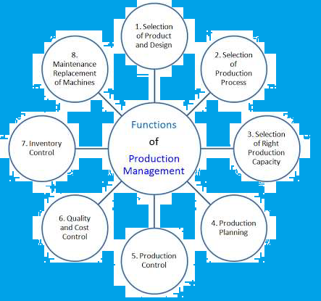
Function of production management

Slide 5
Function of the production management
1. Selection of Product and Design
Production management first selects the right product for production. Then it selects the right design for the product.
selecting the product and design effects the survival and success of the company. The product must be selected only after detailed evaluation of all the other alternative products.
The design must be according to the customers' requirements. It must give the customers maximum value at the lowest cost.

Slide 6
Function of the production management
2. Selection of Production Process
Production management must select the right production process. They must decide about the type of technology, machines, material handling system, etc.
3. Selecting Right Production Capacity
Production management must select the right production capacity to match the demand for the product.
The production manager must plan the capacity for both short and long term's production.
More or less capacity will create problems.

Slide 7
Function of the production management
4. Production Planning
Production management includes production planning. Here, the production manager decides about the routing and scheduling.
Routing means deciding the path of work and the sequence of operations. The main objective of routing is to find out the best and most economical sequence of operations to be followed in the manufacturing process. Routing ensures a smooth flow of work.
Scheduling means to decide when to start and when to complete a particular production activity.

Slide 8
Function of the production management
5. Production Control
Production management also includes production control. The manager has to monitor and control the production. He has to find out whether the actual production is done as per plans or not.
He has to compare actual production with the plans and finds out the deviations. He then takes necessary steps to correct these deviations.

Slide 9
Function of the production management
6. Quality and Cost Control
Production management also includes quality and cost control. Quality and Cost Control are given a lot of importance in today's competitive world.
Customers all over the world want good-quality products at cheapest prices. To satisfy this demand of consumers, the production manager must continuously improve the quality of his products. Along with this, he must also take essential steps to reduce the cost of his products.

Slide 10
Function of the production management
7. Inventory Control
Production management also includes inventory control. The production manager must monitor the level of inventories. There must be neither over stocking nor under stocking of inventories.
If there is an over-stocking, then the working capital will be blocked, and the materials may be spoiled, wasted or misused.
If there is an under-stocking, then production will not take place as per schedule, and deliveries will be affected.
8. Maintenance and Replacement of Machines
Production management ensures proper maintenance and replacement of machines and equipments. The production manager must have an efficient system for continuous inspection (routine checks), cleaning, oiling, maintenance and replacement of machines, equipments, spare parts, etc.

Slide 11
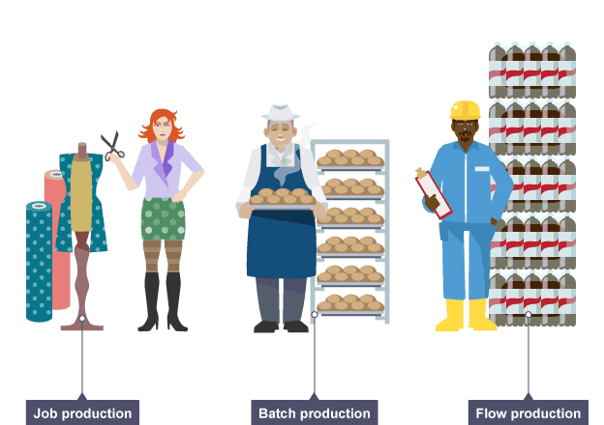
Three main production processes

Slide 12
Job production process
This method produces unique products and they are made one at a time.
Job production is labor-intensive and produced by skilled workers because every job is different.
Job production results in high-quality products that are matched to customer needs.
Employees producing goods using job production can be highly skilled and have interesting and challenging jobs.
Examples of goods made by job production are: wedding dresses and tailor-made suits. Other, large scale examples may include unique buildings, bridges and ships.

Slide 13
Advantages of job production system
A high level of customization is possible to meet the customer's exact requirements.
As the work is concentrated on a specific unit, supervision and inspection of work is relatively simple therefore work is generally of a high quality.
Workers can be easily motivated due to the skilled nature of the work they are performing.
Business is likely to be able to ‘add value’ to the products and possibly create a unique selling point (USP), both of which should enable it to sell at high prices

Slide 14
Disadvantages of job production system
Job production method is the most complex system of production and also difficult to operate.
Raw material and work – in- progress inventories are high due to uneven and irregular flow of work.
Material handling cost is high and large space is required.
It requires the use of specialist labor.

Slide 15
Batch production process
At each stage of the production process work will be completed for the whole batch before the next stage is begun.
Is used to produce a number of similar products - a batch. When an order has been completed another batch is produced.
examples are ; paints industries, Bakeries, education system

Slide 16
Advantages of Batch Production
The company that uses it has a variety of products rather than just one type so therefore it gives customer a larger choice and hence a larger possibility of sales.
Capital investment is comparatively low.
The company is reducing its risk on simply concentrating on one product; it produces a variety of the same type.
Batch production is also useful for a factory that makes seasonal items, products for which it is difficult to forecast demand.

Slide 17
Disadvantages of Batch Production
Work in progress inventory is high and large storage space is required.
Standard sequence of operation is absent.
Machines and tooling arrangement need frequent changes in product design.
There is idle time between one operation and the other. The work has to wait till a particular operation is carried out on the whole batch.
Production time is longer and skills of higher order are required due to the variety of job.

Slide 18
Flow/Mass production process
Flow production involves the production of products on production lines. There is a continuous process – the product flows from one stage of production to the next.
The production process is broken down into a number of small, simple tasks enabling machines or robots to be utilized. The production of the products is much faster than job or batch production so a business can meet the demand of large quantities.
Units are worked upon in each operation and then passed straight on to the next work stage without waiting for the batch to be completed.

Slide 19
Advantages of flow production process
Ease of using just-in-time techniques to eliminate waste and minimize costs
Labor and other production costs will be reduced through detailed planning and the use of robotics and automation
Deviations in the line can be quickly spotted through ongoing quality control techniques.
As there is no rest between operations, work-in-progress levels can be kept low investment in raw materials and parts are quickly converted into sales.
Control is easy.

Slide 20
Disadvantages of flow Production
Setup costs of buying the equipment are high, especially if computer controlled robots are to be used.
Production problems can be costly as the whole production line may have to be stopped.
Workers do not feel motivated.

Slide 22
End of the lecture

