Slide 1
PROJECT MANAGEMENT
IQRA NATIONAL UNIVERSITY
LECTURE NO #01
INTRODUCTION TO PROJECT MANAGEMENT
PREPARED BY ENGR. IMTIAZ KHAN LECTURER CED ,INU PESH

Slide 2
ATTENDENCE
All students are advised to attend 70 percent classes.
Failing to attend 70 would hold them disqualified for the examination.
Fines shall not be held against attendance nor shall be considered for allowance to the examination.

Slide 3
BOOKS TO READ FOR THE COURSE
PROJECT MANAGEMENT (A Systems Approach to Planning, Scheduling, and Controlling)
T E N T H E D I T I O N
H A R O L D K E R Z N E R , P h . D .
Senior Executive Director for Project Management
The International Institute for Learning New York,
New York
A Guide to the Project Management Body of Knowledge
(PMBOK® Guide) – Fifth Edition

Slide 4
METHOD OF ASSIGNMENT
The document will be produced in MS word
Each statement provided in the document will be self written and referred from books mentioned and research papers.
Referencing style to be used is either Vancouver or Harvard.
Research papers can be downloaded from science direct whereas Sci-hub.tw can be used to download the papers by copying DOI of the paper.

Slide 5
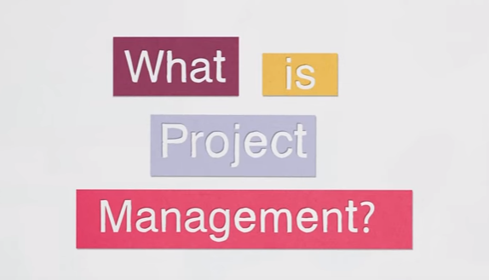
Project management

Slide 6
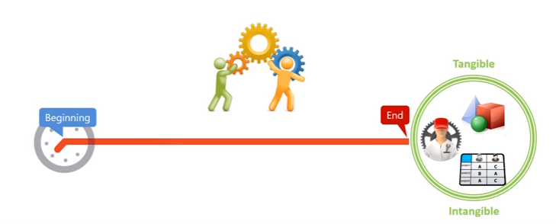
What is project
A project is temporary in that it has a defined beginning and end in time, and therefore defined scope and resources.

Slide 7
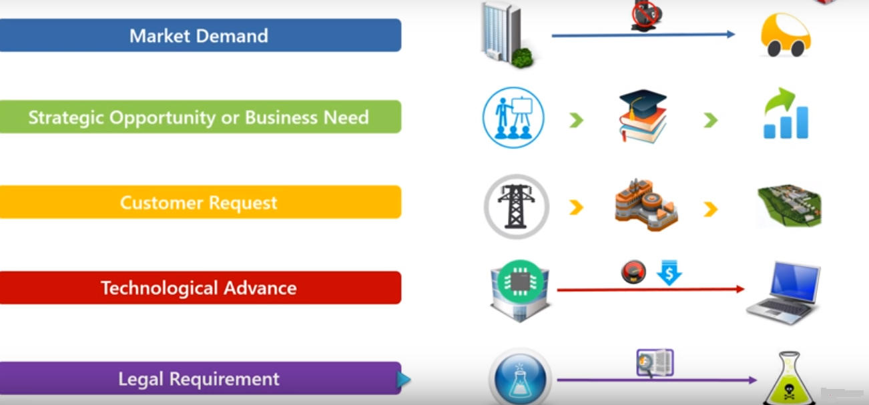
Why projects are started

Slide 8
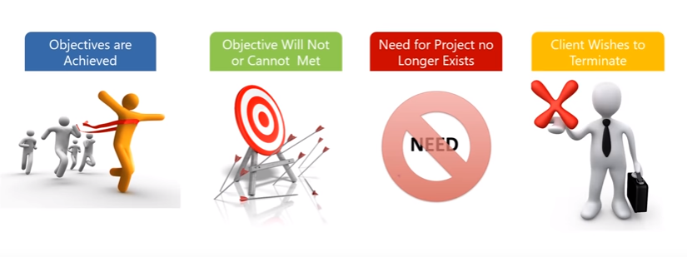
Why project Ends

Slide 9
Project vs Operation

Slide 10
What is project management

Slide 11
Project management

Slide 12
Scope

Slide 13
Time

Slide 14
Cost

Slide 15
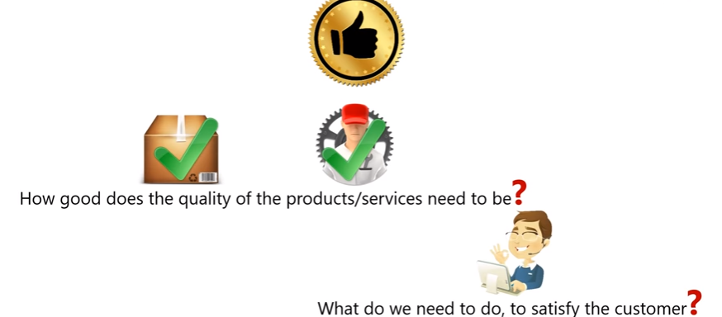
Quality

Slide 16
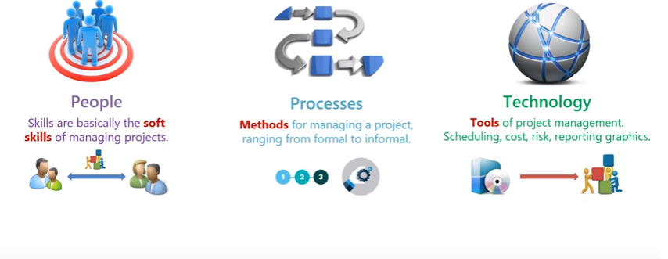
Three major component of project successes

Slide 17
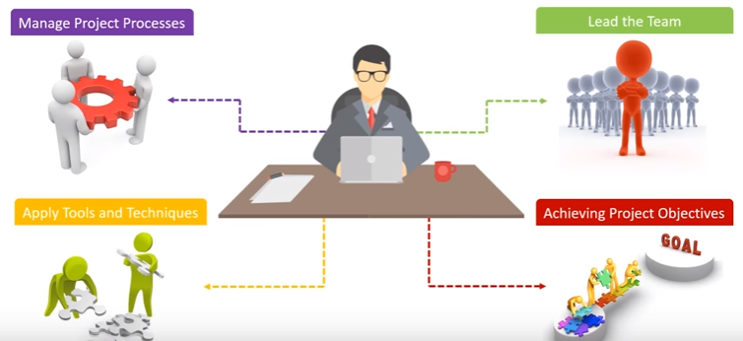
ROLE OF PROJECT MANAGER

Slide 18
RESPONSIBILITIES OF PROJECT MANAGER

Slide 19
PROJECT MANAGER COMPETENCIES

Slide 20
INTERPERSONAL SKILLS OF A PROJECT MANAGER

Slide 21
Management is
SCIENCE
ART
OR

Slide 22
SCIENCE

Slide 23
ARTS

Slide 24
NATURE OF MANAGEMENT

Slide 25
SCIENCE VS ARTS

Slide 26
Management is

Slide 27
ASSIGNMENT NO #01
SUBMITE A DETAIL REPORT ON THE HISTORY OF MANAGEMENT
Note:
Assignment will be only acceptable if it is submitted before the 2nd lecture of PM.
Incase of copied , both the assignments will be given no marks.

Slide 28
END OF THE LECTURE

