Slide 1
Computer Networks
A network is a "group of computers and associated devices that are connected by communication facilities.”
Types of networks:
Local Area Network (LAN): laboratory/office-scale
Metropolitan Area Network (MAN): city-scale
Wide Area Network (WAN): world-wide (Internet -> “collection of networks”)

Slide 2
Network Topology
STAR
RING
MESH
BUS

Slide 3
Examples
Ethernet:
popular, relatively inexpensive, easy-to-install LAN architecture
uses the CSMA/CD media access control
data transmission normally occurs at 100 Mbps (10Mbps in the early forms and 10Gbps in the most recent forms)
partially described in the IEEE 802.3 specification
Wi-Fi:
popular wireless LAN architecture
uses a modified version of the CSMA/CA protocol
partially described in the IEEE 802.11 specification

Slide 4
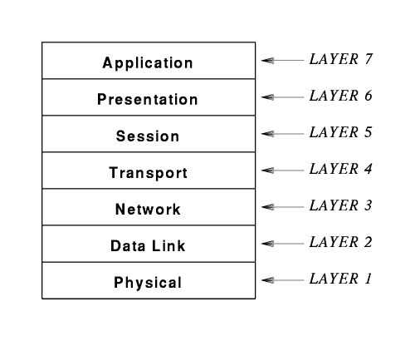
ISO/OSI Model
The International Standards Organization (ISO) Open Systems Interconnect (OSI) is a standard set of rules describing the transfer of data between each layer in a network operating system. Each layer has a specific function (i.e., the physical layer deals with the electrical and cable specifications).

Slide 5
ISO/OSI Model
Physical Layer
Physical/electrical characteristics
Cable type, length, connectors, voltage levels, signal durations, ...
Binary data (bits) as electrical or optical signals.
Data Link Layer
Defines when/how medium will be accessed for transmission
Units typically called “frames”; error detection/correction; divided into sublayers, including: MAC = Medium Access Control (MAC address 6f:00:2b:23:1f:32)
Network Layer
IP = Internet Protocol
Addressing and routing (IP address 147.94.123.15)

Slide 6
ISO/OSI Model
Transport Layer
UDP (User Datagram Protocol)
TCP (Transmission Control Protocol)
Addressing (“ports”), error correction, flow control, congestion control
Session Layer
Management of “sessions”
Presentation Layer
Data translation, formatting, encryption, compression
Application Layer
Interface between user applications and lower network services

Slide 7
What is IP, TCP, UDP?
Internet Protocol (IP):
Take your message and slap a “header” on it (“packet”)
What’s in a header?
Sender address: 112.44.44.23
Receiver address: 147.12.68.211
Routers use it to figure out what to do with it (see next slide for routers)
What does IP do:
mostly addressing
used by routers
Header
Data

Slide 8
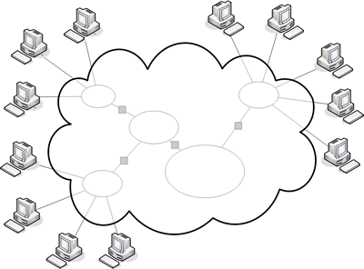
Internet + Routers
Router: links parts of a larger network together
Routing using tables:
“129.74” belongs to University of Notre Dame
How is the table built?
Routers talk to each other to exchange what they know about the world (using ICMP = Internet Control Message Protocol)
Why only remember parts of a network?
32-bit address consists of network address and computer address
Class A, B, C networks: 8/16/24 bits for network, rest for computers
Example: C network 127.45.20.21: 127.45.20 is network address, 21 is computer address (out of 255 computers)
Routing is based on (independent) packets!

Slide 9
UDP = User Datagram Protocol
IP Header
UDP Header
Data
“IP Data”
Slap on another header
Adds more addressing: “ports”
IP address tell you which computer
Ports tell you which application on that computer
Example: a web server “listens” to requests on port 80
Web browser: http://www.google.com:80 = http://216.58.216.100:80
HTTP: HyperText Transfer Protocol
:80: optional
Unreliable!
Packets can get lost; packets can arrive out of order

Slide 10
TCP = Transmission Control Protocol
Reliable protocol
Adds ports (just like UDP), but also provides:
In-order delivery of packets (using sequence numbers)
Reliable delivery: using acknowledgment (ACK) packets
Flow control:
control of traffic between sender and receiver
receiver can throttle sender to avoid getting packets too fast
explicit: “advertised window” in ACK packet (how many more bytes)
Congestion control:
control of traffic flow into the network
routers can throttle sender to avoid getting too many packets
implicit: watch ACKs -> missing ACKs = router overload
Packet
ACK

Slide 11
UDP vs TCP
TCP:
typical choice of most applications
do not want to lose data, out-of-order arrival, etc.
email, web traffic, financial transactions, etc.
UDP:
can be “faster”
no flow/congestion control “slowing down” traffic
no retransmissions
good for “real-time” traffic
out-of-order arrival: can also “reorder” at application level
loss of data: can be acceptable
missing frames in video/audio stream

