Slide 1
Model of Organisational Performance and Change
Burke-Litwin (1992)

Slide 2
The Burke-Litwin (1992) model adopts the open system approach towards an organisation.
In this model, the external environment serves as the input dimension and the individual and the organisational performance serves as the output dimension.
Burke and Litwin assert “. . . Organisational change, especially an overhaul of the company business strategy, stems more from environmental impact than from any other factor”

Slide 3
Transformational factors comprising mission, strategy, leadership and culture play a more important role when large scale organisational change is to be brought about.
Also, mere pronouncement of the strategy by the leader is not sufficient for effective organisational change, it needs to be supported by culture change, its alignment with mission, strategy and leadership behaviour.
The model includes 12 components critical for organisational understanding and analysis.

Slide 4
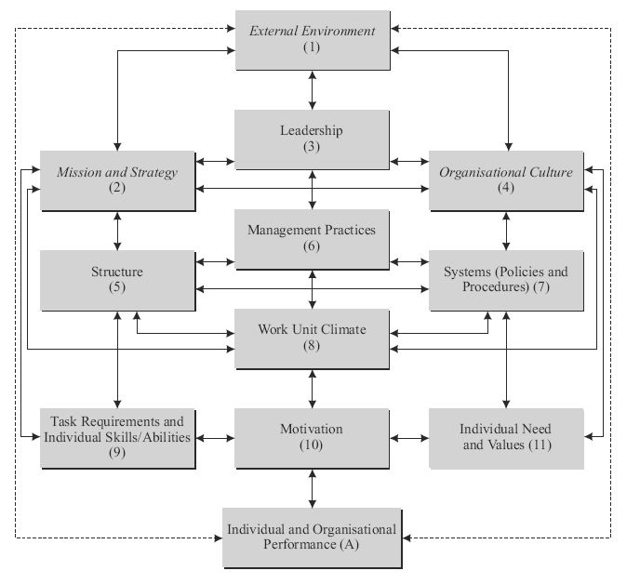

Slide 5
The dimensions can be seen as belonging to different levels—
large system level (variables such as mission, strategy, leadership and culture); group/local work
unit level (variables such as climate);
individual level (variables such as individual needs and values, task requirements and individual skills, and motivation).
The bi-directional arrows signify the open system principle of multiple impact, that is, change in one affects the others.

Slide 6
The ‘Drivers’ of Organisational Transformation
The model’s underlying assumption is that a company is an organic entity and is made up of many individual components, each of which potentially plays a role in change efforts.
Factors such as leadership, organisational mission, strategy and culture shape and drive an organisation’s life in broad ways thereby playing transformational roles in the life of an organisation.
At the same time there are variables like a company’s structure, management practices, systems (technology) that help people conduct their jobs and factors like employee motivation, needs, job fit and work unit climate-that influence how work gets done on an actual everyday basis. These factors influence organisational and individual performance at a “transactional” level.

Slide 7
External environment
These refer to forces or variables outside the organisation that influence the organisational performance such as political and economic conditions, government regulations, market conditions, customer behaviour and satisfaction and changing technology.

Slide 8
Mission and strategy
Mission refers to the organisation’s ultimate purpose or primary goals. In short, it is what the organisation stands for. Strategy refers to the ‘how’ or the process through which the mission is to be accomplished.

Slide 9
Leadership
Leadership roles include responsibilities of persuasion, influence, serving followers, and acting as a role model.
Though leadership often overlaps with management practices, these have definite differences as well.
Leadership is related to vision, using one’s influence, persuasive communication skills, recognising people through praise and providing opportunities to learn new skills.
Management deals with setting objectives, task accomplishments, using the organisation’s resources efficiently and effectively and rewarding people using extrinsic factors such as monetary rewards and elevation in status.

Slide 10
Culture
Organisational culture refers to the way things are done in an organisation and the manner in which these norms and values are communicated and explicitly or implicitly followed.

Slide 11
Systems
Systems are concerned with policies and procedures that are designed to aid and support organisational members with their job and role responsibilities.

Slide 12
Climate
According to Burke (2002), the term climate describes the collective perceptions of members within the same work unit.

Slide 13
Task requirements and individual skills/abilities
This refers to the degree of congruence between the requirements of one’s job, role and responsibilities and the knowledge, skills and abilities of the individual holding the job.

Slide 14
Individual needs and values
This is concerned with the degree to which one’s needs are met on the job and the degree of congruence between what the individual organisational member believes is valuable and what the organisation stands for.
The two components—task requirements and individual needs and values—influence motivation significantly.

Slide 15
Motivation
Motivation results when certain needs are aroused and these continue to persist until some degree of satisfaction has been attained.
It is hence important to remember that the goals that are important for the organisation also correspond to individual needs.

Slide 16
Individual and organisational performance
It refers to the output, that is, the outcomes and results of all the activities that are responses to the external environment (input).

