Slide 1
Thyroid Metabolic Hormone
Dr.Sara Naeem

Slide 2
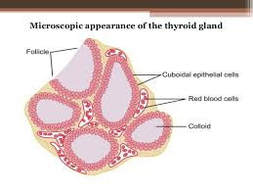

Slide 3
Located immediately below the layrnx on each side and anterior to trachea
Weighs 15 to 20 grams in adults
Composed of large number of closed follicles
Lined with cuboidal epithelial cells and filled with colloidal substance
Major constituent of colloid is thyroglobulin

Slide 4
blood flow about 5 times the weight of the gland each minute
Two major hormones
93% throxine
7% triiodothyronine
Also secretes calcitonin
Secretion is controlled by TSH released from anterior pituitory

Slide 5
Thyroglobulin
Synthesized and secreted by endoplasmic reticulum and golgi bodies into the follicles
Molecular weight is 335000 containing about 70 tyrosine amino acids
Thyroid hormones formed within the thyroglobulin molecule

Slide 6
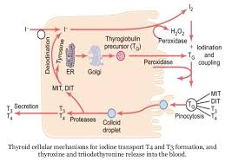
Iodine is required for Thyroxine Formation

Slide 7
About 50 mg of ingested iodine in the form of iodide are required each year or about 1mg/week
Most of the iodides are excreted by kidneys
Occurs only when one fifth is removed from the circulating blood by the gland and is used for synthesis of the hormone

Slide 8
Iodide Trapping
Transport of iodides from the blood into thyroid glandular and follicle cells
Basal membrane pump the iodide actively to the anterior of the cell. This is called iodide trapping
Concentrates the iodide to about 30 times its concentration in the blood

Slide 9
The rate of iodide trapping is mainly influenced by TSH,it stimulates activity of iodide pump

Slide 10
Oxidation of Iodide Ion
Conversion of iodide ions to an oxidized form of iodine
It combines with the amino acid tyrosine ,iodinase enzyme causes the process to occur rapidly
Oxidation is promoted by the enzyme peroxidase or H2O2
Inhibition of peroxidase causes the rate of thyroid hormone formation to fall to zero

Slide 11
Organofication of thyroglobulin
After the release of thyroglobulin from golgi apparatus, iodine binds with about one sixth of tyrosin within the thyroglobulin
Formation of thyroxin and triiodothyronine
Tyrosin oxidized to MIT and DIT
Thyroxin remains part of thyroglobulin molecule

Slide 12
Thyroid hormones are stored in the follicles in the amount sufficient to supply the body with its normal requirements for 2 to 3 months

Slide 13
Release of T3 and T4 from Thyroglobulin
Formation of pinocytic vesicles
Proteases and lysosomes fuses with the vesicles
Digest thyroglobulin molecule to release thyroxin and triiodothyronine
Fuse through capillaries ,released into the blood
Diiodinase enzyme makes iodine available for next cycle

Slide 14
Transport of Thyroxin and Triiodothyronine
self study

