Slide 1
Hospital waste classification, segregation, collection, transport and disposal

Slide 2
Introduction
Clinical waste is the waste (solid or liquid) produced in the course of health care activities during Treatment, diagnosis and immunizing human beings or animals or during research activities
About 75-90% of the waste generated in any health care facility is general waste and may be disposed off with municipal waste
Remaining 10-25% which is medical waste require special handling
Poor management of health care waste may expose health care personnel, waste handlers, and the community to infectious agents, toxic materials, and an increased risk of injury

Slide 3
Introduction
It may also damage the environment (e.g., contamination of water, air, and food)
In addition, if waste is not disposed off properly, members of the community may have an opportunity to collect disposable medical items (particularly syringes) and to repack and sell these materials
Medical waste can potentially be re used without sterilization
This reuse of non-sterile waste material poses a serious threat of the diseases

Slide 4
CATEGORIES OF PERSONS EXPOSED TO RISK OF INFECTION
Sanitation workers and environment
Medical & Paramedical staff
Patients and Public

Slide 5
PROBLEM ASSOCIATED WITH BIOMEDICAL WASTE
ORGANISM | DISEASES CAUSED | RELATED WASTE ITEM
VIRUSES HIV, Hepatitis B, Hepatitis A,C, Arboviruses, Enteroviruses, Herpes Virus | AIDS, Infectious Hepatitis, Dengue, Japanese encephalitis, Ocular infection, Genital Infection | Infected needles, Body Fluids, Human excreta, Blood, Eye secretions, Genital Secretion
BACTERIA Salmonella typhi, Vibrio cholerae, Clostridium Tetani, Pseudomonas, Streptococcus | Typhoid, Cholera, Tetanus Wound infections, Septicemia, rheumatic fever, endocarditis, skin and soft tissue infections | Human excreta and body fluid in landfills and hospital wards, Sharps such as needles, surgical blades in hospital waste.
PARASITES Wucheraria Bancrofti, Plasmodium | Cutaneous leishmaniasis, Filariasis Kala Azar, Malaria | Human excreta, blood and body fluids in poorly managed sewage system of hospitals.

Slide 6
Classification of hospital waste
Wastes in a health care facility cover a diverse range of materials that can be classified as follow:
General waste:
General or non-medical waste poses no additional risk of injury or infection to staff, to patients, to visitors, or to the community at large. It is similar in composition to household trash e.g., office papers, wrapper, kitchen waste, general sweeping etc
Pathological waste:
Pathological wastes consist of tissue, organ, body parts, human fetus and animal carcasses, blood and body fluids
Sharps waste:
Sharps waste consists of used syringes, needles, scalpels and blades or any other item that can cause a cut or puncture wound. Whether or not infected, such items are usually considered as highly hazardous health care waste

Slide 7
General Waste

Slide 8
Classification of hospital waste
Infectious waste:
Potentially infectious waste includes all waste items that are contaminated with or suspected of being contaminated with pathogen e.g., laboratory culture, tissues, swabs, bandages etc., which may transmit these disease causing organisms to healthy human beings
Chemical waste:
Waste containing chemical substances e.g., laboratory chemicals, empty bottles of lab or pharmacy chemicals, disinfectants that have expired or are no longer needed, solvents, diagnostic kits, poisonous and corrosive materials, and cleaning agents and others
Radioactive waste:
Radioactive waste includes unused liquids from radiotherapy or laboratory research, contaminated glassware, packages, or absorbent paper; urine and excreta from patients treated or tested with radioactive substances

Slide 9
Infectious Waste/Pathological Waste

Slide 10
Classification of hospital waste
Pharmaceutical waste:
Waste containing pharmaceutical substances including expired, unused & contaminated pharmaceuticals, e.g., expired drugs, vaccines and seras
Pressurized container:
Many type of gas are used in health care and often are stored in pressurized cylinders, cartridges, and aerosol cans. Many of these once empty or of no further use (although they may still contain residues), are reusable, but certain type notably aerosol cans, must be dispose off. Whether inert or potentially harmful gases in pressurized container should always be handled with care container may explode if incinerated of accidentally punctured
Genotoxic waste:
Genotoxic waste consists of highly hazardous, mutagenic, teratogenic, or carcinogenic waste containing substances with genotoxic properties e.g., Cytotoxic, neoplastic drugs used in cancer treatment, their metabolites and genotoxic chemicals.

Slide 11
Segregation of hospital waste
Segregation is separating waste by type (e.g., infectious waste, pharmaceutical waste) into color-coded bags at the place where it is generated
The key to minimization and effective management of health-care waste is segregation (separation) and identification of the waste
Appropriate handling, treatment, and disposal of waste by type reduce costs and do much to protect public health
Segregation should always be the responsibility of the waste producer, should take place as close as possible to where the waste is generated, and should be maintained in storage areas and during transport
The most appropriate way of identifying the categories of health-care waste is by sorting the waste into color-coded plastic bags or containers

Slide 12
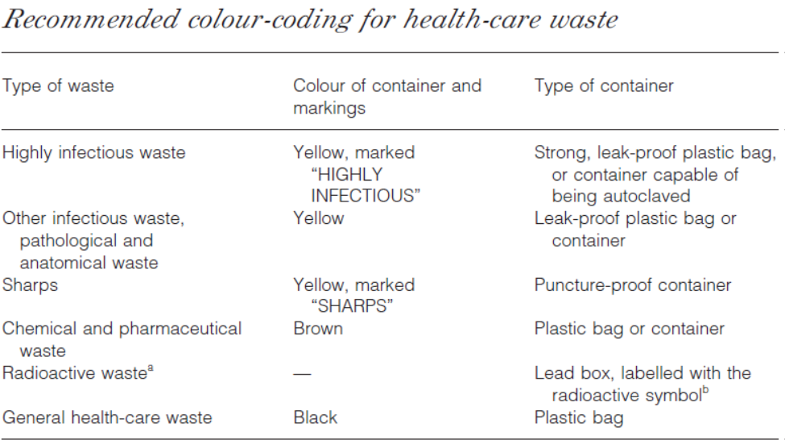

Slide 13
Segregation of hospital waste
In our setting we can design a three-bin system for waste as follows
Danger: containing sharp
Sharps should all be collected together, regardless of whether or not they are contaminated
Containers should be puncture-proof (usually made of metal or high-density plastic) and fitted with covers
They should be rigid and impermeable so that they safely retain not only the sharps but also any residual liquids from syringes
To discourage abuse, containers should be tamper-proof (difficult to open or break) and needles and syringes should be rendered unusable
Where plastic or metal containers are unavailable or too costly, containers made of dense cardboard are recommended (WHO, 1997); these fold for ease of transport and may be supplied with a plastic lining

Slide 14
Segregation of hospital waste
Yellow bags:
They are used for infectious and pathologic waste that needs to be incinerated
Bags and containers for infectious waste should be marked with the international infectious substance symbol
Small amounts of chemical or pharmaceutical waste may be collected together with infectious waste
Black bags:
They are for the general waste that is to be disposed with the normal general waste and is to be transferred by the municipals

Slide 15
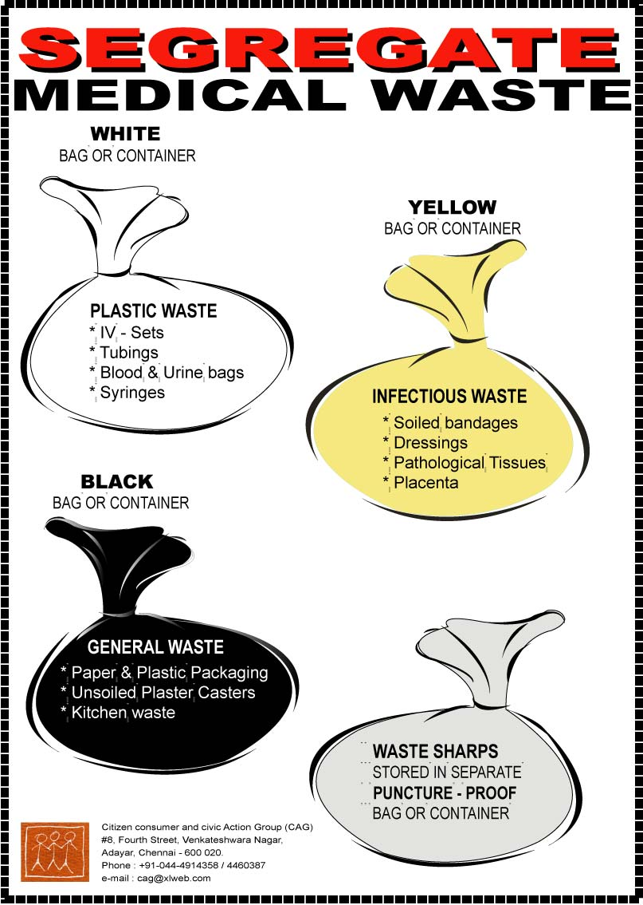
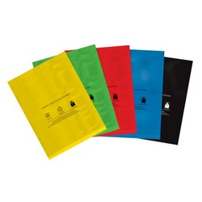
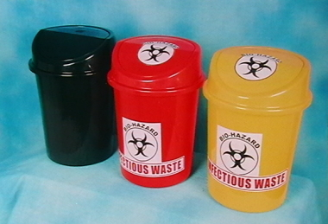

Slide 16
Segregation of hospital waste
Containers should be removed when they are three-quarters full
Staff should never attempt to correct errors of segregation by removing items from a bag or container after disposal or by placing one bag inside another bag of a different color
If general and hazardous wastes are accidentally mixed, the mixture should be treated as hazardous healthcare waste

Slide 17
Collection, transportation and storage of hospital waste
Medical waste should be handled as little as possible before disposal
It should not be collected from patient-care areas by emptying into open carts; this may lead to contamination of the surroundings and to scavenging of waste as well as to an increased risk of injury to staff, clients and visitors
Nursing and other clinical staff should ensure that waste bags are tightly closed or sealed when they are about three-quarters full
Light-gauge bags can be closed by tying the neck, but heavier-gauge bags probably require a plastic sealing tag of the self-locking type
Bags should not be closed by stapling

Slide 18
Collection, transportation and storage of hospital waste
Wastes should not be allowed to accumulate at the point of production
A routine program for their collection should be established as part of the health-care waste management plan
Waste should be collected daily (or as frequently as required) and transported to the designated central storage site
The bags or containers should be replaced immediately with new ones of the same type
A supply of fresh collection bags or containers should be readily available at all locations where waste is produced

Slide 19
Collection, transportation and storage of hospital waste
Health-care waste should be transported within the hospital or other facility by means of wheeled trolleys, containers, or carts that are not used for any other purpose and meet the following specifications:
Easy to load and unload
No sharp edges that could damage waste bags or containers during loading and unloading
Easy to clean
The vehicles should be cleaned and disinfected daily with an appropriate disinfectant

Slide 20
Collection, transportation and storage of hospital waste
All waste-bag seals should be in place and intact at the end of transportation
Waste should be transported to interim storage at the end of every shift
To reduce the risk of infection and of injury, minimize the amount of time waste is stored at the facility
Waste should be stored in an area of controlled access that is minimally trafficked by staff, clients, and visitors
Interim storage time should not exceed two days
It is preferable to have a room to store waste on each floor of the facility, but, if this is difficult, one central storage room should be designated
The storage area should also be included in a cleaning schedule

Slide 21
Disposal of hospital waste
There are two different ways of final disposal at a facility i.e., non-burn and burn techniques.
Non-burn techniques:
It employs burying of solid medical waste
To use the burial method of waste disposal there must be enough space available to dig a burial pit and to enclose it in a fence or a wall
When burying solid medical waste, adhere to the following guidelines:
Burial should be at least 50 meters from the nearest water source, located downhill from any wells, free of standing water, and in an area that does not flood
Burial pit should be 1-2 meters wide and 2-5 meters deep

Slide 22
Disposal of hospital waste
The bottom of the pit should be at least 1.8 meters above the water table
Erect a fence or a wall around the site to keep out animals
Every time solid medical waste is added to the pit, cover it with 10-30 cm of dirt
When the level of waste reaches to within 30- cm of ground level, fill the pit with dirt, seal it with concrete, and dig a new pit

Slide 23
Disposal of hospital waste
Burn technique:
It involve incineration of solid medical waste, Incinerating is the best option for solid waste disposal, since the high temperature (1300 °C) destroys microorganisms and reduces the amount of waste
Burning in an incinerator or oil drum is recommended
Facilities that generate low levels of solid medical waste can use a small drum incinerator
A drum incinerator can be made from a 200 liter or 55 gallon oil drum

Slide 24
Disposal of hospital waste
Disposal of Liquid Medical Waste:
Liquid medical waste can be poured down a sink, drain, and flushable toilet
Disposal of Hazardous Chemical Waste:
Always wear heavy utility gloves and shoes when handling or transporting hazardous chemical waste. Afterwards, wash both gloves and shoes if they become contaminated
Disposing of cytotoxic and radioactive waste should be done in accordance with all local and national laws and regulations
Disposal of sharps container:
Sharps container should be disposed by encapsulation or burning in a separate incinerator is better instead of together with non sharps medical waste

Slide 25
LABEL FOR BIO-MEDICAL WASTE CONTAINERS / BAGS
BIOHAZARD
CYTOTOXIC
HANDLE WITH CARE
Note : Label shall be non-washable and prominently visible.

