Slide 1
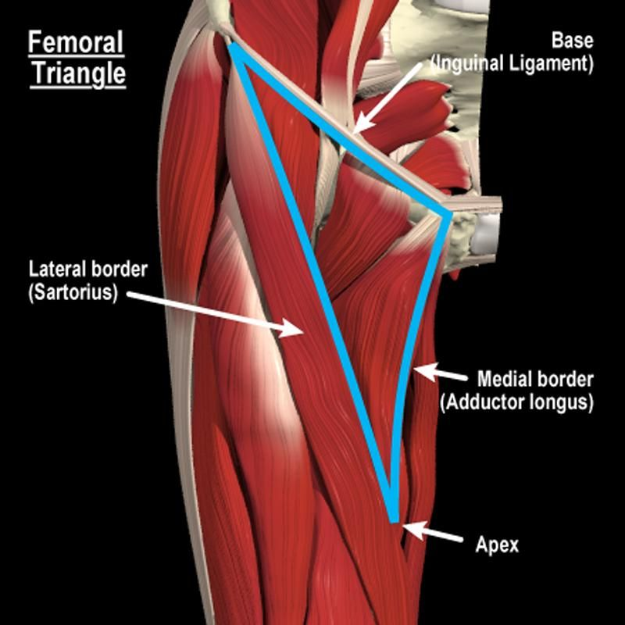
The Femoral Triangle
Dr. M.Jaffar PT
DPT(NCS,KMU)
MS-NMPT*(RIU)

Slide 2
The Femoral Triangle is a region found at the medial aspect of the upper thigh

Slide 3
The Femoral Triangle is a region found at the medial aspect of the upper thigh
The floor of the triangle is gutter shaped

Slide 4
Femoral Triangle Boundaries
Right Femoral
Superior Border
Inguinal ligament
Triangle
Inguinal ligament

Slide 5
Femoral Triangle Boundaries
Right Femoral
Superior Border
Inguinal ligament
Triangle
Inguinal ligament
Lateral Border
Sartorius – medial edge
sartorius

Slide 6
Femoral Triangle Boundaries
Right Femoral
Superior Border
Inguinal ligament
Triangle
Inguinal ligament
Lateral Border
Sartorius – medial edge
sartorius

Slide 7
Femoral Triangle Boundaries
Right Femoral
Superior Border
Inguinal ligament
Triangle
Inguinal ligament
Lateral Border
Sartorius – medial edge
Medial Border
Adductor Longus
- medial edge
sartorius
Adductor longus

Slide 8
Femoral Triangle Boundaries
Right Femoral
Superior Border
Inguinal ligament
Triangle
Inguinal ligament
Lateral Border
Sartorius – medial edge
Medial Border
Adductor Longus
- medial edge
sartorius
Adductor longus

Slide 9
Femoral Triangle Boundaries
Right Femoral
Superior Border
Inguinal ligament
Triangle
Inguinal ligament
Lateral Border
Sartorius – medial edge
sartorius
Medial Border
Adductor Longus
- medial edge
Adductor longus
lateral
medial

Slide 10
Floor of the Femoral Triangle
Right Femoral Triangle
Inguinal ligament
The floor of the Femoral Triangle consists of 3 muscles
It is not flat but gutter shaped
sartorius
Adductor longus
lateral
medial

Slide 11
Floor of the Femoral Triangle
From lateral to medial
Right Femoral Triangle
Inguinal ligament
sartorius
Adductor longus
lateral
medial

Slide 12
Floor of the Femoral Triangle
From lateral to medial
Right Femoral Triangle
Inguinal ligament
Iliacus
sartorius
Adductor longus
lateral
medial

Slide 13
Floor of the Femoral Triangle
From lateral to medial
Right Femoral Triangle
Inguinal ligament
Iliacus
psoas major
Psoas Major
sartorius
Adductor longus
lateral
medial

Slide 14
Floor of the Femoral Triangle
From lateral to medial
Right Femoral Triangle
Inguinal ligament
Iliacus
psoas
Psoas
pectineus
Pectineus and Adductor Longus
sartorius
Adductor longus
lateral
medial

Slide 15
Femoral Triangle Contents
From Lateral to Medial
N - Femoral Nerve

Slide 16
Femoral Triangle Contents
From Lateral to Medial
N - Femoral Nerve A -Femoral Artery

Slide 17
Femoral Triangle Contents
From Lateral to Medial
N - Femoral Nerve
A -Femoral Artery V - Femoral Vein

Slide 18
Femoral Triangle Contents
From Lateral to Medial
N - Femoral Nerve
A -Femoral Artery V - Femoral Vein
(femoral canal containing lymph nodes)

Slide 19
Femoral Triangle Contents
From Lateral to Medial
N - Femoral Nerve A -Femoral Artery
Inside Femoral Sheath
V - Femoral Vein
(femoral canal containing lymph nodes)

Slide 20
Blood Supply

Slide 21
Arterial Supply
External Iliac Artery

Slide 22
Arterial Supply
External Iliac Artery
Common Femoral Artery

Slide 23
Arterial Supply
External Iliac Artery
Common Femoral Artery
Superficial Femoral Artery

Slide 24
Arterial Supply
External Iliac Artery Common Femoral Artery
Superficial Femoral Artery

Slide 25
Arterial Supply
External Iliac Artery Common Femoral Artery
Deep Femoral Artery
or
Profunda Femoris
Superficial Femoral Artery

Slide 26
Arterial Supply
External Iliac Artery Common Femoral Artery
Medial Circumflex Femoral Artery
Deep Femoral Artery
or
Profunda Femoris
Superficial Femoral Artery

Slide 27
Arterial Supply
External Iliac Artery Common Femoral Artery
Medial Circumflex Femoral Artery
Superficial Femoral Artery
Lateral Circumflex Femoral Artery
Deep Femoral Artery
or
Profunda Femoris

Slide 28
Venous System
Femoral Vein Deep System

Slide 29
Venous System
Great Saphenous Vein Superficial System
Femoral Vein Deep System

Slide 30
Venous System
Sapheno-Femoral Junction
Great Saphenous Vein Superficial System
Femoral Vein Deep System

Slide 31
Summary of Muscles in the Femoral Triangle

Slide 32
Anterior Thigh
Sartorius
Origin | Anterior superior iliac spine
Insertion | Superior aspect medial surface of tibial shaft
Action | Flexes, adducts and laterally rotates the hip joint and flexes the knee
Nerve Supply | Anterior division of femoral nerve (L3, L4)
Blood Supply | Femoral artery

Slide 33
Hip Flexors
Iliacus
Origin
Upper 2/3 of iliac fossa of ilium, lateral aspect of sacrum
Lesser trochanter inferior aspect
Flexes and medially rotates hip
Muscular branch of femoral nerve (L2, L3)
Lumbar branch of iliopsoas branch of internal iliac artery
Insertion
Action
Nerve Supply
Blood Supply

Slide 34
Hip Flexors
Psoas
Origin
Anterior surfaces and lower borders of transverse processes of L1 - L5 and bodies and discs of T12 - L5
Lesser trochanter
Flexes and medially rotates the hip
Anterior primary rami L1,2
Lumbar branch of iliopsoas branch of internal iliac artery
Insertion Action
Nerve Supply Blood Supply

Slide 35
Anterior Thigh
Pectineus
Origin | Pectineal surface of the pubis
Insertion | Pectineal line of femur below lesser trochanter
Action | Adducts the thigh, flexes hip joint
Nerve Supply | Femoral nerve & some innervation from the obturator nerve (L2, L3, L4)
Blood Supply | Medial circumflex femoral branch of femoral artery and obturator artery

Slide 36
Anterior Thigh
Adductor Longus
Origin | Anterior surface of body of pubis, just lateral to pubic symphysis
Insertion | Middle third of linea aspera, between the more lateral adductor magnus and brevis insertions and the more medial origin of the vastus medialis
Action | Adducts, flexes and medially rotates the hip joint
Nerve Supply | Anterior division of obturator nerve (L2, L3, L4)
Blood Supply | Obturator artery and medial circumflex femoral artery

Slide 37
THANK YOU

