Slide 1
Social Institutions
Society has a structure and performs certain functions as such..
Society comprises of social institutions;
Social institutions are a product of cultural evolution.

Slide 2
Introduction
In society, human beings must rely upon social institutions in order to survive.
Institutions in society, according to Peter Berger, are distinctive complex of social actions that act as regulatory agencies.
Institutions are social arrangements that channel behavior in prescribed ways in the important areas of social life.
They channel our action in the same way that instinct channel animal behavior.

Slide 3
These institutions not only provide procedures that shape our conduct and actions, but also pressure us to fall in line and reinforce socially acceptable behavioral patterns.
Social institutions perform manifest and latent functions.

Slide 4
An Illustration
Societal Problem Institution
Sexual regulation; maintenance of stable units that ensure continued births and care of dependent children .....................................Family
Socialization of the newcomers to the society..........................................Education
Maintenance of order, the distribution of power......................................Polity
Production and distribution of goods and services; ownership of property......................................................... ......................................Economy
Understanding the transcendental; the search for meaning of life and death and the place of humankind in the world.......................Religion
Understanding the physical and social realms of nature............................Science
Providing for physical and emotional health care.....................................Medicine

Slide 5
Social Institutions
The Family
Education
Religion
Economy
Politics

Slide 6
Families & Intimate Relationships

Slide 7
Family: an introduction
The purpose for creating families in a social sense is to extend kinship patterns. Families are structured around kinship
Kinship is a social bond, based on blood, marriage, or adoption, that joins individuals into families.
Kinship is important because all societies must transmit culture, property, wealth, and power from one generation to the next
kinship facilitates these processes.

Slide 8
Kinship enables a society to perpetuate itself over time
Kinship can also be a mechanism for placing individuals into a broader social network that helps to order social relationships.
Traditional societies often are organized by elaborate family networks, but in industrial society members of the nuclear family are the center of each person's most important kin relationships.
Thus, it is important to see that as the institution of the family breaks down, the very fabric of society may be at risk as well.

Slide 9
The institution of family is a basic unit in the society, and the multifaceted functions performed by it makes it a much-needed institution in a society
Some of the important functions performed by the family include, reproduction of new members and socializing them, and provision of emotional and physical care for older persons and young.
Family in fact, is an institution which resolves or eases a large number of social problems.

Slide 10
Traditional Definition of Family
A group of people who are related by blood, marriage, or adoption, live together, are an economic unit, and bear and raise children.
Murdock (1949) defines family as;
a “social group characterized by common residence, economic co-operation and reproduction. It includes adults of both sexes, at least two of whom maintain a socially approved sexual relationship and one or more children - own or adopted - of the sexually cohabiting adults.”

Slide 11
Haralombos and Herald (1997), define family as;
a procedure for socialization, economic activity and sexual activities that consists of two persons of opposite genders who will indulge in sexual activity at least for the sake of pleasure and would also consist of children and a group of decedents.

Slide 12
New Definition of Family
Relationships in which people live together with commitment, form an economic unit and care for any young, and consider their identity to be significantly attached to the group.

Slide 13
The Family: some basic concepts
Family of orientation: The family into which a person is born can be referred to as the family of orientation
Family of procreation: is constructed by the adult individual who creates a family as he or she becomes an adult
Families of affinity: people with or without legal or blood ties who feel they belong together
Extended (consanguine)Family: It consists of an old system of family with the close connections of two or three generations of relations
Nuclear (conjugal)Family: consists of two elders and their children. It is often referred to as the “immediate family”

Slide 14
The Family: marriage patterns
Slide 14
Endogamy & Exogamy
Monogamy &Polygamy
There are two types of polygamy:
Polygyny- a man may marry more than one wife (patrilineal descent more common)
Polyandry- a woman may have more than one husband (matrilineal descent more common, Tibetan region)

Slide 15
The Family: residential patterns
Patrilocal
Matrilocal
Neolocal
Patriarchal & matriarchal families

Slide 16
The Family: Patterns of Descent
Patrilineal | Matrilineal | Bilineal
Family name is traced through the father’s line Son is typically the inheritor of property Patriarchy | Family name is traced though the mother’s line Daughter is typically the inheritor of property Matriarchy | Use of both parents to trace descent Women still assume husband’s surname No determination of which child will inherit property

Slide 17
Family Structure
Size and form of family has typically been tied to the needs of subsistence and ability to reproduce itself
Traditionally families were a source of production—more and more they are a source of consumption
Structure
Extended families
Nuclear families

Slide 18
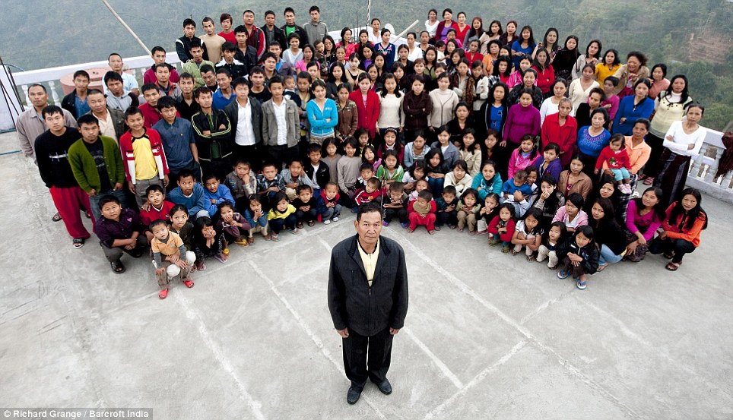

Slide 19
Extended Family
Advantages
Extended families are very important in countries where there is no social security net
Extended families help prevent elderly people from becoming poor
the grandparents can look after the children and both of the parents are free to work on the farm or earn money in jobs
More confidence among off springs
help us to learn interpersonal relationship and living in a society
kids feel closer to their grandparents, uncles, aunts and cousins
Disadvantages
Sometimes you have no privacy because there are so many members
They can also cause conflict and problems
meddling in other family members' problems- petty feuds in families
sharing other family members' problems can also become burdensome on other members
they often start highlighting and even exploiting others` weaknesses, which also create political arena in the household
Most parents tend to always keep their children under their domination even when they have come of age and are in a position to take charge of their lives

Slide 20
Nuclear or “Micro Family”
The nuclear families are usually a well maintained economical family.
there is less interference of others, fewer problems arise.
A nuclear life makes you independent and enables you to bring up your children the way you want
Every person needs privacy, some time to be alone, but being a part of a joint family sometimes it is not possible to sit alone and ponder
The Father and mother, if both are going to work then in that case they have to leave their child or children alone or to be baby - sitted, where the child grows away from their family values.
Weak socialization
Weaker family control

Slide 21
Theoretical Perspectives on the Family
Functionalism
Family is a crucial institution in maintaining the stability of society
Family is structured to meet certain needs of society in the best way possible
Changes to the family structure can disrupt internal harmony and have broader implications on societal equilibrium
Favors the traditional family model (Husband as breadwinner—Wife as homemaker)

Slide 22
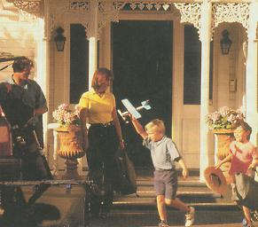
Family Functions
Reproduction
Regulation of Sexual Behavior
Socialization
Protection, affection, and companionship
Social placement
Others?

Slide 23
Theoretical Perspectives on the Family
Conflict Theory: family perpetuate social inequality in three major ways
Property & inheritance
Patriarchy
Race & ethnicity
Emphasis on the social placement function of the family
Family works to reproduce social inequalities within a society
Argues that traditional family form contributes to the inequality of the sexes

Slide 24
Theoretical Perspectives on the Family
Symbolic Interactionism
Emphasizes:
Changing meanings attached to family
Overtime
Across groups
Across cultures
Changing roles that are performed within families
What are the roles to be performed by men and women?
What roles do children play and how are they valued?

Slide 25
Changes in Family Patterns Worldwide
The declining clans & other kin groups
The free choice of a spouse
Women’s rights regarding initiating marriage & making decisions within the family
Kin marriages are less common.
Higher levels of sexual freedom
The extension of children’s rights

Slide 26
Marriage and Family: Latest Trends
Cohabitation is increasing.
More women work in the labor market.
The average age at marriage have increased.
Divorce rates stable but high.
Modernization and secular change in attitudes promote individualism & make marriage less important than it once was.
Media (particularly social)

Slide 27
The Dark Side of the Family
Family violence: child abuse & spousal abuse
Spousal abuse is more common among low-income couples. Goode (1971) suggested that low-income men may be more prone to violence because they have few other means to control their wives.
The high levels of stress induced by poverty and unemployment may lead to more violence within families.
Gelles & Cornell (1990) found that unemployed men are nearly twice as likely as employed men to assault their wives.

Slide 28
Sociological Debate: Should We Save the Traditional Family?
Marriage is weaker today because women are rejecting patriarchal relationships. Do you agree? Why or why not?
Do we need to change family patterns for the well-being of our children? As you see it, what specific changes are called for?

Slide 29
Critical Thinking Qs
in Great Britain. According to a new national survey, in some areas of the UK 75% of women are having children out of wedlock. For many, this has some serious repercussions for British society and culture. Do you foresee such trend in certain areas of Pakistan?
the feminist empowerment narrative that women don't need the shackles of men or the oppression of marriage to have children, sociologically speaking this trend does have consequences in a society. Discuss

Slide 30
comments
Why would women want to join an institution (marriage) that favors men? Marriage is not around to serve modern women. It dates back to a time when women were chattel, sold from father to husband. She NEEDED a husband in order to fulfill her social role – mother and nurturer. Society didn’t offer many opportunities to earn a sufficient income to raise children, so she needed to be married.
But today, all bets are off. As women now are the majority of college graduates, they now are able to earn a wage that they can support a family on. Women can earn the money they once could only see via a spouse’s income.
They don’t require the “family” unit they once did for child rearing. Businesses, not extended family, (preschool, childcare, nannies etc.) will help raise children. Also, friendships, parent communities, coops have filled in where family left off. The fact is many people don’t even live in close proximity to extended family any more making that relationship debatable.
Society’s roles are not keeping up with the changing world, but Britain is a great example of a new, different norm being established. Seems some men still want that old idea of marriage, while most women don’t. Couldn’t we be changing into a society that doesn’t value marriage? Aren’t we almost there?
So why marry the bull??

Slide 31
Religion
a social institution involving beliefs and practices based on a conception of the sacred.
“religion implies a relationship not only between man and man but also between man and some higher power” MacIver

Slide 32
Some basic concepts
The focus of religion is “ things that surpass the limits of our knowledge” Durkheim
Profane vs sacred
Ritual- formal sacred ceremonial behavior
Religion is a matter of faith
Faith- belief anchored in conviction rather than scientific evidence
The concept of ‘Haram & Halal’

Slide 33
Theoretical Analysis
Structural-Functional Analysis
Functions of religion
Social cohesion, unity and identity
Social control
Providing meaning and purpose
Emotional comfort and peace of mind
Promotes welfare and provides recreation
Support for the govt. and economy
Dysfunctions
Increases conflict; Sectarianism, religious terrorism
Religious wars
Religious persecution
Resists change
May induce inactivity and dependence

Slide 34
Symbolic interaction analysis
Constructing the sacred
Religion is socially constructed through rituals
Society sharply distinguish between sacred and profane by putting and judging everyday events in ‘ cosmic frame of reference’
Rape vs Marriage
We turn to religion and seek God’s shelter whenever we are threatened

Slide 35
Conflict analysis
Religion is opium of the people
Religion serve ruling elites by legitimizing status quo and diverting people’s attention from inequality.
Religion promotes patriarchy- does God favor males?
There is a close alliance between religious and political elites ( and also business elites)
Shia- Sunny
Hindu-Muslim
Judaism vs Islam
Fundamentalism vs Modernity
Religion and social stratification- members of Masjid committee are laregly those who are financially strong and contribute more ‘chanda’.

Slide 36
Religious Fundamentalism
Fundamentalism: a conservative religious doctrine that opposes intellectualism and worldly accommodation in favor of restoring traditional, otherworldly spirituality.
Religious fundamentalism is distinctive in five ways;
Fundamentalists interpret sacred text literally
Fundamentalists rejects religious pluralism
Fundamentalists pursue the personal experience of God’s presence
Fundamentalism opposes “ secular humanism”
Fundamentalists endorse conservative political goals

Slide 37
Islam, Fundamentalism, & Terrorism
Islam: its literal meaning
Early history: egalitarian and pluralistic
Islam under siege- the rise of European (Christian) empires
Islam Vs Judaism
Islam vs Hinduism
The Clash of Civilizations
Are Muslims really a chosen people?
The labeling Theory and today’s Islam

Slide 38
Religions in Modern Days
The cyber space and religions- Aalim online
Religion vs Science and technology
Secularization- the historical decline in the importance of supernatural and the sacred
Secularization is attacked by religious fundamentalists
Civil religion- a quasi-religious loyalty binding individuals in a basically secular society
Can we survive without religion?

Slide 39
Education

Slide 40
Definition
Education is the formal process by which society deliberately transmits its knowledge, skills, norms and values from one generation to another
The social institution guiding a society’s transmission of knowledge- including basic facts, job skills, and also cultural norms and values- to its members.

Slide 41
Education systems
Low-income countries:
schooling reflects local culture with limited opportunity for education
High income countries:
Education as a right and of high standards
Iran
Bangladesh
Pakistan
Zimbabwe
Thailand
Nicaragua
Japan
USA
South Korea
UK
Australia
Germany

Slide 42
Theoretical perspectives

Slide 43
Functionalism: the functions of schooling
Manifest functions
Socialization: Knowledge and skills
Cultural innovation- education stimulates critical thinking & new ideas
Cultural transmission
Social integration- curriculum as a source of patriotism and nationalism, common language, compulsory subjects
Social Control- moral and ethical education. Discipline. Awareness of law & merit
Social placement- education helps young people to assume culturally approved statuses and roles
Agent of Change: social programs, mobility, diffusion and innovation.

Slide 44
Functionalism: the functions of schooling
Latent functions
Child care
Ensure conformity to norms at a time when youth is highly prone to delinquency and crime
Establishing relationships and networks
Life long friendships
Hunt for spouses
Affiliation with schools, colleges, universities

Slide 45
Conflict: schooling and inequality
Schools routinely provide learning according to students’ social background
Societies consider schooling more important for males
Reproduces social order and control through status quo--control of resources
Standardized testing- bias exists in our education testing system
Inequality among education institutions

Slide 46
Conflict: schooling and inequality
Intolerance and inequality
Credentialism- evaluating a person on the basis of educational degrees
Status: Standardized Testing, Tracking, Public/private, gender, Class, and Race.
racial disparities and discrimination in education
Access to higher education
Educational institutes transform social disadvantage into personal deficiency

Slide 47
Interactionism
Self-concept and labeling
Teacher-expectancy effect (looking-glass-self)
Informal Structures: peers and youth subculture -Student Subcultures
Collegiates
Academics
Vocational
Non-conformists

Slide 48
Problems Of Education In Pakistan.
the educational system of Pakistan is based on unequal lines.
regional disparity is also a major problem.
the ratio of gender discrimination in enrollment.
the lack of technical education is a biggest flaw in the educational policy
the allocation of funds for education are very low
Poverty is also another factor that restrict the parents to send their children to schools. So, they prefer to send their children to madressahs where education is totally free.

Slide 49
Discipline and violence in schools
Students passivity
Dropping out- quitting school before earning a high school certificate
Poor academic standards
Low quality HR of education dept.
Corruption- material & moral- and indifference of teachers/staff

Slide 50
Food for Thought
“We now live in a nation where doctors destroy health, lawyers destroy justice, universities destroy knowledge, governments destroy freedom, the press destroys information, religion destroys morals, and our banks destroy economy.”
Chris Hedges

