Slide 1
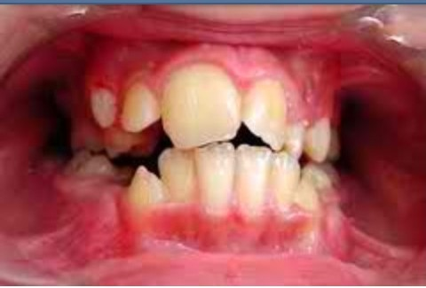
L DISTURBANCES OF THE TEETH
Prepared by: Dr. Irfan Ali Khan
Resident Oral Pathology Department

Slide 2
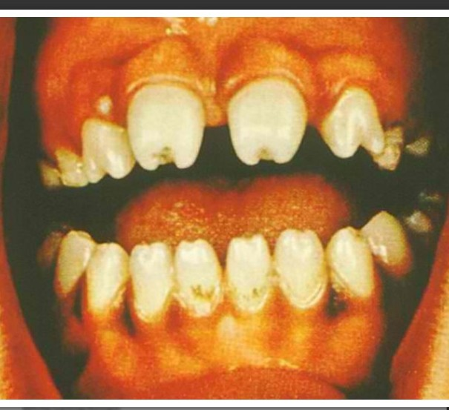
Developmental Disturbances
(1) Size
(2) Number and Eruption
(3) Shape/Form
(4) Defects of Enamel and Dentin

Slide 3
Amelogenesis Imperfecta
also known as:
Hereditary Enamel Dysplasia
Hereditary Brown Enamel
Hereditary Brow Opalescent Teeth

Slide 4
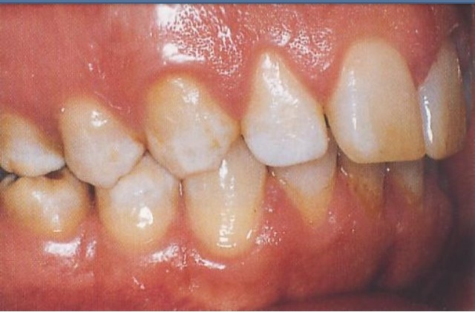
Amelogenesis Imperfecta
group of conditions caused by defects in the genes encoding enamel matrix proteins
genes that encode for enamel proteins:
amelogenin
enamelin
others
mutated in in patients with this condition

Slide 5
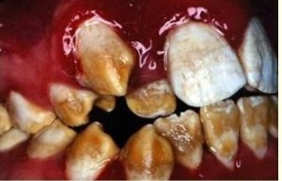
Amelogenesis Imperfecta
affects both dentition
deciduous
permanent
classified based on pattern of inheritance:
hypoplasia
hypomaturation
hypocalcified

Slide 6
Amelogenesis Imperfecta
➢ No treatment except for improvement of cosmetic appearance

Slide 7
Hypoplastic Amelogenesis Imperfecta
inadequate formation of matrix
enamel is randomly:
pitted
grooved or very thin
hard + translucent
defects become stained but teeth are not especially susceptible to caries unless enamel is scanty and easily damaged

Slide 8
Hypoplastic Amelogenesis Imperfecta
reduced enamel thickness
abnormal contour
absent interproximal contact points
Radiographically:
enamel reduced in bulk
shows thin layer over occlusal
+ interproximal surfaces

Slide 9
Hypoplastic Amelogenesis Imperfecta
dentin + pulp chambers appear normal
no treatment is necessary

Slide 10
Hypomaturation Amelogenesis Imperfecta
enamel is normal in form on eruption but:
opaque
white to brownish-yellow
softer than normal
tends to chip from underlying
dentin

Slide 11
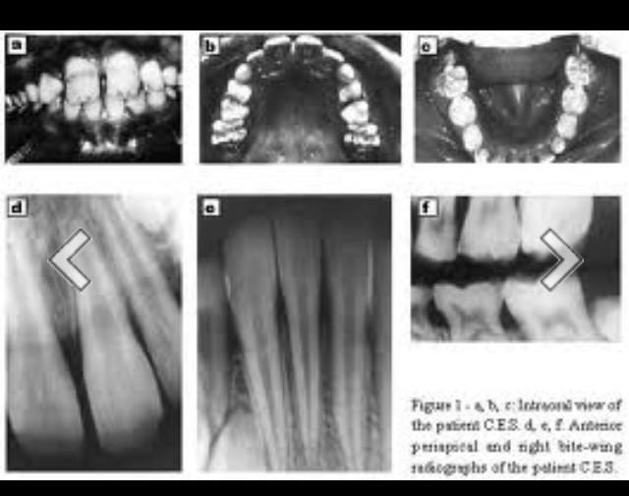
Hypomaturation Amelogenesis Imperfecta
➢ Radiographically:
✓ affected enamel exhibits radiodensity similar to dentin

Slide 12
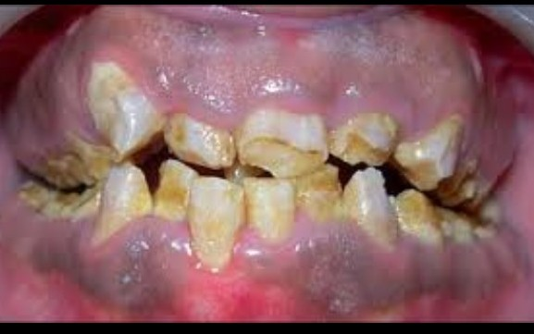
Hypocalcified Amelogenesis Imperfecta
enamel matrix is formed in normal quantity
poorly calcified
when newly erupted:
enamel is normal in thickness
normal form
but weak
opaque or chalky in appearance

Slide 13
Hypocalcified Amelogenesis Imperfecta
with years of function:
coronal enamel is removed
except for cervical portion that is occasionally calcified better
Radiographically:
density of enamel + dentin are similar

Slide 14
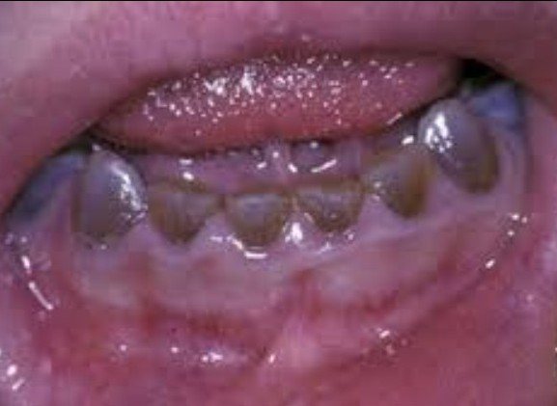
Dentinogenesis Imperfecta
also known as “Hereditary Opalascent Dentin”
✓ due to clinical discoloration of teeth
mutation in the dentin sialophosphoprotein
affects both primary + permanent dentition

Slide 15
Dentinogenesis Imperfecta
have blue to brown discoloration
with distinctive translucence
enamel frequently separates easily from underlying defective dentin

Slide 16
Dentinogenesis Imperfecta
Radiographically:
bulbous crowns
cervical constriction
thin roots
early obliteration of roots canals + pulp chambers

Slide 17
Dentinogenesis Imperfecta
Treatment:
prevent loss of enamel + subsequent loss of dentin through attrition
cast metal crowns on posterior
jacket crowns on anterior teeth

Slide 18
Dentinogenesis Imperfecta
Classification:
Type I
Type II
Type III

Slide 19
Type I Dentinogenesis Imperfecta
occurs in families with Osteogenesis Imperfecta
primary teeth are more severely affected than permanent teeth

Slide 20
Type I Dentinogenesis Imperfecta
Radiographically:
partial or total obliteration
of pulp chambers + root canals
by continued formation of dentin
roots may be short + blunted
cementum, periodontal membrane + bone appear normal

Slide 21
Type II Dentinogenesis Imperfecta
never occurs in association with osteogenesis imperfecta unless by chance
most frequently referred to as hereditary opalascent dentin
only have dentin abnormalities and no bone disease

Slide 22
Type II Dentinogenesis Imperfecta
Radiographically:
partial or total obliteration
of pulp chambers + root canals
by continued formation of dentin
roots may be short + blunted
cementum, periodontal membrane + bone appear normal

Slide 23
Type III Dentinogenesis Imperfecta
“Bradwine type”
racial isolate in Maryland
multiple pulp exposures in deciduous not seen in type I or II
periapical radiolucencies

Slide 24
Type III Dentinogenesis Imperfecta
enamel appears normal
large size of pulp chamber is due not to resorption but
rather to insufficient + defective dentin formation

Slide 25
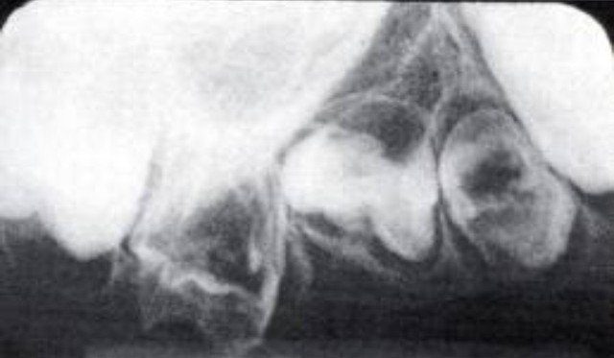
Dentin Dysplasia
also known as “Rootless Teeth”
rare disturbance of dentin formation
normal enamel
atypical dentin formation
abnormal pulpal morphology
hereditary disease

Slide 26
Dentin Dysplasia
Classification:
Type I (Radicular Type)
Type II (Coronal Type)

Slide 27
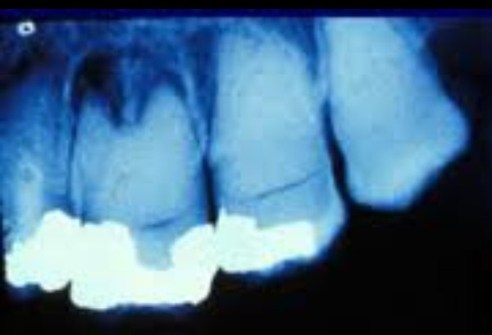
Type I (Radicular Type)
both dentitions are of normal color
periapical lesion
premature tooth loss may occur because of short roots or periapical inflammatory lesions

Slide 28
Type I (Radicular Type)
Radiographically:
roots are extremely short
pulps almost completely obliterated
periapical radiolucencies:
granulomas
cysts
chronic abscesses

Slide 29
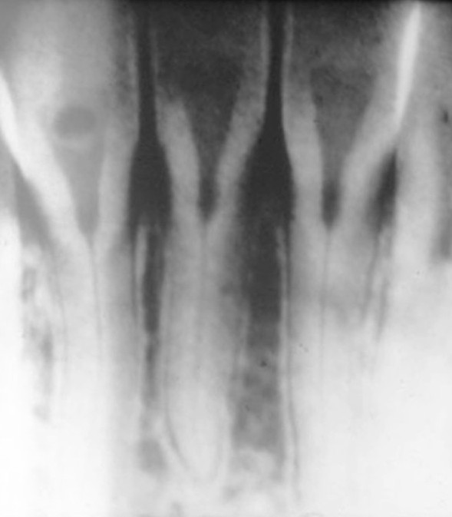
Type II (Coronal Type)
color of primary dentition is opalescent
permanent dentition is normal
coronal pulps are usually large (thistle tube appearance)
✓ filled with globules of abnormal dentin

Slide 30
Type II (Coronal Type)
Radiographically:
(Deciduous)
roots are extremely short
pulps almost completely obliterated
(Permanent)
abnormally large pulp chambers in coronal portion of tooth

Slide 31
Regional Odontodysplasia
also known as:
Odontogenic Dysplasia
Odontogenesis Imperfecta
Ghost Teeth

Slide 32
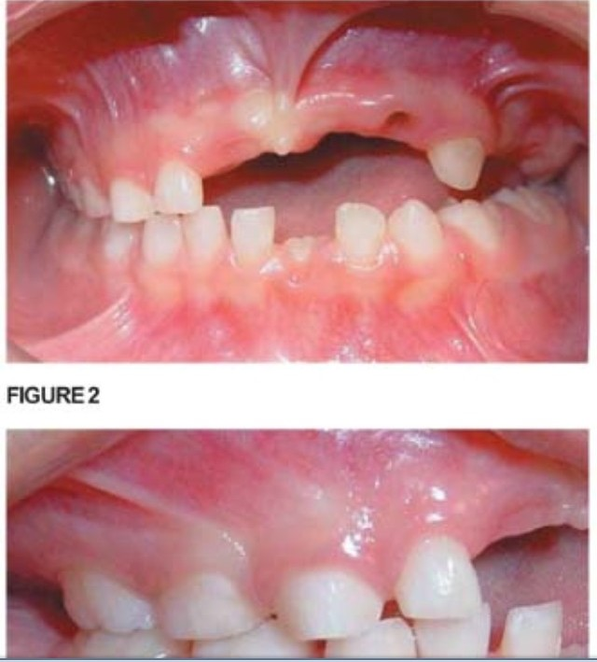
Regional Odontodysplasia
one or several teeth in a localized area are affected
maxillary teeth are involved more frequently than mandibular area
etiology is unknown

Slide 33
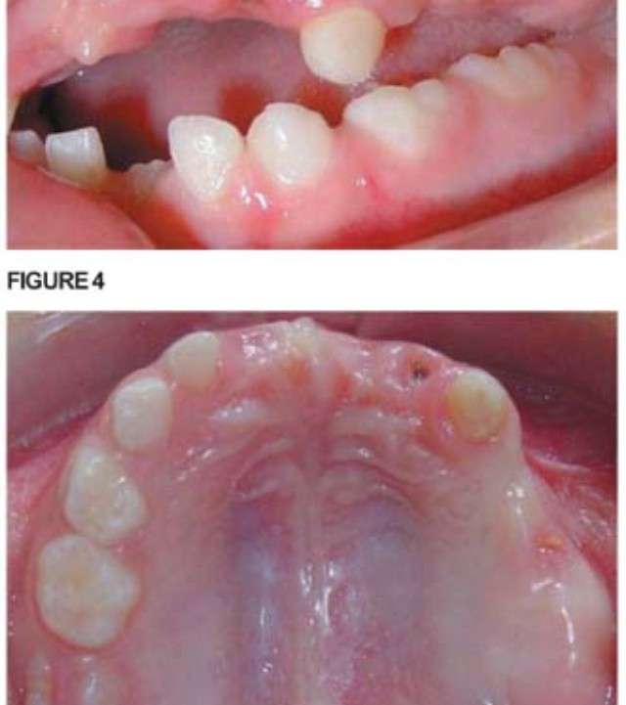
Regional Odontodysplasia
teeth affected may exhibit a delay or total failure in eruption
shape is altered, irregular in appearance

Slide 34
Regional Odontodysplasia
Radiographically:
marked reduction in radiodensity
teeth assume a “ghost” appearance
both enamel + dentin appear very thin
pulp chamber is exceedingly large

Slide 35
Regional Odontodysplasia
Treatment:
poor cosmetic appearance of teeth
extraction with restoration by prosthetic appliance

Slide 36
Shell Tooth
normal thickness enamel
extremely thin dentin
enlarged pulps
thin dentin may involve entire tooth or be isolated to the root
most frequently in deciduous

Slide 37
References:
❖ Books
Cawson, R.A: Cawson’s Essentials of Oral Oral Pathology and Oral Medicine,
8th Edition
(pages 24-36)
Neville, et al: Oral and Maxillofacial Pathology 3rd Edition
(pages 77-113)
Regezi, Joseph et al: Oral Pathology, Clinical Pathological Correlations
₅th
Edition
(pages 361-373)
Shafer, et al: A textbook of Oral Pathology, 3rd Edition
(pages 37-69)

