Slide 1
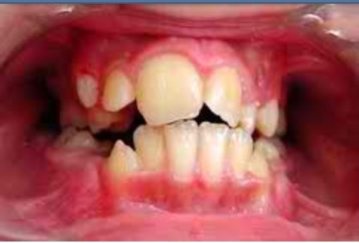
L DISTURBANCES OF THE TEETH
Prepared by: Dr. Irfan Ali Khan
Resident: Oral & Maxillofacial Pathology Department

Slide 2
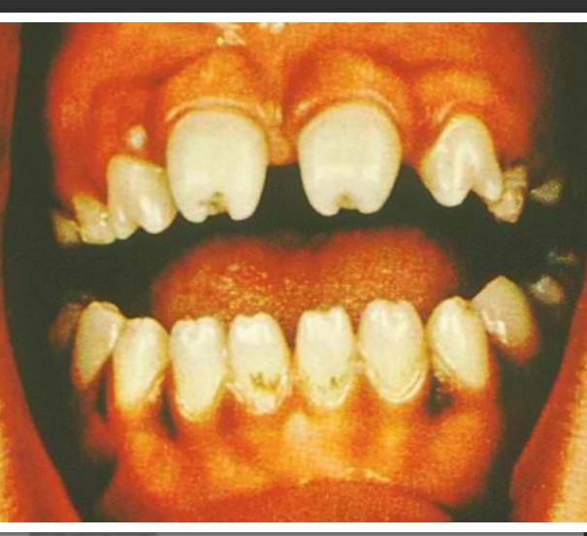
Developmental Disturbances
(1) Size
(2) Number and Eruption
(3) Shape/Form
(4) Defects of Enamel and Dentin

Slide 3
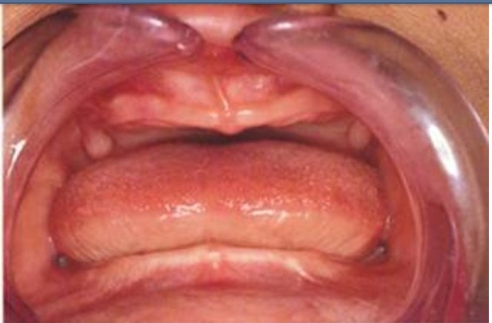
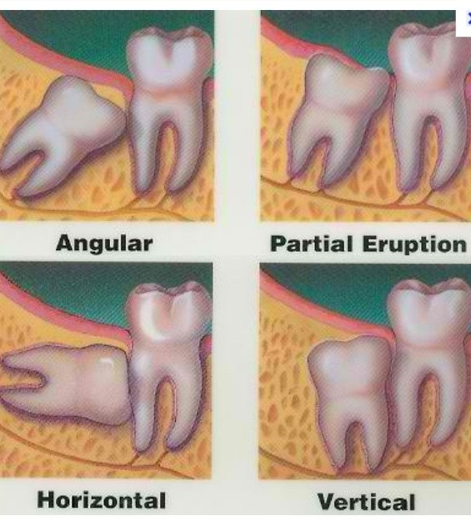
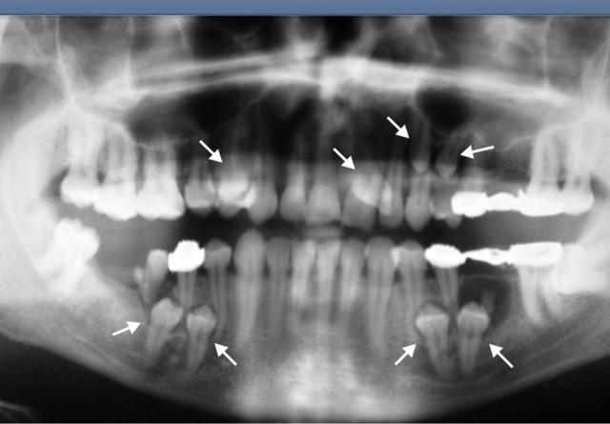
Number and Eruption
Supernumerary
Anodontia
Impaction

Slide 4
Number and Eruption
Supernumerary
  results from continued proliferation of permanent or primary dental lamina to form third tooth germ
  teeth may have:
    normal morphology
    rudimentary
    miniature

Slide 5
Number and Eruption
Supernumerary
  more often in permanent dentition than primary dentition
  more in the maxilla than in mandible

Slide 6
Number and Eruption
Supernumerary
  may be impacted erupted or impacted
  because of additional tooth bulk, it causes:
    malposition of adjacent teeth
    prevent their eruption

Slide 7
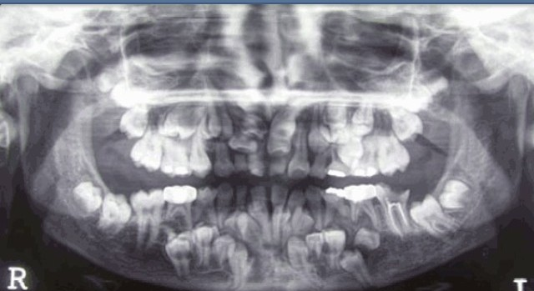
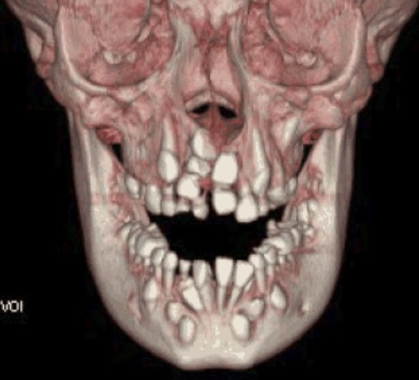
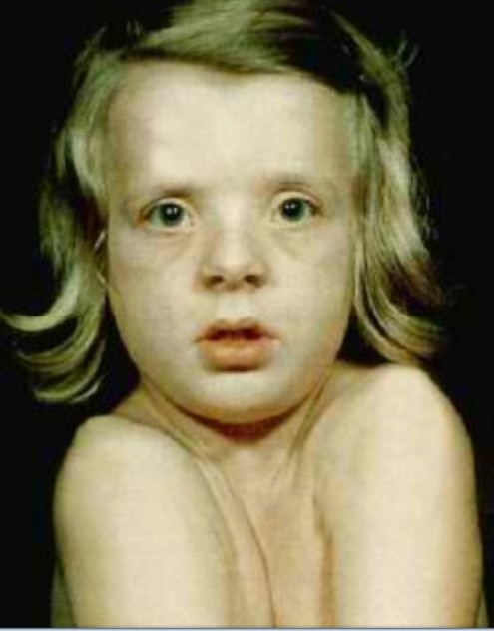
Number and Eruption
Supernumerary
  many are impacted
    characteristically found
in cleidocranial dysostosis

Slide 8
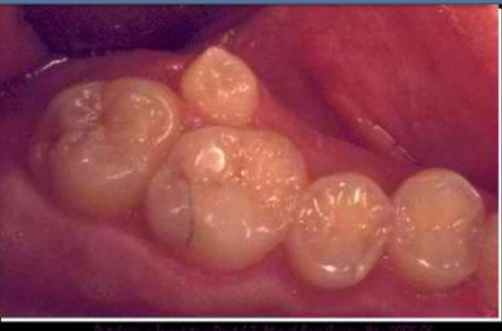
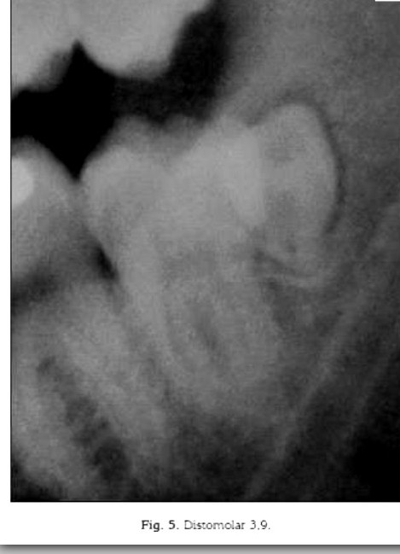
Number and Eruption
Supernumerary
  Mesiodens
  Fourth molar
    Maxillary Paramolar
    Distomolar or Distodens
  Mandibular Premolar
  Maxillary lateral incisors

Slide 9
Number and Eruption
Supernumerary
  Mandibular central incisors
  Maxillary Premolars

Slide 10
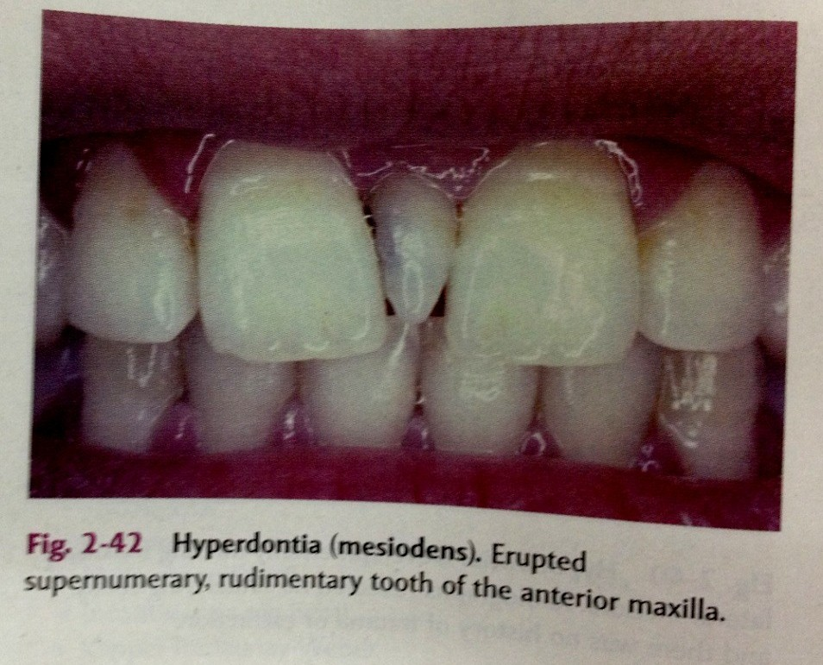
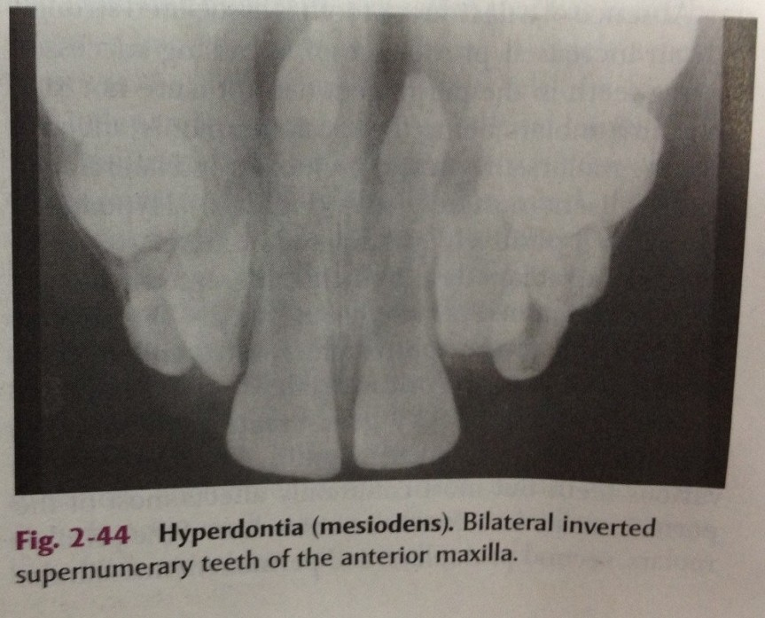
Mesiodens
most common supernumerary tooth
tooth situated between maxillary central incisors
  singly
  paired
  erupted or impacted
  inverted

Slide 11
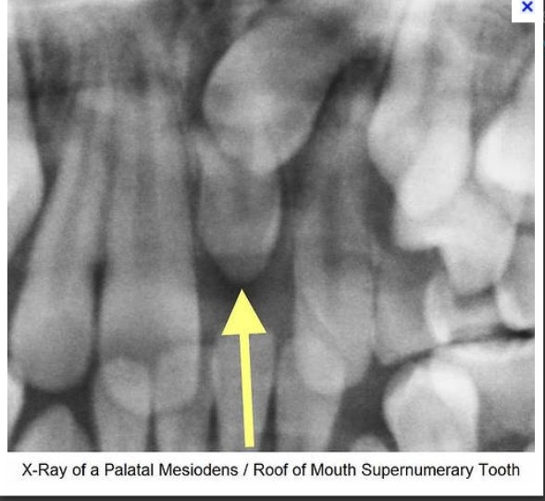
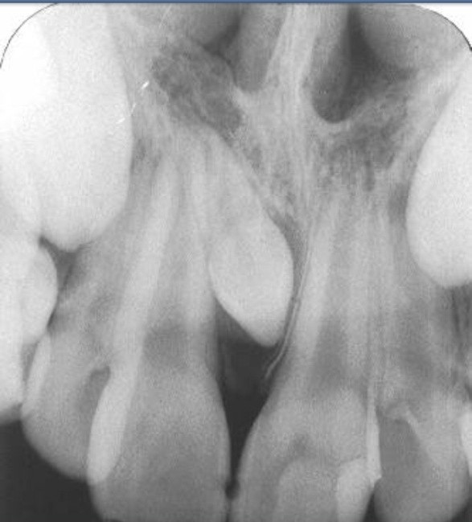
Mesiodens
small tooth
cone-shaped crown
short root

Slide 12
Fourth Molar
2nd most common
situated distal to 3rd molar
small rudimentary tooth, but may be of normal size
mandibular 4th molar also is seen occasionally, but less common than maxillary molar

Slide 13
Paramolar
small + rudimentary
situated bucally or lingually to one of the maxillary molars
interproximally between 1st
+ 2nd or 2nd + 3rd maxillary molars

Slide 14
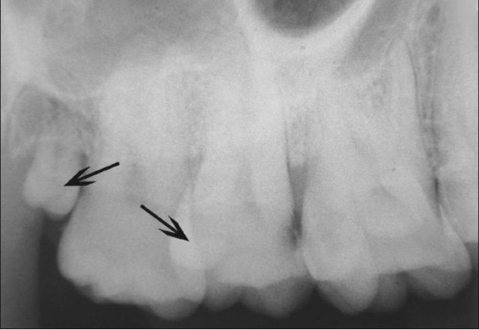
Distomolar/Distodens
➢ molar located distal to molar

Slide 15
Number and Eruption
Supernumerary
Anodontia
Impaction

Slide 16
Number and Eruption
Anodontia
  lack of tooth development
  absence of teeth

Slide 17
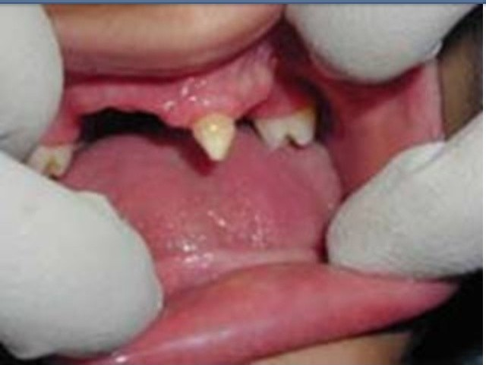
Number and Eruption
Anodontia
  Complete Anodontia
  Partial Anodontia
    Hypodontia
    Oligodontia
  Pseudoanodontia
  False Anodontia

Slide 18
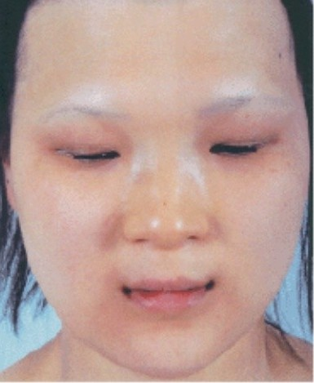
Complete Anodontia
when all teeth are missing
rare
often associated with a syndrome known as hereditary ectodermal dysplasia

Slide 19
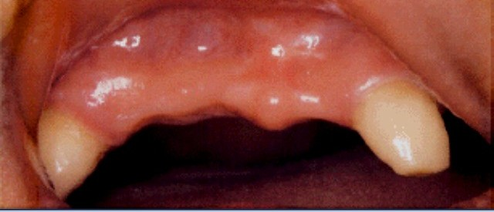
Hypodontia
➢ lack of development of one or more teeth

Slide 20
Oligodontia
➢ lack of development of six or more teeth

Slide 21
Pseudoanodontia
➢ when teeth are absent clinically because of impaction or delayed eruption

Slide 22
False Anodontia
➢ when teeth have been exfoliated or extracted

Slide 23
Number and Eruption
Supernumerary
Anodontia
Impaction

Slide 24
Number and Eruption
Impaction
  most often affects the mandibular 3rd molars + maxillary canines
  less commonly:
    premolars
    mandibular canines
    second molars

Slide 25
Number and Eruption
Impaction
  occurs due to obstruction from crowding
  from some other physical barrier
  occasionally, may be due to an abnormal eruption path, presumably because of unusual orientation of tooth germ

Slide 26
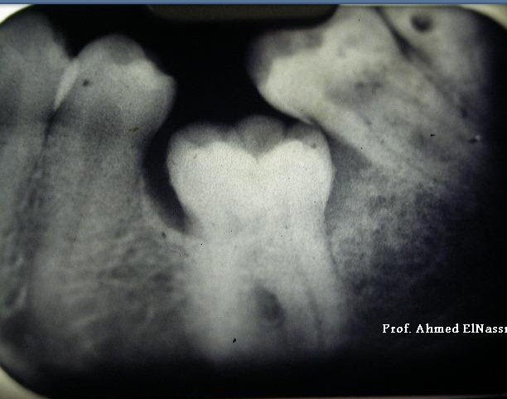
Number and Eruption
➢ Impaction
✓ Ankylosis

Slide 27
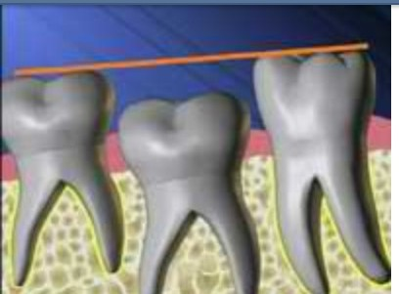
Ankylosis
fusion of a tooth to surrounding bone
with focal loss of periodontal ligament, bone + cementum become inextricably mixed
✓ cause fusion of tooth to alveolar bone

