Slide 1
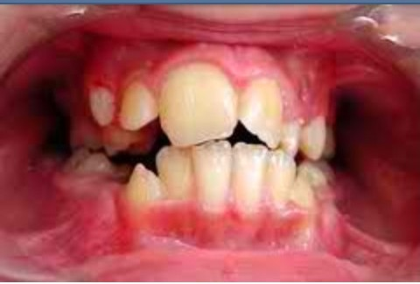
L DISTURBANCES OF THE TEETH
Prepared by: Dr. Irfan Ali Khan
Resident Oral Pathology Department

Slide 2
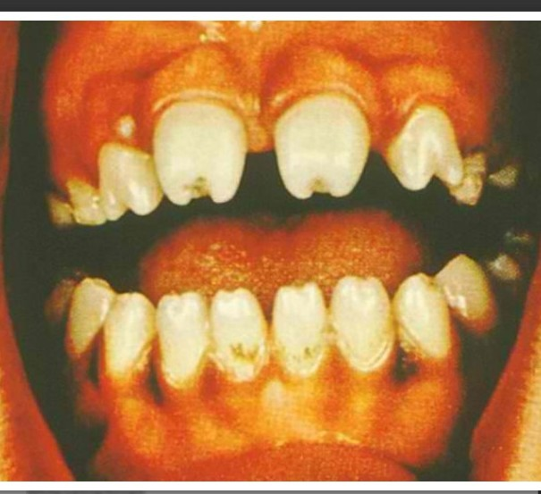
Developmental Disturbances
(1) Size
(2) Number and Eruption
(3) Shape/Form
(4) Defects of Enamel and Dentin

Slide 3
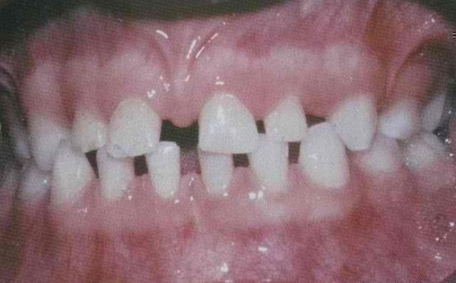
Size
Microdontia
Macrodontia

Slide 4
Size
Microdontia
(1) True Generalized Microdontia
(2) Relative Generalized Microdontia
(3) Focal or Localized Microdontia

Slide 5
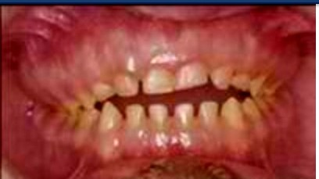
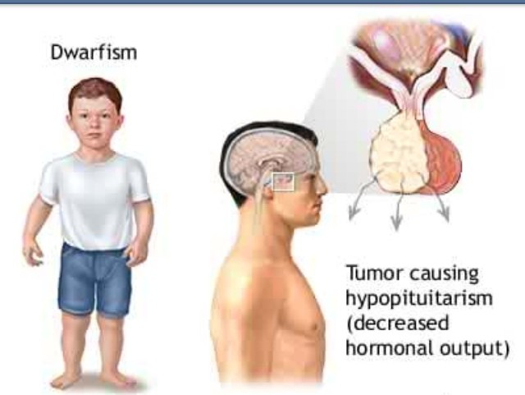
(1) True Generalized
Microdontia
➢ all teeth are smaller than normal
occur in some cases of pituitary dawrfism
exceedingly rare
teeth are well formed

Slide 6
(2) Relative Generalized
Microdontia
➢ normal or slightly smaller than normal teeth
➢ are present in jaws that are somewhat larger than normal

Slide 7
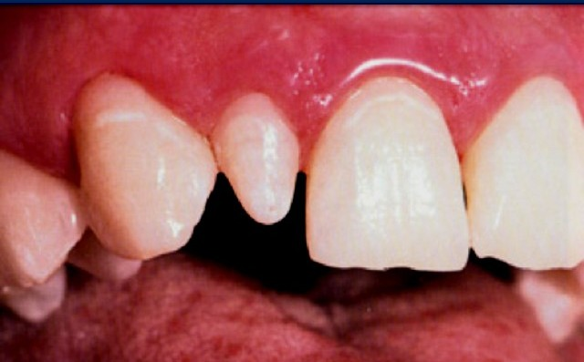
(3) Focal/Localized Microdontia
common condition
affects most often maxillary lateral incisior + 3rd molar
these 2 teeth are most often congenitally missing

Slide 8
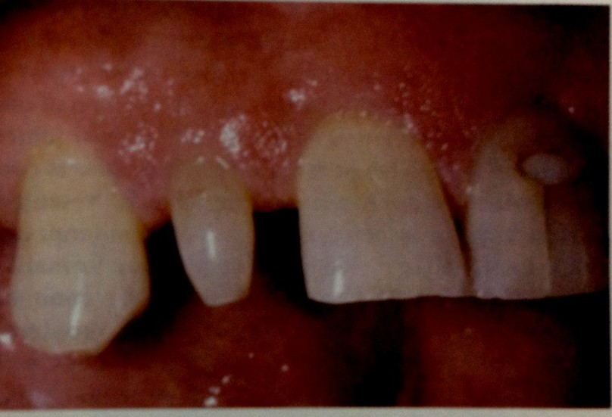
(3) Focal/Localized Microdontia
common forms of localized microdontia is that which affects maxillary lateral incisior
peg lateral
instead of parallel or diverging mesial + distal surfaces

Slide 9
(3) Focal/Localized Microdontia
sides converge or taper together incisally
forms cone-shaped crown
root is frequently shorter than usual

Slide 10
Size
Microdontia
Macrodontia

Slide 11
Size
Macrodontia
(1) True Generalized Macrodontia
(2) Relative Generalized Macrodontia
(3) Focal or Localized Macrodontia

Slide 12
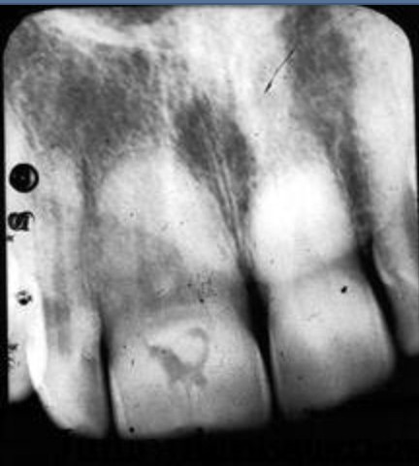
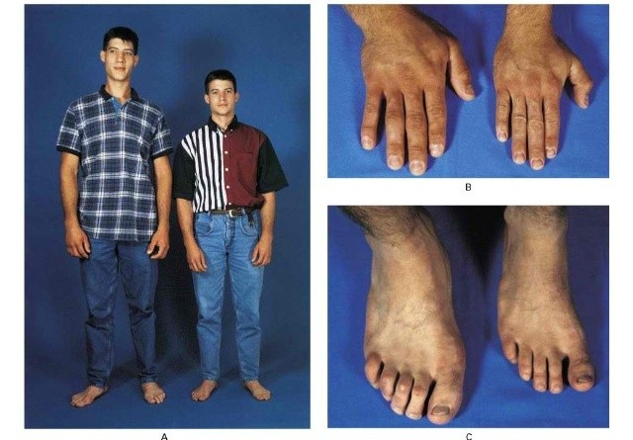
(1) True Generalized
Macrodontia
➢ all teeth are larger than normal
associated with pituitary gigantism
exceedingly rare

Slide 13
(2) Relative Generalized
Macrodontia
➢ normal or slightly larger than normal teeth in small jaws
results in crowding of teeth
insufficient arch space

Slide 14
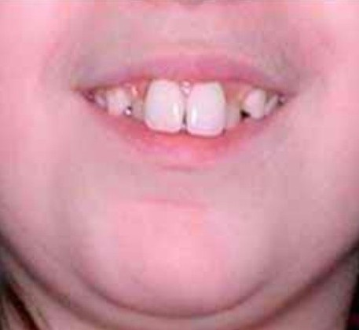
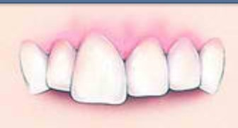
(3) Focal/Localized Macrodontia
uncommon condition
unknown etiology
usually seen with mandibular 3rd molars

