Slide 1
DENTAL WAXES

Slide 2
DEFINITION
variety of natural waxes and resins have been used in dentistry for specific and well defined applications
Waxes are thermoplastic materials which are solids at room temperature but melt without decomposition to form mobile liquids

Slide 3
CLASSIFICATION OF DENTAL WAXES
Pattern waxes:
Inlay wax
Casting wax
Base plate wax
Wax rim
Shellac denture bas

Slide 4
Processing wax
Sticky wax
Utility wax
Block-out wax
Boxing & beading wax

Slide 5
Impression wax
Corrective wax
Bite registration

Slide 6
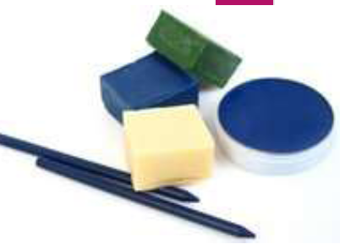
Inlay wax
It is a type of pattern wax
Various colors ( blue, green, purple)
Available in sticks, cakes, blocks

Slide 7
Composition
Paraffin wax: 60%
Carnuaba wax: 20%
Ceresin wax: 10%
Bees wax: 5%
Gum dammar wax: 5%

Slide 8
Uses of inlay wax
1) It is used to make patterns for metallic restorations.
2) Patterns for inlays
3) Crowns and bridges is first made in wax and then converted into metal or ceramic by casting.

Slide 10
Casting wax
It is a type of pattern wax.
The pattern for the metallic framework of removable partial dentures and other similar structures is fabricated from casting waxes
These waxes are available in the form of sheets, usually of 28- and 30-gauge

Slide 12
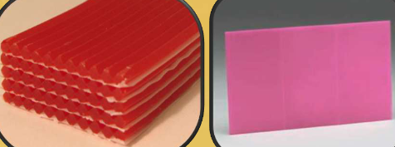
Base plate wax
It is a type of pattern wax.
Available in thin sheet and sticks ( pink or red )
Mouldable at room temp

Slide 13
Uses
Used mainly in preparing wax patterns for dental prosthesis.

Slide 14
Wax rim (bite rim)
It is a type of pattern wax.
Restoring the occlusal relationship
Arrangement of teeth.

Slide 15
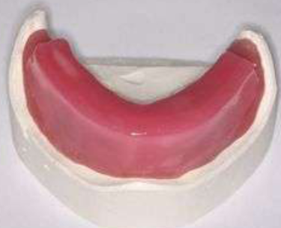
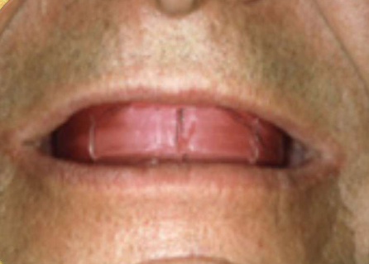

Slide 16
Shellac denture base
It is a type of pattern wax
Wax like resin stable at mouth temp.
It has high softening temperature than other waxes.
It is used as a temporary denture

Slide 17
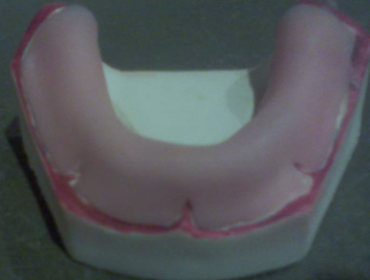

Slide 18
Processing wax
Sticky wax:
It is a type of processing wax
If movement occurs the wax tends to fracture than distort.
At room temperature the wax is brittle and breaks easily

Slide 19
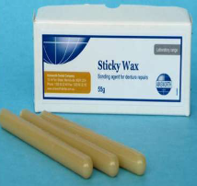
Uses
It is used to align fractured parts of acrylic dentures .
It is used to align fixed partial denture units before soldering .
It is used to seal a plaster splint to the stone cast during

Slide 20
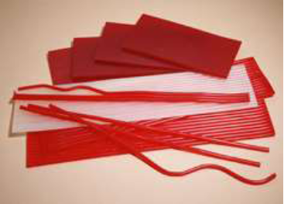
UTILITY WAX
It is a type of processing wax
Supplied as : It is available in the form of sticks and sheets. Orange or dark red in color.
In orthodontics, periphery wax is white in color

Slide 21
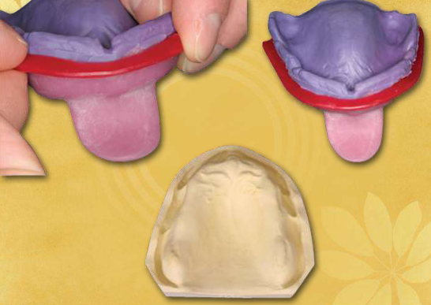
Uses
May be used on the lingual portion of a bridge pontic to stabilize it while a labial plaster splint is poured

Slide 22
Boxing & beading waxes
It is a type of processing wax.
Uses:
Beading wax is adapted around the impression borders to create the land area of the cast
Boxing wax is used to build up vertical walls around the impression in order to pour the gypsum product to make a cast base.

Slide 23
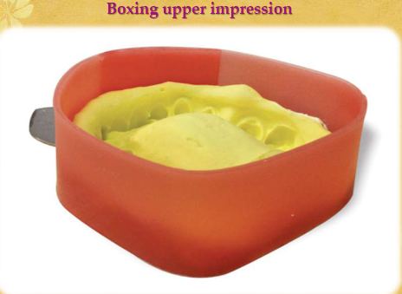

Slide 24
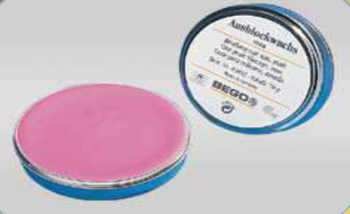
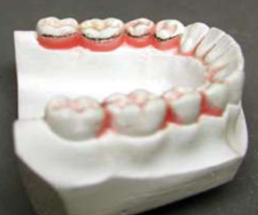
Block out wax
It is a type of processing wax.
Used for filling the undercut area on the cast during processing of the Cr-Co frame work

Slide 25
Impression waxes
Corrective wax:
Wax in combination with resins of low melting point can be used in corrective impression technique in partial and complete denture prosthesis
Availability: sheets
Used to restore the selected region in the edentulous patients to reproduce the details of mucous membrane

Slide 26
Bite registration wax
It is used to record the relationship of the upper
& lower teeth in dentulous patients

Slide 27
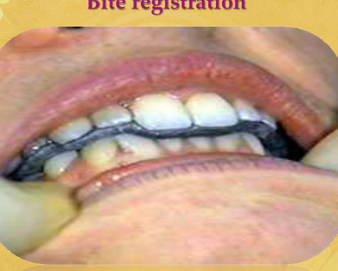

Slide 28
Thank you

