Slide 1
Analog and Digital Communication System
Engr.Latif Jan
Lecture -1

Slide 2
Analog and Digital Communication System
Course Objectives
To develop the basic concepts of Analog and Digital Communication systems.
Text Book
Modern Digital And Analog Communication Systems
By B. P Lathi, 3rd Edition
Reference books
Digital Communication by Sklar
Analog and Digital Communication by Simon Haykin
Evaluation
Assignments + Quizzes 20%
Mid Term Exam 30%
Final Term Exam 50%

Slide 3
Chapter 1 Overview
1. Communication systems
2. Analog versus digital communication
3. Modulation

Slide 4
Communication systems (Cont..)
Nowadays communications is essential to all sectors of society.
From stock market to battlefield, fast and reliable information transmission is EXTREMELY IMPORTANT.
In this era of Information Technlogy, it is believed that the prosperity and continued development of modern nations will depend primarily on communications.
Communications involves transfer of information over a distance
Communications had its beginning in 1837 with the invention of the telegraph by Samuel Morse, followed bythe invention of the telephone in 1876.

Slide 5
Communication systems (Cont..)
Signal
  The actual entity (electrical, optical, mechanical, etc.) that is transmitted from sender to receiver.
Message
  knowledge that is transmitted
Information
  Knowledge communicated or received concerning some fact or circumstance
Message and information are quite closely related.

Slide 6

Communication systems (Cont..)
scheme of a simplified communication system
source: originates a message
transmitter: converts the message into a signal that can be transmitted over a channel
Channel: transport of the signal over a certain medium (e.g. wire, optical fiber or a radio link)
Receiver: converts the received signal back into a readable message
Sink/destination: end user

Slide 7
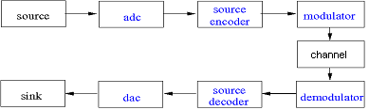
Communication systems (Cont..)
scheme of a more detailed digital communication system
adc (analog/digital converter): converts the physical analog signal into a digital electronic signal
source encoder: encodes the data in a format that removes redundancy and irrelevant information
modulator: adaptation of the frequency according to the channel characteristics
on the receiver side all transformation steps must be reversed

Slide 8
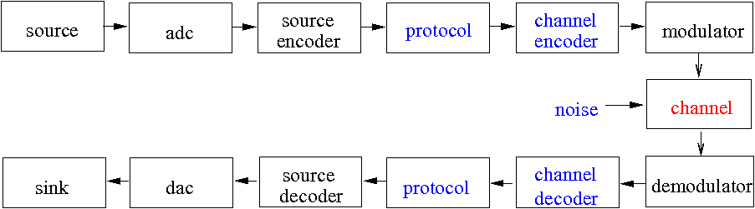
Communication systems (Cont..)
scheme of a (nearly) complete digital communication system
channel encoder: encodes the signal pulses in a format that is required by the channel
protocol: controls start, end of transmission and error recovery by adding additional bits for error detection and/or correction
noise: inside the channel the signal is disturbed by noise

Slide 9
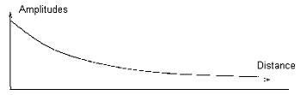
Communication systems (Cont..)
• In a realistic channel a signal is disturbed by:
noise: random and unpredictable modifications of the signal amplitude
thermal noise, caused by random movements of electrons in conductors
external noise, caused e.g. by interference with other channels
attenuation: the amplitude of the signal decreased caused by the resistance of the channel
the maximum length is restricted; amplifiers are required in certain distances!
distortion: the distortion depends on the frequency, different signal frequencies suffer different signal distortion.

Slide 10
Analog versus Digital
Communication
Analog messages are characterized by data with values from a
continuous range.
they have an indefinite number of values
there is an indefinite number of possible waveforms in a time interval.
Digital messages are constructed from a finite number of symbols.
Mostly only a binary message is used.

Slide 11
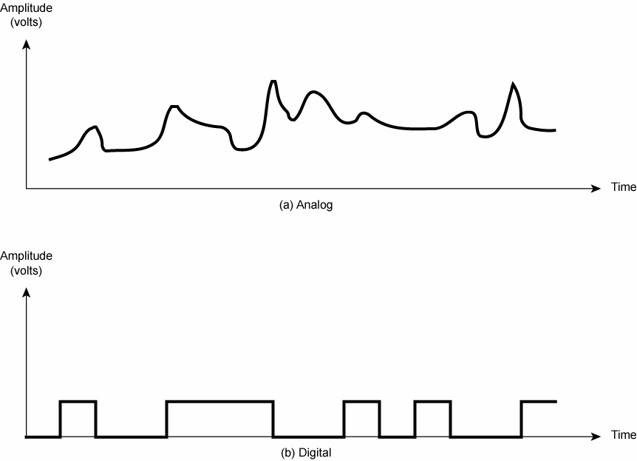
Analog versus Digital communication (Cont’d)
• Analog example:
• Digital example: (k=2)

Slide 12
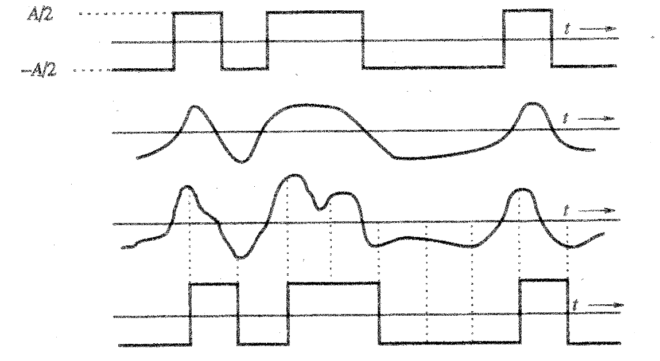
Analog versus Digital communication (Cont’d)
In a binary digital signal a "1" can be transmitted by an electric pulse of amplitude A/2, a "0" by a pulse of amplidude –A/2
Receiver must only decide, if the signal level is above 0 or not:
transmitted signal
received distorted
signal without noise
received distorted signal with noise
regenerated signal

Slide 13
Analog versus Digital communication (Cont’d)
Distorted and noisy digital signals can mostly be recovered without error
if repeaters are placed along a digital communication path, they can regenerate the signal before amplifying it.
digital messages can be reliably transmitted over long distances
Distorted and noisy analog signals cannot be recovered
there is no way to avoid accumulation of noise and distortion
amplification does not help because both signal and noise are amplified in the same proportion!
analog messages can only be transmitted over short distances if a high quality is desired

Slide 14
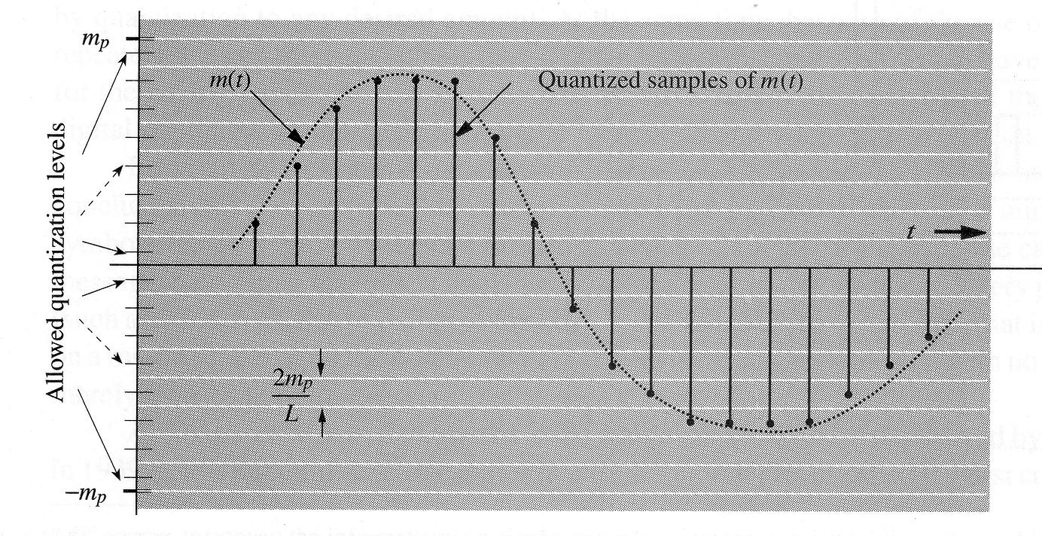
Analog versus Digital communication (Cont’d)
An analog signal can be converted to a digital signal by sampling
and quantization:

Slide 15
Analog versus Digital communication (Cont’d)
The Nyquist theorem/sampling theorem (Details later) states that the analog signal can be reconstructed from the samples, if
fsample > 2 fmax
(where fsample is the sampling frequency and
fmax is the highest signal frequency)
For quantization the range of the amplitude (–mp, mp) is partitioned into L intervals, each of magnitude m = 2 mp / L
At each sample point the amplitude is approximated by the midpoint of the interval in which the sample value falls
the unavoidable approximation error can be decreased by increasing the number L of levels)
for understanding a voice signal, L = 16 levels are sufficient; a higher quality speech signal requires at least L = 256 levels

Slide 16
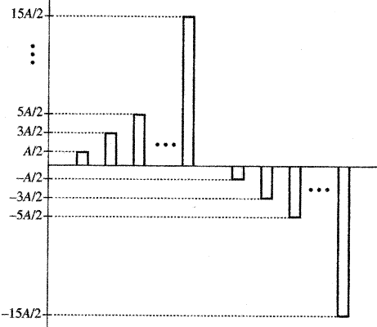
Analog versus Digital communication (Cont’d)
The quantized signal can be transmitted over a channel by using
a multiamplitude pulse-code with L signal levels. e.g. ± A/2,
± 3A/2, ± 5A/2... , ± (L–1)A/2
Example for L = 16:
(receiver can distinguish the L levels only, if A is large compared to the noise level)

Slide 17
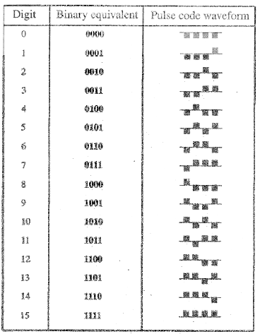
Analog versus Digital communication (Cont’d)
Alternatively, a binary pulse- code can be used that assigns to each of the L levels a short sequence of pulses with amplitudes A/2 and – A/2
Example for L = 16:
much more robust against noise
than multiamplitude pulse code!)

Slide 18
signal-to-noise ratio (SNR) ,Channel Bandwidth (B), and the Rate of Communication (C)
A high signal-to-noise ratio (SNR) is required for a high quality communication
– SNR = power of signal / power of noise
However in a realistic channel
– the noise is accumulating along the channel's path
– the signal amplitude is decreasing
the SNR is continuously decreasing along the channel.
The band width of a channel is the range of frequencies that it can transmit with reasonable fidelity.
e.g. lowest frequency f1= 300 Hz, highest frequency f2= 4000 Hz
Bandwidth B= f2 - f1 => 4000-300 =>3700 Hz
the Rate of Communication C= B log2 (1+ SNR) bits/s
This is known as Shannon’s equation, C is the channel capacity

Slide 19
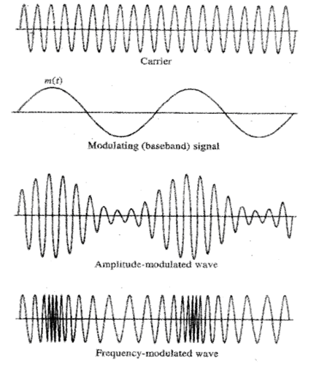
Modulation
Modulation is a process that causes a shift in the range of frequencies of a signal.
Normally the frequency range
of the signal is different from the
frequency range supported by
the physical channel
a high frequency carrier signal is
modulated by the data signal
• Two different important kinds
of modulation:
1) Amplitude modulation (AM)
2) Frequency modulation (FM)

Slide 20
Randomness, Redundancy, and Coding
Randomness means unpredictability , or uncertainty, of the outcome.
If a source had no unpredictability or uncertainty, it would be known beforehand and convey no information.
Because of redundancy, we are able to decode a message accurately despite errors in the received message.
Binary data can be transmitted using a number of different types of pulses. The choice of a particular pair of pulses to represent the symbols 1 and 0 is called Line Coding.

Slide 21
Lecture 2

Slide 22
Chapter-2
Signals and systems
Size of signal
Classification of signals
Signal operations
The unit impulse function
Correlation
Orthogonal signals

Slide 23
Signals and systems
A signal is any time-varying quantity of information or data.
Here a signal is represented by a function g(t) of the
independent time variable t. Only one-dimensional signals are considered here.
Signals are processed by systems.
"A system is composed of regularly interacting or interrelating groups of activities/parts which, when taken together, form a
new whole." (from Wikipedia)
Here a system is an entity that processes an input signal g(t) to produce a new output signal h(t).

Slide 24


Size of Signals
The size of any entity is a number that indicates the largeness or strength of that entity
Energy
The energy Eg of a signal g(t) can be calculated by the formula
For complex valued signal g(t) it can be written as
The energy is finite only, if

Slide 25


Size of Signals (cont…)
Power
The power Pg of a signal g(t) can be calculated by the formula
For complex valued signal g(t) it can be written as
The power represents the time average(mean) of the signal amplitude squared. It is finite only if the signal is periodic or has statistical regularity.

Slide 26
Size of Signals (cont…)
Examples for signals with finite energy (a) and finite power (b):
Remark:
The terms energy and power are not used in their conventional sense as electrical energy or power, but only as a measure for the signal size.

Slide 27
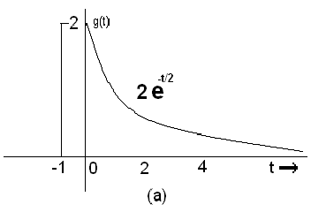
Example 2.1 Page: 17
Determine the suitable measures of the signals given below:
The signal (a) 0 as Therefore, the suitable measure for this signal is its energy given by

Slide 28

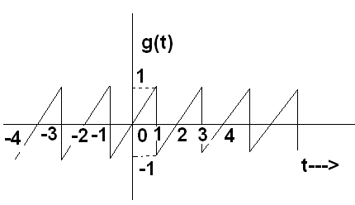
Example 2.1 Page: 17 (Cont.)
The signal in the fig. Below does not ---→ to 0 as t → . However it is periodic, therefore its power exits.

Slide 29




Example 2.2 page-18
(a)

Slide 30


Example 2.2 (cont…)
Remarks:
A sinosoid of amplitude C has power of regardless of its frequency and phase .

Slide 31




Example 2.2 (cont…)

Slide 32




Example 2.2 (cont…)
We can extent this result to a sum of any number of sinusoids with distinct frequencies.

Slide 33





Example 2.2 (cont…)
Recall that
Therefore
The rms value is

Slide 34
Classification of signals
1) Continuous-time and discrete-time signals
2) Analog and digital signals
3) Periodic and aperiodic signals
4) Energy and power signals
Deterministic and random signals
Causal vs. Non-causal signals

Slide 35
Classification of signals
Continuous time (CT) and discrete time (DT) signals
CT signals take on real or complex values as a function of an independent variable that ranges over the real numbers and are denoted as x(t).
DT signals take on real or complex values as a function of an independent variable that ranges over the integers and are denoted as x[n].
Note the use of parentheses and square brackets to distinguish between CT and DT signals.

Slide 36
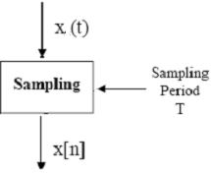
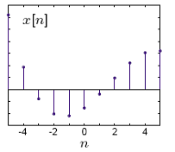
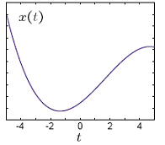
Classification of signals
Analog continuous time signal x(t)
Analog discrete time signal x[n]

Slide 37
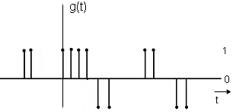
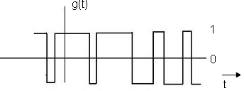
Classification of signals
Digital continuous time signal
Digital discrete time signal

Slide 38
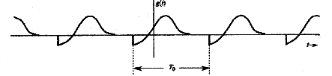
Classification of signals
periodic and aperiodic signals
Examples:

Slide 39
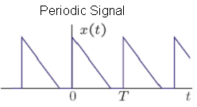
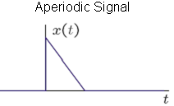
Classification of signals

Slide 40
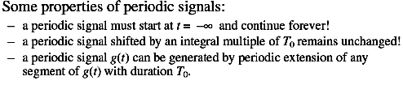
Classification of signals

Slide 41
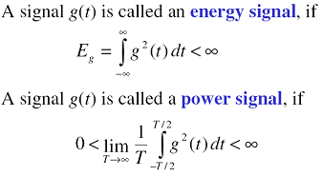
Classification of signals
Energy and Power Signals

Slide 42
Classification of signals
Remarks:
A signal with finite energy has zero power.
A signal can be either energy signal or power signal, not both.
A signal can be neither energy nor power e.g. ramp signal

Slide 43
Classification of signals
Deterministic and Random signals
A signal g(t) is called deterministic, if it is completely known and can be described mathematically
A signal g(t) is called random, if it can be described only by
terms of probabilistic description, such as
  distribution
  mean value (The average or expected value)
  squared mean value (The expected value of the squared error)
  standard deviation (The square root of the variance)

Slide 44

Classification of signals
Causal vs. Non-causal signals
A causal signal is zero for t < 0 and an non-causal signal is zero for t > 0 or
A causal signal is any signal that is zero prior to time zero. Thus, if x(n) denotes the signal amplitude at time (sample) n, the signal x is said to be causal if x(n)=0 for all n< 0

Slide 45

Classification of signals
Right- and left-sided signals
A right-sided signal is zero for t < T and a left-sided signal is zero for t > T where T can be positive or negative.

Slide 46
Classification of signals
Even signals xe(t) and odd signals xo(t) are defined as
xe(t) = xe(−t) and xo(−t) = −xo(t).
If the signal is even, it is composed of cosine waves. If the signal is odd, it is composed out of sine waves. If the signal is neither even nor odd, it is composed of both sine and cosine waves.

Slide 47
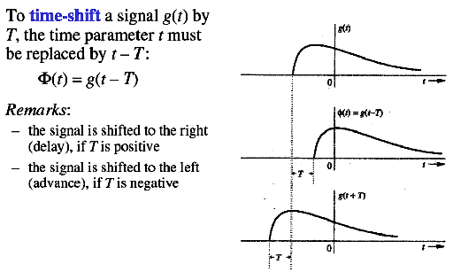
Signal operations
Time Shifting

Slide 48
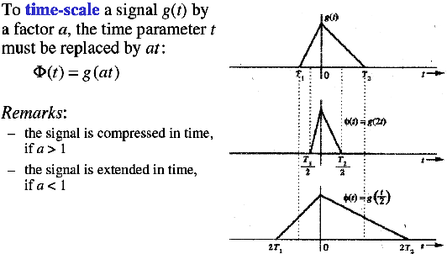
Signal operations (cont'd)
Time-Scaling

Slide 49
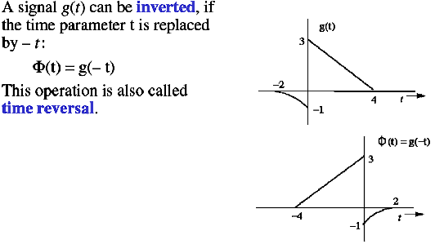
Signal operations (cont'd)
Time- Inversion/ Time-Reversal

Slide 50
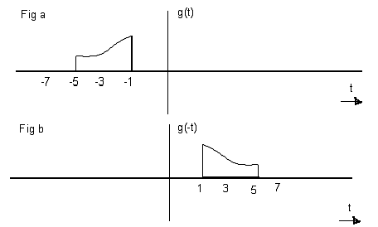
Signal operations (cont'd)
Example: 2.4
For the dignal g(t), shown in the fig. Below , sketch g(-t)

Slide 51
Lecture 3

Slide 52
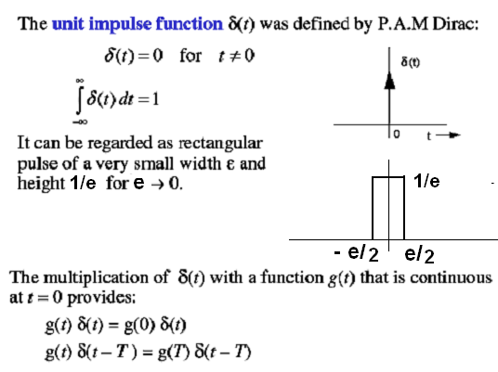
Unit Impulse Function

Slide 53
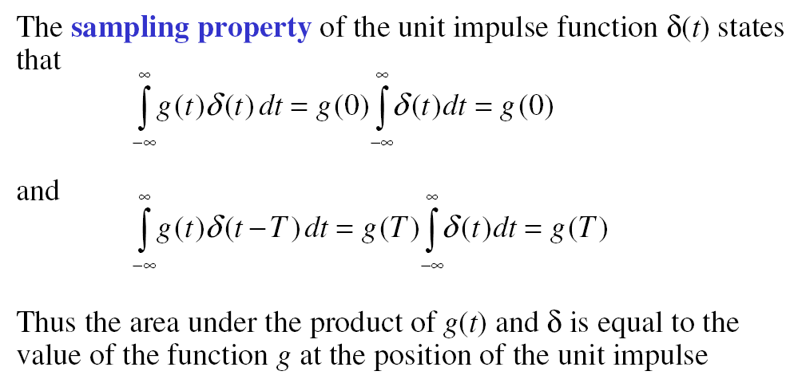
Unit Impilse Function

Slide 54
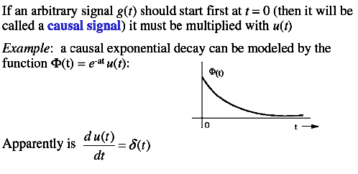
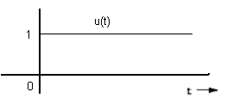

Unit Step Function

Slide 55
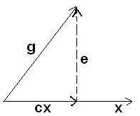
Signals and Vectors
Analogy between Signals and Vectors
--A vector can be represented as a sum of its components
--A Signal can also be represented as a sum of its components
Component of a vector:
A vector is represented by bold-face type
Specified by its magnitude and its direction.
E.g
Vector x of magnitude | x | and Vector g of magnitude | g |
Let the component of vector g along x be cx
Geometrically this component is the projection of g on x
The component can be obtained by drawing a perpendicular from the tip of g on x and expressed as
    g = cx + e

Slide 56
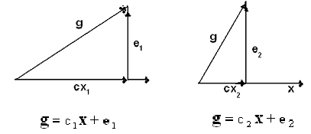
Component of a Vector
There are infinite ways to express g in terms of x
g is represented in terms of x plus another vector which is called the error vector e
If we approximate g by cx

Slide 57

Component of a Vector (cont..)
The error in this approximation is the vector e
e = g - cx
The error in the approximation in both cases for last figure are

Slide 58

Component of a Vector (cont..)
We can mathematically define the component of vector g along x
We take dot product (inner or scalar) of two vectors g and x as:
g.x = | g || x | cos θ
The length of vector by definition is
| x | ² = x . x
The length of component of g along x is
c| x | = | g | cos θ
Multiply both sides by | x |
c | x | ² = | g | | x | cos θ = g . x

Slide 59

Component of a Vector (cont..)
Consider the first figure again and expression for c
Let g and x are perpendicular (orthogonal)
g has a zero component along x gives c = 0
From equation g and x are orthogonal if the inner (scalar or dot) product of two vectors is zero i.e.
g . x = 0

Slide 60

Component of a Signal
Vector component and orthogonality can be extended to signals
Consider approximating a real signal g(t) in terms of another real signal x(t)
The error e(t) in the approximation is given by

Slide 61
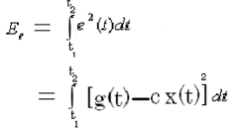

Component of a Signal
As energy is one possible measure of signal size.
To minimize the effect of error signal we need to minimize its size-----which is its energy over the interval
This is definite integral with dummy variable t
Hence function of c (not t)
For some choice of c the energy is minimum
Necessary condition

Slide 62



Component of a Signal

Slide 63


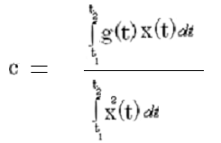
Component of a Signal
Remarkable similarity between behavior of vectors and signals. Area under the product of two signals corresponds to the dot product of two vectors
The energy of the signal is the inner product of signal with itself and corresponds to the vector length squared (which is the inner product of the vector with itself)
Recall equation for two vectors

Slide 64
Component of a Signal
Consider the signal equation again:
Signal g(t) contains a component cx(t)
cx(t) is the projection of g(t) on x(t)
If cx(t) = 0 c = 0
signal g(t) and x(t) are orthogonal over the interval

Slide 65
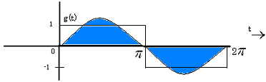
Example 2.5 Component of a Signal (cont..)
For the square signal g(t), find the component of g(t) of the form sint or in other words approximate g(t) in terms of sint

Slide 66
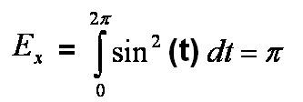
Example 2.5 (cont…)
and
From equation for signals

Slide 67
Orthogonality in complex signals
For complex functions of t over an interval
Coefficient c and the error in this case is

Slide 68
Orthogonality in complex signals
We know that:

Slide 69
Orthogonality in complex signals
So, two complex functions are orthogonal over an interval, if
or

Slide 70
Energy of the sum of orthogonal signals
Sum of the two orthogonal vectors is equal to the sum of the lengths of the squared of two vectors. z = x+y then
Sum of the energy of two orthogonal signals is equal to the sum of the energy of the two signals. If x(t) and y(t) are orthogonal signals over the interval, and if
z(t) = x(t)+ y(t) then

Slide 71
Correlation
Consider vectors again:
Two vectors g and x are similar if g has a large component along x OR
If c has a large value, then the two vectors will be similar
c could be considered the quantitative measure of similarity between g and x
But such a measure could be defective. The amount of similarity should be independent of the lengths of g and x

Slide 72
Correlation
Doubling g should not change the similarity between g and x
However:
Doubling g doubles the value of c
Doubling x halves the value of c
c is faulty measure for similarity
Similarity between the vectors is indicated by angle between the vectors.
The smaller the angle , the largest is the similarity, and vice versa
Thus, a suitable measure would be , given by
Independent of the lengths of g and x

Slide 73
Correlation
This similarity measure is known as correlation co-efficient.
The magnitude of is never greater than unity
Same arguments for defining a similarity index (correlation co-efficient) for signals
consider signals over the entire time interval
normalize c by normalizing the two signals to have unit energies.

Slide 74
Correlation
consider
Related signals-------Best friends
If k is positive then:
Negative then:
Dissimilarity worst enemies
If g(t) and x(t) are orthogonal then
Unrelated signals-------Strangers

Slide 75
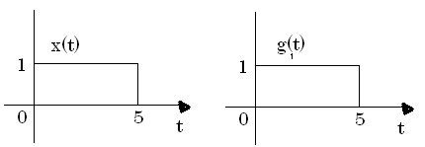
Example 2.6
Find the correlation co-efficient between the pulse x(t) and the pulses
Similarly
Maximum possible similarity

Slide 76
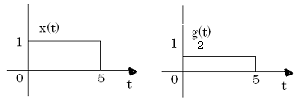
Example 2.6 (cont…)
Maximum possible similarity……independent of amplitude

Slide 77
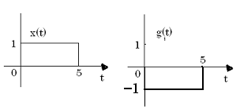
Example 2.6 (cont…)
Similarly

Slide 78
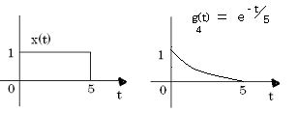
Example 2.6(cont…)
Here
Reaching Maximum similarity

Slide 79
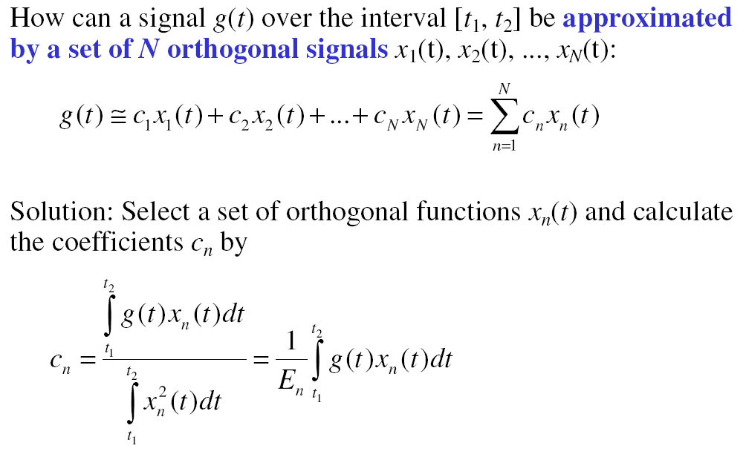
Orthogonal Signal Space

Slide 80
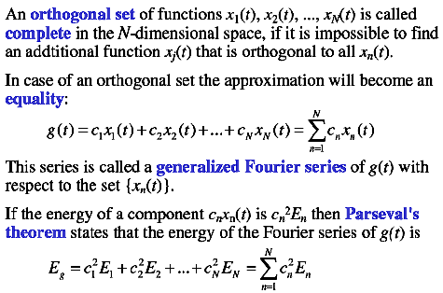
Orthogonal Signal Space

Slide 81
End of Chapter 1 & 2

