Slide 1
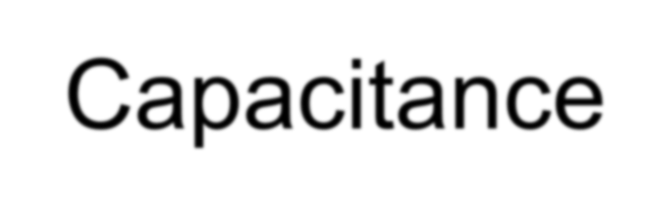
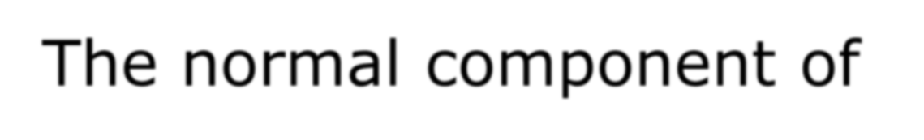






Capacitance
The normal component of E at any point on the surface of either conductor is given
by
❖
ρ
ˆ
(4.106)
E = n ⋅ E =
s
n
ε
(at conductor surface)
ρ_{s} – surface charge density at that point
n – outward normal unit vector at the same location
ε - permitivity of dielectric medium separating the conductor

Slide 2
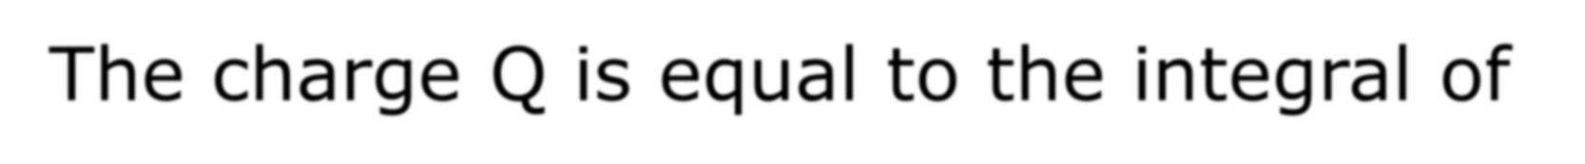
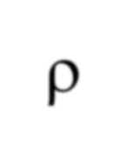


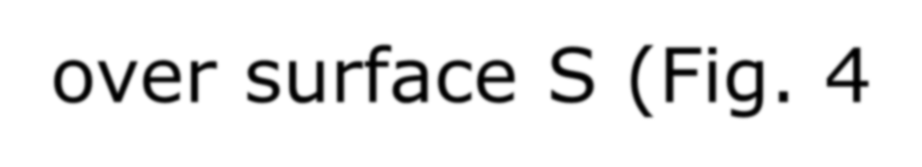

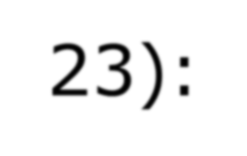
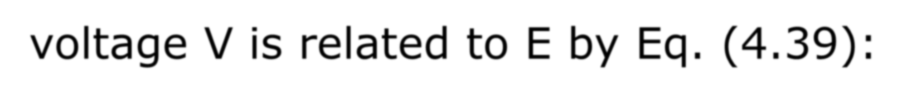
Capacitance
The charge Q is equal to the integral of ρ_{s}
over surface S (Fig. 4-23):
ρ ds = εnˆ ⋅ Eds = εE ⋅ ds (4.107)
Q =
∫_{S} ∫ ∫
s
S S
Where use was made of Eq. (4.106). The voltage V is related to E by Eq. (4.39):

Slide 3



Capacitance
❖
❖
∫
P
(4.108)
V = V = −
1
E ⋅ dl
12
P₂
Where P1 and P2 are any two points on conductors 1 and 2, respectively.

Slide 4
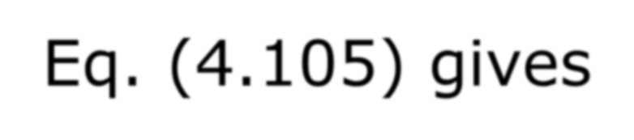

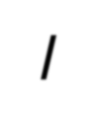

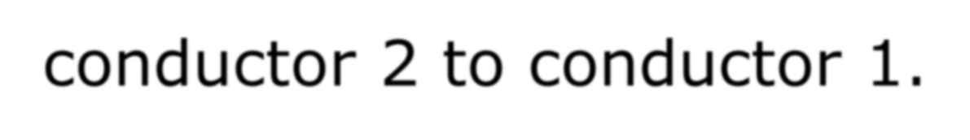
Capacitance
Substituting Eqs. (4.107) and (4.108) into Eq. (4.105) gives
❖
❖
∫
εE ⋅ ds
C =
(F ) (4.109)
S
❖ 
_{∫l} E ⋅ dl
Where l is the integration path from conductor 2 to conductor 1.

Slide 5




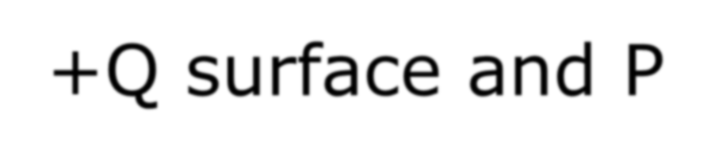

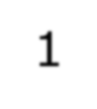



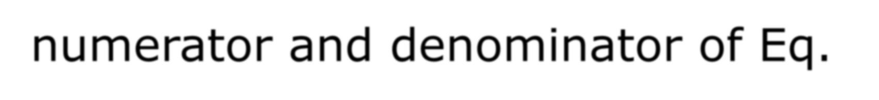
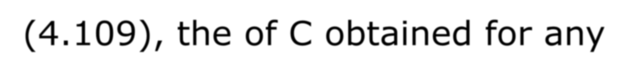


Capacitance
To avoid making sign errors when applying Eq. (4.109), it is important to remember that surface S is the
+Q surface and P₁ is on S.
Because E appears on both the numerator and denominator of Eq. (4.109), the of C obtained for any specific capacitor configuration is always independent of E.

Slide 6
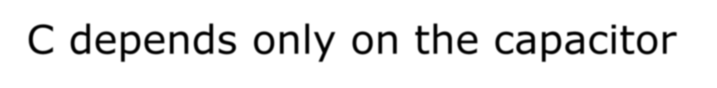



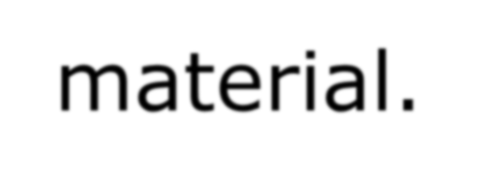
Capacitance
C depends only on the capacitor geometry (sizes, shapes and relative positions of the two conductors) and the permittivity of the insulating material.

Slide 7
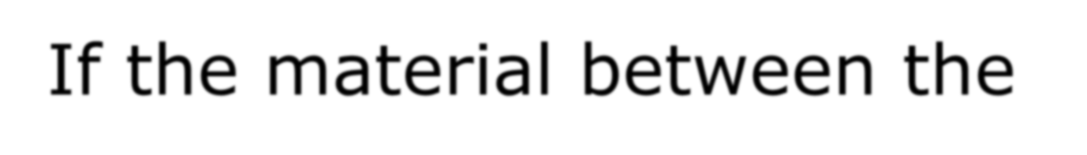
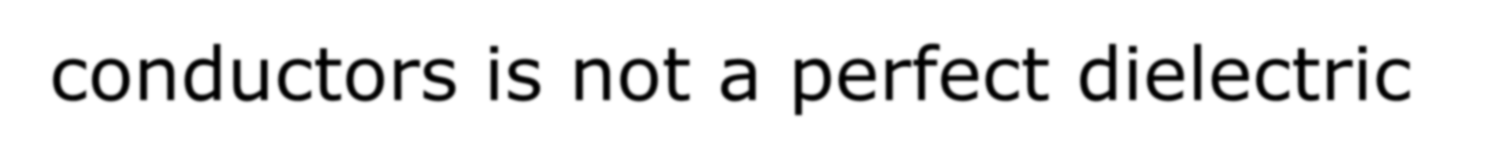
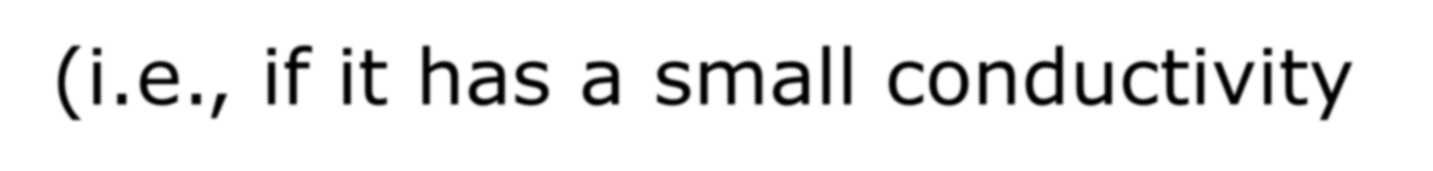
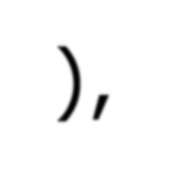
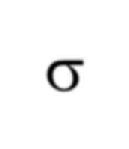


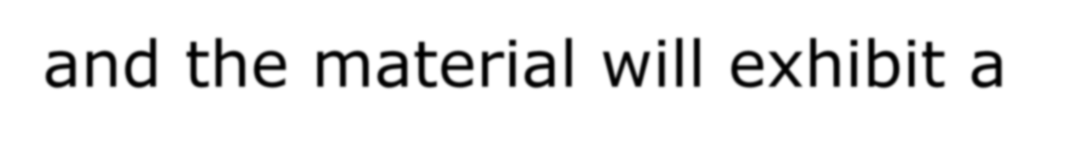
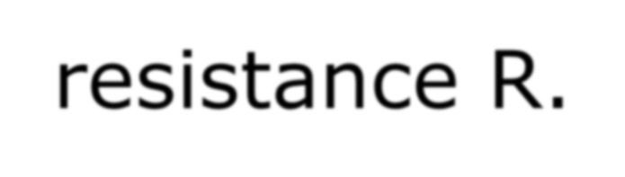
Capacitance
If the material between the conductors is not a perfect dielectric (i.e., if it has a small conductivity σ), then current can flow through the material between the conductors, and the material will exhibit a resistance R.

Slide 8




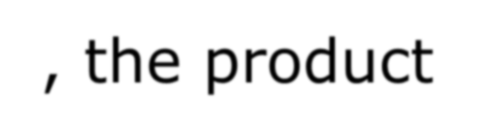
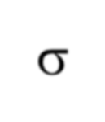
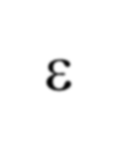



Capacitance
The general expression for R for a resistor of
arbitrary shape is given by
❖ 
∫
E ⋅ dl
R =
l 
(Ω) (4.71)
❖
∫σE ⋅ ds
S
For a medium with uniform σ and ε, the product of Eqs. (4.109) and (4.110) gives
RC = ^{ε}
(4.111)
σ
This simple relation allows us to find R if C is
known, or vice versa.

Slide 9




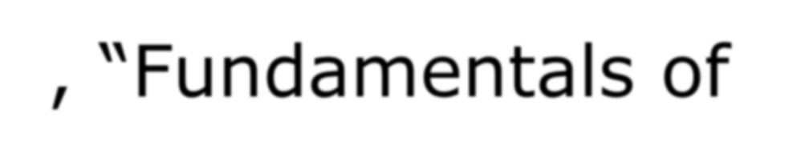
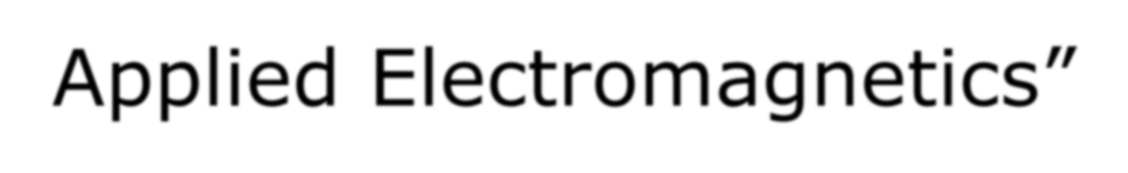


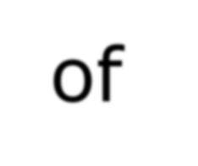
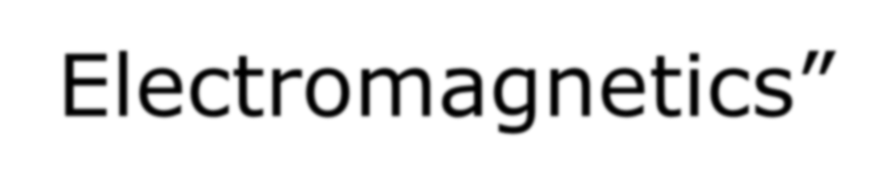
Reference
Fawwaz T. Ulaby, “Fundamentals of Applied Electromagnetics”
Sadiku, “Elements of Electromagnetics”

