Slide 1
Study Question 2: What is special about small businesses?
Small businesses …
  Ones with 100 or fewer employees.
  Independently owned and operated.
  50 percent of the private labour force works in small businesses.
  Are established by:
    Starting a new business.
    Buying an existing business.
    Buying and running a franchise.

Slide 2
Study Question 2: What is special about small businesses?
Entrepreneurship and the Internet …
  The Internet offers numerous entrepreneurial opportunities.
    Online buying and selling
    Dot-com businesses
  Businesses are limited only by personal creativity.
  Business-to-Business (B2B) ventures are possible.

Slide 3
Study Question 2: What is special about small businesses?
International business entrepreneurship …
  Provides strategic opportunities for small businesses.
  Creates exporting and importing opportunities.
  Supported through appropriate governmental and non-governmental organizations.

Slide 4
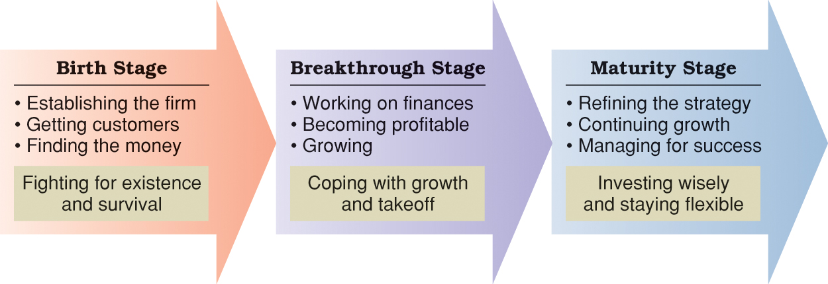
Figure 6.3 Stages in the life cycle of an entrepreneurial firm.

