Slide 1
BACTERIOLOGY
HUMA IMTIAZ

Slide 2
INTRODUCTION
Bacteriology is the branch and specialty of biology that studies the morphology, ecology, genetics and biochemistry of bacteria as well as many other aspects related to them.
This subdivision of microbiology involves the identification, classification and characterization of bacterial species.
The branch of science concerned with the study of bacteria.

Slide 3
BACTERIA
Bacteria are microscopic living organisms
Normally are unicellular with no distinct nuclei (prokaryotic cells)
Reproduce by fission or forming spore
Found everywhere and can exist independently (free living) or dependently (parasitic)
Can be dangerous as cause diseases
Can be beneficial as process of fermentation.

Slide 4
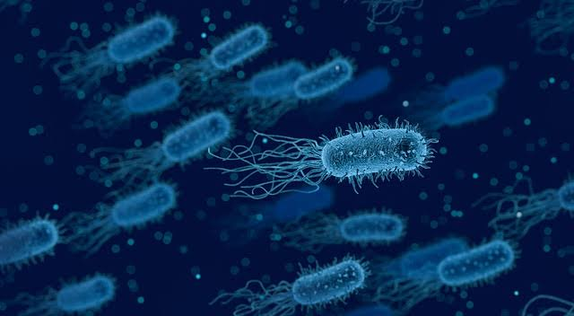

Slide 5
FEATURES OF PROKARYOTIC CELLS
1.DNA is:
Not enclosed within a nuclear membrane.
A single circular chromosome.
Not associated with histones proteins.
2. Lack membrane-enclosed organelles like mitochondria, chloroplasts, Golgi, etc.
3. Cell walls usually contain peptidoglycan, a complex polysaccharide.
4. Divide by binary fission.

Slide 6
FEATURES OF EUKARYOTIC CELLS
1. DNA is:
Enclosed within a nuclear membrane.
Several linear chromosomes.
Associated with histones and other proteins.
2. Have membrane-enclosed organelles like mitochondria, chloroplasts, Golgi, endoplasmic reticulum, etc.
3. Divide by mitosis.

Slide 7
BACTERIAL CELL SIZE
Cell Size:
Dimensions of most bacterial cells:
Diameter: 0.2 to 2.0 μm.
Human red blood cell is about 7.5-10 μm in diameter.
Length: 2 to 8 μm.
Some cyanobacteria are up to 60 μm long.

Slide 8
CELL SHAPES/ARRANGEMENTS
Coccus (plural: cocci): Spherical.
May have the following arrangements:
Diplococci: A pair of attached cocci.
Streptococci: Chainlike arrangement.
Tetrads: Groups of four. Divide in two planes.
Sarcinae: Groups of eight. Divide in three planes.
Staphylococci: Grapelike clusters. Divide in multiple planes.

Slide 9
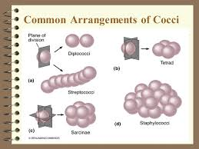

Slide 10
Cont…
Bacillus (plural: bacilli): Rod-shaped. Most bacilli appear as single rods but may see:
Diplobacilli: A pair of attached bacilli.
Streptobacilli: Chainlike arrangement.
Coccobacillus: Intermediate shape between coccus and bacillus. Oval rods.

Slide 12
Cont…
Spiral Bacteria: Have one or more twists:
Vibrio: A comma shaped cell. Look like curved rods.
Spirilla: Helical, corkscrew shaped bacteria
Use whip like external flagella to move.
Spirochetes: Helical bacteria with flexible bodies.
Use axial filaments (internal flagella) to move.

Slide 14
Cont…
Other less common shapes:
Star
Flat and square
Triangular

Slide 15
Cont…
Pleomorphic bacteria: Have several possible shapes. Found in a few groups:
Corynebacterium
Rhizobium
Most bacteria are monomorphic: Maintain a single shape. However environmental factors may affect cell shape.

