Slide 1
Embedded Systems
Muhammad Waqas

Slide 2
7 Segment Display
Seven Segment displays are used in a number of systems to display the numeric information.
The seven segment can display one digit at a time.
Thus the no. of segments used depends on the no. of digits in the number to be displayed.

Slide 3
Interfacing seven segment with a controller or MCU is tricky.
It displays the digits 0 to 9 continuously at a predefined time delay.

Slide 4
A seven segment consists of 8 LEDs which are aligned in a manner so as to display digits from 0 to 9 when proper combination of LED is switched on.
Seven segment uses seven LED’s to display digits from 0 to 9 and the eighth LED is used for the dot.
A typical seven segment looks like as shown in the figure below.

Slide 5
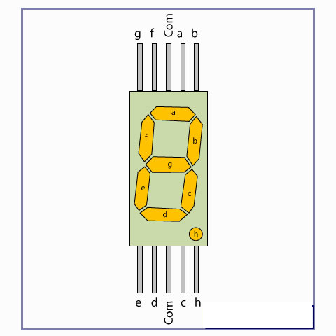

Slide 6
Seven Segment are available in two configuration –
(1) Common Anode
(2) Common Cathode.

Slide 7
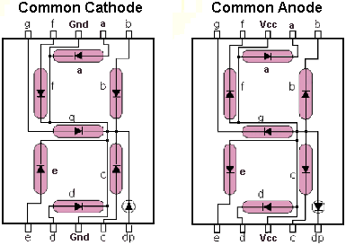

Slide 8
Here common anode seven segment display is used because the output current of the microcontroller is not sufficient enough to drive the LED’s, similar to the case of driving an LED.

Slide 9
The circuit diagram shows the connections of seven segment to the controller.
The pins ‘a’ to ‘g’ of the Seven Segment are connected to the Port P2 of the microcontroller.
The common pin of the seven segment is connected to Vcc.
The ‘h’ has not been used, which is the dot pin of the controller.

Slide 10
Since the seven segment display works on negative logic, we will have to provide logic 0 to the corresponding pin to make an LED glow.
Table below shows the hex values used to display the different digits.

Slide 11
DIGIT | a | b | c | d | e | f | g | HEX Value
0 | 0 | 0 | 0 | 0 | 0 | 0 | 1 | 0x40
1 | 1 | 0 | 0 | 1 | 1 | 1 | 1 | 0xF9
2 | 0 | 0 | 1 | 0 | 0 | 1 | 0 | 0x24
3 | 0 | 0 | 0 | 0 | 1 | 1 | 0 | 0x30
4 | 1 | 0 | 0 | 1 | 1 | 0 | 0 | 0x19
5 | 0 | 1 | 0 | 0 | 1 | 0 | 0 | 0x12
6 | 0 | 1 | 0 | 0 | 0 | 0 | 0 | 0x02
7 | 0 | 0 | 0 | 1 | 1 | 1 | 1 | 0xF8
8 | 0 | 0 | 0 | 0 | 0 | 0 | 0 | 0x00
9 | 0 | 0 | 0 | 1 | 1 | 0 | 0 | 0x10

Slide 12
When the values corresponding to the digits 0 to 9 are given on the output port, the digit gets displayed on the seven segment.

Slide 13
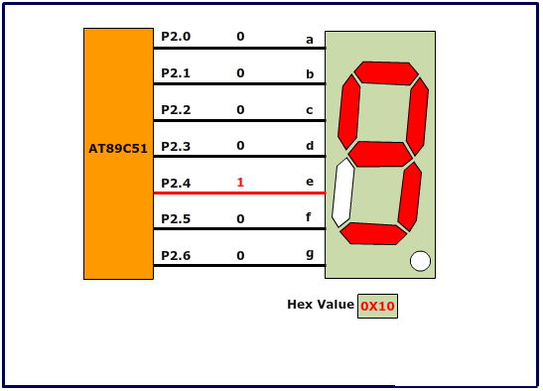

Slide 14
char num[]={0x40,0xF9,0x24,0x30,0x19,0x12,0x02,0xF8,0x00,0x10}; // Hex values corresponding to digits 0 to 9 int c;
while(1) { for(c=0;c<10;c++) { P2=num[c]; delay_ms(200); } }

Slide 15
Other Method
An easier method to interface a 7 segment display is to use a BCD to 7 Segment decoder or driver.
74LS47 is such a driver that we will use.
The DM74LS47 accepts four lines of BCD (8421) input data, generates their complements internally and decodes the data with seven AND/OR gates having open-collector outputs to drive indicator segments directly.

Slide 16
Each segment output is guaranteed to sink 24 mA in the ON (LOW) state and withstand 15V in the OFF (HIGH) state with a maximum leakage current of 250 mA.
Auxiliary inputs provided blanking, lamp test and cascadable zero-suppression functions.

Slide 17
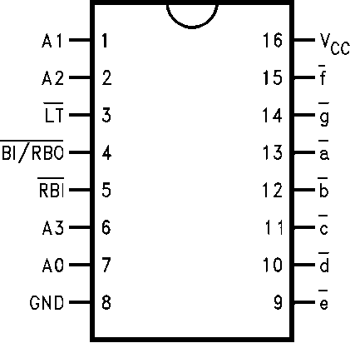

Slide 18
A0–A3 BCD Inputs
a –g Segment Outputs (Active LOW)

Slide 19
0 | L L L L | L L L L L L H
1 | L L L H | H L L H H H H
2 | L L H L | L L H L L H L
3 | L L H H | L L L L H H L
4 | L H L L | H L L H H L L
5 | L H L H | L H L L H L L
6 | L H H L | H H L L L L L
7 | L H H H | L L L H H H H
8 | H L L L | L L L L L L L
9 | H L L H | L L L H H L L

Slide 20
