Slide 1
1. Free Wheeling Diodes 2. Diodes with RL Circuit 3. Diodes with RC circuits
Week 5

Slide 2
Video Links Free wheeling Diode
https://www.youtube.com/watch?v=arzxDfx9fWU
optional
https://www.youtube.com/watch?v=RSqJU1igy_U
https://www.youtube.com/watch?v=RfwOBagj8zg

Slide 3
Free wheeling Diode
A freewheeling diode is basically a diode connected across the inductive load terminals to prevent the development of high voltage across the switch.
When the inductive circuit is switched off, this diode gives a short circuit path for the flow of inductor decay current and hence dissipation of stored energy in the inductor.
This diode is also called Flywheel or Flyback diode.

Slide 4
Purpose of Freewheeling Diode
The main purpose of freewheeling or flyback diode is to free wheel the stored energy in inductor by providing a short circuit path.
This is necessary else a sudden decay in circuit current will give rise to high voltage across the switch contacts and diode

Slide 5
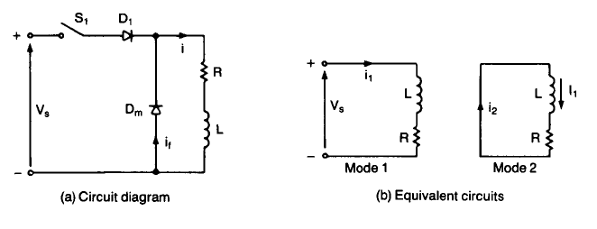
Dm is the free wheeling diode in the circuit

Slide 6
The inductor has property to store energy
In ac current, during positive high cycle the inductor stores energy .
At negative half cycle the inductor de-energies.
This may cause reverse damage to circuit
To avoid energy dissipation freewheeling diode is used.
In negative half cycle ,the freewheeling diode becomes forward biased so that the current will flow through diode
Therefore it de-energies inductor.

Slide 7
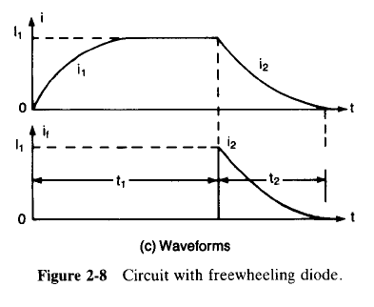

Slide 8
Video Link Diodes with RL Circuit
https://www.youtube.com/watch?v=RBC3HejyqWw (Watch till 5 min mark)
https://www.youtube.com/watch?v=_v5F0iZGohE

Slide 9
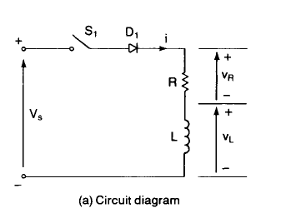
Diode in RL Circuit

Slide 11
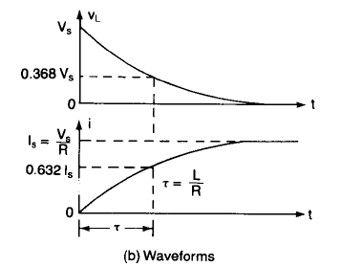

Slide 12
Video Link Diodes with RC Circuit
https://www.youtube.com/watch?v=Ygpw7DOgvJs (Watch from 4min onwards)
https://www.youtube.com/watch?v=2GW1nsIsx8E

Slide 13
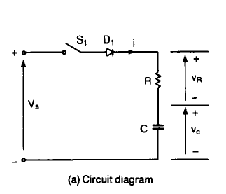
Diodes with RL Circuit

Slide 15
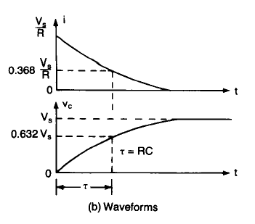
Do Example 2.2 from book

