Slide 1
Microcontroller System & Interfacing
Muhammad Waqas

Slide 2
A micro-controller can be compared to a small stand alone computer
it is a very powerful device
it is capable of executing a series of pre-programmed tasks
It is able to interact with other hardware devices.

Slide 3
Being packed in a tiny integrated circuit (IC) whose size and weight is usually negligible, it is becoming the perfect controller for robots or any machines requiring some kind of intelligent automation.
A single microcontroller can be sufficient to control a small mobile robot, an automatic washer machine or a security system.

Slide 4
Any microcontroller contains a memory to store the program to be executed, and a number of input/output lines that can be used to interact with other devices, like reading the state of a sensor or controlling a motor.

Slide 5
Nowadays, microcontrollers are so cheap and easily available that it is common to use them instead of simple logic circuits like counters for the sole purpose of gaining some design flexibility and saving some space.
Some machines and robots will even rely on a multitude of microcontrollers, each one dedicated to a certain task.

Slide 6
Most recent microcontrollers are 'In System Programmable', meaning that you can modify the program being executed, without removing the microcontroller from its place.
Most common example is the 89S52

Slide 7
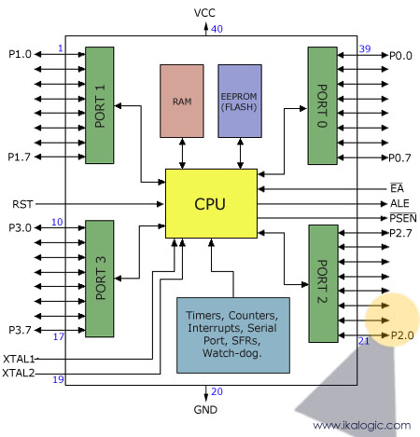
8051 microcontroller architecture

Slide 8
This figures shows the main features and components that the designer can interact with.
You can notice that the 89S52 has 4 different ports, each one having 8 Input/output lines providing a total of 32 I/O lines.
Those ports can be used to output DATA and orders to other devices, or to read the state of a sensor, or a switch.

Slide 9
Most of the ports of the 89S52 have 'dual function' meaning that they can be used for two different functions:
the first one is to perform input/output operations
the second one is used to implement special features of the microcontroller like counting external pulses, interrupting the execution of the program according to external events, performing serial data transfer or connecting the chip to a computer to update the software.

Slide 10
Each port has 8 pins, and will be treated from the software point of view as an 8-bit variable called 'register', each bit being connected to a different
You can also notice two different memory types: RAM and EEPROM.

Slide 11
RAM is used to store variable during program execution
EEPROM memory is used to store the program itself, that's why it is often referred to as the 'program memory'.

Slide 12
The special features of the 89S52 microcontroller are grouped in the blue box at the bottom of the previous figure.
It is important to note that the 89S52 incorporates hardware circuits that can be used to prevent the processor from executing various repetitive tasks and save processing power for more complex calculations.
Those simple tasks can be counting the number of external pulses on a pin, or generating precise timing sequences.

Slide 13
It is clear that the CPU (Central Processing Unit) is the heart of the microcontrollers, It is the CPU that will Read the program from the FLASH memory and execute it by interacting with the different peripherals discussed above.

Slide 14
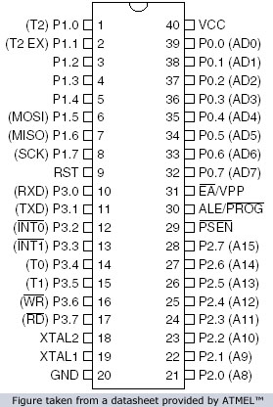

Slide 15
The figure shows the pin configuration of the 89S52, where the function of each pin is written next to it, and, if it exists, the dual function is written between brackets.
The pins are written in the same order as in the block diagram of the previous figure , except for the VCC and GND pins which I usually note at the top and the bottom of any device.

Slide 16
Note that the pin that have dual functions, can still be used normally as an input/output pin.
Unless your program uses their dual functions, All the 32 I/O pins of the microcontroller are configured as input/output pins.

Slide 17
Most of the function of the pins of the 89S52 microcontroller will be discussed in detail, except for the pins required to control an external memory, which are the pins number 29, 30 and 31.
Since we are not going to use any external memory, pins 29 and 30 will be ignored through all.
pin 31 (EA) always connected to VCC (5 Volts) to enable the micro-controller to use the internal on chip memory rather than an external one (connecting the pin 31 to ground would indicate to the microcontroller that an external memory is to be used instead of the internal one).

