Slide 1
Lecture # 02 Software Process Models

Slide 2
Outline
Software Process Model
Generic process framework
Waterfall model
Incremental model
Prototyping model
Spiral model
Summary

Slide 3
The software process
A structured set of activities required to develop a software system.
Many different software processes but all involve:
Specification – defining what the system should do;
Design and implementation – defining the organization of the system and implementing the system;
Validation – checking that it does what the customer wants;
Evolution – changing the system in response to changing customer needs.
A software process model is an abstract representation of a process. It presents a description of a process from some particular perspective.

Slide 4
Plan-driven and agile processes
Plan-driven processes are processes where all of the process activities are planned in advance and progress is measured against this plan.
In agile processes, planning is incremental and it is easier to change the process to reflect changing customer requirements.
In practice, most practical processes include elements of both plan-driven and agile approaches.
There are no right or wrong software processes.

Slide 5
Process Model
Defines a distinct set of activities, actions, tasks, milestones, and work products that are required to engineer high-quality software
The activities may be linear, incremental, or evolutionary
5
Notes:
In process model we define a set of activities for example we define different activities to collect requirement. First activity is to collect requirements from the admission department, second activity is to collect requirement from the finance and so on.
Milestone is, that for example if you say that we have one month to collect the requirement from the customer so your milestone is that after one month you must have all these requirements.
Once you collect the requirement so you have a set of all these requirement this your one of work product.

Slide 6
Generic Process Framework
Communication
Involves communication among the customer and other stake holders; encompasses requirements gathering
Planning
Establishes a plan for software engineering work; addresses technical tasks, resources, work products, and work schedule
Modelling (Analyse, Design)
Encompasses the creation of models to better under the requirements and the design
Construction (Code, Test)
Combines code generation and testing to uncover errors
Deployment
Involves delivery of software to the customer for evaluation and feedback
6
Notes:
In Planning phase we make a plan for the whole project from the beginning to the its deployment. In this phase we divide the project into different tasks. We assign resources to each tasks. We see that who will work on this project.
Let suppose if you we make a plan that person A, B and C will collect the requirement from the customer. If you are making a MIS system for university so it includes admission, finance, HR etc. So you decide that person A will go the admission to collect the requirements, person B will go to the finance, person C will go to the HR deptt.
Work product is that once we perform these task, for example if we collect requirements from the admission office then we got a work product.
In work schedule we decide that how many time will assign to collect the requirements from the admission deptt.

Slide 7
Traditional Process Models
Notes:
Why called traditional process models? Because these are the very basic process models.
We will see what process models are used in software industries these days.

Slide 8
Waterfall Model
Oldest software lifecycle model
The first formal description of the waterfall model is often cited as a 1970 article by Winston W. Royce
A Water Fall Model is easy to flow.
It can be implemented for any size of project.
Every stage has to be done separately at the right time so you cannot jump stages.
Documentation is produced at every stage of a waterfall model allowing people to understand what has been done.
Testing is done at every stage.
Used when requirements are well understood and risk is low
Work flow is in a linear (i.e., sequential) fashion
Used often with well-defined adaptations or enhancements to current software
8

Slide 9
Phases of Waterfall Model
Waterfall model has 5 different phases
Which are following:
Requirement gathering and Analysis
Design
Coding
Testing
Maintenance

Slide 10
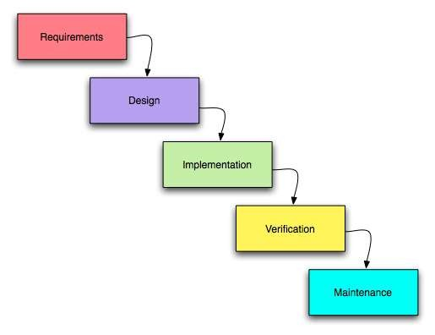
Waterfall Model (Diagram)
10
Notes:
Planning- Tracking: Tracking means whether we are working according to the time-frame or not.

Slide 11
Requirement gathering and Analysis
This is the first phase of waterfall model which includes a meeting with the customer to understand his requirements.
This is the most crucial phase as any misinterpretation at this stage may give rise to validation issues later.
The software definition must be detailed and accurate with no ambiguities.
It is very important to understand the customer requirements and expectations so that the end product meets his specifications.
Requirement gathering and Analysis phase the basic requirements of the system must be understood by software engineer, who is also called ANALYST.
All this requirements are then well documented and discussed further with the customer for reviewing.

Slide 12
Design
It is a intermediate step between requirements analysis and coding
The customer requirements are broken down into logical modules for the ease of implementation.
Hardware and software requirements for every module are Identified and designed accordingly.
Also the inter relation between the various logical modules is established at this stage.
Algorithms and diagrams defining the scope and objective of each logical model are developed.
In short, this phase lays a fundamental for actual programming and implementation
Design focuses on program attribute such as-
Data Structure
Software Architecture
Algorithm Details
The design needs to be documented for further use.

Slide 13
Coding
Coding is a step in which design is translated into machine-readable form.
If design is done in sufficient detail then coding can be done effectively.
Programs are created in this phase.
In this phase all software divided into small module then after doing coding for that small module rather than do coding whole software.
According to design programmers do code and make class and structure of whole software.

Slide 14
Testing
In this stage, both individual components and the integrated whole system are systematically verified to ensure that they are error-free and fully meet the requirements outlined in the first step.
Types of testing:
Inside test.
Outside test.

Slide 15
Maintenance
This is the final phase of the waterfall model, in which the completed software product is handed over to the client after alpha, beta testing.
After the software has been deployed on the client side
It is the duty of the software development team to undertake routine maintenance activities by visiting the client site.
If the customer suggests changes or enhancements the software process has to be followed all over again right from the first phase i.e requirement analysis.

Slide 16
Advantages of Waterfall Model
The water fall model is easy to implement.
For implementation of small systems water fall model is used.
The project requires the fulfillment of one phase, before proceeding to the next.
It is easier to develop various software through this method in short span of time.

Slide 17
Disadvantages of Waterfall Model
The requirement analysis is done initially and sometimes it is not possible to state all the requirement explicitly in the beginning.
The customer can see working model of the project only at the end.
If we want to go backtrack then it is not possible in this model.
It is difficult to follow the sequential flow in software development process.

Slide 18
Incremental Model

Slide 19
Incremental Model
In incremental model the whole requirement is divided into various builds.
Each module (independent units) passes through the requirements, design, implementation and testing phases.
The incremental build model is a method of software development where the product is designed, implemented and tested incrementally until the product is finished.
Each subsequent(coming after something in time) release of the module adds function to the previous release.
The process continues till the complete system is achieved

Slide 20
Incremental Model (Diagram)
Increment #1
Communication
Planning
Modeling
Increment #2
Construction
Deployment
Communication
Planning
Modeling
Increment #3
Construction
Deployment
Communication
Planning
Modeling
Construction
Deploy………
20

Slide 21
Incremental Model Cont...
Used when requirements are well understood
Multiple independent deliveries are identified
Work flow is in a linear (i.e., sequential) fashion within an increment.
Iterative in nature; focuses on an operational product with each increment
Provides a needed set of functionality sooner while delivering optional components later
Useful also when staffing is too short for a full-scale development
21

Slide 22
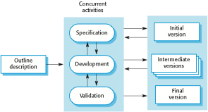
Incremental development

Slide 23
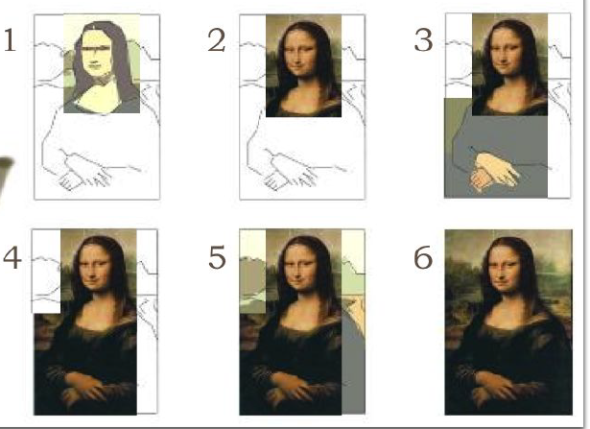
Incremental Model Cont...

Slide 24
Advantages of Incremental Model
Generates working software quickly and early during the software life cycle.
This model is more flexible, less costly to change scope and requirements.
It is easier to test and debug during a smaller iteration.
In this model customer can respond to each built.
Lowers initial delivery cost.
Easier to manage risk because risky pieces are identified and handled during it’s iteration.

Slide 25
Disadvantages of Incremental Model
Needs good planning and design.
Needs a clear and complete definition of the whole system before it can be broken down and built incrementally.
Total cost is higher than waterfall.

Slide 26
Prototyping Model

Slide 27
WHAT IS PROTOYPE
Prototype is the process of quickly putting together a working model (a prototype) in order to test various aspects of a design.
A Prototype is an early sample or model built to test a concept or process or to act as a thing to be replicated or learned from.
A prototype is a model or a program which is not based on strict planning, but is an early approximation of the final product or software system

Slide 28
Prototyping Model (Diagram)
Quick Planning
Communication
Start
Modeling
Quick Design
Deployment,
Delivery,
and Feedback
Construction
Of Prototype
28
Notes:
Prototype: A early sample or model of the product.

Slide 29
Prototyping Model (Description)
Follows an evolutionary and iterative approach
Used when requirements are not well understood
Serves as a mechanism for identifying software requirements
Focuses on those aspects of the software that are visible to the customer/user
Feedback is used to refine the prototype
29

Slide 30
Steps of Prototyping Model
Requirements Gathering and Analysis:
A prototyping model begins with requirements analysis, and the requirements of the system are defined in detail. The user is interviewed in order to known the requirements of the system.
Quick Design:
When requirements are known, a preliminary design or quick design for the system is created.
It is not a detailed design. However it includes the important aspects of the system, which gives an idea of the system to the user.
Build Prototype :
Information gathering from quick design is modified to form a prototype. It represents a ’rough’ design of the required system.

Slide 31
Steps of Prototyping Model
Customer Evaluation:
After delivering the system developer needs to provide training about how to use the system.
This activity is supported by customer evaluation, and if any changes are found then updation is done.
Review And Update:
There might be also change in input data or system environment.
All this require modification of software.
After customer is satisfied final design and further process is carried out.
This model doesn't include all the features but provides client basic idea about the proposed system.

Slide 32
Types Of Prototype Model
Throw away/Rapid Prototyping:
The prototype is developed as a part of throw away approach will not form final solution.
This type of prototyping uses very little efforts with minimum requirement analysis to build a prototype.
Throw away prototypes are useful way of exploring ideas and gaining feedback from end-user.
Evolutionary Prototyping:
Evolutionary prototyping approach is used when exact requirement of the solution cannot be set in advance.
Using evolutionary prototyping only well understood requirements are included in the prototype and the other requirements are added when they are understood.

Slide 33
Need of prototype model
A prototype is made completely built sample model is shown to user and based on his feedback
Prototypes are an essential part of the design process: realizing a design in a physical form.
This is beneficial in proving whether a new product is viable, in terms of its mechanical, electronic and ergonomic design.
Having a working prototype demonstrates the benefits of your idea to industry, in a convincing way, to help inspire confidence in the idea.

Slide 34
Advantages of Prototype model
Reduces development time.
Reduces development cost.
Requires user involvement.
Missing functionality can be identified easily.
Results in higher user satisfaction.
Good guarantees of success.
It is very simple model so it is easy to understand.
No need of specialize experts require to build model.
It is flexible so easy to modified the model.
High user involvement to build the model .
It is faster than other models.

Slide 35
Disadvantages of Prototype model
The focus on a limited prototype can distract developers from properly analyzing the complete project. This can lead to overlooking better solutions, preparation of incomplete specifications or the conversion of limited prototypes into poorly engineered final projects that are hard to maintain.
If the user is not satisfied with the developed prototype, then a new prototype is developed . This process goes on until a perfect prototype evolves . Thus , this model is time consuming and expensive.
Prototyping can lead to false expectations. It often creates a situation where the user believes that the development of the system is finished when it is not.
The developer loses focus of the real purpose of prototype and compromises on the quality of the product . For example , he may apply some of the inefficient algorithms or inappropriate programming languages used in developing the prototype

Slide 36
Spiral Model

Slide 37
Spiral Model
Spiral model is an evolutionary software process model which is a combination of an iterative nature of prototyping and systematic aspects of traditional waterfall model.

Slide 38
History of Spiral Model
The spiral model was defined by Barry Boehm in his 1988 article.
This model was not the first model to discuss iterative development, but it was the first model to explain why the iteration matters.

Slide 39
When to use Spiral Model
When costs and risk evaluation is important.
For medium to high-risk projects.
Users are unsure of their needs.
Requirements are complex.
Significant changes are expected.

Slide 40
Four Fold Procedure
Planning
The objectives, alternatives and constraints of the project are determined and are documented.
Risk Analysis
All possible alternatives, which can help in developing a cost effective project are analyzed
This phase identify and resolve all the possible risks in the project development
Engineering
The actual development of the project is carried out
The output of this phase is passed through all the phases iteratively in order to obtain improvements in the same.
Customer Evaluation
Developed product is passed on to the customer in order to receive customer’s comments and suggestions.
This phase is very much similar to TESTING phase.

Slide 41
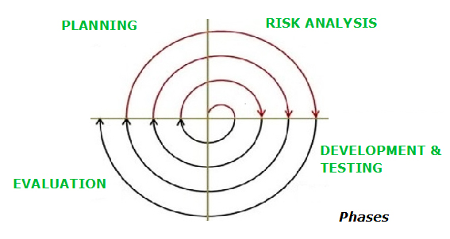
Spiral Model (Diagram)

Slide 42
Spiral model sectors
Objective setting
Specific objectives for the phase are identified.
Risk assessment and reduction
Risks are assessed and activities put in place to reduce the key risks.
Development and validation
A development model for the system is chosen which can be any of the generic models.
Planning
The project is reviewed and the next phase of the spiral is planned.

Slide 43
Applications
The spiral model is used most often in large projects.
For smaller projects, the concept of agile software development is becoming a viable alternative.
It is also reasonable to use the spiral model in projects where business goals are unstable.
Inner spirals focus on identifying software requirements and project risks; may also incorporate prototyping
Outer spirals take on a classical waterfall approach after requirements have been defined, but permit iterative growth of the software

Slide 44
Advantages of Spiral Model
Changing requirements can be accommodated.
Allows for extensive use of prototypes.
Requirements can be captured more accurately.
Users see the system early.
Early and frequent feedback from users

Slide 45
Disadvantages of Spiral Model
End of project may not be known early.
Not suitable for small or low risk projects and could be expensive for small projects.
Process is complex
Spiral may go indefinitely.
Risk assessment expertise is required.

Slide 46
Summary
Generic process framework
Waterfall model
Incremental model
Prototyping model
Spiral model

