Slide 1
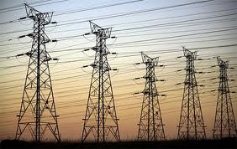
TRANSMISSION SYSTEM

Slide 2
Contents
Introduction
Overhead lines
Conductor materials
Types of line supports
Conductor configurations , span and spacing
Insulator materials
Types of Insulators

Slide 3
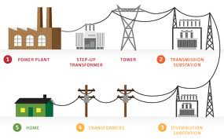
Introduction
Electrical energy is generated in large hydro-electric, thermal and nuclear power stations which are located far away from the load centers.
This necessitates an extensive power supply network between generating stations and the consumer’s loads.
This network is divided into two parts:
Transmission system
Distribution system

Slide 4
Overhead Lines
The three-phase transmission and distribution system consists of overhead lines and underground cables.
Because of cost consideration , the transmission system is generally overhead.
The overhead line conductor material should have:
High tensile strength
Low resistivity

Slide 5
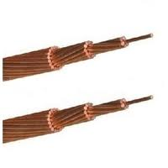
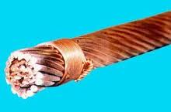
Conductor materials
The two most common conductor materials are
Hard drawn copper and aluminium.
Hard drawn copper has very high conductivity good tensile strength and weather resisting properties.

Slide 6
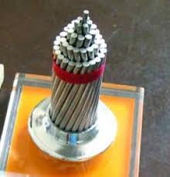
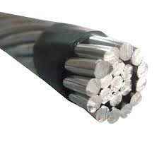
Aluminium has the following advantages over copper:
Lower cost
Lesser weight
Larger diameter
However ,the tensile strength of aluminium is lower than copper.
Therefore an All Aluminium Conductor (AAC)is rarely used except for low voltage distribution lines of short spans.
AAC

Slide 7
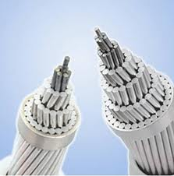
ACSR (Aluminium Conductor Steel Reinforced) conductor comprises hard drawn aluminium wires stranded around a core of single or multiple strand galvanized steel wire.
Aluminium provides conductivity while steel provides necessary mechanical strength.
All the transmission lines use
ACSR conductor.
ACSR

Slide 8
Types of line supports
Wooden poles
RCC poles
Steel tubular poles
Steel towers

Slide 9
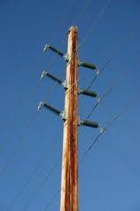
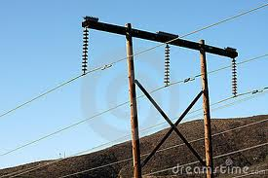
Wooden poles
Made of chemically treated wood.
Used for distribution lines especially in areas where good quality wood are available.
Very economical but capable to decay.
To protect from decay,poles have zinc or aluminium cap at the top and Bitumen coating at the bottom.

Slide 10
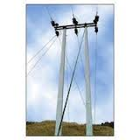
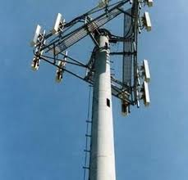
2.RCC poles
Made of reinforced concrete cement
Stronger than wood poles but more costly
Very long life and need little maintenance
Bulky and heavy
Widely used for distribution lines upto 33kV
Can be manufactured at site.

Slide 11
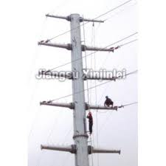
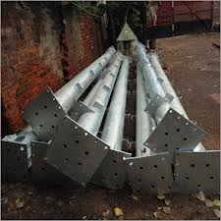
3.Steel tubular poles
Stepped pole manufactured from a single tube , the diameter being reduced in parallel steps.
More costly than RCC and wood poles
Have light weight , high strength to weight ratio and long life
Widely used for lines upto 33kV.

Slide 12
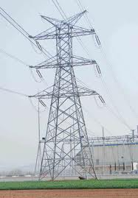
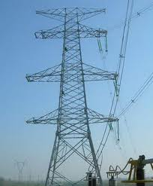
4.Steel towers
Used for lines of 66kV and above
Very long life and high degree of reliability
Can withstand very severe weather conditions
Overhead HV , EHV , and UHV lines mostly use self supporting steel towers.

Slide 13
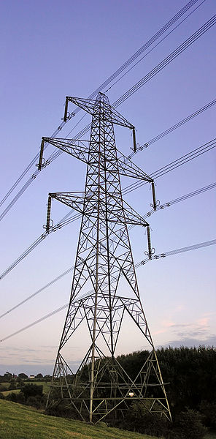
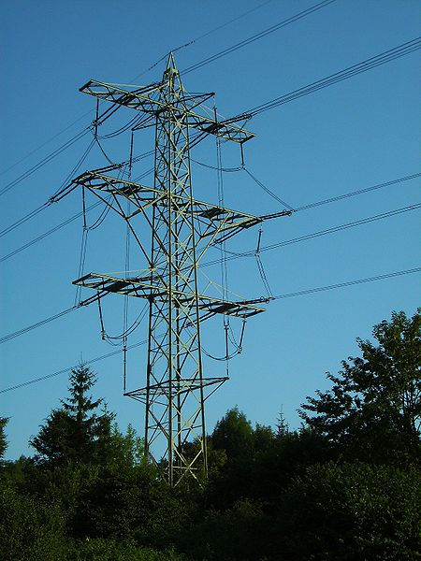
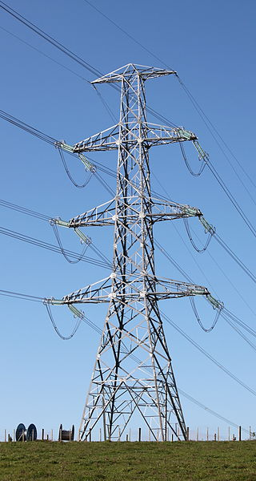
Suspension Tower
Transposition Tower
Tension Tower

Slide 14
Types of Towers
Type A Tower (Tangent Tower with suspension string)
Used on straight runs and up to 2° line diversion
Type B Tower (Small Angle Tower with tension string)
Used for line deviation from 2° to 15°
Type C Tower (Medium Angle Tower with tension string ).
Used for line deviation from 15° to 30°.
Type D Tower (Large angle tower with tension string)
Used for line deviation from 30° to 60°
Type E Tower (Dead End Tower with tension string)
Used for line termination & starting
Suspension Tower (Span ≈ 1000 m)
Used for River crossing, Mountain crossing etc.
Transposition Tower
Used for transposition of tower

Slide 15
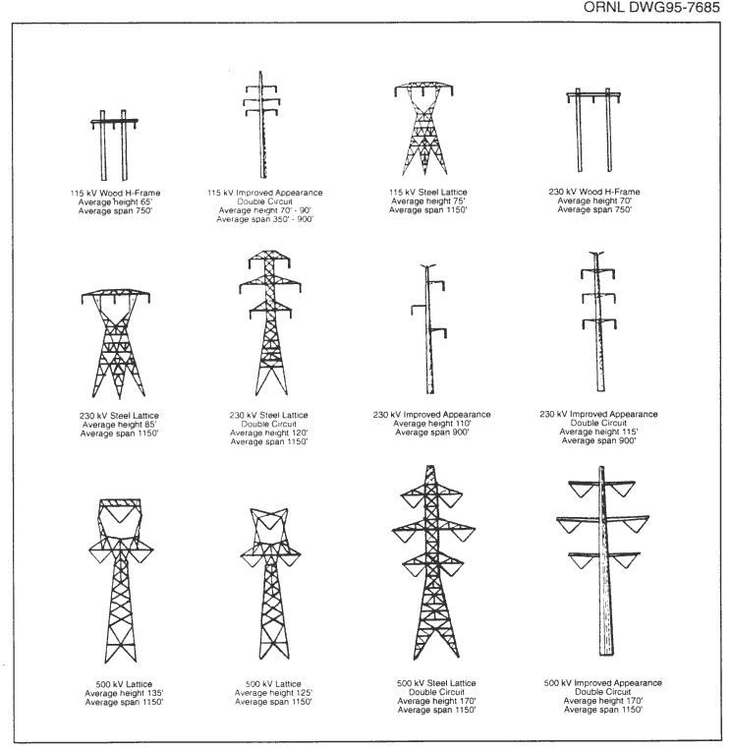

Slide 16
Span , conductor configuration and spacing
A longer span means smaller number of towers but the towers are taller and more costly.
Higher the operating voltage , greater should be the span.
From mechanical consideration , there is a maximum value of span for each conductor size.
Modern high voltage lines have spans between 200m and 400m.

Slide 17
There are different conductor configurations used in practice.
In most cases flat horizontal or vertical configurations are used.
Flat horizontal means lesser tower height but a wider right of way.
Vertical configuration means taller tower and increased lightning hazards.

Slide 18
There must be adequate spacing between conductors so that they do not come within sparking distance of each other , even while swinging due to wind.

Slide 19
Insulator materials
To provide necessary clearance between conductors and metal works , the conductors are attached to insulators.
Also provides mechanical support for the conductor.
The most suitable materials for insulators are:
Toughened glass
Porcelain

Slide 20
Toughened glass
It is achieved by rapidly cooling the glass insulator after shaping and then allowing the interior to cool slowly.
Can withstand great tension.
Glass is cheaper than porcelain in simpler shapes.
Used very rarely
For lines below 25kV with short spans.

Slide 21
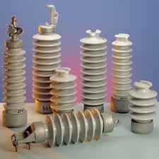
Porcelain
Mechanically stronger than glass
Less affected by changes in temperature
Most commonly used material for manufacturing of insulators.

Slide 22
Types of Insulators
Pin type insulators
Suspension type
Post type
Strain insulators

Slide 23
Pin type insulators
Small , simple in construction and cheap.
Used on lines upto and including 33kV.
For higher voltages they tend to be more heavy and costly.

Slide 24
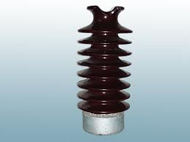
Suspension type insulators
Used for lines above 33kV.
Also known as disc or string insulators.
Consists of porcelain discs mounted one above the other.
The conductor is suspended below the point of support by an insulator string.
Mechanical stresses are reduced.

Slide 25
Post Insulators
Used for supporting bus bars and disconnecting switches in sub-stations.
In extra high voltage sub-stations , polycon post insulators are used.
Similar to pin insulator but has a metal base and metal cap so that more than one unit can be mounted in series.

Slide 26
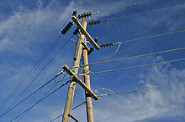
Strain Insulators
Special mechanically strong suspension insulators
Similar to suspension type insulators
Used to take the tension of the conductors at the line terminations and at portions where there is a change in direction of line.

