Slide 1
Microcontroller Systems & Interfacing
Muhammad Waqas

Slide 2
Example 2
Write an 8051 C program to send hex values for ASCII characters of 0, 1, 2, 3, 4, 5, A, B, C, and D to port P1.
Solution:
#include <reg51.h>
void main(void)
{
unsigned char mynum[]=“012345ABCD”;
unsigned char z;
for (z=0;z<10;z++)
P1=mynum[z];
}

Slide 3
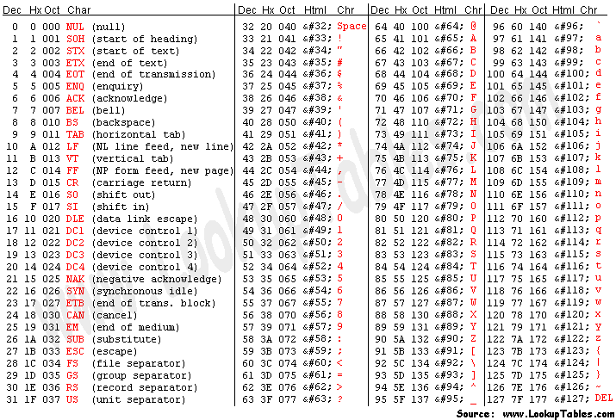

Slide 4
Write an 8051 C program to toggle all the bits of P1 continuously.
Solution:
//Toggle P1 forever
#include <reg51.h>
void main(void)
{
for (;;)
{
p1=0x55;
p1=0xAA;
}
}

Slide 5
Signed char
The signed char is an 8-bit data type
Use the MSB D7 to represent – or +
Give us values from –128 to +127
We should stick with the unsigned char unless the data needs to be represented as signed numbers
temperature

Slide 6
Example 3
Write an 8051 C program to send values of –4 to +4 to port P1.
Solution:
//Singed numbers
#include <reg51.h>
void main(void)
{
char mynum[]={+1,-1,+2,-2,+3,-3,+4,-4};
unsigned char z;
for (z=0;z<=8;z++)
P1=mynum[z];
}

Slide 7
Unsigned and Signed int
The unsigned int is a 16-bit data type
Takes a value in the range of 0 to 65535 (0000 – FFFFH)
Define 16-bit variables such as memory addresses
Set counter values of more than 256
Since registers and memory accesses are in 8-bit chunks, the misuse of int variables will result in a larger hex file

Slide 8
Signed int is a 16-bit data type
Use the MSB D15 to represent – or +
We have 15 bits for the magnitude of the number from –32768 to +32767

Slide 9
Write an 8051 C program to toggle bit D0 of the port P1 (P1.0)
50,000 times.
Solution:
#include <reg51.h>
sbit MYBIT=P1^0;
void main(void)
{
unsigned int z;
for (z=0;z<=50000;z++)
{
MYBIT=0;
MYBIT=1;
}
}

Slide 10
Time Delay
There are two ways to create a time delay in 8051 C
Using the 8051 timer
Using a simple for loop
be mindful of three factors that can affect the accuracy of the delay
The 8051 design
The number of machine cycle
The number of clock periods per machine cycle
The crystal frequency connected to the X1 – X2 input pins
Compiler choice
C compiler converts the C statements and functions to Assembly language instructions
Different compilers produce different code

Slide 11
Write an 8051 C program to toggle bits of P1 continuously forever
with some delay.
Solution:
//Toggle P1 forever with some delay in between
//“on” and “off”
#include <reg51.h>
void main(void)
{
unsigned int x;
for (;;) //repeat forever
{
p1=0x55;
for (x=0;x<40000;x++); //delay size
//unknown
p1=0xAA;
for (x=0;x<40000;x++);
}
}

Slide 12
Write an 8051 C program to toggle bits of P1 ports continuously with a 250 ms.
Solution:
#include <reg51.h>
void MSDelay(unsigned int);
void main(void)
{
while (1) //repeat forever
{
p1=0x55;
MSDelay(250);
p1=0xAA;
MSDelay(250);
}
}
void MSDelay(unsigned int itime)
{
unsigned int i,j;
for (i=0;i<itime;i++)
for (j=0;j<1275;j++);
}

Slide 13
LEDs are connected to bits P1 and P2. Write an 8051 C program that
shows the count from 0 to FFH (0000 0000 to 1111 1111 in binary)
on the LEDs.
Solution:
#include <reg51.h>
#define LED P2;
void main(void)
{
P1=00; //clear P1
LED=0; //clear P2
for (;;) //repeat forever
{
P1++; //increment P1
LED++; //increment P2
}
}

