Slide 1
QoS Basic Concepts
Ch 1 & 2
By William Hardy
QoS Measurement and Evaluation of Telecommunications
By: Mansoor Qadir

Slide 2
Previous Lecture
Paper on QoS in Telecom Networks
QoS definition
Telecom qos characteristics
QoS parameters
QoS management schemes
Policy based network management

Slide 3
Today’s Lecture
Intrinsic vs Perceived QoS
Perceived vs Assesed QoS
Measurement and Evaluation
Data vs Information
Measures vs Quantifiers
Concerns
Objectives

Slide 4
Developing measures of QoS
3 principles for defining and developing measures of QoS
Meaningful
Useful
Cost-effective

Slide 5
Meaningful, Useful, Cost-Effective
Meaningful
Considering the concern of users of that service
So that we can develop evaluation concepts to understand measures and measurement schemes
Useful
Measurement of QoS must be based on measures i.e.
interpreted by users
Related to the performance characteristics of the system delivering a service

Slide 6
Meaningful, Useful, Cost-Effective
Cost-Effective
This measurement of QoS can be realized only when the means of quantifying or estimating any measure is consciously selected on the basis of consideration of both the intended use of the measure and readily available sources of data.

Slide 7
Quality of Telecommunication Services
Reason of Qos:
To define measures of quality of service (QoS) that can be used to evaluate telecommunications services in ways that are operationally meaningful, useful to decision-makers, and which can be achieved with a minimum investment in time and money

Slide 8
‘Service’ in QoS
Something that is provided day-to-day for the use of user
Telecommunications service is a particular capability to communicate with other parties by transmitting and receiving information in a way that is fully specified with respect to;
How the user initiates a transaction
The mode in which the information is exchanged
How the information is formatted for transmission
how end-to-end exchanges of the information are effected
how the transactions completed are billed and paid for

Slide 9
‘Quality’ in QoS
‘‘excellence of character”
In Telecommunication Systems quality is something by which a user of the service will judge how good the service is
Quality if singular – excellence
Quality if plural – multidimensional
W.r.t attributes of the service a user will value
Perspectives in the service

Slide 10
Attributes of service
imagine yourself trying to sell a telephone service that is otherwise excellent in all respects, but is horribly deficient in some aspect e.g.
our service will always be there and ready to go when you want to use it. So we just do not see how you can possibly be worried about that little 1-min call set-up time problem
99.95% of calls placed with our service will result in a connection! And, only 50.7% of those connections will be to the wrong number.
99.9% of calls placed with our service will result in the right connection! Now, we understand that there might be some difficulty in hearing each other, when the connection is up

Slide 11
Attributes of service
So there can be many perceptions of user quality
User expectation may vary from one another
stylish design of an automobile chassis
nicely appointed leather interior can compromise on engine’s performance
Thus qos involves collection of measures rather than ‘the’ measure of qos

Slide 12
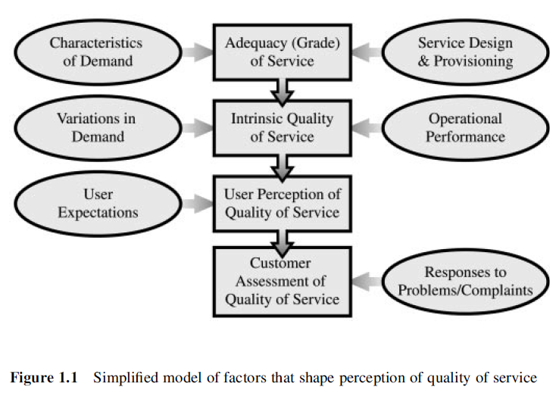
Attributes of service

Slide 13
Evaluation of QoS
Three interrelated notations of QoS
Intrinsic quality
Perceived quality
Assessed quality

Slide 14
Intrinsic quality
Intrinsic quality of service is what may make a particular service attractive to a buyer in the first place
Intrinsic quality is achieved via;
Technical design of the transport network and terminations, which determine the characteristics of the connections made through the network
Provisioning of network accesses, terminations, and switch-to-switch links, which determines whether the network will have adequate capacity to handle the anticipated demand
Notes:
Since the goal is to be able to implement within that network various telecommunications services whose quality should be competitive in the target
marketplace, intrinsic service quality is usually gauged by expected values of measures of operational performance characteristics and verified by demonstration
that those scores compare favorably with analogous scores of competing services.

Slide 15
Perceived quality
Results when the service is actually used
The expectations in intrinsic quality of the service must meet the demands of the user

Slide 16
Assessed quality
when the user/customer who pays for the service makes the determination whether the quality of service is good enough to warrant its continued use
Figure 1.1, this notion of quality of service depends directly on the perceived quality of service, but is also affected by other considerations i.e. vendor responses to problems with the service

Slide 17
Intrinsic vs Perceived QoS
It is perceived, rather than intrinsic, quality that ultimately determines whether a user will be satisfied with the service delivered
Adequacy of Post Dial Delay (PDD)
The intrinsic quality of a particular service w.r.t PDD is set by the design of the underlying network, depending on
how calls are routed
whether dialed digits are translated for switching
how variable length numbers are handled
node-to-node signaling i.e. in-band or out-band

Slide 18
Intrinsic vs Perceived QoS
However the measures of intrinsic PDD can be accurate only to the extent that the different types of routes actually used by the target community replicate the distribution of different types of routes over the network
A vendor can set the intrinsic PDD by pre defining the time for certain routes

Slide 19
Perceived vs Assessed QoS
Perceived determines whether that buyer will find the service acceptable when it is delivered
Assessed determine whether the buyer will retain the service or dump it at the first opportunity
Basic requirement of Assessed quality is perceived quality is acceptable to the user community
Factors that results in unsatisfactory assessment
Disconnect
Dropped
Bill

Slide 20
Measurement and Evaluation
Measurement, is one which produces quantitative descriptions of attributes of a telecommunications
service that affect the user perception of its quality
Evaluation, one whereby those quantitative descriptions are interpreted to answer some specific question;
whether user satisfaction with a particular service
what can done to improve user satisfaction
whether users might find some change in intrinsic quality

Slide 21
Analysis of QoS
Measurement + Evaluation = Analysis of QoS
Functions of Measurement & Evaluation
“The only good reason to measure anything is to reduce uncertainty with respect to some course of action that must be decided”
Without underlying the information the result will be of no use to decision-makers E.g.
what new car to buy
what telephone services to order
how to go about correcting a recognized problem
how to recognize that a problem has emerged
when to sell a stock.

Slide 22
Analysis of QoS
Audience: which decision-makers are to be supported by the results of the analysis?
Utility: what kinds of decisions are to be facilitated? How must measurements be evaluated to produce information that can be used for those decisions?
Concerns: what are the questions that those decision-makers are likely to want to have answered during the course of making those decisions?
Objectives: what are the courses of action that will be decided or determined by appeal to the results of the analysis?

Slide 23
Audience types
Service users
User representatives
Service provider sales and marketing personnel
Service operations and maintenance personnel
System architects and engineers

Slide 24
Data and Information
Data: A collection of facts, observations, or measurements that might be used in assigning a value to a measure.
Information: The results of interpretation of data to produce answers to specific questions whose answers will effectively reduce uncertainty with respect to a decision that must be made.

Slide 25
Measures and Quantifiers
Measures: which define what is to be described in quantitative terms without any restriction on what is to be calculated from data
Quantifiers: which describe how the associated measure is to be (was) expressed as a quantity.
The measure can be the name of quantifying a particular attribute of an entity being analyzed i,e, ‘‘height’’ of a person, the quantifier becomes an expression that specifies one of possibly many ways that a numerical value is to be assigned to that attribute, e.g. ‘‘height’’

Slide 26
Measures and Quantifiers
Availability – another quantifier of measure
MTBF/(MTBF + MTTR) =
total time the service was up and ready for use
total time the service was observed

Slide 27
Concerns and Objectives
Concerns explain the reason for conducting an analysis where as the objectives define there characterizes its envisioned utility to the intended audience
The analysis will be used to determine when there has been significant change in the time it takes to complete a call
The analysis will be used to decide whether the service is competitive with respect to time required to complete a call

Slide 28
Concerns and Objectives
The analysis will be used to decide whether the call set-up process for the service in question is functioning properly and isolate any deterioration in performance

