Slide 1
Embedded Systems
Muhammad Waqas

Slide 2
8051
Intel introduced 8051, referred as MCS-51, in 1981
The 8051 is an 8-bit processor
The CPU can work on only 8 bits of data at a time
The 8051 had
128 bytes of RAM
4K bytes of on-chip ROM
Two timers
One serial port
Four I/O ports, each 8 bits wide
6 interrupt sources

Slide 3
The 8051 became widely popular after allowing other manufactures to make and market any flavor of the 8051, but remaining code-compatible.

Slide 4
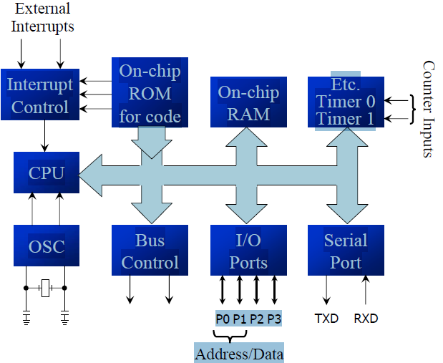

Slide 5
The 8031 is a ROM-less 8051
Add external ROM to it
You lose two ports, and leave only 2 ports for I/O operations

Slide 6
Feature | 8051 | 8052 | 8031
ROM (on-chip program in bytes) | 4K | 8K | 0K
RAM (bytes) | 128 | 256 | 128
Timers | 2 | 3 | 2
I/O pins | 32 | 32 | 32
Serial port | 1 | 1 | 1
Interrupt sources | 6 | 8 | 6

Slide 7
8751 microcontroller
UV-EPROM
PROM burner
UV-EPROM eraser takes 20 min to erase
AT89C51 from Atmel Corporation
Flash (erase before write)
ROM burner that supports flash
A separate eraser is not needed
DS89C4x0 from Dallas Semiconductor, now part of Maxim Corp.
Flash
Comes with on-chip loader, loading program to on-chip flash via PC COM port

Slide 8
DS5000 from Dallas Semiconductor
NV-RAM (changed one byte at a time), RTC (real-time clock)
Also comes with on-chip loader
OTP (one-time-programmable) version of 8051
8051 family from Philips
ADC, DAC, extended I/O, and both OTP and flash

Slide 9
INSIDE THE 8051 (Registers)
Register are used to store information temporarily, while the information could be
a byte of data to be processed, or
an address pointing to the data to be fetched
The vast majority of 8051 register are 8-bit registers
There is only one data type, 8 bits

Slide 10
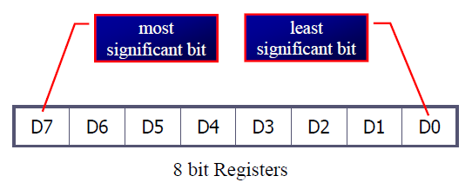
The 8 bits of a register are shown from MSB D7 to the LSB D0
With an 8-bit data type, any data larger than 8 bits must be broken into 8-bit chunks before it is processed

Slide 11
The most widely used registers
A (Accumulator)
For all arithmetic and logic instructions
B, R0, R1, R2, R3, R4, R5, R6, R7
DPTR (data pointer), and PC (program counter)

Slide 12
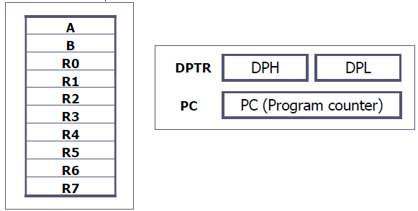

Slide 13
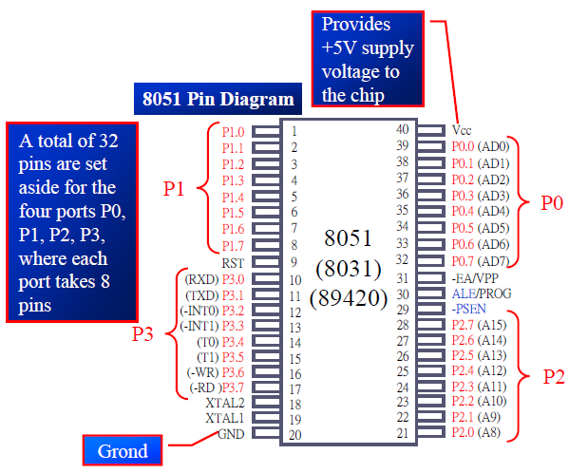

Slide 14
I/O
The four 8-bit I/O ports P0, P1, P2 and P3 each uses 8 pins
All the ports upon RESET are configured as input, ready to be used as input ports
When the first 0 is written to a port, it becomes an output
To reconfigure it as an input, a 1 must be sent to the port
To use any of these ports as an input port, it must be programmed

Slide 15
It can be used for input or output, each pin must be connected externally to a 10K ohm pull-up resistor
This is due to the fact that P0 is an open drain, unlike P1, P2, and P3
Open drain is a term used for MOS chips in the same way that open collector is used for TTL chips

Slide 16
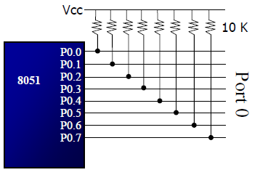

Slide 17
WHY PROGRAM 8051 IN C
Compilers produce hex files that is downloaded to ROM of microcontroller
The size of hex file is the main concern
Microcontrollers have limited on-chip ROM
Code space for 8051 is limited to 64K bytes
C programming is less time consuming, but has larger hex file size

Slide 18
The reasons for writing programs in C
It is easier and less time consuming to write in C than Assembly
C is easier to modify and update
You can use code available in function libraries
C code is portable to other microcontroller with little of no modification

Slide 19
Data Types
A good understanding of C data types for 8051 can help programmers to create smaller hex files
Unsigned char
Signed char
Unsigned int
Signed int
Sbit (single bit)
Bit and sfr

