Slide 1
Introduction to Computing
Muhammad Waqas

Slide 2
PowerPoint 2010: Animation and Slide Transitions
Benefits of adding animation and slide transitions:
They provide visual interest to your presentation and grab the audience's attention (as long as they are not overused).
You can reveal points on slides in a staggered way (i.e. one bullet displayed at a time) to keep the audience focused only on the point which you are discussing at the given time.
You can automate the presentation so it runs on its own.

Slide 3
Adding Slide Transitions
Slide transitions control how your presentation moves from slide to slide.
In either the Slide Sorter or Normal view, select the slide or slides which you want to apply the transition to.
From the menu ribbon, select the Transitions tab.

Slide 4
The most commonly used animations will appear in the center. To preview more transition options, click the down arrow.

Slide 5
Select a transition from the list. Clicking it will apply the transition to the slide. You can also select Apply to All to apply the same transition to all your slides. In the Duration option, enter the speed at which you want the transition to play.

Slide 7
In the Sound field, use the drop-down menu to select a sound to play during a slide transition, if desired.

Slide 8
Indicate how you want the slide transition to occur by selecting an option under the Advance Slide heading. Select On mouse Click if you want the transition to take place when you click the left mouse button. Select Automatically After if you want the transition to occur after a specified time. Use the up and down arrow keys in the blank box to specify the number of seconds which should pass before the transition takes place.

Slide 9
Applying an Animation to an Object
Animation refers to how individual options on your slide move onto or off of the slide.
In either the Slide Sorter or Normal view, select the objects within a slide that you want to apply the animations to.
From the menu ribbon, select the Animations tab.

Slide 10
Select an animation, customize your play speed, and set your sound preferences. Click Preview to play the animations.

Slide 12
Creating Custom Animations
You can create custom animations to specify exactly what you want to animate and how it should be done.
Select the slide which you want to apply the animation to.
From the menu bar, select the Animations tab and the Animation Pane button. The Animation Pane appears on the right side of the screen.

Slide 13
Click on an element of the slide that you want to animate. For example, you could select a title, bulleted list, or graphic. Click Add Effect. A menu appears with a list of effect categories. Entrance effects control how the element enters the slide. Emphasis effects make the element do something after it enters the slide. Exit effects control how it leaves the slide. Motion paths allow you to specify where the element travels on the slide.

Slide 14
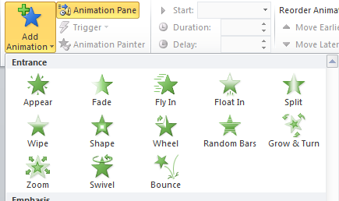

Slide 15
Select one of the effects. Details about the effect appear in the Animation Pane. In the Start field, use the drop-down menu to select an event which will trigger the animation. With Previous means the animation will occur at the same time as the previous animation on the slide or it will occur when the slide appears if there are no previous animations. After Previous means the animation will occur after the previous animation. Use the lists in the Animation Pane to adjuct options such as animation speed and direction.

