Slide 1
Embedded Systems
Muhammad Waqas

Slide 2
You can choose any standard LCD available in market.
We use a 20x2 LCD.
It means LCD has 2 lines of 20 characters each.
Many other LCDs like 16×2, 24×2, 32×2, 20×4 etc. are available.

Slide 3
Functionally all these LCDs are same.
To develop a protocol to interface this LCD with 89C51 first we have to understand how they function.

Slide 4
Command/Instruction Register-
stores the command instructions given to the LCD.
A command is an instruction given to LCD to do a predefined task like initializing, clearing the screen, setting the cursor position, controlling display etc.
Data Register-
stores the data to be displayed on the LCD.
The data is the ASCII value of the character to be displayed on the LCD.

Slide 5
Commonly used LCD Command codes
Hex Code | Command to LCD Instruction Register
1 | Clear screen display
2 | Return home
4 | Decrement cursor
6 | Increment cursor
E | Display ON, Cursor ON
80 | Force the cursor to the beginning of the 1st line
C0 | Force cursor to the beginning of the 2nd line
38 | Use 2 lines and 5x7 matrix

Slide 6
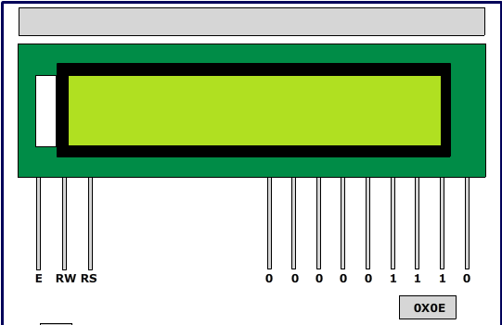

Slide 7
P1 = 0x0E
EN = 1
RS = 0
RW = 0
EN = 0

Slide 8
Pin configuration
Pin | Symbol | Description
1 | V_{SS} | Ground | 0 V
2 | V_{CC} | Main power supply | +5 V
3 | V_{EE} | Power supply to control contrast | Contrast adjustment by providing a variable resistor through V_{CC}
4 | RS | Register Select | RS=0 to select Command Register RS=1 to select Data Register
5 | R/W | Read/write | R/W=0 to write to the register R/W=1 to read from the register
6 | EN | Enable | A high to low pulse (minimum 450ns wide) is given when data is sent to data pins
7 | DB0 | To display letters or numbers, their ASCII codes are sent to data pins (with RS=1). Also instruction command codes are sent to these pins.
8 | DB1
9 | DB2
10 | DB3 |  | 8-bit data pins
11 | DB4
12 | DB5
13 | DB6
14 | DB7
15 | Led+ | Backlight V_{CC} | +5 V
16 | Led- | Backlight Ground | 0 V

Slide 9
Programming the LCD
Data pin8 (DB7) of the LCD is busy flag and is read when R/W = 1 & RS = 0.
When busy flag=1, it means that LCD is not ready to accept data since it is busy with the internal operations.
Therefore before passing any data to LCD, its command register should be read and busy flag should be checked.

Slide 10
To send data on the LCD, data is first written to the data pins with R/W = 0 (to specify the write operation) and RS = 1 (to select the data register).
A high to low pulse is given at EN pin when data is sent.
Each write operation is performed on the positive edge of the Enable signal.

Slide 11
To send a command on the LCD, a particular command is first specified to the data pins with R/W = 0 (to specify the write operation) and RS = 0 (to select the command register).
A high to low pulse is given at EN pin when data is sent.

Slide 12
Displaying single character ‘A’ on LCD
The LCD is interfaced with microcontroller (AT89C51).
This microcontroller has 40 pins with four 8-bit ports (P₀, P₁, P₂, and P₃).
Here P₁ is used as output port which is connected to data pins of the LCD.
The control pins (pin 4-6) are controlled by pins 2-4 of P₀ port.

Slide 13
Pin 3 is connected to a preset of 10k to adjust the contrast on LCD screen.
This program uses the above concepts of interfacing the LCD with controller by displaying the character ‘A’ on it.

Slide 14
P2 = ‘A’
rs= 1
rw=0
e=1
delay(1)
e=0

Slide 15
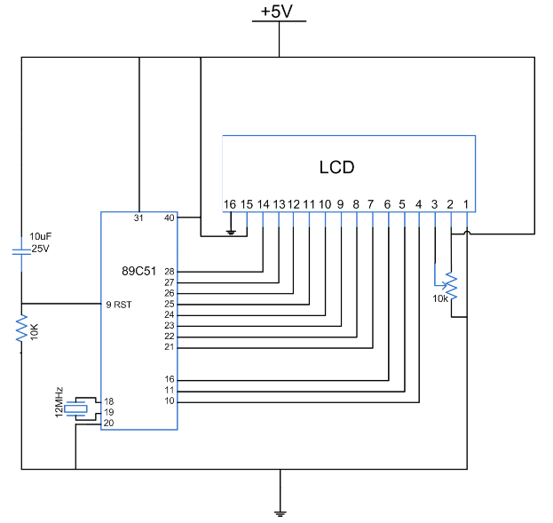

Slide 16
//Program to test LCD. Display single character "A"
#include<reg51.h>
#define cmdport P3
#define dataport P2
sbit rs = cmdport^0; //register select pin
sbit rw = cmdport^1; // read write pin
sbit e = cmdport^6; //enable pin
void delay(unsigned int msec) // Function to provide time delay in msec.
{
int i,j ;
for(i=0;i<msec;i++)
for(j=0;j<1275;j++);
}

Slide 17
void lcdcmd(unsigned char item) //Function to send command to LCD
{
dataport = item;
rs= 0;
rw=0;
e=1;
delay(1);
e=0;
}
void lcddata(unsigned char item) //Function to send data to LCD
{
dataport = item;
rs= 1;
rw=0;
e=1;
delay(1);
e=0;
}

Slide 18
void main()
{
lcdcmd(0x38); // for using 8-bit 2 row mode of LCD
delay(100);
lcdcmd(0x0E); // turn display ON for cursor blinking
delay(100);
lcdcmd(0x01); //clear screen
delay(100);
lcdcmd(0x06);
delay(100);
lcdcmd(0x86); // bring cursor to position 6 of line 1
delay(100);
lcddata('A');
}

