Slide 1
Electronic communication
By Kennedy Davis
4Th Edition

Slide 2
Chapter
waveguides

Slide 3
Topics to be covered in this chapter
Waveguide .
Reflection from conducting plane .
Modes .
Group velocity and phase velocity .
Parallel plane waveguide.
Cut off wavelength .
Cut off frequency .
Rectangular waveguide .
Standard rectangular waveguide .

Slide 4
Wave guide :
Guiding the wave is called waveguide .
A waveguide is hallow metallic conducting tube , that is used to guide , electrical energy from one point to another point in the form of EM wave , at extremely high frequency ( i.e in the GHZ range ).
It can be rectangular or circular in shape .
The walls of waveguide are made of conductor.
Energy trend in the form of EM wave .

Slide 5
Wave guide :
Handle 10 times more power then transmission line .
Frequency range 3- 100 GHZ .
It is used for short communication .
Another advantage of wave guide is that we can used a single frequency to take different signals , by making it reflect at different angles.
Waveguide is unguided transmission medium.

Slide 6
Wave guide :
TRANSMISSIOON LINE TYPE | ATTENUATION db/100m
Foam dielectric coaxial cable | 10
Air dielectric coaxial cable | 40
Copper waveguide | 1.9

Slide 7
Reflection from conducting plane
Electric field and magnetic field are at 90° to the direction of propagation hence they are called transverse electromagnetic wave ( or TEM waves ) .
TEM waves are not used in waveguide , because the electric field is short circuit by the walls .
In waveguide , the EM wave is sent in such manner that it becomes of it walls at certain angle ,hence the wave travel in a zig- zig fashion.

Slide 8
Reflection from conducting plane
Velocity of wave has reduced in the direction of propagation because its now travel more distance than on free space .

Slide 9
Mode :
Q : What is mode ?
Ans : When an electromagnetic wave is introduced at one end of waveguide , it is continuously reflect from the inner walls of the waveguide and propagate in the forward direction . These various reflected wave interact with each other and produce infinite number discrete field pattern , each such pattern / configuration is known as a mode .

Slide 10
Types of mode
A waveguide support two types of modes .
1 :TM mode or transverse magnetic mode
2 : TE mode or transverse electric mode .
TM mode or transverse magnetic mode :
A mode of which there is no component of magnetic field in the direction of propagation it is called TM mode .

Slide 11
Types of mode
TE mode or transverse electric mode:
A mode of which there is no component of Electric field in the direction of propagation it is called TE mode .

Slide 12
Group velocity (Vg)
The actual velocity with which a signals travel with in the waveguide is known as the group velocity . In other word it is velocity with which energy travels with in the waveguide .
It is denoted by “ Vg” .
Parallel wavelength λp = λ/ cosθ
Normal wavelength λn = λ/ sinθ
Vg is less than Vc .
Vg = Vc sin θ

Slide 13
Phase velocity (Vp)
The phase velocity is actually the velocity of the constant phase points on the wave , traveling with in the waveguide .
It is denoted by Vp .
Or
An electromagnetic wave has two velocities , the one with which it propagates as the group velocity and other with which it change its phase is known as the phase velocity .
Velocity of phase along the direction of propagation in waveguide is called phase velocity .

Slide 14
Phase velocity (Vp)
Phase velocity can be greater than or equal to the speed of lights .
Vp is depend on λp .
Vp = λp ×f

Slide 15
Parallel plane waveguide :
In order to understand how wave pattern are formed inside the waveguide , lets first review standing wave in a transmission line .
We know that a wave ( V or I ) traveling in forward direction is reflected from the load . As a result there is backward wave ( V or I) present on the T. L . The overall effect is that a standing wave is form .
And now consider an EM wave traveling in forward direction and is reflected from conductor . As result there will be backward wave present in the same medium as the forwards wave .therefore standing wave will be formed which is exactly the same as standing waves in transmission line .

Slide 16
Parallel plane waveguide :
In the above case we have made the EM wave incident on the conductor at 90° angle ( or with surface normal)
Two component Vp and Vn .
Vp will cause this standing wave to travel along the walls . So we are saying the standing wave is traveling .
Now consider two walls
If m= 3 so we have enclosed 3 half wavelength of the wave across the width .
a = 3×λn/2

Slide 17
Parallel plane waveguide :
In general
a = m×λn/2
Where
a= width of the parallel plane waveguide .
m = number of half wavelength or also called the sub mode of the guide .
It is also noted as the second wall is added , the wave will reflect again .The phenomena remain the same ,As the result is that standing wave travel along the walls and the wave does not attenuate .

Slide 18
Parallel plane waveguide :
TE mode :
Now if we have the wave such that the magnitude of E does not vary along the height of the walls ( i-e E is constant ) than n = 0 .We call the waveguide to be operated in mode .
In practice mode is very common and is also called the dominant mode

Slide 19
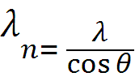
Cut of wavelength (λ₀):
The maximum value of λ which can travel in waveguide is called cut of wavelength for that waveguide ,operating in a particular mode .
Mathematical derivation
we know that
but

Slide 20
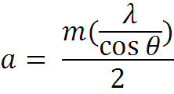
Cut of wavelength (λ₀):

Slide 21
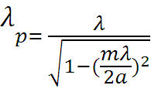
Cut of wavelength (λ₀):
Also we have
Put value from equation 1

Slide 22
Cut of wavelength (λ₀):
If we put λ 0 than ,
This effectively means that the wave is not travelling

Slide 23
Cut of wavelength (λ₀):
This value of λ is called as the cut off wavelength and is represented by λ₀ therefore ,

Slide 24
Cut of frequency (f₀) :
As we know that Vc = fλ
f = Vc /λ
if λ = λ₀ than
f = f₀ = Vc/ λ₀
And is called the cut off frequency
Mathematically

Slide 25
Cut of frequency (f₀) :
Where
f₀ = lower cut of frequency
A and b = dimension of waveguide
m and n = mode of operation

Slide 26
Group velocity and phase velocity relationship
We know that
Vg = Vc sinθ
Vp = Vc/ sinθ
sinθ = Vg /Vc and sinθ = Vc / Vp
Vg/ Vc = Vc /Vp

Slide 27
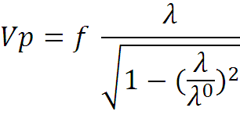
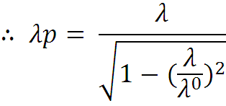
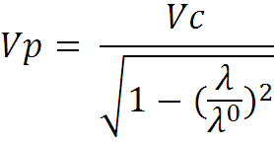
Group velocity and phase velocity relationship
Also

Slide 28
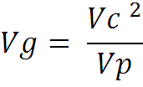
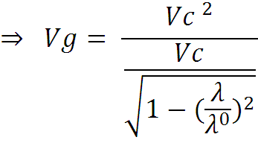
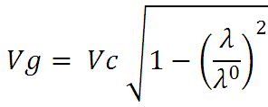
Group velocity and phase velocity relationship
From equation 1 we have
If λ =λ₀
Vg = 0 it means the wave does not travel forward

Slide 29
Rectangular waveguide :
If we add two more conducting walls to a parallel waveguide on top and bottom , then it becomes a rectangular waveguide .
The width of a rectangular waveguide is represented by “ a” and its heights by “b “
In rectangular waveguide , mode are labeled as and .
Where
m = number of half wavelength along width ‘a’ .
n= number of half wavelength along height ‘b’ .

Slide 30
Rectangular waveguide :
mode :
The electric field is uniform along the height of a rectangular waveguide .therefore it does not matter whether the top or bottom walls exist or not .
Hence all the equation of modes derived for parallel waveguide are the same for rectangular waveguide s( in ) also .they are as fallow .

Slide 31
Rectangular waveguide :
mode

Slide 32
Rectangular waveguide :
mode

Slide 33
Rectangular waveguide :
mode
Variation in the electric field along the height , we will have mode .
All the equation of the previous section , only equation 1 will be different here .

Slide 34
Rectangular waveguide :
mode

Slide 35
Rectangular waveguide :
TM mode :
The magnetic field is transverse to the direction of propagation and electric field has no component in the direction of propagation .
According to (EMF) , we know that magnetic field is always in closed loop .
Magnetic field changes in two dimension (always) , therefore mode are not possible in TM mode .The minimum value of n=1 for TM waves .

Slide 36
Rectangular waveguide :
mode :
All equation are the same for mode as in previous section except for equation 5 .

Slide 37
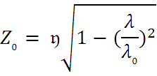
Rectangular waveguide :
mode :

Slide 38
Example 10.7 page 328
Rectangular waveguide
Given data :
f = 9 GHZ
a= 4.5 cm
b= 3 cm
Find λ₀ ,λр ,Vg ,Vp and Z₀
For (a) mode
(b) mode (Home work)

Slide 39
Standard rectangular waveguide :
It is a waveguide whose aspect ratio is 2:1 . In other words b= a/2.
Cut off wavelength of a standard waveguide

Slide 40
;
The End

