Slide 1
Chapter 2 The Marketing Environment

Slide 2
Environmental Monitoring
Environmental scanning
Process of
Gathering information regarding company’s external environment
Analyzing it
Forecasting the impact of whatever trends analysis suggested

Slide 3
The actors and forces outside marketing that affect marketing management’s ability to build and maintain successful relationships with target customers
Two levels of external factors
Macro influences (affects all firms)
Micro influences (affects a particular firm)

Slide 4
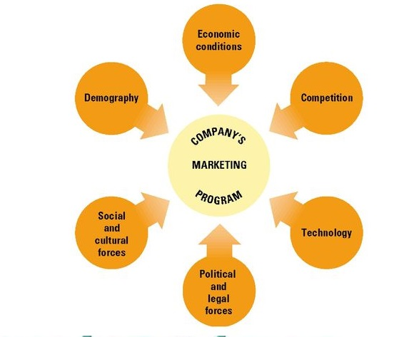
External Macro Environment
Demographic
Economic conditions
Competition
Social and cultural factors
Political factors
Technology

Slide 5
Considerable influence on any organization’s activities and opportunities
Interrelated- change in one can affect other
Largely uncontrollable but not totally
In international market a company can improve its competitive position by joint venture.
E.g. coca cola and nestle- iced Nestea

Slide 6
Demo graphics
The study of human populations in terms of size, location, distribution, growth, age and other statistics.
Changes in age distribution are the result of many factors, including the quality of health care and nutrition.
People make market therefore demographics are special interest to marketers
World population is increasing at high rate
Food supply- demand high
Another notable demographic trend is the rapid growth of minority markets and their buying power.

Slide 7
Economic conditions
People alone don’t make market, they must have money to spend and be willing to spend it.
Purchasing and spending pattern of customers
Economic environment is a significant force that affects marketing environment of any organization.
Marketing program is affected by economic factors
Stage of business cycle
Inflation
Interest rate

Slide 8
Stage of business cycle
Goes through
Prosperity- period of economic growth . Organizations expand their marketing programs, add new product and enter new markets
Recession- period of retrenchment (for consumer and business); we tighten our economic belt. People become discouraged, scared and angry. Business face serious marketing challenges. (unemployment, decreased profit). E.g. customers cut on eating outside home and entertainment.
Recovery- business moves from recession to prosperity. Marketer challenge to determine how quickly prosperity will return and to what level (decreased unemployment, profit).

Slide 9
Inflation
Rise in prices of goods and services
Prices rise at faster rate than personal income, consumer buying power declines.
Inflation rates affect government policies, consumer psychology and also marketing programs.
Deflation- (decreasing prices)
Present challenges for marketers
Difficult to rise prices because of customer resistance
As a result need to cut cost otherwise profit will evaporate

Slide 10
Interest rate
If high consumers tend not to make long term purchases
Marketer sometimes offer below-market interest rates (a form of price cost)
As promotional device to increase business
Auto manufacturers use this tactics

Slide 11
Competition
Major influence
Three types of competition
Brand competition- similar products (MCD and KFC)
Substitute product- satisfy same needs (wooden floor instead of carpets)
Customer’s limited buying power- completion may exist among different companies

Slide 12
Company should constantly monitor competition market’s activities:
Price, product, distribution system and promotion program
Enterprise strives to gain advantages
Any features of organization/ brand- perceived to be desirable and different from competition
Attracts customer

Slide 13
Social and Cultural Forces
Socio-cultural patterns- Lifestyles, values and beliefs -Are more complex and are changing more quickly than they used to.
Few Social and Cultural forces that have significant marketing implications are:
Concerned about natural environment
Changing gender roles
Premium on time
Physical fitness and health

Slide 14
Concerned about Natural Environment
Many consumers emphasize on quality of life rather than quantity of goods consumed.
The theme is “not more, but better”
Consumers express concerns on air and water pollution, holes in ozone layer, acid rain, solid waste disposal and the destruction of rainforests and other natural resources
These concerns raise the public’s level of environmental consciousness
In 2005, Procter and Gamble introduced Tide coldwater; new detergent that is designed to clean clothes in cold water and save energy.

Slide 15
Changing Gender Roles
Changing roles of women
Increasing number of 2 income households
Male-female roles related to families, jobs, recreation and buying behaviors are changing drastically
E.g. more men shop for household necessities, particularly groceries, where as now more women purchase products like cars, mutual funds etc
Marketers should be aware that these 2 groups of men, “Change Adapters” and “Change Opposers” buy different items and shop in different ways.

Slide 16
Premium on time
Since 1990’s many people are working longer hours than their parents did.
Many people also consider it necessary to be involved in activities such as continuing education, personal fitness and also placed more emphasis on family
Short free time people seek to maximize the benefit of whatever free time they have
E.g. Many people, especially 2 income households, with more income but less time are more willing to pay for convenience.

Slide 17
Physical fitness and health
Most demographic and economic segments of our society seem to reflect an increased interest in physical fitness and health.
Participation in fitness activities from yoga to aerobic in on raise. Diets for wait loss; food low in salt, cholesterol and foods high in vitamins, minerals etc
Fitness centers as well as manufacturers of exercise equipment have benefited
Many consumers changing their dietary habits, they are aware of the relationship between diet, heart diseases and cancer.

Slide 18
Thus companies need to recognize and respond to the public’s growing health interest in health.
E.g. most supermarkets now stock an assortment of heath foods.

Slide 19
Political and Legal Forces
Political and Legal Forces on marketing can be grouped into the following 4 categories:
Monetary and fiscal policies
Social legislation and regulations
Governmental relationships with industries
Legislation related specifically to marketing

Slide 20
Monetary and fiscal policies
Marketing efforts are affected by the level of government spending, the money supply and tax legislation.
Social legislation and regulations
Legislation affecting the environment
e.g. antipollution laws
Regulation se by Environmental Protection Agency

Slide 21
Governmental relationships with industries
Subsides in agriculture, shipbuilding, passenger rail transportation and other industries.
Tariffs and import quotas also affect specific industries.
Government deregulation continues to have an effect on financial institutions and public utilities (such as electric and natural gas suppliers) as well as on the telecommunications and transportation industries.

Slide 22
Legislation related specifically to marketing
Marketers need not be a lawyers, but they should know something about laws affecting marketing
Why they were passed, their main provision and current ground rules set by the courts and regulatory agencies for administering them.
E.g. nutritional labels

Slide 23
Technology
Technology has a tremendous impact on consumers lifestyle, their consumption patterns and their economic well-being
E.g. Technology Development such as TV, computers etc. at present all these has reached their major market share.

Slide 24
Technological breakthrough can affect markets in 3 ways:
By starting entirely new industries, as computers have done
By radically altering or virtual destroying, existing industries
When TV crippled the radio and movie industries,
Computers replaced Typewriters
By stimulating markets and industries not related to new technology
New home appliances and microwavable foods give people additional time in which they can engage in other activities.

Slide 25
External Micro-Environment
The 3 additional environment forces which are external to an organization and affect its marketing activities are:
The firm’s market
Suppliers
Marketing intermediaries
These represent the Micro-environmental forces for a company.

Slide 27
The market
The people or organizations whose wants and needs the firm intend to satisfy- its customers or consumers
How to reach customer and serve it profitable and in a socially responsible manner.
3 specific factors need to be considered
People or organizations with needs,
Their purchasing power,
Their buying behavior
Suppliers
A business cannot sell a product without being able to make or buy it.
We consider firms suppliers a vital part of its marketing environment.

Slide 28
Marketing Intermediaries
Marketing intermediaries are of 2 types
Middlemen (wholesalers and retailers)
Facilitating organizations (transportation, warehousing and financing that are needed to complete exchanges between buyers and sellers.

Slide 29
Internal Environmental Forces
Internal factors influence the firm’s marketing strategies, programs and activities and have the potential to affect customer satisfaction
R&D, production, systems financial are all critical to what marketing can do
Human resources may be the most important of all the internal departments- the concepts of internal market is very important
Marketing activities have to be consistent with corporate goals, positioning and image

Slide 30
