Slide 1
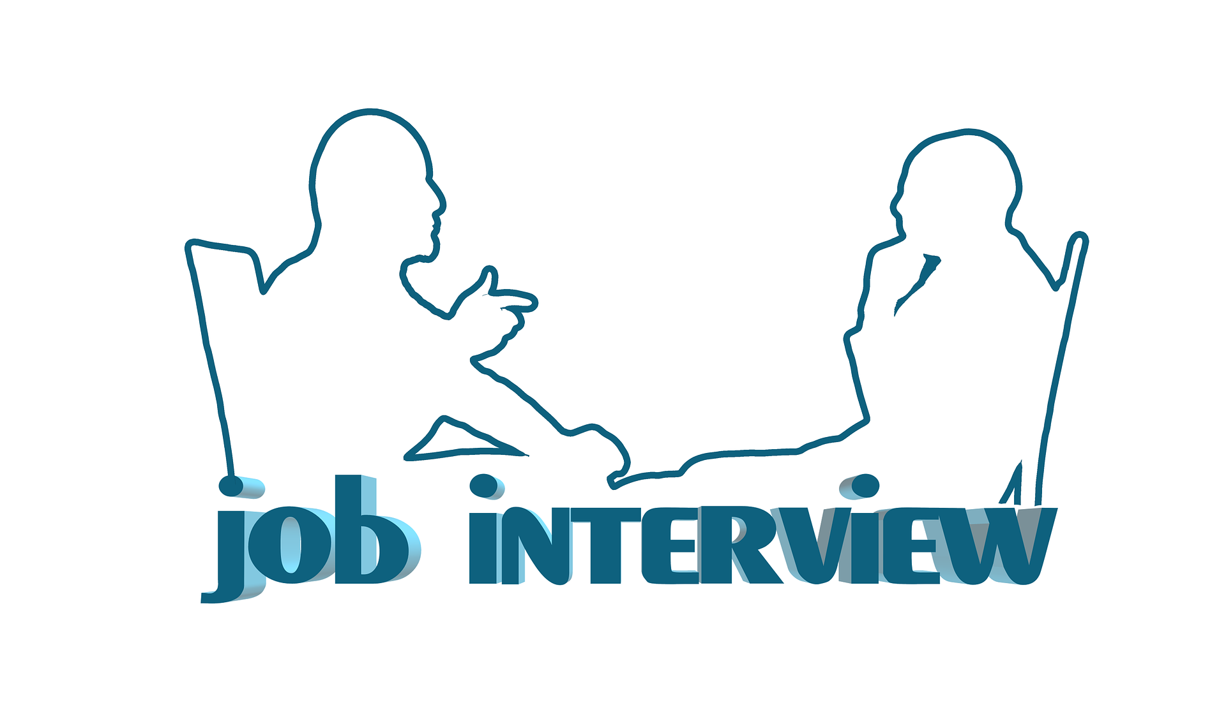
Interview Etiquette
Notes:
American Business Interview Etiquette
Unit 9
“Putting It All Together”

Slide 3
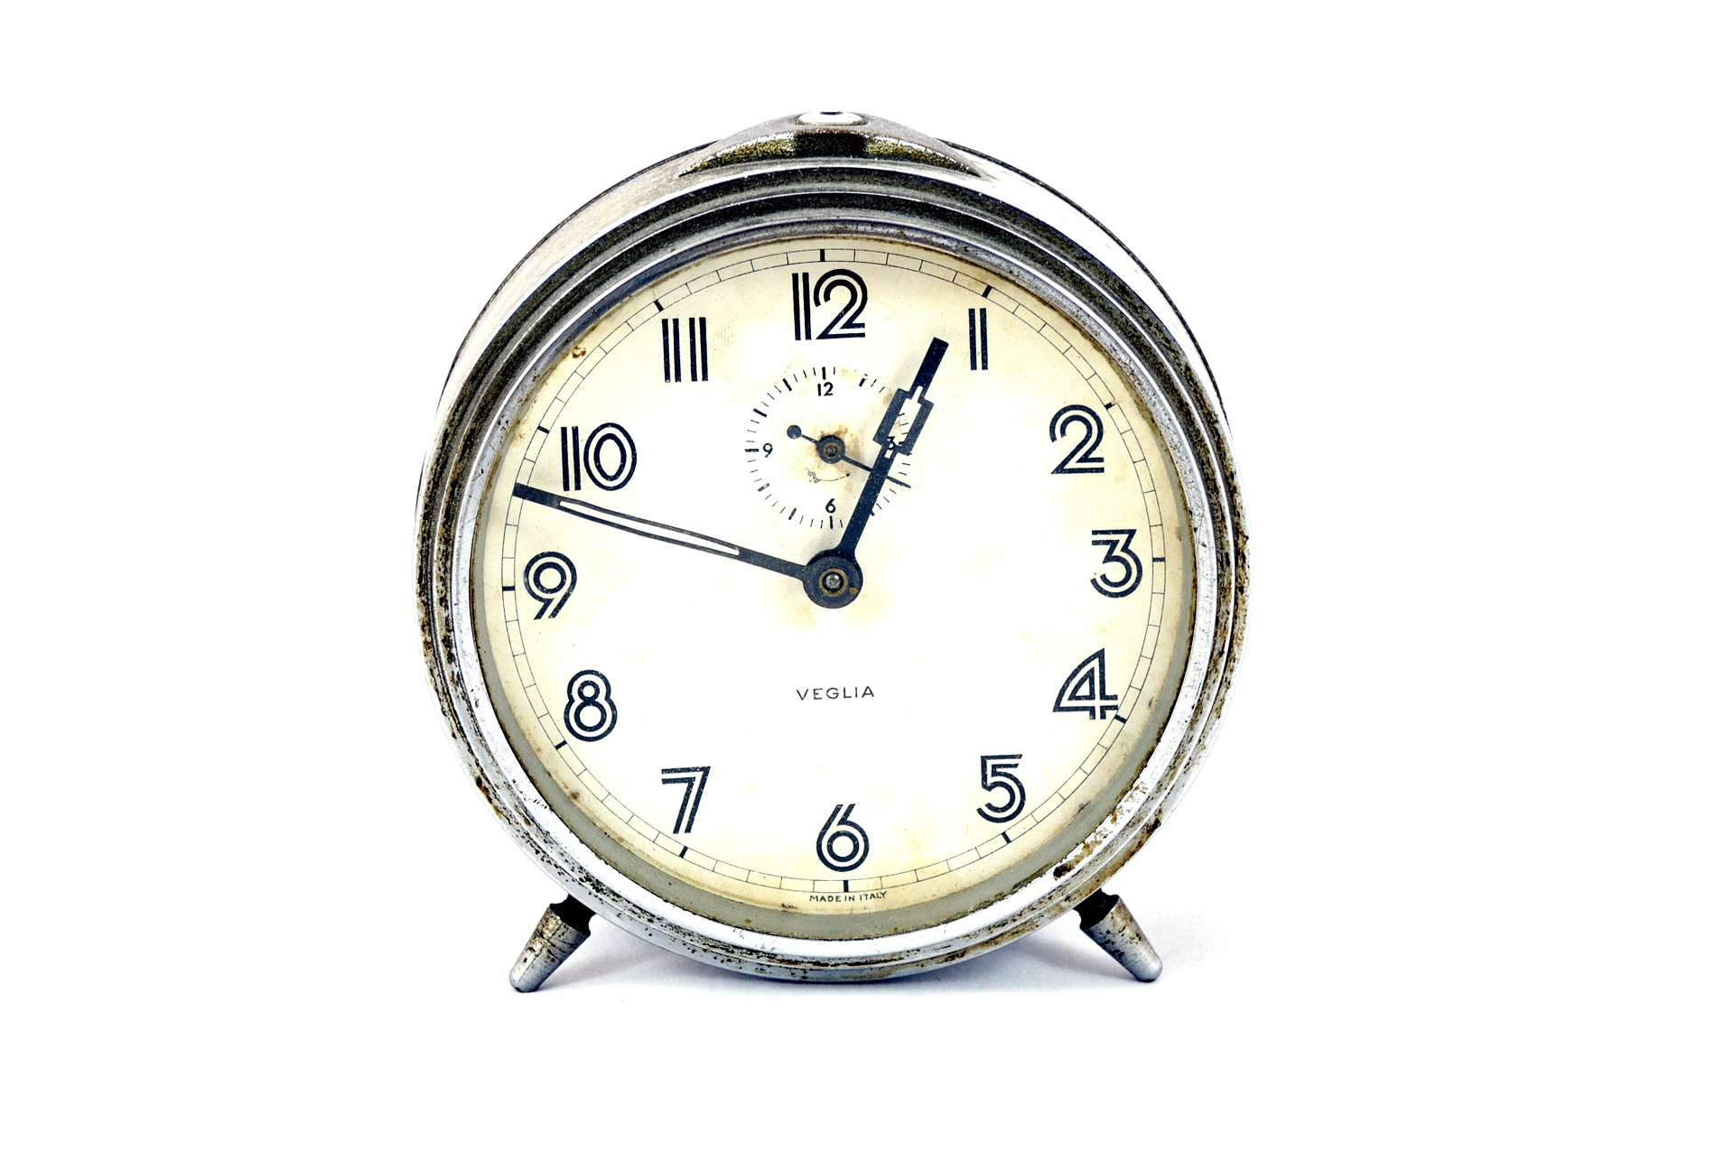
Arriving
Arrive 10 minutes early, no earlier.
Introduce yourself to the receptionist.
Sit at attention in the waiting area–no cell phone or magazines.
Stand and shake hands with whoever comes to escort you into the interview.
Notes:
Arriving
Arrive 10 minutes early, no earlier.
Introduce yourself to the receptionist.
Sit at attention in the waiting area–no cell phone or magazines.
Stand and shake hands with whoever comes to escort you into the interview.

Slide 4
Dress Professional
Avoid wardrobes malfunctions.
Dress up and dress conservatively.
Notes:
Dress Professional
Avoid wardrobes malfunctions.
Dress up and dress conservatively (even if for a fast food job or relaxed IT environment).This indicates that you think the interview and potential employer matter and you respect them and the situation.

Slide 5
Smile
Smiling not only show confidence, but a pleasant nature.
It invitees others to get to know you.
Notes:
The Power of a Smile
In American business culture a smile not only show confidence, but a pleasant nature.
It invites others to get to know you.
Note: Remember that not only is an employer filling an opening in a workforce, but is filling an opening in a business family.

Slide 6
Body Language
Your body language says a lot about you.
Sit up straight and plant your feet firmly.
Don’t sit with both hands in your lap beneath the table.
Make eye contact and maintain an open posture.
Do not fidget in your chair, cross your legs, or wring your hands.
Do not use too many hand gestures.
Notes:
Body Language
Employers interpret your attitude and interest in the job vacancy and in their company through your body language, just as they do from your smile and your words.
Sit up straight and plant your feet firmly on the floor during an interview.
Don’t sit with both hands in your lap beneath the table–you will look nervous.
Make eye contact and maintain an open posture.
Do not fidget in your chair, cross your legs, or wring your hands, and
Do not to use too many hand gestures.

Slide 7
The American Business Handshake
Begin with your hand parallel to the floor and thumb pointing to the ceiling.
Go all the way into your partner’s hand until the space between thumbs and index fingers touch.
Wrap your thumb and fingers all the way around your partner’s hand and squeeze assertively–not painfully–and shake 3-4 times.
Always stand for a handshake in business.
In a North American business environment, the space between partners is approximately 2 feet.
Never have your left hand in a trouser pocket when shaking hands.
Notes:
The American Business Handshake
Begin with your hand parallel to the floor with your thumb pointing to the ceiling.
Go all the way into your partner’s hand until the space between thumbs and index fingers touch.
Wrap your thumb and fingers all the way around your partner’s hand and squeeze assertively–not painfully–and shake 3-4 times.
Always stand for a handshake in business.
In a North American business environment the space between partners is approximately 2 feet.
Never have your left hand in a trouser pocket when shaking hands.
Don’t feel obligated to return a double handshake (left hand placed over the two hands shaking) or a pat on the upper right arm.
Maintain an open posture when shaking hands, smile, make eye contact, and say your first and last name.

Slide 8
Business Greetings
In first time meetings, as you shake hands use an honorific (Mr. Ms., Mrs., Dr., Gen.) and their last name.
This applies to both men and women in business.
When meeting people from other countries, research cultural differences.
Notes:
Business Greetings
When meeting for the first time, always try to say their name as you shake hands and use an honorific (Mr. Ms., Mrs., Dr., Gen.) and their last name.
These rules apply to both men and women in a North American business environment.
When meeting people from other countries, you need to research cultural differences.

Slide 9
What’s in the name?
Use names when you meet and say good-bye to interviewers.
Use an individual’s name shake hands and say “Good morning, Mr. Peterson. It’s a pleasure to meet you.”
When introducing yourself, either in person or on the telephone, use your first and last name.
Notes:
What’s in the name?
Use names when you meet interviewers and when you say goodbye.
When you enter the interview room, you can use an individual’s name when you shake hands: “Good morning, Mr. Peterson. It’s a pleasure to meet you.”
When introducing yourself, either in person or on the telephone, use your first and last name.

Slide 10
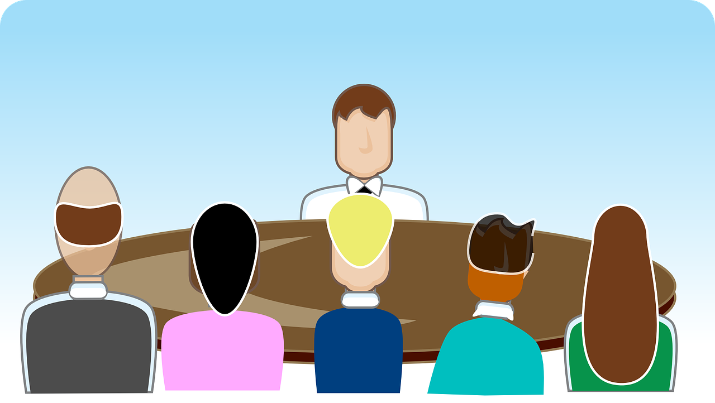
In the Room Talk
After shaking hands, stand behind a chair until you are invited to sit down, or politely ask where they’d like you to sit.
Do not place personal items on the table.
You may place a portfolio or notepad and pen in front of you.
If offered a beverage, decline politely.
Sit up straight.
Notes:
In the Room Talk
After shaking hands, stand behind a chair until you are invited to sit down, or politely ask where the interviewer would like you to sit.
Do not place personal items on the table–no cell phones, handbags, briefcases, water bottles or coffee cups.
You may place a portfolio or notepad and pen in front of you.
If a beverage is offered, decline politely.
Sit up straight.

Slide 11
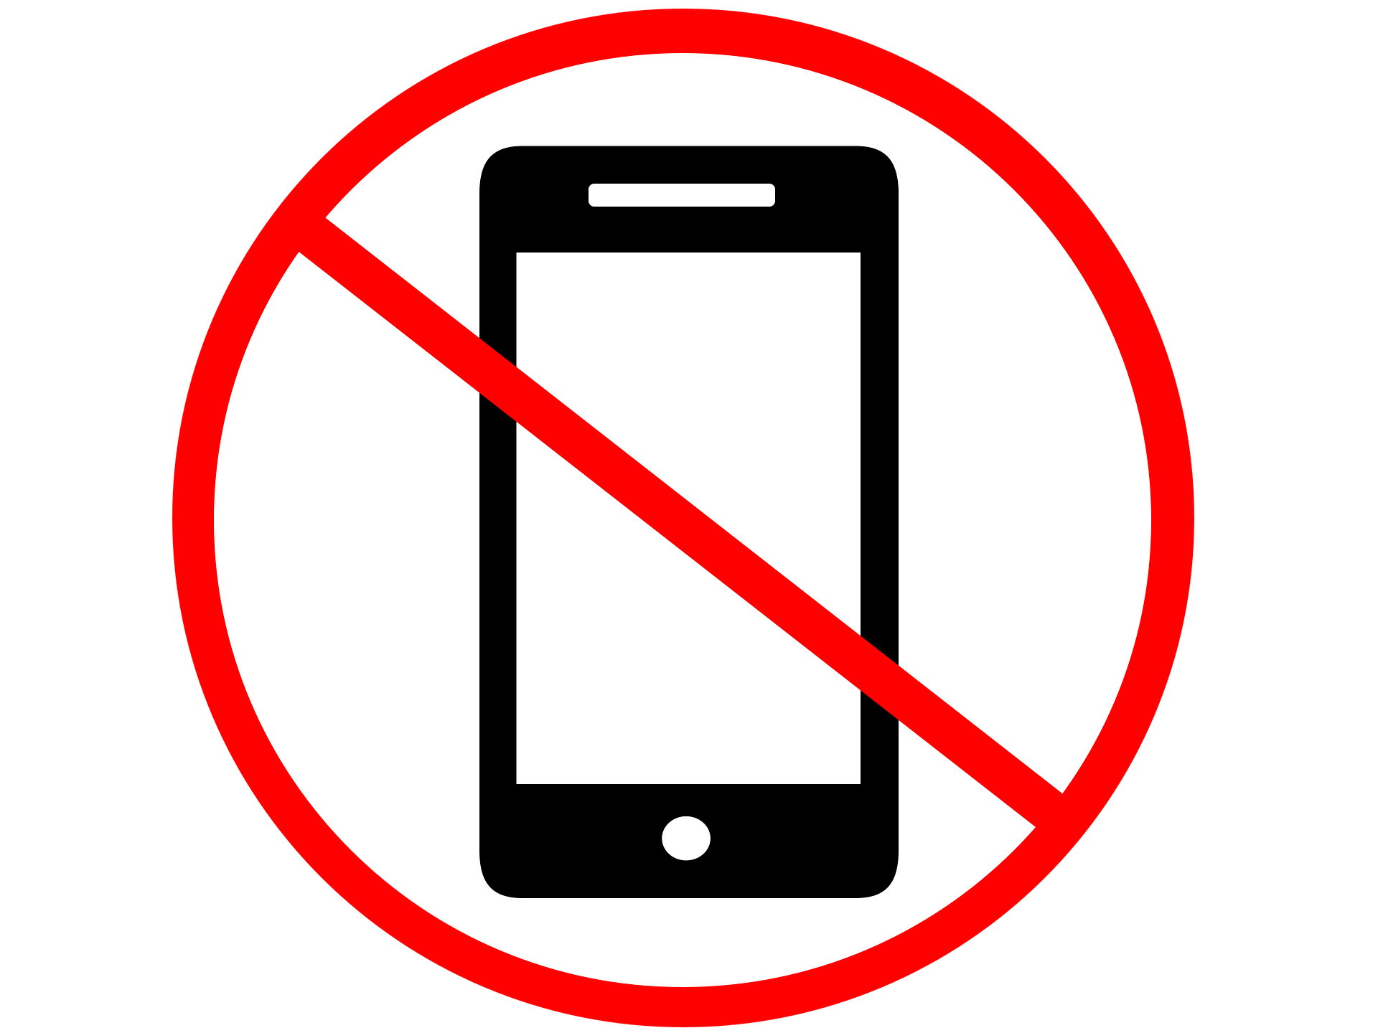
Cell Phones
Avoid embarrassing mishaps.
Turn Cell Phone Off (not on vibrate).
No exceptions!

Slide 12
End of Interview
Reiterate your interest in the position, and thank the individual or group.
You may request the time frame for filling the position and notifying candidates.
Make eye contact, shake hands with everyone, use their name as you shake hands.
If possible, thank the individual who greeted and escorted you when you arrived.
Keep a smile on your face and your cell phone off until you’re out of the building.
Notes:
End of Interview
When the interview is over, reiterate your interest in the position (if sincere), and thank the group for spending time with you.
You may ask about the time frame for filling the job and notifying candidates.
Make eye contact, shake hands with everyone in the room and try to use the name of each individual as you shake hands.
If Possible, thank the individual who greeted you when you arrived or who escorted you into the interview room. This is not a strategy, just good manners.
Keep a smile on your face and your cell phone turned off until you leave the building.

Slide 13
After the Interview
Send a thank you note to each person on the interview panel within 24-48 hrs.
You may send interviewers a quick thank you email, if you think your note will take too long.
Hand-written notes are a better choice and shows your good manners.

Slide 14
For more on this topic…
Top 10 Interview Etiquette Tips https://www.thebalance.com/top-job-interview-etiquette-tips-2061360
Top 10 Rules of Interview Etiquette https://www.themuse.com/advice/the-10-rules-of-interview-etiquette
Top 10 Interview Tips from a Business Etiquette Professional https://www.experience.com/advice/job-search/interviews/top-10-interview-tips-from-an-etiquette-professional/
Job Interview Etiquette https://www.job-interview-wisdom.com/interview-etiquette.html
Notes:
For more on this topic… use the links provided…
Top 10 Interview Etiquette Tips https://www.thebalance.com/top-job-interview-etiquette-tips-2061360
Top 10 Rules of Interview Etiquette https://www.themuse.com/advice/the-10-rules-of-interview-etiquette
Top 10 Interview Tips from a Business Etiquette Professional https://www.experience.com/advice/job-search/interviews/top-10-interview-tips-from-an-etiquette-professional/
Job Interview Etiquette https://www.job-interview-wisdom.com/interview-etiquette.html

Slide 15
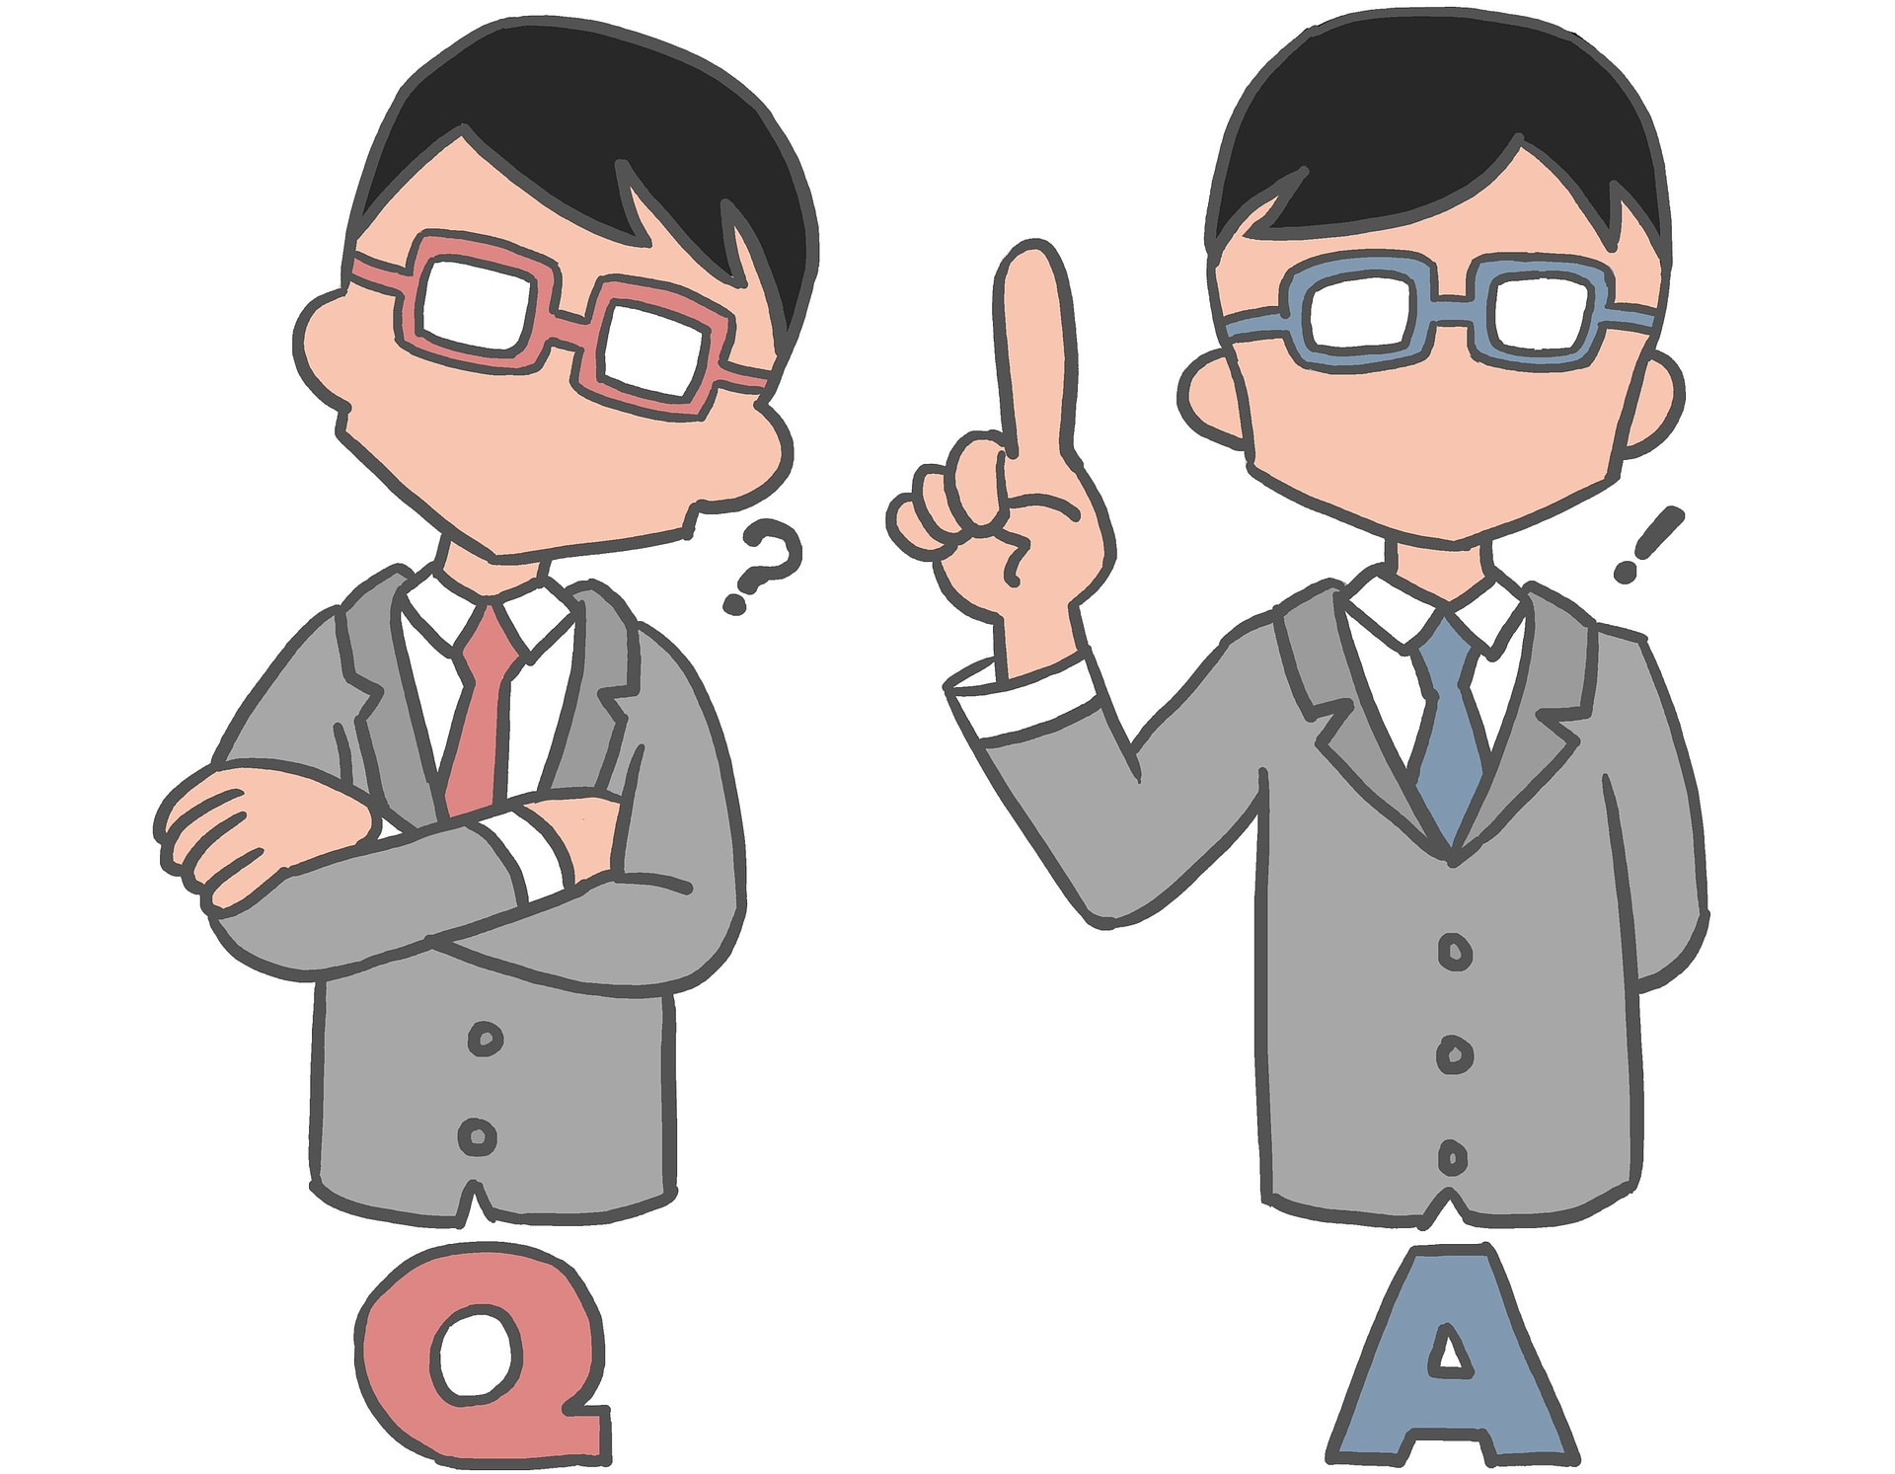
Questions
Notes:
Questions

