Slide 1
Numerical Integration
trapezoidal rule
Simpson’s Rule

Slide 2
Trapezoidal rule:
In mathematics, and more specifically in numerical analysis, the trapezoidal rule, also known as the trapezoid rule or trapezium rule, is a technique for approximating the definite integral.
The trapezoidal rule works by approximating the region under the graph of the function f(x) as a trapezoid and calculating its area

Slide 3
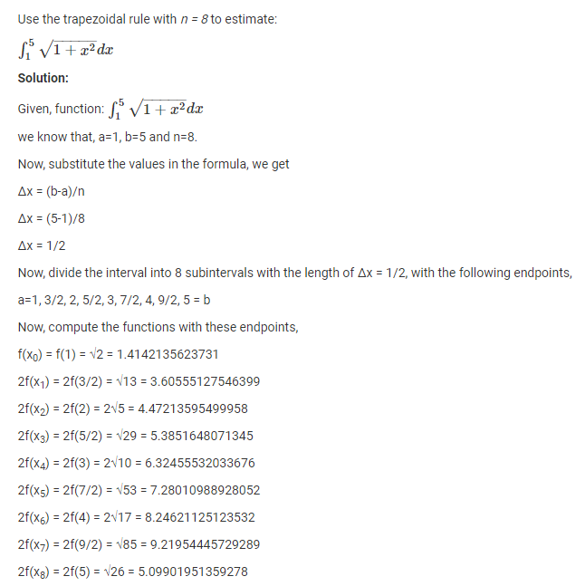
Example:

Slide 4
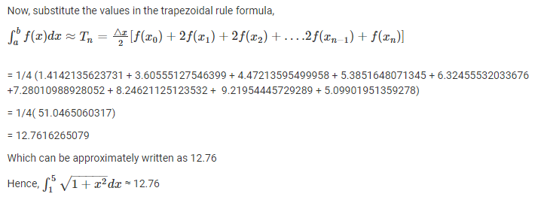

Slide 5
