Slide 1
STRATEGIC MARKETING PROCESS
The strategic marketing process is a deliberate series of steps to help you identify and reach your goals, and discover what your customers want and develop products that meet those needs.

Slide 2
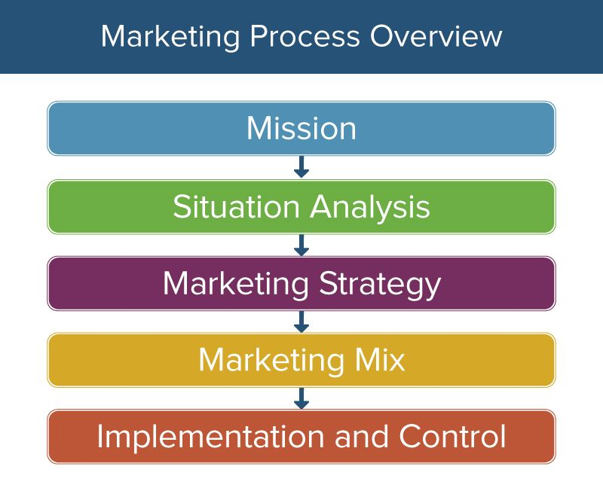

Slide 3
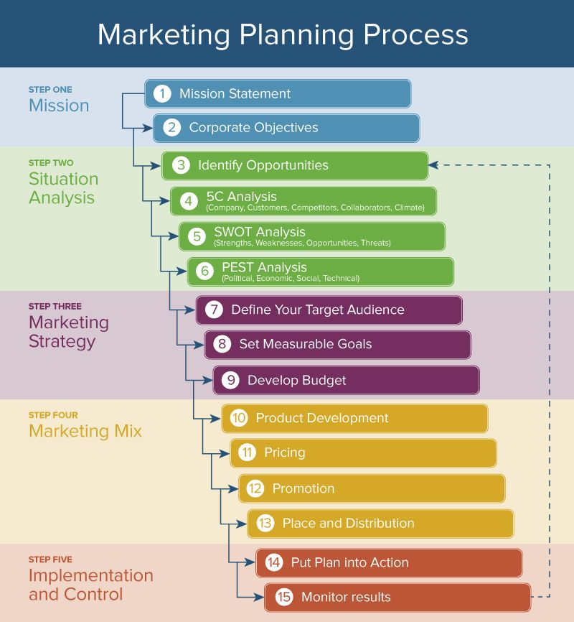

Slide 4
STEP 1: MISSION
First, identify and understand the company’s mission. Maybe it’s written down and promoted throughout the organization. If not, talk to stakeholders to find out why your company exists. A mission statement explains why a company is in business and how it can benefit consumers.
The mission statement is a core message that guides and influences your marketing strategy

Slide 5
STEP TWO: SITUATION ANALYSIS
The second step of the strategic marketing process is to evaluate internal and external factors that affect your business and market.
Your analysis will check your strengths and the challenges you face either with internal resources or with external competition in the marketplace.
Situation analysis provides a clear, objective view of the health of your business, your current and prospective customers, industry trends, and your company’s position in the marketplace.
Identifying opportunities to satisfy unfulfilled customer needs
Before identifying customer needs, firms needs to understand its own capabilities in which its operating.

Slide 6
Firms need to analyze the external and internal environment.( macro & micro environment )
Situation analysis should include past, present and future aspects.
Framework that can be used to add structure to the situation analysis
5C analysis – Company. Customers, competitors, Collaborators climate. Company covers internal situation and the rest external situation
PEST analysis – political, economic, social and technological
SWOT analysis – Strength, weaknesses, opportunity and threat

Slide 8
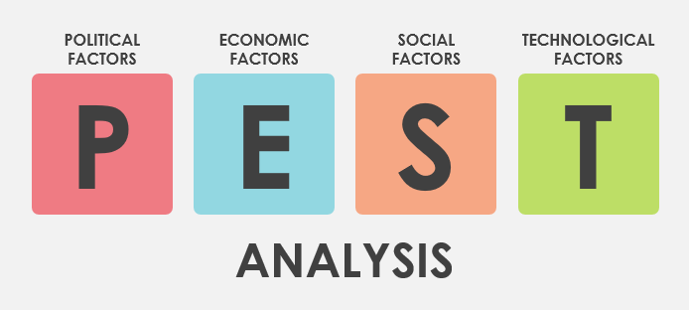
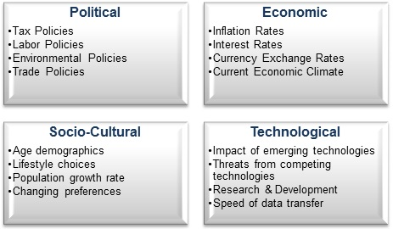

Slide 10
STEP 3: MARKETING PLAN
Now that you’ve identified opportunities through your analysis, you should prioritize and map out which ones you are going to pursue. Writing a marketing plan will specify your target customers and how you will reach them, and should also include a forecast of the anticipated results.

Slide 11
Define Your Target Audience
Few companies can meet the needs and wants of the entire market. You want to split the market into a segment that aligns best with your strengths and opportunities. Your goal is to identify customers. You can select your target market by choosing all kinds of characteristics, behaviors, and demographics.

Slide 13
STEP 4: DEVELOPING MARKETING MIX DECISIONS
Marketing Mix decisions falls into 4 controllable categories
Product- Brand name, quality, styling, safety packaging
Price– Pricing strategy, flexibility, discrimination
Place- distribution channel, centers, members
Promotion – Promotional campaign development, advertising, sales promotion.

Slide 14
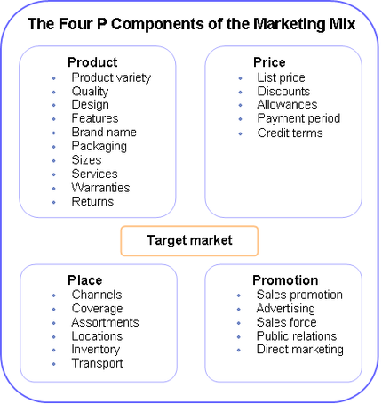

Slide 15
STEP 5: IMPLEMENTATION AND CONTROL
At this point we assume that the marketing plan has been developed and the product has been launched.
As the market changes, marketing mix can be adjusted to accommodate the changes either changing the advertising message or redesign the entire product entirely
Implementation is needed to accommodate these changes and continual monitoring us needed to fulfill customer needs consistently.
Control makes sure that the marketing programme moves in the direction set for it.

