Slide 1
Transportation Engineering- II Lecture 6
By
Engr. Muhammad Majid Naeem
Lecturer Department of Civil Engineering
Iqra National University, Peshawar

Slide 2
Horizontal Alignment
The alignment of a highway is composed of horizontal and vertical elements
The horizontal alignment includes the straight (tangent) sections of the roadway and the circular curves that connect their change in direction
The vertical alignment includes straight (tangent) highway grades and the parabolic curves that connect these grades

Slide 3
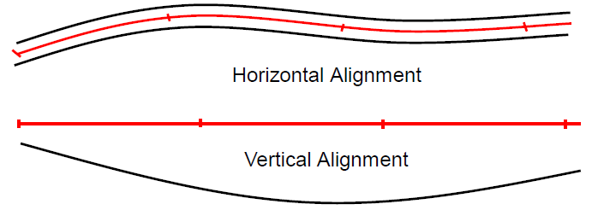
Horizontal Alignment
Highway Location of points is either done by Coordinate system or by Stationing
Instead of using the coordinates system, highway positioning and length are defined as the distance usually measured along the center line of the highway from a specified point
The notation for stationing distance is such that a point on highway 4250 ft (1295.3 m) from a specified origin (0+00 or 0+000) is said to be at station:
42+50 ft (42 stations and 50 feet)
1+295.300 meter( 1 station and 295.300 meters)

Slide 4
Horizontal Alignment
The horizontal alignment consists of straight sections of the road (known as tangents) connected by curves
The curves are usually segments of circles, which have radii that will provide for a smooth flow of traffic
The critical design feature of horizontal alignment is the horizontal curve that transitions the roadway between two straight (tangent) sections.
Highway engineers must design a horizontal alignment to accommodate the cornering capability of a variety of vehicles (cars to combination trucks)

Slide 5
Horizontal Alignment

Slide 6
Horizontal Alignment

Slide 7
Horizontal Alignment
The design of the horizontal alignment entails the determination of:
The minimum radius of the curve
Determination of the length of the curve
Side friction factor
Super elevation
Adequate stopping sight distance

Slide 8
Horizontal Alignment
To achieve balance in highway design, all geometric elements should, as far as economically practical, be designed to operate at a speed likely to be observed under the normal conditions for that roadway for a vast majority of motorists
Generally, this can be achieved through the use of design speed as an overall design control

Slide 9
Concept of Super-elevation
Centrifugal force and Centripetal Forces
Centrifugal force (Latin for "center fleeing") describes the tendency of an object following a curved path to fly outwards, away from the center of the curve. It's not really a force; it results from inertia i.e. the tendency of an object to resist any change in its state of rest or motion
Example: Mud flying off a tire; children pushed out on a roundabout
Centripetal force is a "real" force that counteracts the centrifugal force and prevents the object from "flying out", keeping it moving instead with a uniform speed along a circular path
Example: Satellite orbiting a planet

Slide 10
Concept of Super-elevation
Super-elevation or banking is the transverse slope provided at horizontal curve to counteract the centrifugal force, by raising the outer edge of the pavement with respect to the inner edge, throughout the length of the horizontal curve
This centrifugal force is sustained by:
A component of the vehicle’s weight related to the roadway
Side friction developed between the vehicle’s tires and the pavement surface
or by a combination of the two
Must be done gradually over a distance without noticeable reduction in speed or safety

Slide 11
Concept of Super-elevation

Slide 12
Concept of Super-elevation
Forces acting on a vehicle on horizontal curve of radius R (m) at a speed of V m/sec^2
P = centrifugal force acting horizontally out-wards through the center of gravity
W = weight of the vehicle acting down-wards through the center of gravity, and
F = friction force between the wheels and the pavement, along the surface inward

Slide 13
Concept of Super-elevation

Slide 14
Concept of Super-elevation

Slide 15
Maximum Super-elevation
The maximum rates of super elevation used on highways are controlled by four factors:
Climate conditions: (i.e., frequency and amount of snow and ice)
Terrain conditions (i.e., flat, rolling, or mountainous)
Type of area (i.e., rural or urban)
Frequency of very slow-moving vehicles whose operation might be affected by high super elevation rates

Slide 16
Maximum Super-elevation
AASHTO recommends the use of maximum super elevation rates between 4% and 12%. For design purposes, only increments of 2% are used
The highest super elevation rate for highways in common use is 10 percent, although 12 percent is used in some cases.
Drivers feel uncomfortable on sections with higher rates, and driver effort to maintain lateral position is high when speeds are reduced on such curves

Slide 17
Maximum Super-elevation
Super elevation rates above 8 percent are only used in areas without snow and ice. Many agencies use this as an upper limit regardless, due to the effect of rain or mud on highways. Ice on the road can reduce friction force and vehicle travelling at less than the design speed on the excessively super elevated curve slide inward off the curve due to gravitational forces.
In urban areas, where speeds may be reduced frequently due to congestion, maximum rates of 4%-6% are often used
On low-speed urban streets or at intersections, super elevation may be eliminated

Slide 18
Side-Friction Factor
Important factors affecting side friction factor
Speed of the vehicle (f decreases as speed increases (less tire/pavement contact))
The type and condition of the roadway surface
Type and condition of the vehicle tires
The side friction factors vary with the design speed from 0.40 at 15 km/h [0.38 at 10 mph] to 0.14 at 80 km/h [50 mph] to 0.08 at 130 km/h [80 mph].

Slide 19
Side-Friction Factor

Slide 20
Side-Friction Factor

Slide 21
Super elevation Example -1
A roadway is being designed for a speed of 70 mi/h. At one horizontal curve, it is known that the super elevation is 8.0% and the coefficient of side friction is 0.10. Determine the minimum radius of curve (measured to the traveled path) that will provide for safe vehicle operation

Slide 22
Super elevation Example -2
Determine the proper super elevation rate for an urban highway with a design speed of 50 mph and degree of curvature of 8 degrees
R = 5729.6/D
R in feet, D in degrees

Slide 23
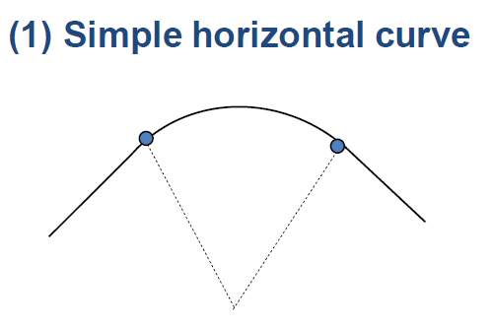
Horizontal Curves - Types of Curves
Horizontal Curves: curves used in horizontal planes to connect two straight tangent sections.
Simple Curve: circular arc connecting two tangents

Slide 24
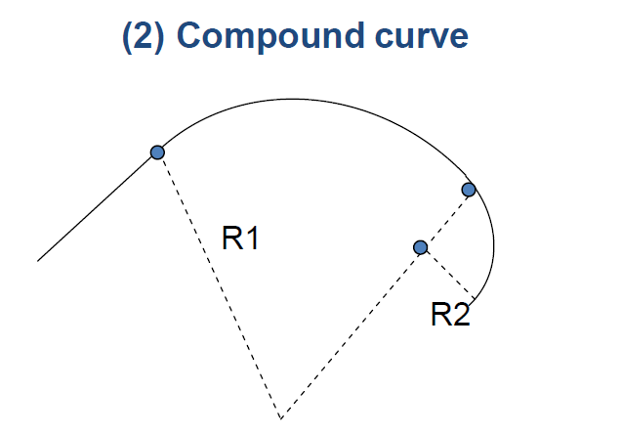
Horizontal Curves - Types of Curves
Compound Curve: a curve which is composed of two or more circular arcs of different radii, with centers on the same side of the alignment
Compound curves are used to fit horizontal curves to very specific alignment needs …..interchange ramps, intersection curves etc.
Radii should not be very different- difficult for drivers to maintain lane position as they transition from one to another curve

Slide 25
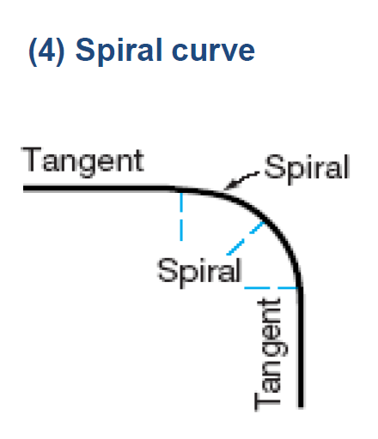
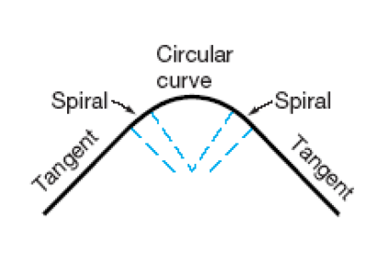
Horizontal Curves - Types of Curves
Spiral Curve: A curve with constantly changing radius
A curve whose radius decreases uniformly from infinity at the tangent to that of the curve it meets.

Slide 26
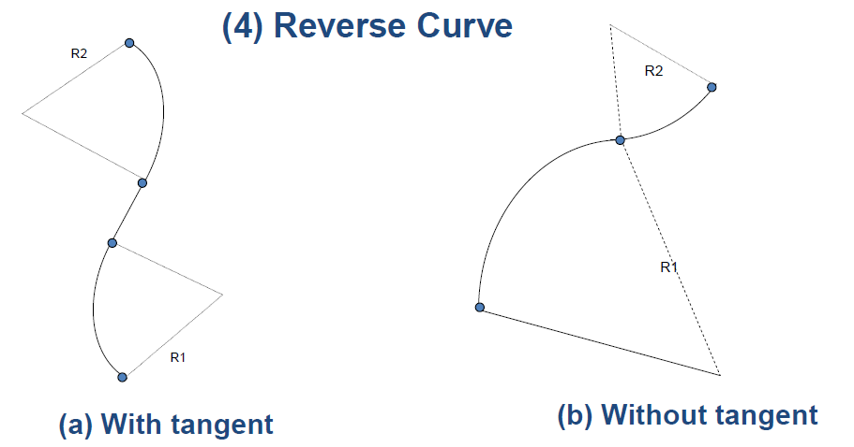
Horizontal Curves - Types of Curves
Reverse Curve: Two circular arcs tangent to each other, with their centers on opposite sides of the alignment
Two consecutive curves that turn in opposite direction
Not recommended- drivers may find it difficult to stay in their lane as a result of sudden change in alignment.

Slide 27
Tangent and Curves

Slide 28
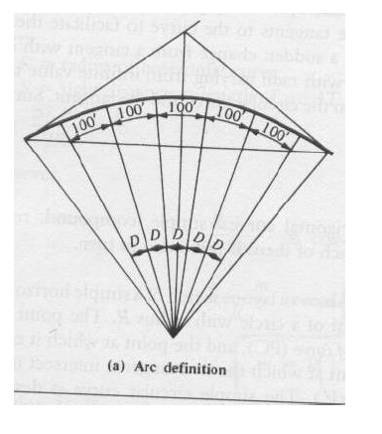
Properties of Circular Curves
Degree of Curvature
Traditionally, the “steepness” of the curvature is defined by either the radius (R) or the degree of curvature (D)
Degree of curvature = angle subtended by an arc of length 100 feet

Slide 29
Properties of Circular Curves
Degree of curvature = angle subtended by an arc of length 100 feet
By simple ratio: D/360 = 100/2*Pi*R
Therefore
R = 5730 / D
D = Degree of curvature - degrees
R = Radius of curvature - feet

Slide 30
Length of Curve
Length of Curve: The length of the curve derives directly from the arc definition of degree of curvature
A central angle equal to the degree of curvature subtends an arc of 100 ft, while the actual central angle (Δ) subtends the length of the curve (L).
By simple ratio
D/100=Δ/L
L = 100 Δ / D
Or (from R = 5730 / D, substitute for D = 5730/R)
L = Δ R / 57.30

Slide 31
Horizontal Curves Fundamentals -Layout

Slide 32
Horizontal Curves Fundamentals -Layout

Slide 33
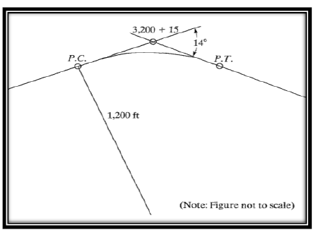
Horizontal Curves – Example
Two tangent lines meet at Station 3,200 + 15. The radius of curvature is 1,200 ft, and the angle of deflection is 14◦. Find the length of the curve, the stations for the P.C. and P.T , and all other relevant characteristics of the curve (L.C., M, E).

