Slide 1
STATIC ELECTRICITY

Slide 2
Overview
Static electricity occurs when there is a build up of electric charge on the surface of a material.
It is called static electricity because the charges don’t move.
The electricity we use everyday involves moving charges.
Static = Charge does not move or flow

Slide 3
After being rubbed, a plastic ruler can attract paper scraps.
Ruler carries electric charge.
It exerts electric force on paper.
This charging method is called charging by friction.
The interaction between static electric charges is called electrostatics.

Slide 4
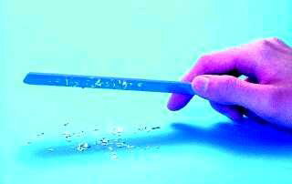

Slide 5
Example
When a balloon rubs a piece of wool, electrons are pulled from the wool. The balloon has more electrons than usual.
The balloon = - charged
The wool = + charged
Rubbing materials does NOT create electric charges. It just transfers electrons from one material to the other.

Slide 6
Example
Rubbing a balloon on your hair
Walking across carpet
Comb attracting pieces of paper

Slide 7
Example
Combing transfers electrons from the hair to the comb by friction, resulting in a negative charge on the comb and a positive charge on the hair.
Charged and neutral objects (not touching) are attracted because electrons move in the neutral object.
Electrons move toward a +ve charged object and away from a –ve charged one. This is called “induced charge

Slide 8
Charging by Induction
An understanding of charging by induction requires an understanding of the nature of a conductor and an understanding of the polarization process.
Polarization : This can be easily explained by an example. An aluminum pop can that is taped to a Styrofoam cup. The Styrofoam cup serves as both an insulating stand and a handle.
A rubber balloon is charged negatively, perhaps by rubbing it against animal fur. If the negatively charged balloon is brought near the aluminum pop can, the electrons within the pop can will experience a repulsive force.

Slide 9
Cont..
The repulsion will be greatest for those electrons that are nearest the negatively charged balloon. Many of these electrons will be induced into moving away from the repulsive balloon.
Being present within a conducting material, the electrons are free to move from atom to atom.
As such, there is a mass migration of electrons from the balloon's side of the aluminum can towards the opposite side of the can.
This electron movement leaves atoms on the balloon's side of the can with a shortage of electrons; they become positively charged

Slide 10
Cont..
And the atoms on the side opposite of the can have an excess of electrons; they become negatively charged. The two sides of the aluminum pop can have opposite charges.
Overall the can is electrically neutral; it's just that the positive and negative charge has been separated from each other. We say that the charge in the can has been polarized.

Slide 11
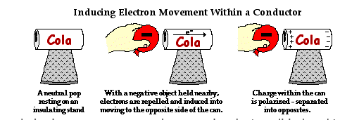
Polarization

Slide 12
Charging by conduction
Charging by conduction involves the contact of a charged object to a neutral object.
Suppose that a positively charged aluminum plate is touched to a neutral metal sphere. The neutral metal sphere becomes charged as the result of being contacted by the charged aluminum plate.
Or suppose that a negatively charged metal sphere is touched to the top plate of a neutral needle electroscope. The neutral electroscope becomes charged as the result of being contacted by the metal sphere.

Slide 13
Cont..
And finally, suppose that an uncharged DPT student stands on an insulating platform and touches a negatively charged generator. The neutral DPT student becomes charged as the result of contact with the generator.
Each of these examples involves contact between a charged object and a neutral object. In contrast to induction, where the charged object is brought near but never contacted to the object being charged, conduction charging involves making the physical connection of the charged object to the neutral object.
Because charging by conduction involves contact, it is often called charging by contact.

Slide 14
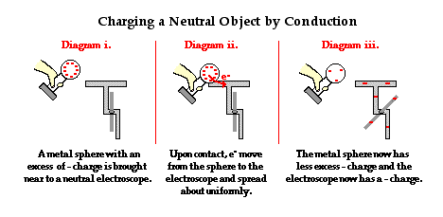
Charging by Conduction Using a Negatively Charged Object

Slide 15
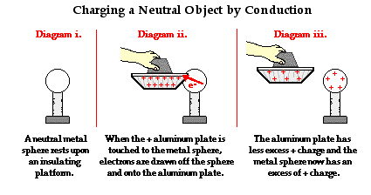
Charging by Conduction Using a Positively Charged Object

Slide 16
Goldleaf electroscope (Video)
https://www.youtube.com/watch?v=Iu6QCvQCkMc

Slide 17
Dear Doctors
THANKYOU

