Slide 1
Equations with
SEPARABLE VARIABLES

Slide 2
Definition:
A differential equation of the form
M(x) + N(y) = 0
Where,
M(x) is a pure function of x
&
N(y) is a pure function of y
is called separable equation.

Slide 3
Question:
Find the general solution of each differential
equation and when initial conditions are given.

Slide 4
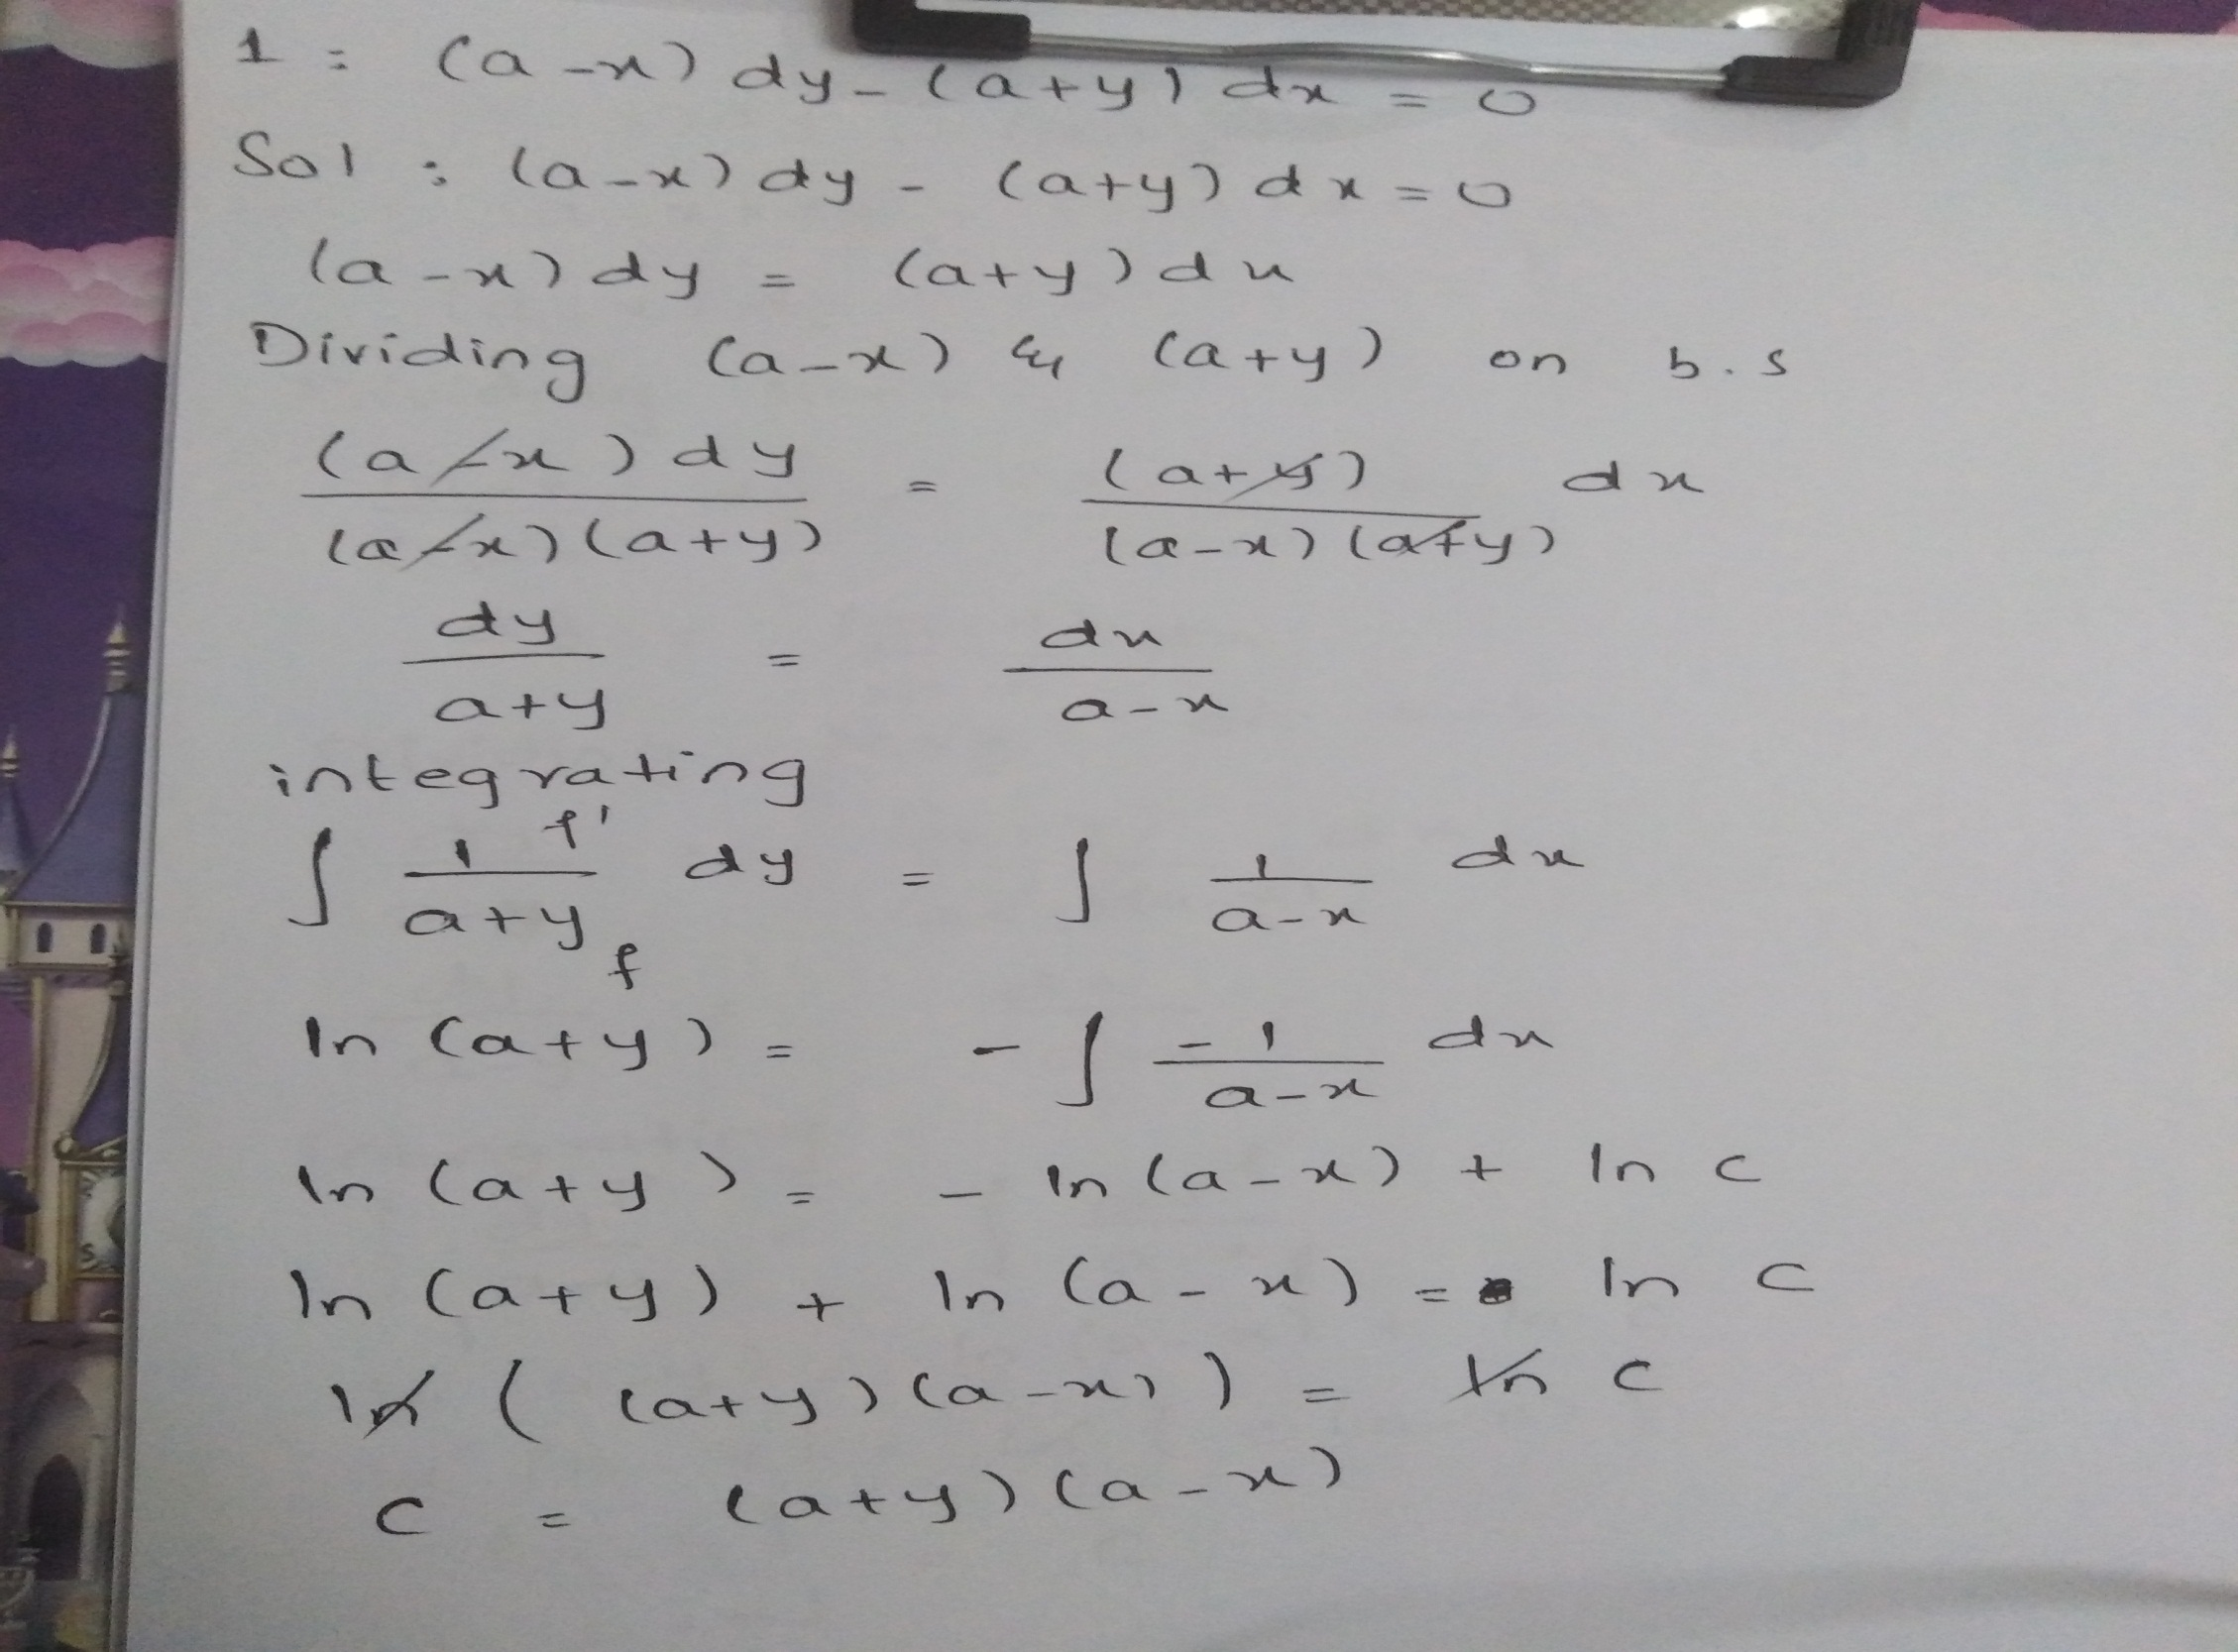

Slide 5
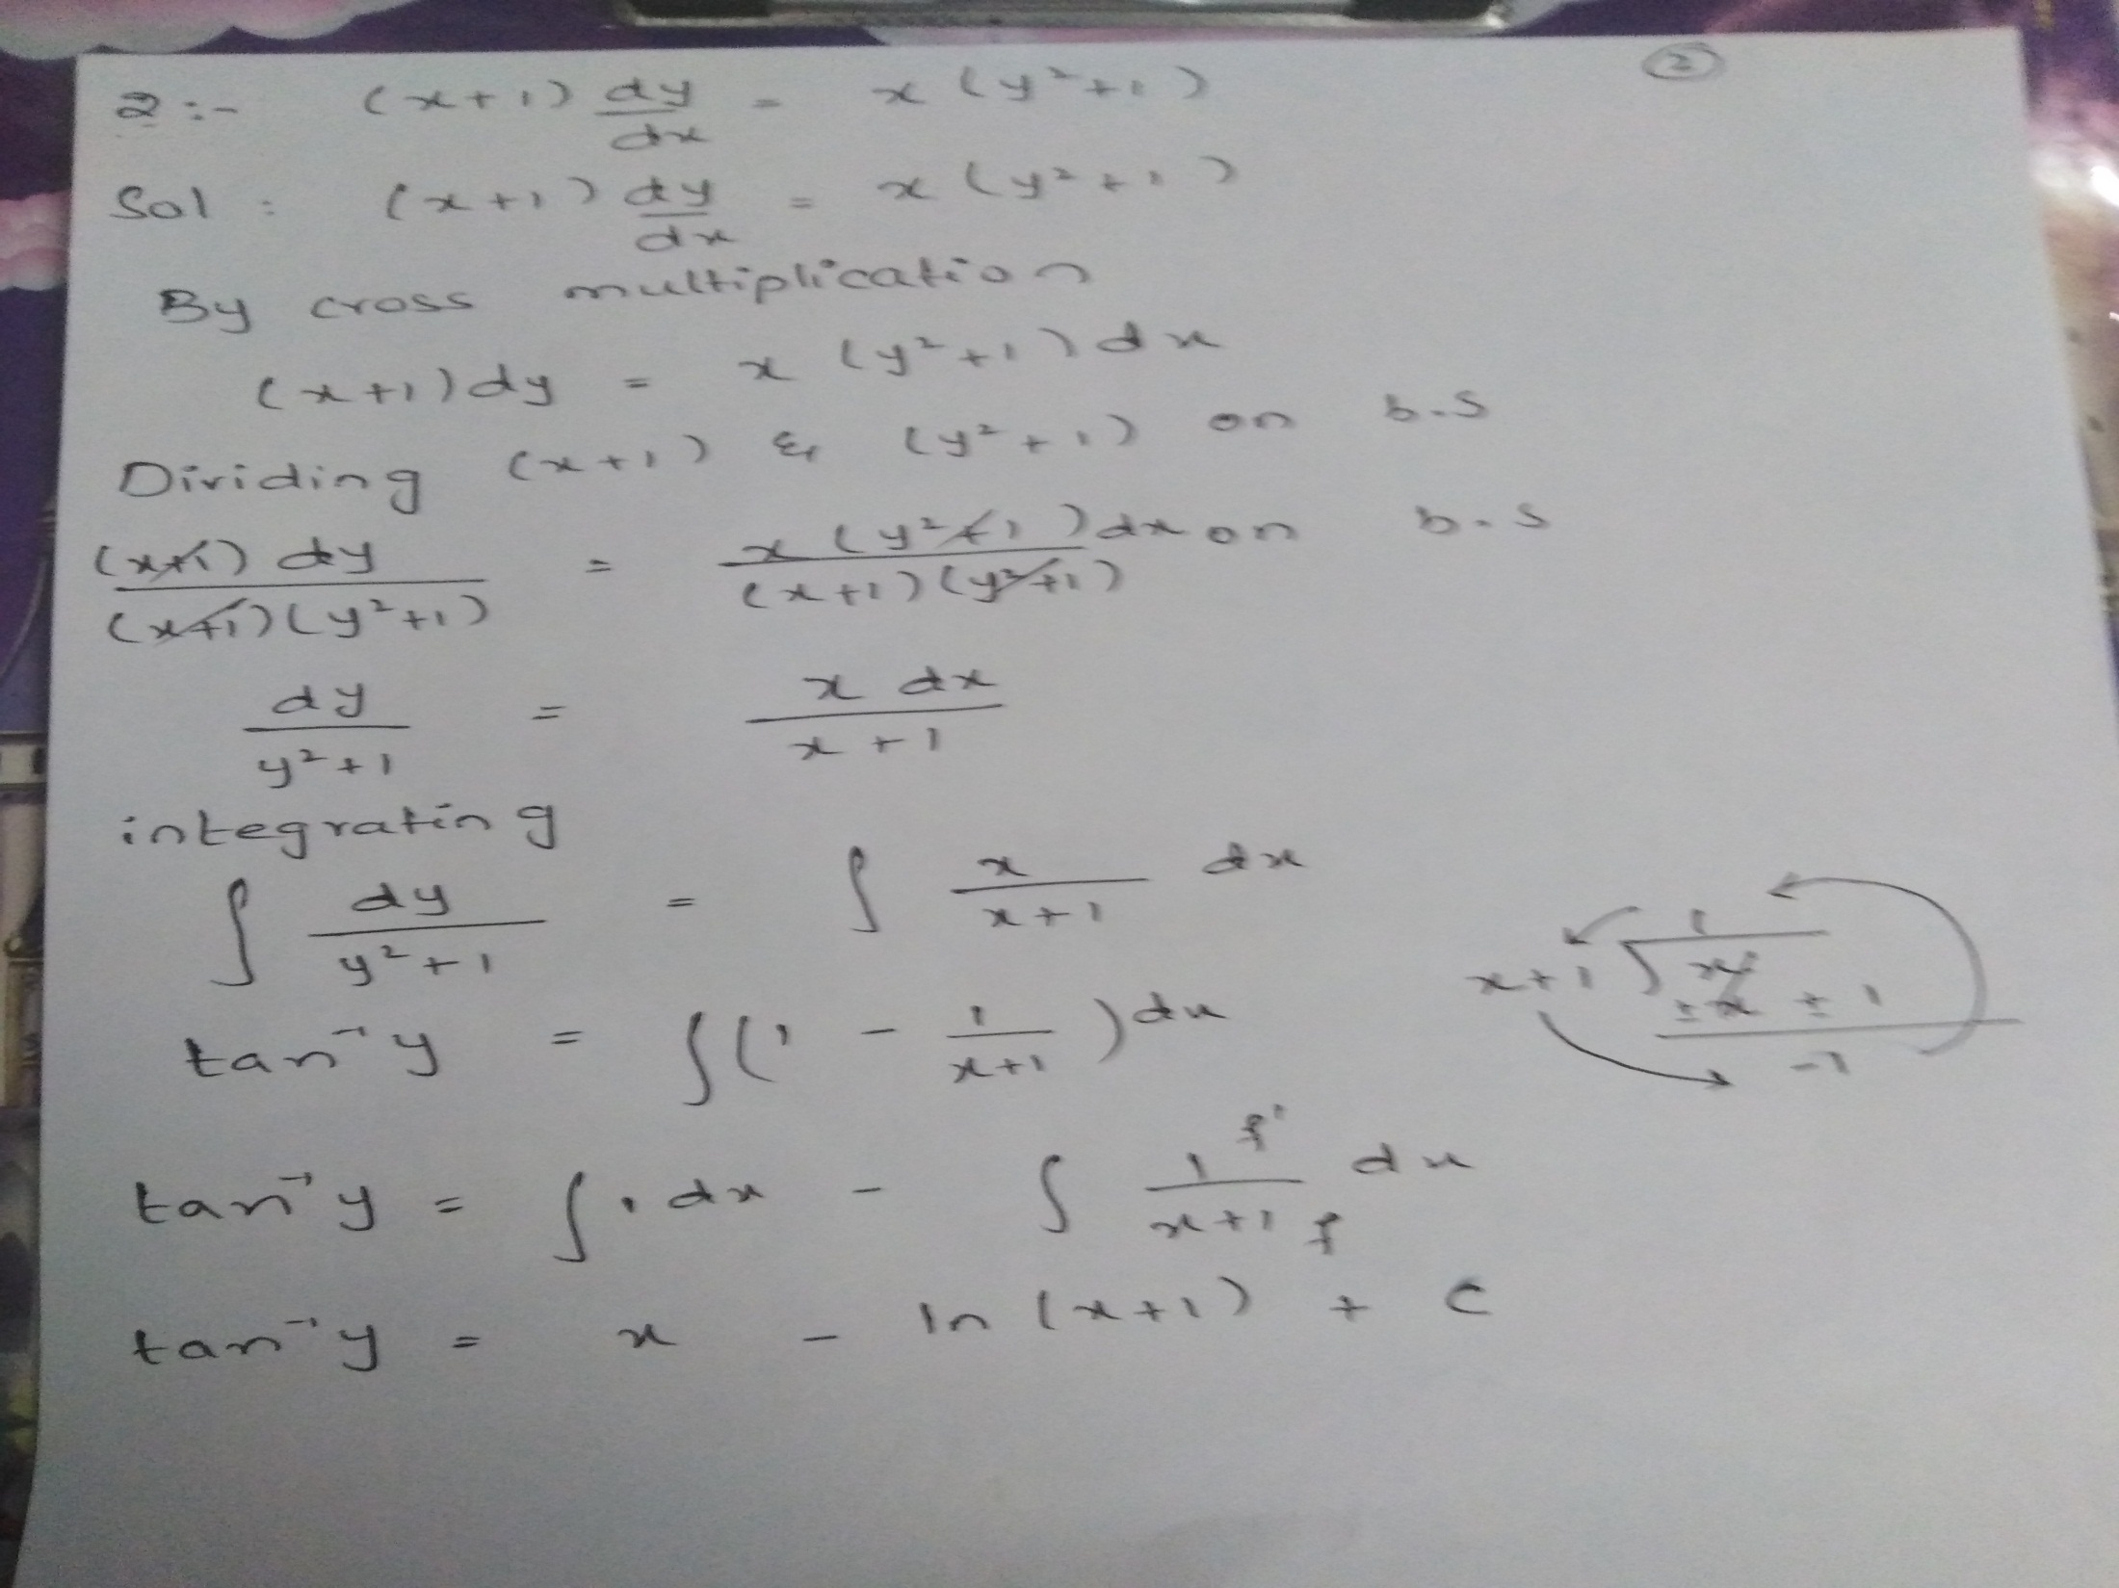

Slide 6
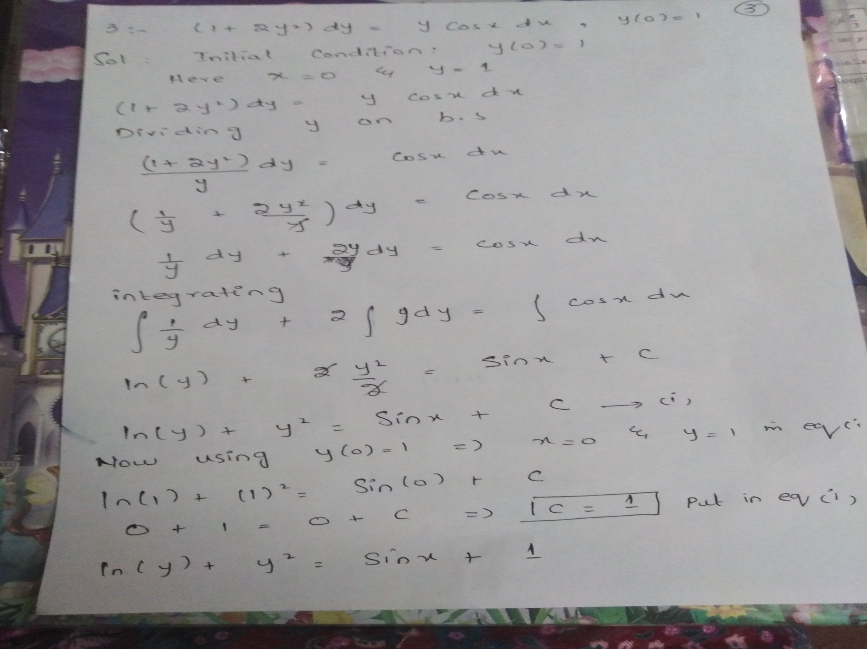

Slide 7
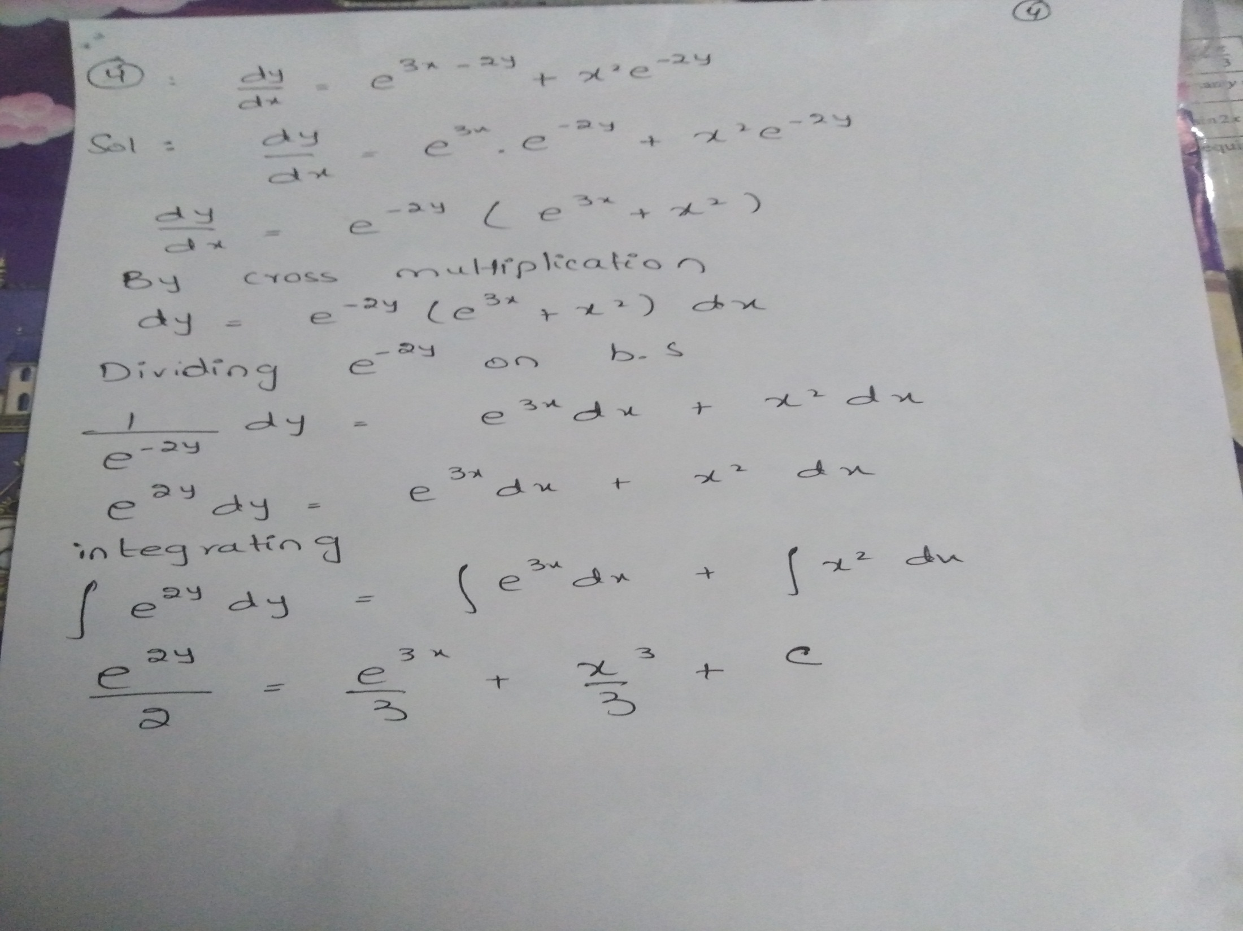

Slide 8
PRACTICE QUESTIONS

Slide 9
