Slide 1
The Problems with our Requirements Practices
We have trouble understanding the requirements that we do acquire from the customer
We often record requirements in a disorganized manner
We spend far too little time verifying what we do record
We allow change to control us, rather than establishing mechanisms to control change
Most importantly, we fail to establish a solid foundation for the system or software that the user wants built
(more on next slide)

Slide 2
The Problems with our Requirements Practices (continued)
Many software developers argue that
Building software is so compelling that we want to jump right in (before having a clear understanding of what is needed)
Things will become clear as we build the software
Project stakeholders will be able to better understand what they need only after examining early iterations of the software
Things change so rapidly that requirements engineering is a waste of time
The bottom line is producing a working program and that all else is secondary
All of these arguments contain some truth, especially for small projects that take less than one month to complete
However, as software grows in size and complexity, these arguments begin to break down and can lead to a failed software project

Slide 3
A Solution: Requirements Engineering
Begins during the communication activity and continues into the modeling activity
Builds a bridge from the system requirements into software design and construction
Allows the requirements engineer to examine
the context of the software work to be performed
the specific needs that design and construction must address
the priorities that guide the order in which work is to be completed
the information, function, and behavior that will have a profound impact on the resultant design

Slide 4
Requirements Engineering Tasks
Seven distinct tasks
Inception
Elicitation
Elaboration
Negotiation
Specification
Validation
Requirements Management
Some of these tasks may occur in parallel and all are adapted to the needs of the project
All strive to define what the customer wants
All serve to establish a solid foundation for the design and construction of the software

Slide 5
Inception
Elicitation
Elaboration
Negotiation
Specification
Validation
Requirements
Management

Slide 6
Inception Task
During inception, the requirements engineer asks a set of questions to establish…
A basic understanding of the problem
The people who want a solution
The nature of the solution that is desired
The effectiveness of preliminary communication and collaboration between the customer and the developer
Through these questions, the requirements engineer needs to…
Identify the stakeholders
Recognize multiple viewpoints
Work toward collaboration
Break the ice and initiate the communication

Slide 7
The First Set of Questions
These questions focus on the customer, other stakeholders, the overall goals, and the benefits
Who is behind the request for this work?
Who will use the solution?
What will be the economic benefit of a successful solution?
Is there another source for the solution that you need?

Slide 8
The Next Set of Questions
These questions enable the requirements engineer to gain a better understanding of the problem and allow the customer to voice his or her perceptions about a solution
How would you characterize "good" output that would be generated by a successful solution?
What problem(s) will this solution address?
Can you show me (or describe) the business environment in which the solution will be used?
Will special performance issues or constraints affect the way the solution is approached?

Slide 9
The Final Set of Questions
These questions focus on the effectiveness of the communication activity itself
Are you the right person to answer these questions? Are your answers "official"?
Are my questions relevant to the problem that you have?
Am I asking too many questions?
Can anyone else provide additional information?
Should I be asking you anything else?

Slide 10
Inception
Elicitation
Elaboration
Negotiation
Specification
Validation
Requirements
Management

Slide 11
Elicitation Task
Eliciting requirements is difficult because of
Problems of scope in identifying the boundaries of the system or specifying too much technical detail rather than overall system objectives
Problems of understanding what is wanted, what the problem domain is, and what the computing environment can handle (Information that is believed to be "obvious" is often omitted)
Problems of volatility because the requirements change over time
Elicitation may be accomplished through two activities
Collaborative requirements gathering
Quality function deployment

Slide 12
Collaborative Requirements Gathering
Meetings are conducted and attended by both software engineers, customers, and other interested stakeholders
Rules for preparation and participation are established
An agenda is suggested that is formal enough to cover all important points but informal enough to encourage the free flow of ideas
A "facilitator" (customer, developer, or outsider) controls the meeting
A "definition mechanism" is used such as work sheets, flip charts, wall stickers, electronic bulletin board, chat room, or some other virtual forum
The goal is to identify the problem, propose elements of the solution, negotiate different approaches, and specify a preliminary set of solution requirements

Slide 13
Quality Function Deployment
This is a technique that translates the needs of the customer into technical requirements for software
It emphasizes an understanding of what is valuable to the customer and then deploys these values throughout the engineering process through functions, information, and tasks
It identifies three types of requirements
Normal requirements: These requirements are the objectives and goals stated for a product or system during meetings with the customer
Expected requirements: These requirements are implicit to the product or system and may be so fundamental that the customer does not explicitly state them
Exciting requirements: These requirements are for features that go beyond the customer's expectations and prove to be very satisfying when present

Slide 14
QFD process (1)
The basic idea of QFD is to construct relationship matrices between customer needs, technical requirements, priorities and (if needed) competitor assessment.
To achieve this the following process is prescribed:
Identify stakeholder’s attributes or requirements
Identify technical features of the requirements
Relate the requirements to the technical features
Conduct an evaluation of competing products
Evaluate technical features and specify a target value for each feature
Prioritize technical features for development effort.

Slide 15
RE Tasks (Cont…)
Inception
Elicitation
Elaboration
Negotiation
Specification
Validation
Requirements
Management

Slide 16
Quality Function Deployment
This is a technique that translates the needs of the customer into technical requirements for software
It emphasizes an understanding of what is valuable to the customer and then deploys these values throughout the engineering process through functions, information, and tasks
It identifies three types of requirements
Normal requirements: These requirements are the objectives and goals stated for a product or system during meetings with the customer
Expected requirements: These requirements are implicit to the product or system and may be so fundamental that the customer does not explicitly state them
Exciting requirements: These requirements are for features that go beyond the customer's expectations and prove to be very satisfying when present

Slide 17
Elicitation Work Products
The work products will vary depending on the system, but should include one or more of the following items
A statement of need and feasibility
A bounded statement of scope for the system or product
A list of customers, users, and other stakeholders who participated in requirements elicitation
A description of the system's technical environment
A list of requirements (organized by function) and the domain constraints that apply to each
A set of preliminary usage scenarios (in the form of use cases) that provide insight into the use of the system or product under different operating conditions
Any prototypes developed to better define requirements

Slide 18
Inception
Elicitation
Elaboration
Negotiation
Specification
Validation
Requirements
Management

Slide 19
Elaboration Task
During elaboration, the software engineer takes the information obtained during inception and elicitation and begins to expand and refine it
Elaboration focuses on developing a refined technical model of software functions, features, and constraints
It is an analysis modeling task
Use cases are developed
Domain classes are identified along with their attributes and relationships
State machine diagrams are used to capture the life on an object
The end result is an analysis model that defines the functional, informational, and behavioral domains of the problem

Slide 20
Developing Use Cases
Step One – Define the set of actors that will be involved in the story
Actors are people, devices, or other systems that use the system or product within the context of the function and behavior that is to be described
Actors are anything that communicate with the system or product and that are external to the system itself
Step Two – Develop use cases, where each one answers a set of questions

Slide 21
Questions Commonly Answered by a Use Case
Who is the primary actor(s), the secondary actor(s)?
What are the actor’s goals?
What preconditions should exist before the scenario begins?
What main tasks or functions are performed by the actor?
What exceptions might be considered as the scenario is described?
What variations in the actor’s interaction are possible?
What system information will the actor acquire, produce, or change?
What information does the actor desire from the system?
Does the actor wish to be informed about unexpected changes?

Slide 22
Elements of the Analysis Model
Scenario-based elements
Describe the system from the user's point of view using scenarios that are depicted in use cases and activity diagrams
Class-based elements
Identify the domain classes for the objects manipulated by the actors, the attributes of these classes, and how they interact with one another; they utilize class diagrams to do this

Slide 23
Elements of Analysis Model
Behavioral elements
Use state diagrams to represent the state of the system, the events that cause the system to change state, and the actions that are taken as a result of a particular event; can also be applied to each class in the system
Flow-oriented elements
Use data flow diagrams to show the input data that comes into a system, what functions are applied to that data to do transformations, and what resulting output data are produced

Slide 24
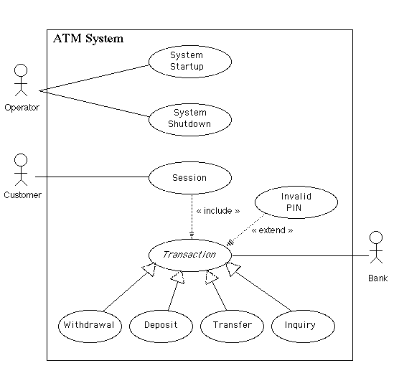
Use Case Example

Slide 25
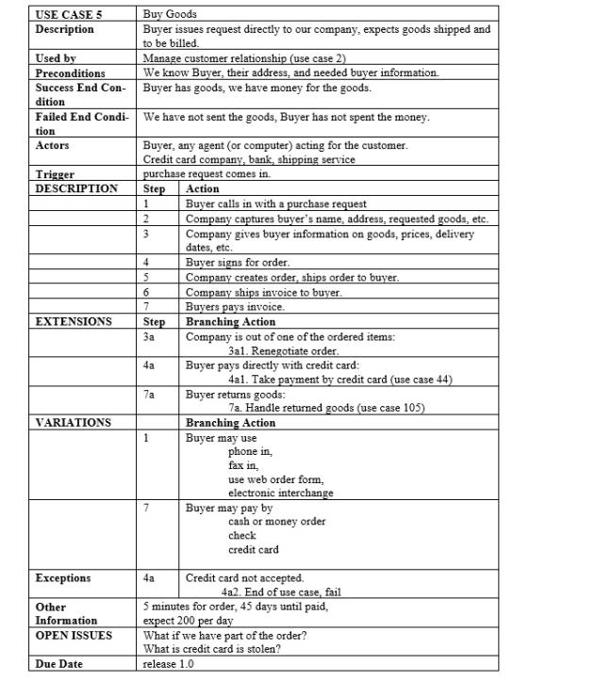
Use Case Example

Slide 26
Inception
Elicitation
Elaboration
Negotiation
Specification
Validation
Requirements
Management

Slide 27
Negotiation Task
During negotiation, the software engineer reconciles the conflicts between what the customer wants and what can be achieved given limited business resources
Requirements are ranked (i.e., prioritized) by the customers, users, and other stakeholders
Risks associated with each requirement are identified and analyzed
Rough guesses of development effort are made and used to assess the impact of each requirement on project cost and delivery time
Using an iterative approach, requirements are eliminated, combined and/or modified so that each party achieves some measure of satisfaction

Slide 28
Inception
Elicitation
Elaboration
Negotiation
Specification
Validation
Requirements
Management

Slide 29
Specification Task
A specification is the final work product produced by the requirements engineer
It is normally in the form of a software requirements specification
It serves as the foundation for subsequent software engineering activities
It describes the function and performance of a computer-based system and the constraints that will govern its development
It formalizes the informational, functional, and behavioral requirements of the proposed software in both a graphical and textual format

Slide 30
Typical Contents of a Software Requirements Specification
Requirements
Required states and modes
Software requirements grouped by capabilities (i.e., functions, objects)
Software external interface requirements
Software internal interface requirements
Software internal data requirements
Other software requirements (safety, security, privacy, environment, hardware, software, communications, quality, personnel, training, logistics, etc.)
Design and implementation constraints

Slide 31
Typical Contents of a Software Requirements Specification
Qualification provisions to ensure each requirement has been met
Demonstration, test, analysis, inspection, etc.
Requirements traceability
Trace back to the system or subsystem where each requirement applies

Slide 32
Inception
Elicitation
Elaboration
Negotiation
Specification
Validation
Requirements
Management

Slide 33
Validation Task
During validation, the work products produced as a result of requirements engineering are assessed for quality
The specification is examined to ensure that
all software requirements have been stated unambiguously
inconsistencies, omissions, and errors have been detected and corrected
the work products conform to the standards established for the process, the project, and the product
The formal technical review serves as the primary requirements validation mechanism
Members include software engineers, customers, users, and other stakeholders

Slide 34
Questions to ask when Validating Requirements
Is each requirement consistent with the overall objective for the system/product?
Have all requirements been specified at the proper level of abstraction? That is, do some requirements provide a level of technical detail that is inappropriate at this stage?
Is the requirement really necessary or does it represent an add-on feature that may not be essential to the objective of the system?
Is each requirement bounded and unambiguous?
Does each requirement have attribution? That is, is a source (generally, a specific individual) noted for each requirement?

Slide 35
Questions to ask when Validating Requirements (continued)
Do any requirements conflict with other requirements?
Is each requirement achievable in the technical environment that will house the system or product?
Is each requirement testable, once implemented?
Approaches: Demonstration, actual test, analysis, or inspection
Does the requirements model properly reflect the information, function, and behavior of the system to be built?
Has the requirements model been “partitioned” in a way that exposes progressively more detailed information about the system?

Slide 36
Inception
Elicitation
Elaboration
Negotiation
Specification
Validation
Requirements
Management

Slide 37
Requirements Management Task
During requirements management, the project team performs a set of activities to identify, control, and track requirements and changes to the requirements at any time as the project proceeds
Each requirement is assigned a unique identifier
The requirements are then placed into one or more traceability tables
These tables may be stored in a database that relate features, sources, dependencies, subsystems, and interfaces to the requirements
A requirements traceability table is also placed at the end of the software requirements specification

Slide 38
Requirement tractability matrix

Slide 39
Summary
Negotiation
Specification
Validation
Requirements management

Slide 40
Inception
Elicitation
Elaboration
Negotiation
Specification
Validation
Requirements
Management

