Slide 1
CSE 303 – Software Design and Architecture
LECTURE 4 B

Slide 2
Software Design Methods

Slide 3
Software Design Methods
In a Software development process, the Software Design Methodology (SDM) refers to specific set of procedures used to manage and control the SDLC (Software Development Life Cycle).
Notes:
Procedure to control and manage SDLC. What to select or keep on

Slide 4
Software Design Methods
The choice of the SDM primarily depends upon several factors, namely,
the type of the software (such as standalone or distributed and networked; Strategic or operational etc.)
the scope of the development project (such as renovation of the existing system or new system, the number of modules involved, underlying complexity of the coding, system testing and implementation etc),
the resources constraints (such as time, money, expertise)
Notes:
Standalone update easily ram update.
Scope: 2 module vs 200 module, NASA or School Library, Single machine or server client expertise and value what to select based with these resources constraints

Slide 5
Software Design Methods
Systematic approaches to developing a software design.
Structured (Function-Oriented)
Object-Oriented
Data-Oriented (Data-structure-centered)
Component-based
Formal Methods

Slide 6
Software Design Methods
Structured Methods
Process functions are identified
Object-Oriented
develop an object model of a system
Data-Oriented
Entities are determined for each sub-system, then entity inter-relationships are examined to develop the additional entities needed to support the relationships.
Notes:
SM: bases of process function, focus on functionalities
Check functionality. Enroll, registration attendance result what is required for all these? How they will be
OO: look into object terms. Student object, attributes, behavior DO: focus on entities, and data set and their interaction account customer data

Slide 7
Software Design Methods
Component-based
Divide the system into components
Formal Methods
Requirements and programs are translated into mathematical notation
Notes:
Components vs modules difference is marketable, independent weather
FM based on Mathematical model (all above graphs and text)

Slide 8
Which method to choose?
Data oriented design is useful for systems that process lots of data, e.g. database and banking applications
Structured design is useful for process intensive systems that will be programmed using a procedural language such as C.
OO methods are useful for any system that will be programmed using an object oriented language such as C++.
Notes:
SD: focus on Functionalities and program is developed in procedural language OO: Close to real world, properties

Slide 9
Component-based Methods are used for the large systems that can be modularized.
Formal methods are considered to be an alternative to OO and classical design methods,
but their use is expensive and claims of reduced errors remain unproven.
However, the ability to formally validate the correctness of a software artifact is appealing and research on formal methods is ongoing.
Notes:
Least effect. Crash of one not effect more ambiguity. Loss of life expensive expertise why used

Slide 10
Design Paradigms

Slide 11
Software Design Paradigms
Structured Design/Function Oriented Design
Object-Oriented Design

Slide 12
Structured/Procedural Paradigm
Focus on procedures and functions.
Design the system by decomposing it based on the processes and functions.
Top-down algorithmic decomposition.
This approach separates data from procedures.

Slide 13
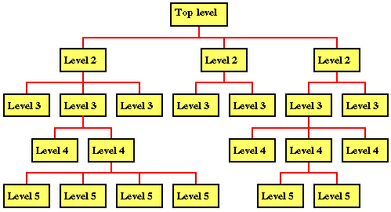

Slide 14
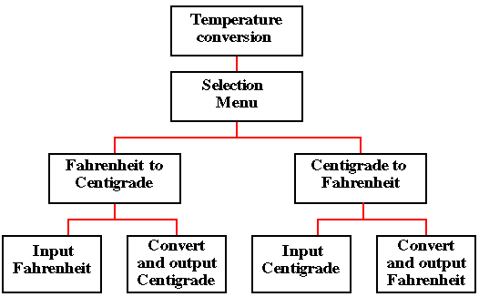
Example:

Slide 15
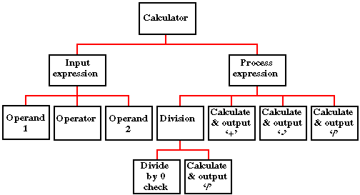

Slide 16
Drawbacks
Interdependencies between various functions and processes.
Cannot be reused easily.
Data related to each function is not attached.

Slide 17
Object-Oriented Paradigm
Describing the software solution in terms of collaborating objects, with responsibilities.
Objects,
classes,
encapsulation,
States,
inheritance,
composition,
polymorphism

Slide 18
Object-Oriented Design
Bottom-up
Encapsulate data and procedures in objects and classes.
Refinement in classes lead to a composed larger system.

Slide 19
Benefits
Enjoys all the benefits of Modular approach
Dependencies can be handled by finding the commonalities through inheritance and polymorphism.
Naturalness
OO paradigm models the real world better because everything in real world is an object.
Reusability
Using the existing classes or components in future design, without much effort.

Slide 20
If OO design is incorrect, the implementation derived from the design in an OOP language would be very complex.

Slide 21
Case Study : Fire Alarm
The owner of a large multi-stored building wants to have a computerized fire alarm system for his building.
Smoke detectors and fire alarms would be placed in each room of the building.
The fire alarm system would monitor the status of these smoke detectors.

Slide 22
Whenever a fire condition is reported by any of the smoke detectors, the fire alarm system should determine the location at which the fire condition is reported by any of the smoke detectors, the fire alarm system should determine the location at which the fire condition has occurred and then sound the alarms only in the neighbouring locations.

Slide 23
The fire alarm system should also flash an alarm message on the computer console. Fire fighting personnel man the console round the clock.
After a fire condition has been successfully handled, the fire alarm system should support resetting the alarms by the fire fighting personnel.

Slide 24
Function-Oriented Approach
/* Global data (system state) accessible by various functions */
BOOL detector_status[MAX_ROOMS];
int detector_locs[MAX_ROOMS];
BOOL alarm_status[MAX_ROOMS];
/* alarm activated when status is set */
int alarm_locs[MAX_ROOMS];
/* room number where alarm is located */
int neighbor-alarm[MAX_ROOMS][10];
/* each detector has atmost 10 neighboring locations */

Slide 25
Function-Oriented Approach
The functions which operate on the system state are:
interrogate_detectors();
get_detector_location();
report_fire_location();
determine_neighbor();
ring_alarm();
reset_alarm();

Slide 26
Object-Oriented Approach
class detector
attributes
status, location, neighbors
operations
create, sense-status, get-location, find-neighbors
class alarm
attributes
location, status
operations
create, ring-alarm, get_location, reset-alarm

Slide 27
Structured vs. OO Paradigm
In structured design, data and functions are kept separately.
Usually all of the data are placed before any of the functions are written.
Sometimes, it is not intuitively known which data works with which function.

Slide 28
Structured vs. OO Paradigm
In OO design, the related data and functions of an object are placed together within one unit.
In Structured approach abstraction exists in functions unlike OO approach where abstraction is in terms of objects

Slide 29
Design Goals and trade-offs

Slide 30
List of Design Goals
Reliability
Modifiability
Maintainability
Understandability
Adaptability
Reusability
Efficiency
Portability
Traceability of requirements
Fault tolerance
Backward-compatibility
Cost-effectiveness
Robustness
High-performance
Good documentation
Well-defined interfaces
User-friendliness
Reuse of components
Rapid development
Minimum # of errors
Readability
Ease of learning
Ease of remembering
Ease of use
Increased productivity
Low-cost
Flexibility

Slide 31
Relationship Between Design Goals

Slide 32
Typical Design Trade-offs
Functionality vs. Usability
Cost vs. Robustness
Efficiency vs. Portability
Rapid development vs. Functionality
Cost vs. Reusability
Backward Compatibility vs. Readability

