Slide 1
SOFTWARE DESIGN AND ARCHITECTURE
LECTURE 16

Slide 2
Review
Component Based Architecture

Slide 3
Outline
Interface Design
Styles of interfaces
Design Considerations
Evaluation of Design

Slide 4
Interface Design
The architecture of user interfaces supports its look and feel and usability aspects.
The evolution from textual user interfaces to graphical user interfaces can give us an idea about why the look and feel and the usability came to be.

Slide 5
Interface Design
A user interface itself, especially the graphical user interface, is sophisticated software.
It needs codes not only for
displaying,
arranging, and
laying out all buttons, labels, and components but also
for linking these elements in the user interface with the internal functions of the software.

Slide 6
Interface Design
Many programming languages, such as Visual Basic, Java, etc., provide built-in components and layout managers for implementing user interfaces.
Many IDEs support drag-and-drop metaphors for making the implementation of graphical user interfaces easier.

Slide 7
Look and Feel (Syntax) of User Interfaces
The design and implementation of the look and feel are based on the belief that most humans know how to appreciate artwork.
In general, graphical user interfaces have three styles:
static,
dynamic, and
customizable.

Slide 8
Static style

Slide 9
Static Style of User Interfaces
The static style of user interfaces refers to those user interfaces that have statically “prefixed” components and compositions.
Example
Windows calculator

Slide 10
Static Style
The components used on the user interface include button, radio button.

Slide 11
Static Style
The frequently used digits and commands are in the right-hand column.
The infrequently used commands,
including scientific, statistic,
and memory access commands,
are in the left-hand column.
The digits [0-9] are grouped into a panel that is almost the same as the digit panels on other popular devices like phones.

Slide 12
Static Style
The architecture provides context for the content and tells us what we can do.
The architecture also illustrates
the syntax of the user interface.
In addition, the “Help” menu is one
of precious tools for helping
users find tutorials and hints on using the system.

Slide 13
Static Style
Many user interfaces fall into this style, such as text editors and IDEs for software development.
These user interfaces are well-defined, in the sense that they are usually developed by professionals, and many are commercial products.

Slide 14
Static Style
Secondly, the IDEs have a clearly defined application domain and serving targets, that of supporting program development with a selected programming language;
an IDE deals with a certain set of menus, such as File, Edit, Search, Build, Run, and so on.
The organization and layout of these user interfaces of IDEs and Editors can be summarized in the following.

Slide 15
Static Style
Four types:
1 Dimensional
2 Dimensional
3 Dimensional
4 Dimensional

Slide 16
Static Style – 1D Layout
1D layout:
This simply has only one menu bar that supports fundamental functions for editing—such as MS Notepad, MS Word, and so on—and leaves central space for information editing.

Slide 17
Static Style – 2D Layout
2D layout:
besides a menu system along the x-direction, there are certain left or right panels along the y-direction for arranging more tool bars or for displaying properties.
Some of them also use the bottom portion for displaying status. TextPad, Visual Basic editor, and Paint are some examples of this kind.

Slide 18
Static Style – 3D Layout
3D layout:
a menu along the x-direction, toolbars along the y-direction, and tabs or more multiple choices along the z-direction, such as Eclipse, Java Studio IDEs, and .NET studio

Slide 19
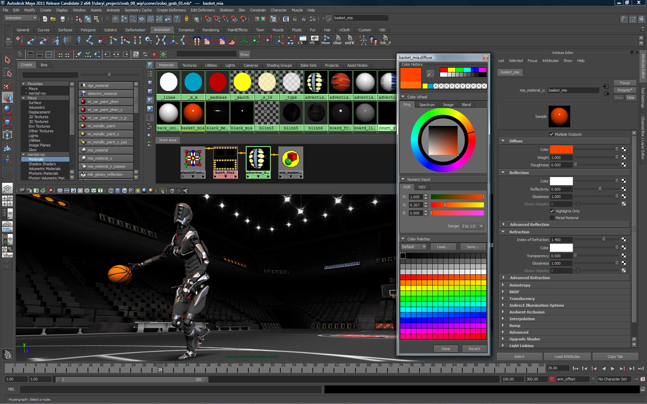
Static Style – 4D Layout
4D layout:
The user interface of Maya is one example.

Slide 20
Static Style – 4D Layout
4D layout:
It has a
menu along the x-direction,
toolbars along the ydirection,
tabs along the z-direction, and
when the menu-sets—which include Animation, Modeling, Dynamics, Rendering, and Live etc.—change from one to the other, part of the menu is changed.
This creates an additional direction.

Slide 21
dynamic style

Slide 22
Dynamic Style of User Interfaces
Websites allow users to ask, browse, and search for information that the user would like to obtain.
This kind of user interface also provides menus, tabs, and some static links.
Specifically, these user interfaces leave space for displaying information, and the information may embed many “dynamic” links, known as hyperlinks.
These dynamic hyperlinks are not part of prefixed UI components but are dynamic occurrences of components that guide users from one web page to another or from one website to the world.

Slide 23
Dynamic Style of User Interfaces
Consequently, a website needs to accept a user's query, conduct searching, and display the results with further searching links that dynamically depend on the displayed contents.
A browser (e.g., MS Internet Explorer) can be used to access any available web object uniquely linked by the Unified Resource Locator (URL).
Today, almost all organizations have their own websites and so do many individuals. These websites provide different content and embedded hyperlinks to guide users to search more URLs.

Slide 24
Dynamic Style of User Interfaces
Web pages, with their hyperlinks and displayed content, need to have a structure, an organization, and a labeling system.
The structure determines the appropriate levels of granularity for the information units.
The organization involves grouping those components into meaningful and distinctive categories.
The labeling system can be used for figuring out what to call those categories for the series of navigation links that lead to them.

Slide 25
Customizable style

Slide 26
Customizable Style of User Interfaces
A developing trend of user interfaces is the customizable style. This style of user interface is tightly integrated with the entire software system.
This means that the entire software system supports all needed functions with a specific customizable user interface.
Many user interfaces that belong to the static style also have some setting functions for customizing the user interface appearance, such as text colors, contents of tool bars, etc.
However, they do not change the functionality provided via the user interface.

Slide 27
Latest Interactive GUIs
Multi-touch sensing enables a user to interact with a system with more than one finger at a time.
Such sensing devices are also inherently able to accommodate multiple users simultaneously, which is especially useful for larger interaction scenarios such as interactive walls and tabletops.
The technique is force sensitive, and provides unprecedented resolution and scalability that can be used to create sophisticated multipoint widgets for displaying panels large enough to accommodate both hands and multiple users.

Slide 28
Usability (Semantics) of User Interfaces
The semantics of user interfaces mainly refers to usability, consistency, and integration (Torres, 2001).
Usability is the key attribute that determines the quality of a user interface.
Usability of a user interface depends not only on the architecture of the user interface and the entire software system,
but also refers to the needs, experiences, and capabilities of the system users.

Slide 29
Usability
Usability also includes information presentation
Presentation may simply be a direct representation of the input information,
such as text in a word processor,
or it may present the information in some other more meaningful way,
such as information returned by web pages as images or even videos.

Slide 30
Design Considerations of User Interfaces
User-centered:
User interface design must take into account the needs, experiences, and capabilities of the system users.
A user interface must be a user-centered product.
In order to understand users' needs, prototyping is an essential step.

Slide 31
Design Considerations of User Interfaces
Intuitive:
No matter how many variants there are, the central attributes remain the same: simplicity, intuitiveness, and usability.
The “best” user interface is one that people can figure out how to use quickly and effectively even without instructions.
Graphical user interfaces are better than textual user interfaces in the sense that a graphical user interface usually consists of windows, menus, buttons, and icons, and is operated by using a mouse.

Slide 32
Design Considerations of User Interfaces
Consistency:
Designers must consider the physical and mental limitations of users of the software system.
They need to recognize the limitations on the size of short-term memory and to avoid overloading users with information.
The interface should use terms and concepts drawn from the experience of the anticipated class of users;
should be consistent in that comparable operations can be activated in the same way

Slide 33
Design Considerations of User Interfaces
Integration:
The software system should integrate smoothly with other applications.
For example, different editors in the Windows operating system, such as MS Notepad and MS Office applications, can use “Clipboard” commands (Cut, Copy, and Paste) to directly perform data interchange.

Slide 34
Design Considerations of User Interfaces
Friendliness
Simple
Aesthetic
Productive - indicates that a minimal number of work steps can accomplish a task.
Customizable

Slide 35
Evaluation of User Interfaces
Possible usability attributes of a user interface include:
How long does it take a new user to become productive with the user interface?
For example, a new user can master the usage of the user interface in a three-day training seminar.
What percentage of the user interface components and the system functions are usable for users?
For example, some components of the user interface and functions of the system are “redundant.”

Slide 36
Evaluation of User Interfaces
What is the user's observation of the look and feel of the user interface?
For example, the user may operate the user interface without looking at it, the system is well implemented with consistency and integration, and the system uses colors to distinguish important information.

Slide 37
Evaluation of User Interfaces
How effective is the user interface at recovering from user errors?
For example, the system can check spelling and automatically correct spelling errors.
The system can format source codes and automatically import packages. The system can redo 50 step actions.
Can the user interface be customized and adapted to a new environment?
For example, the user interface can be switched from one version to the other for different users.
The user interface can incorporate additional components with plug-and-play.

Slide 38
Evaluation of User Interfaces
How well does the system response match the user's work practice?
For example, a right-click context sensitive menu saves user's actions.
How tolerant is the system of user error?
For example, what happens if the user accidentally clicked two components or hit three keys at the same time? Will the system be aborted?
Is the user interface complete?
For example, the system also includes a user guidance, tutorials, and help tools.

Slide 39
Summary
Interface Design
Styles of interfaces
Design Considerations
Evaluation of Design

