Slide 1
SOFTWARE DESIGN AND ARCHITECTURE
LECTURE 05

Slide 2
Review
Software design methods
Design Paradigms
Typical Design Trade-offs

Slide 3
Outline
Introduction to software architecture
Architecture vs Design
Architect’s responsibilities
Architecture Business Cycle

Slide 4
Software Architecture

Slide 5
Software Architecture
is the description of elements from which system is built, interactions among those elements, patterns that guide their composition, and constraints on the patterns.
Considers system as a collection of components and their interactions.

Slide 6
Components & their Interactions
Components are such things as clients and servers, databases, layers, etc.
Interactions among components can be procedure calls, shared variable access, etc.
At the architectural level, we also consider system-level issues such as capacity, consistency, performance, etc.

Slide 7
Software Architecture
the fundamental organization of a system embodied in its components, their relationships to each other, and to the environment, and the principles guiding its design and evolution [IEEE standard 1471–2000 ].

Slide 8
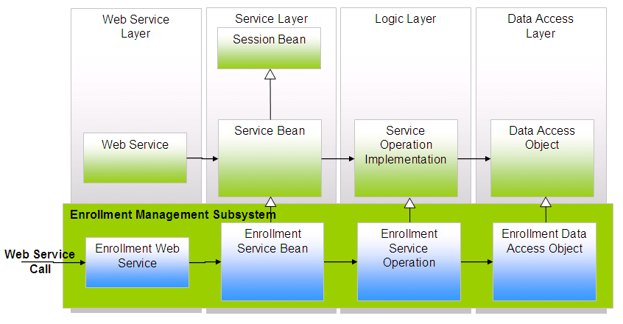
Software Architecture
What is the nature of the elements?
What are the responsibilities of the elements?
What is the significance of the connections?
What is the significance of the layout?

Slide 9
Where does architecture design come from?
The architecture design representation is derived from the system requirement specification and the analysis model.

Slide 10
Who is responsible for developing the architecture design?
Software architects and designers are involved in this process by translating (mapping) the software system requirements into architecture design.

Slide 11
Why is software architecture design so important?
A poor design may result in a deficient product that
does not meet system requirements,
is not adaptive to future requirement changes,
is not reusable,
exhibits unpredictable behavior, or
performs badly.

Slide 12
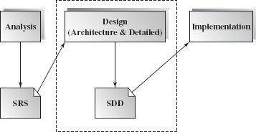
When is software design conducted?
Software design is an early phase of the Software Development Life Cycle (SDLC).

Slide 13
What is the outcome of the software architecture design?
Simply put, it is an overall representation of the software to be built.
A complete software architecture specification must describe not only
the elements and connectors between elements, but also the
constraints and runtime behaviors
so that developers know what and how the design should be implemented.

Slide 14
Architecture and Design

Slide 15
Architecture vs. Design
“All architecture is design, not all design is architecture”.
Architectural design is outward looking
Focus on stakeholders, not technology
Architecture doesn't describe the complete characteristics of components – Design does.

Slide 16
architecture
design
implementation
CODE

Slide 17
Software Architecture in Context

Slide 18
Architect’s tasks

Slide 19
Architectural influences
Influences
System Stakeholders
Developing organization
Architects’ background and experience
Technical environment
Precautionary measures
Know your constraints
Early engagement of stakeholders

Slide 20
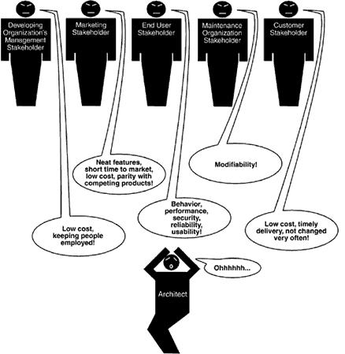

Slide 21
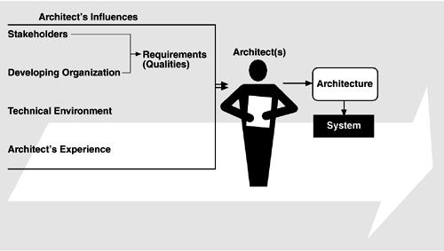
Influences on the architecture

Slide 22
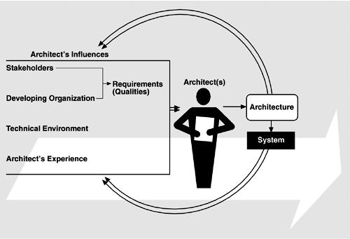
The Architecture Business Cycle

Slide 23
AN ARCHITECT’S TASKS
Perform static partition and decomposition of a system into subsystems and communications among subsystems.
A software element can be configured, delivered, developed, and deployed, and is replaceable in the future.
Each element's interface encapsulates details and provides loose coupling with other elements or subsystems.

Slide 24
AN ARCHITECT’S TASKS
Establish dynamic control relationships among different subsystems in terms of data flow, control flow orchestration, or message dispatching.
Consider and evaluate alternative architecture styles that suit the problem domain at hand.

Slide 25
AN ARCHITECT’S TASKS
Perform tradeoff analysis on quality attributes and other nonfunctional requirements during the selection of architecture styles.
For example, in order to increase a distributed system's extensibility, portability, or maintainability, software components and Web services may be the best choice of element types, and a loose connection among these elements may be most appropriate.

Slide 26
Architecture Business Cycle

Slide 27
Architecture Business Cycle (ABC)
Software architecture is a result of technical, business and social influences.
These are in turn affected by the software architecture itself.
This cycle of influences from the environment to the architecture and back to the environment is called the Architecture Business Cycle (ABC).

Slide 28
ABC Activities
Creating the business case for the system
Why we need a new system, what will be its cost? Time to market, integration with existing systems?
Understanding the Requirements
Various approaches for requirements elicitation i.e., object-oriented approach, prototyping etc.
The desired qualities of a system shape the architectural decisions – architecture defines the tradeoffs among requirements
Creating/selecting the architecture

Slide 29
ABC Activities …
Communicating the architecture
Inform all stakeholders (i.e., developers, testers, managers, etc.)
Architecture’s documentation should be unambiguous
Analysing or evaluating the architecture
Evaluate candidate designs
Architecture maps the stakeholders’ requirements/needs
Implementation based on architecture
Ensuring conformance to an architecture

Slide 30
Summary
Introduction to software architecture
Architecture vs Design
Architect’s responsibilities
Architecture Business Cycle

