Slide 1
Software Design and Architecture

Slide 2
Introduction

Slide 3
Objective
To be introduced to principles of good design, and techniques for the evaluation of software design quality.
To cover the principal architectural issues associated with the design and construction of software systems including architectural design and documentation, component models and technologies, and frameworks.
To introduce the students to a number of design patterns and their applications.

Slide 4
Course Contents
The course is divided into two major modules
The first module covers the introduction to software design and provides details of software architecture and architectural styles.
The second module covers the detailed design phase with introduction to Object Oriented Design and various design patterns.

Slide 5
Course Contents

Slide 6
 | Topics
1 | Introduction Software design and architecture
2 | Principles of good software design. Correctness and Robustness Flexibility, reusability and efficiency
3 | Introduction to software architecture
4 | Software architectural design Software architectural attributes Attribute types Trade-off of attributes and choices
5 | Software Architectural Styles Data flow architctures Layered Event-based Data-centered MVC Multi-tier distributed Service Oriented

Slide 7
 | Topics
6 | ANALYSIS PHASE (OBJECT ORIENTED DESIGN) Functional Modeling Activity Diagrams Use case diagrams
7 | ANALYSIS PHASE (OBJECT ORIENTED DESIGN) Structural Modeling Classes, Attributes, and Operations, Relationships CRC Cards Class Diagrams
8 | ANALYSIS PHASE (OBJECT ORIENTED DESIGN) Behavioural Modeling Objects, operations, and messages Sequence Diagrams Behavioural State Machines – States, Events, Transitions, Actions, and Activities
9 | DESIGN PHASE (OBJECT ORIENTED DESIGN) Evolving the analysis models into design models

Slide 8
 | Topics
10 | Introduction to Components and Component Oriented Design
11 | Pattern oriented Design Creational patterns Structural patterns Behavioral pattern

Slide 9
Assessment Criteria
The course shall be comprised of presentations, various assignments and quizzes that shall be dispersed through out the course.
Mid and Final exams shall be conducted.
The final grade shall depend on your performance in EACH of the above mentioned artifacts.

Slide 10
Course Pre - requisites
Software Engineering I
Software Requirements Specification

Slide 11
Books to follow
Software Architecture And Design Illuminated By Kai Qian, Xiang Fu, Lixin Tao, Chong-wei Xu, Jones And Bartlett Publishers.
Object-Oriented Systems Analysis and Design using UML, by Simon Bennett, McRobb & Farmer McGraw-Hill.
Applying UML and Patterns: An Introduction to Object-Oriented Analysis and Design and Iterative Development, By Craig Larman

Slide 12
Motivation

Slide 13
A staircase that leads right
into a wall!!!

Slide 14
A door that would drop you 10 feet down!

Slide 15
An impossible to use
ATM machine

Slide 16
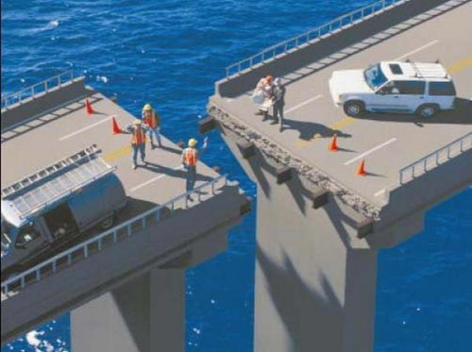

Slide 17
What do you think is wrong in these real life scenarios?
The requirements are correct!
A staircase next to the outer wall
A door on the first floor
An ATM outside the bank branch
The bridge
The design is flawed!
The execution based on the design results in disaster.

Slide 18
Software are no different.
For a useful software, it has to be ‘engineered’; which involves giving specific attention to every phase of software development.

Slide 19
Problems in software development
Common issues
The final software does not fulfill the needs of the customer
Hard to extend and improve: if you want to add a functionality later its mission impossible
Bad documentation
Bad quality: frequent errors, hard to use, ...
More time and costs than expected

Slide 20
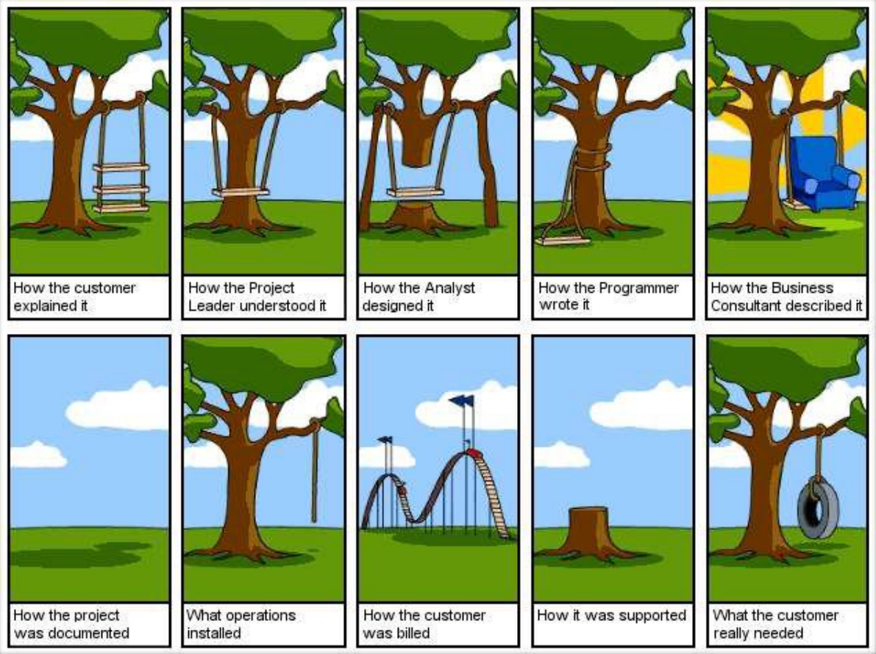
http://www.projectcartoon.com

Slide 21
Ariane 5 Flight 501
Cause: design errors in the software
http://www.youtube.com/watch?v=kYUrqdUyEpI
Notes:
Cluster was a constellation of four European Space Agency spacecraft which were launched on the maiden flight of the Ariane 5 rocket, Flight 501, and subsequently lost when that rocket failed to achieve orbit. The launch, which took place on Tuesday, 4 June 1996, ended in failure due to an error in the software design caused by assertions having been turned off, which in turn caused inadequate protection from integer overflow. This resulted in the rocket veering off its flight path 37 seconds after launch, beginning to disintegrate under high aerodynamic forces, and finally self-destructing by its automated flight termination system. The failure has become known as one of the most infamous and expensive software bugs in history.^{[1]} The failure resulted in a loss of more than US$370 million

Slide 22
Software Design

Slide 23
What is Design?
Design is the first step in the development phase for any engineered product or system.
Design is about HOW the system will perform its functions.

Slide 24
Software Design
A software design is a meaningful engineering representation of some software product that is to be built.
“The process of applying various techniques and principles for the purpose of defining a device, a process or a system in sufficient detail to permit its physical realization” [TAY59]

Slide 25
Software Design
The literature on design methods began to appear in the 1950s and 60s.
Since then, design methodology has become an independent discipline of scientific study.
What are the essential characteristics of design?
What processes are used by designers?
Is one process better than another, constituting ‘right’ and ‘wrong’ ways to design?
Why are some processes favourable over others?
Do different processes lead to different qualities of results?

Slide 26
Software Design
As one of the most complex man-made artifacts, computer software is very difficult to design.
There are many factors that affect designs and many stakeholders,
i.e. people who participate in the design process, play various different roles in the design processes and influence the design of software.

Slide 27
Software Design - Simplified
Requirements specification was about the WHAT the system will do
Design is about the HOW the system will perform its functions
provides the overall decomposition of the system
allows to split the work among a team of developers
also lays down the groundwork for achieving non-functional requirements (performance, maintainability, reusability, etc.)
takes target technology into account (e.g., kind of middleware, database design, etc.)

Slide 28
Why Design is important?
Without a proper design, we risk building an unstable system
one that will fail when small changes are made
one that may be difficult to test
one whose quality cannot be assessed until late in the software process, perhaps when critical deadlines are approaching and much capital has already been invested into the product.

Slide 29
Major Design Challenges
Design team should not do too much
Detailed design should not become code
Design team should not do too little
It is essential for the design team to produce a complete detailed design

Slide 30
Summary
Introduction to design
Importance of design
Difference between design and architecture

