Slide 1
Software Design and Architecture
Zain Shaukat

Slide 2
Objective
To be introduced to principles of good design, and techniques for the evaluation of software design quality.
To cover the principal architectural issues associated with the design and construction of software systems including architectural design and documentation, component models and technologies, and frameworks.
To introduce the students to a number of design patterns and their applications.
Notes:
SW must be of good quality (difference between you and other’s work), evaluation of design
OO Design

Slide 3
Course Contents
The course is divided into two major modules
The first module covers the introduction to software design and provides details of software architecture and architectural styles.
The second module covers the detailed design phase with introduction to Object Oriented Design and various design patterns.
Notes:
Basically A and D is in SD
A=skeleton of a system, what kind of data are present and how do modules interact with each other…. What is done and where it is done.
D=design of individual module, what are the components of module, how to it perform its functions (limitation) (how it is done)

Slide 4
Course Contents

Slide 5
 | Topics
1 | Introduction Software design and architecture and its significance
2 | Principles of good software design. Correctness and Robustness Flexibility, reusability and efficiency
3 | Introduction to software architecture
4 | Software architectural design Software architectural attributes Attribute types Trade-off of attributes and choices
5 | Software Architectural Styles Data flow architectures Layered Event-based Data-centered MVC Multi-tier distributed Service Oriented
Notes:
2+2=4 but after 2 minutes, 2+2=3 within a second???
Serves the purpose but not efficiently is not a good software.
Different a styles for different sw (mosques vs schools)

Slide 6
 | Topics
6 | ANALYSIS PHASE (OBJECT ORIENTED DESIGN) Functional Modeling Activity Diagrams Use case diagrams
7 | ANALYSIS PHASE (OBJECT ORIENTED DESIGN) Structural Modeling Classes, Attributes, and Operations, Relationships CRC Cards Class Diagrams
8 | ANALYSIS PHASE (OBJECT ORIENTED DESIGN) Behavioral Modeling Objects, operations, and messages Sequence Diagrams Behavioral State Machines – States, Events, Transitions, Actions, and Activities
9 | DESIGN PHASE (OBJECT ORIENTED DESIGN) Evolving the analysis models into design models
Notes:
What diagrams are required for OO based SW
Function? Activities?
Smodelelign class objects attributes etc
BM how they are related to each other.

Slide 7
 | Topics
10 | Introduction to Components and Component Oriented Design
11 | Pattern oriented Design Creational patterns Structural patterns Behavioral pattern
Notes:
You can get components (API’s). Cricket scores APP but I need weather app as it is not of my business so Ill use it from some one else
Where to use and avoid patterns

Slide 8
Motivation

Slide 9
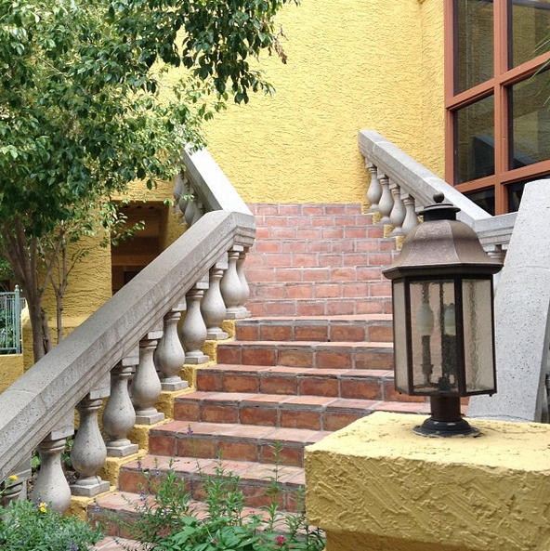
A staircase that leads right
into a wall!!!

Slide 10
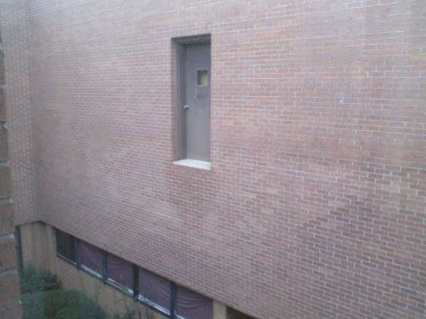
A door that would drop you 10 feet down!

Slide 11
An impossible to use
ATM machine
Notes:
Works well but not the design (inconvience)

Slide 12
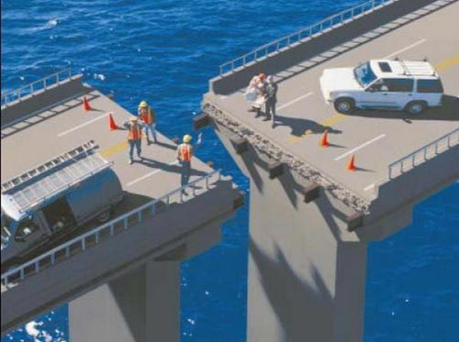
Notes:
Terrible engineering

Slide 13
What do you think is wrong in these real life scenarios?
The requirements are correct!
A staircase next to the outer wall
A door on the first floor
An ATM outside the bank branch
The bridge
The design is flawed!
The execution based on the design results in disaster.
Notes:
Wrong measurement in design are error prone

Slide 14
Software are no different.
For a useful software, it has to be ‘engineered’; which involves giving specific attention to every phase of software development.
Notes:
Engineering: Application of engineering principles to a product/process development
Planning: Without the perfect plan, calculating the strengths and weaknesses of the project, 2. Analysis: 3. Design: Basically building the architecture of the project. This step helps remove possible flaws by setting a standard and attempting to stick to it. 4. Development & Implementation: The actual task of developing the software starts here with data recording going on in the background. 5. Testing: The testing stage assesses the software for errors and documents bugs if there are any. 6. Maintenance: Once the software passes through all the stages without any issues, it is to undergo a maintenance process wherein it will be maintained and upgraded from time to time to adapt to changes..

Slide 15
Problems in software development
Common issues
The final software does not fulfill the needs of the customer
Hard to extend and improve: if you want to add a functionality later its mission impossible (resource intensive)
Bad documentation
Bad quality: frequent errors, hard to use, ...
More time and costs than expected
Notes:
SW is complex.
You can spot the problem at bit earlier in CED.

Slide 16
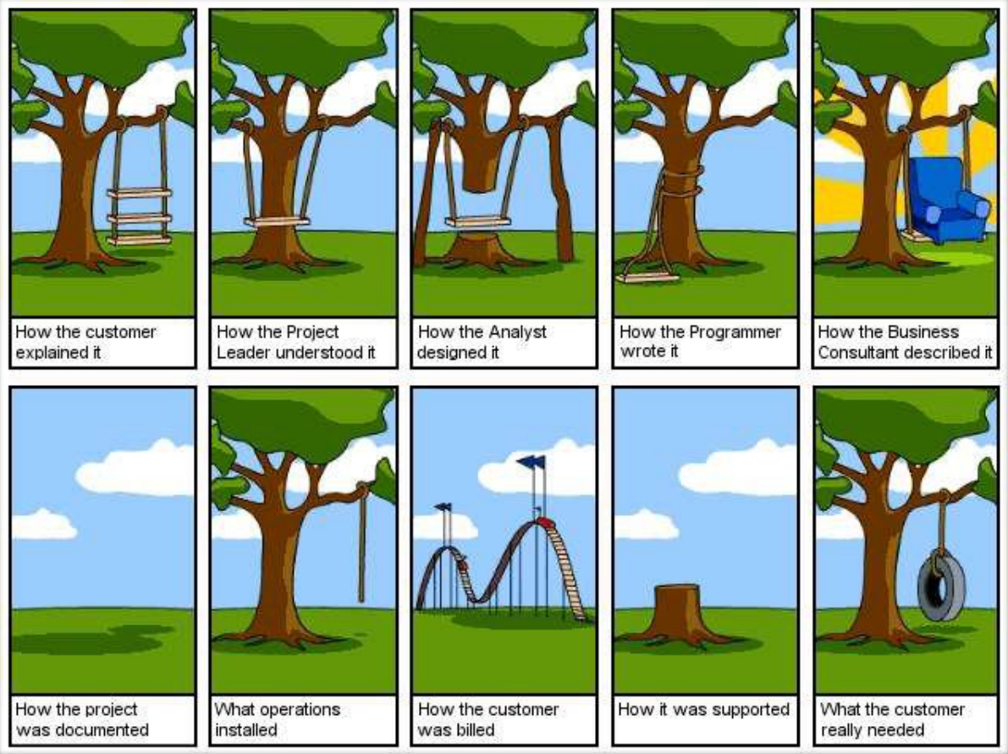
http://www.projectcartoon.com

Slide 17
Ariane 5 Flight 501
Cause: design errors in the software
Float into integer
http://www.youtube.com/watch?v=kYUrqdUyEpI
Notes:
Cluster was a constellation of four European Space Agency spacecraft which were launched on the maiden flight of the Ariane 5 rocket, Flight 501, and subsequently lost when that rocket failed to achieve orbit. The launch, which took place on Tuesday, 4 June 1996, ended in failure due to an error in the software design caused by assertions having been turned off, which in turn caused inadequate protection from integer overflow. This resulted in the rocket veering off its flight path 37 seconds after launch, beginning to disintegrate under high aerodynamic forces, and finally self-destructing by its automated flight termination system. The failure has become known as one of the most infamous and expensive software bugs in history.^{[1]} The failure resulted in a loss of more than US$370 million

Slide 18
The software architecture of a program or computing system is the structure or structures of the system,
which comprise software components,
the externally visible properties of those components, and the relationships between them.
Software design is a process of problem-solving and planning for a software solution.

Slide 19
Summary
Introduction to design
Importance of design
Difference between design and architecture

